Slide 1

Pushdown Automaton
Chua, Ivan Wesley
Lim, Trisha Jean
Palmaras, Joseph Gabriell
Sandimas, Daniel Kenneth
Vidal, Sonia Margarette

Slide 2
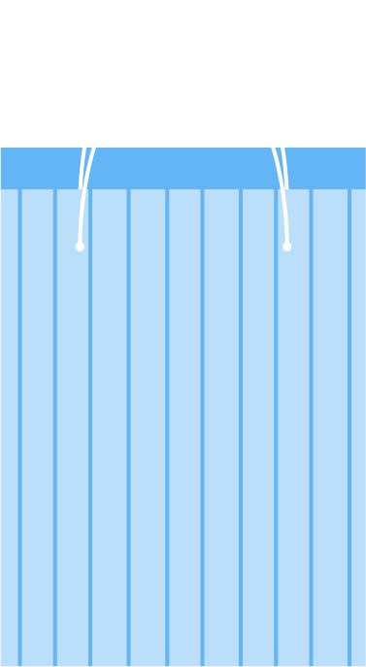

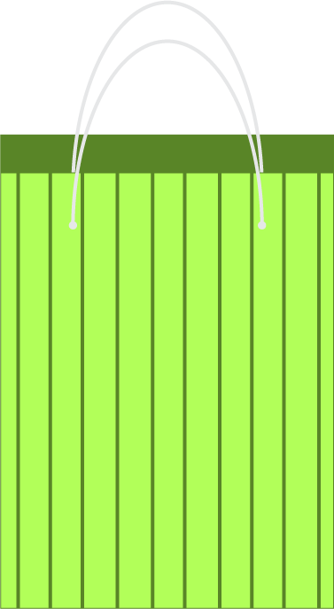




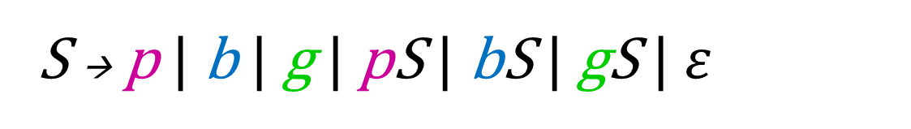
Context Free Grammar (CFG)
S → p | b | g | pS | bS | gS | $ε$

Slide 3

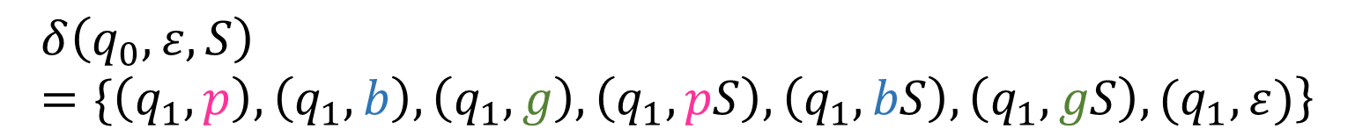
Transition Functions
$$\left.δ\left(q_{0}, S, Z_{0}\right)=\{\left(q_{1}, S\right)\right\}$$
$$\left.δ\left(q_{0},ε, S\right)=\{\left(q_{1}, p\right), \left(q_{1}, b\right), \left(q_{1}, g\right), \left(q_{1}, pS\right), \left(q_{1}, bS\right), \left(q_{1}, gS\right), (q_{1}, ε)\right\}$$

Slide 4
Operations
Push
Pop
Replace

