Slide 1

AI-Driven Smart Healthcare Management Platform
Autonomous Workflow & Emergency Care System — Presented by Team LAZEHERS, Chennai Institute of Technology, Dept. of Computer Science & Engineering (Academic Year 2025–2026).

Slide 2



Introduction — Why this platform matters
Modern healthcare faces fragmented systems, manual routing, slow request handling, and weak emergency coordination. Our platform combines AI classification, automated workflow routing, real-time tracking, home-care scheduling, emergency ambulance dispatch, and digital prescriptions to restore speed, transparency, and prioritization across care pathways.
AI-based Triage
Automated Workflow Routing
Emergency Dispatch
Natural language processing classifies requests instantly and assigns urgency.
Nearest ambulance assigned with live ETA and emergency unit notifications.
Requests are routed to the right department automatically with SLA timers.

Slide 3

Problem Statement
Hospitals today struggle with manual department assignments, missing SLA tracking, delayed escalations, and siloed ambulance/appointment systems. These issues increase wait times, overload staff, and reduce patient satisfaction. There is an urgent need for an integrated, AI-driven system that provides transparency and enforces SLAs.

Slide 4
Aim & Objectives
Aim
Key Objectives
Design an intelligent healthcare automation platform for efficient, transparent, and real-time medical service delivery.
Automate inter-department workflows
Classify requests using AI (NLP + risk scoring)
Monitor SLA compliance with self-healing alerts
Enable home test booking with geolocation
Provide 24/7 doctor appointments (online & onsite)
Integrate emergency ambulance dispatch with ETA
Generate secure digital prescriptions
Expose real-time analytics dashboard

Slide 5
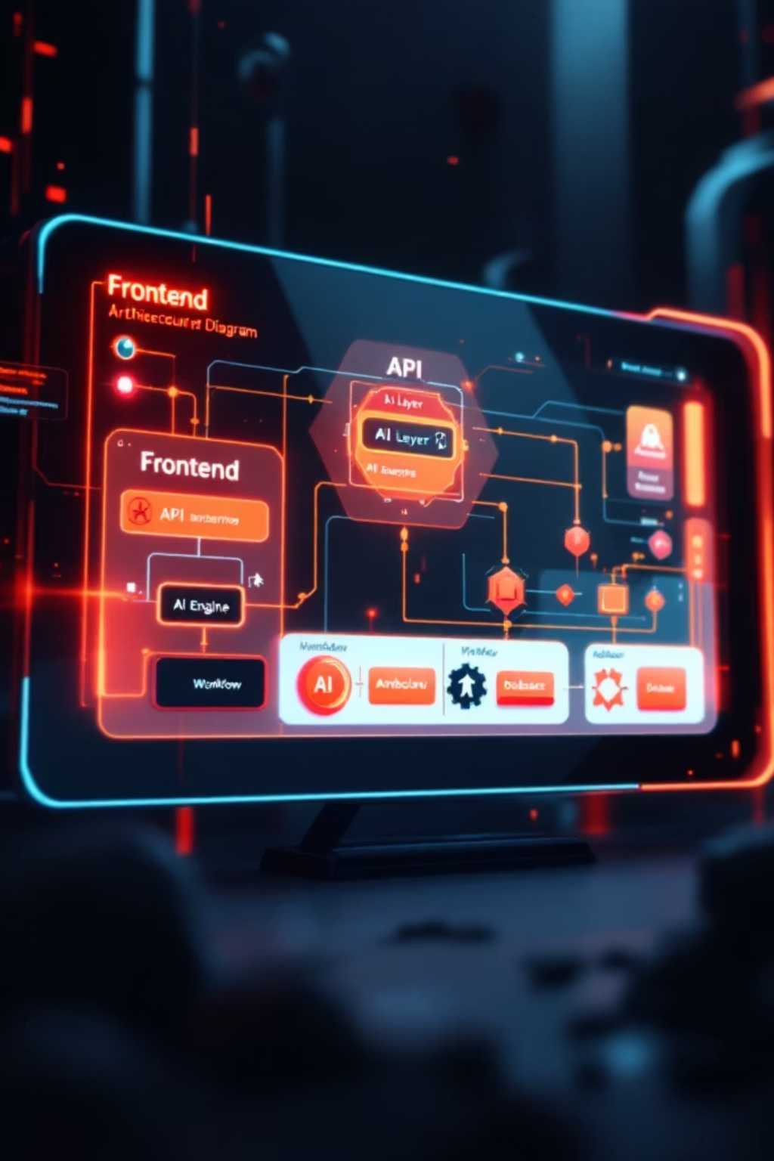

System Overview — Core Modules
The platform is modular and extensible. Core modules include: AI Request Classification, Intelligent Workflow Routing, Self-Healing SLA Monitor, Home Test Scheduling, Emergency Ambulance Dispatch, 24/7 Appointments, Digital Prescription Generator, Real-Time Progress Tracker, and Data Science Analytics Dashboard.
AI Engine
NLP classification, urgency scoring, anomaly detection.
Workflow
Rule-based and ML-assisted routing with SLA timers.
Emergency
GPS-based dispatch and ETA calculation.
Analytics
Dashboards for operations, SLAs, and health trends.

Slide 6

Clean Architecture Diagram
Frontend & Support
React+TypeScript UI, Doctor Panel, Home Tests, GPS/ETA
API Layer
REST endpoints and WebSocket real-time updates
Core Services
AI Engine, Workflow & SLA, Emergency Ambulance
The diagram depicts clear separation: reactive frontend, stateless API layer for real-time updates, modular microservices for AI, routing, and emergency handling, and a centralized patient data store for analytics and audit trails.

Slide 7
Technical Architecture Explanation
Frontend
Backend & Integrations
React + TypeScript with Vite for fast iteration. Tailwind CSS for consistent design tokens. Reusable components, real-time progress indicators via WebSocket, and embedded analytics charts.
Node.js/Express or FastAPI serving REST + WebSocket endpoints. AI models served via model API (containerized). Database options: MongoDB for flexible records or PostgreSQL for relational integrity. Background workers handle SLA timers, retries, and self-healing workflows.
Security: role-based access control, encrypted data-at-rest, audit logs, and secure API tokens for integrations.

Slide 8
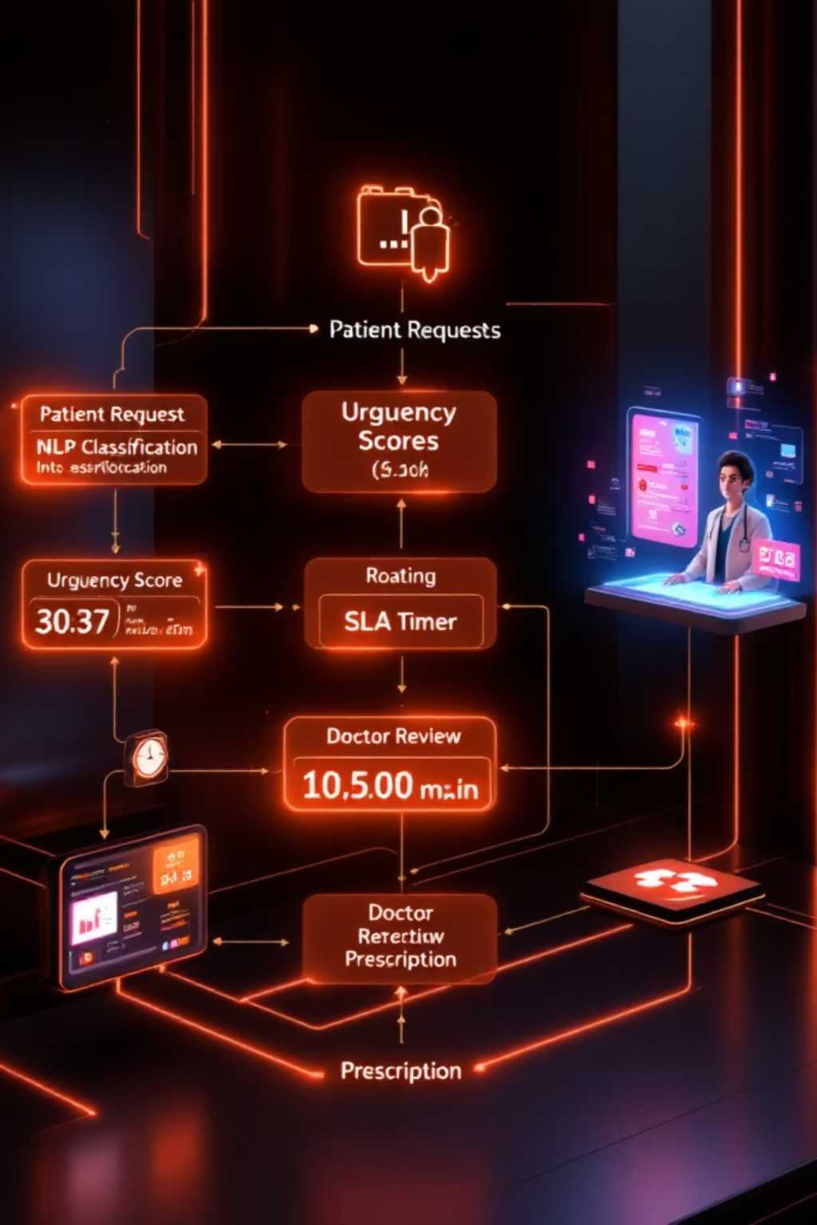
AI Processing Workflow
Patient submits request via app/portal (text, voice, or form).
NLP model extracts symptoms, context, and performs intent classification.
Urgency level assigned (Normal / High / Emergency) with risk score.
Workflow engine routes the request to the right department; SLA timer starts.
Doctor or technician receives notification; tests or ambulance scheduled if required.
Digital prescription generated; progress and ETA updates pushed in real time.
The pipeline enforces SLAs and supports auto-escalation and re-routing for stuck requests.

Slide 9
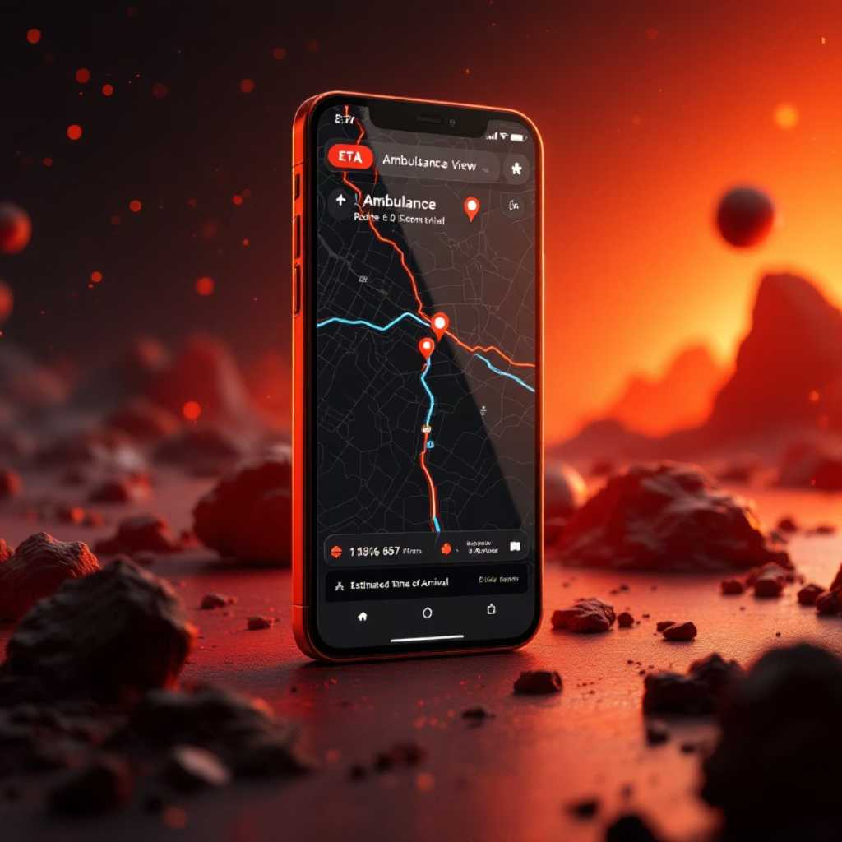
Emergency & Live Tracking
Emergency workflow captures location (GPS or manual), runs a rapid severity classifier, identifies nearest available ambulance, calculates ETA using traffic-aware routing, and notifies the assigned emergency unit and receiving facility. The patient and care team receive live ETA and status updates throughout the response.
GPS capture and fallback to manual address
Severity detection for priority dispatch
Ambulance assignment with ETA & route preview
Continuous live progress tracking and SLA alerting

Slide 10
Analytics, Implementation & Next Steps
Results & Future Enhancements
APIs & Deployment
Early pilots show reduced manual delays, improved transparency, and reliable emergency dispatch. Planned enhancements: IoT vitals streaming, predictive risk models, blockchain-backed medical records, and wearable integrations.
Data Science & Dashboards
Key endpoints include /submit-request, /request-status/{id}, /book-home-test, /book-appointment, /emergency-ambulance, /generate-prescription. Deploy using containers, orchestration, and CI/CD.
Real-time charts: request distribution (pie), department workload (bar), trends (line), SLA compliance and anomaly alerts. Techniques: time-series, regression, NLP, and clustering.
Thank you — Team LAZEHERS, Chennai Institute of Technology. Questions & demo requests welcome.

