Slide 1
AI for inter-well saturation mapping
AI Berserkers

Slide 2
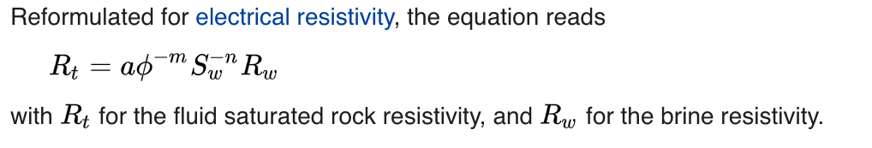
The problem and solution
Data Driven Method
Data Driven+Physics
Take the Data and use ensemble ML models:
-SciKit Bagging regressor. Train 2 hours. MSE - 0.086
- Catboost - CatBoost regressor.Train 10 minutes. MSE - 0.055
- XGBRegressor. Train 20 seconds. MSE-0.076
Take the Data and use ensemble ML models plus use physical models simulation:
- Archie's law, Archie's - Dahnov formula. We need more parameters for the equation.We use a=1,n=2,m=2 and Pickett plot.

Slide 3
Challenges deep-dive
Challenge 1
Challenge 2
Challenge 3
Data interpretation problem.
We try to understand how the data is organise. It takes some time to understand but we manage it.
Materials about petrophysics.
We try to get some domain specific information about problem.
Choose right models and combine with physics simulations.
We need to choose ensemble models, deep learning models. What best models Archie,double water ets?

Slide 4
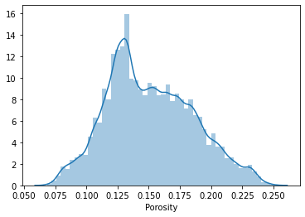
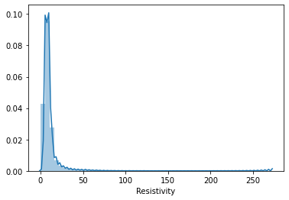
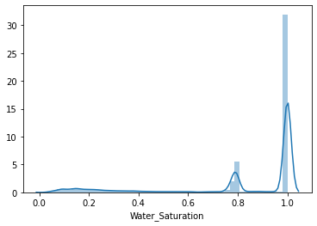
Data Exploration
Porosity Distribution
Clearly see close to normal data distribution.
Resistivity Distribution
Most of the data between 0 and 15.
Water Saturation Distribution
Two peaks 1.0 and 0.8
Challenge 1
Challenge 2

Slide 5
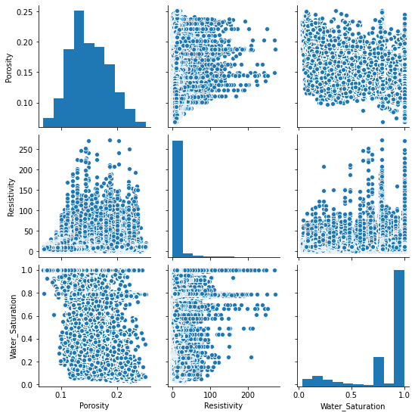
Pair plot correlation chart between all features. Not seen any good correlation.

Slide 6
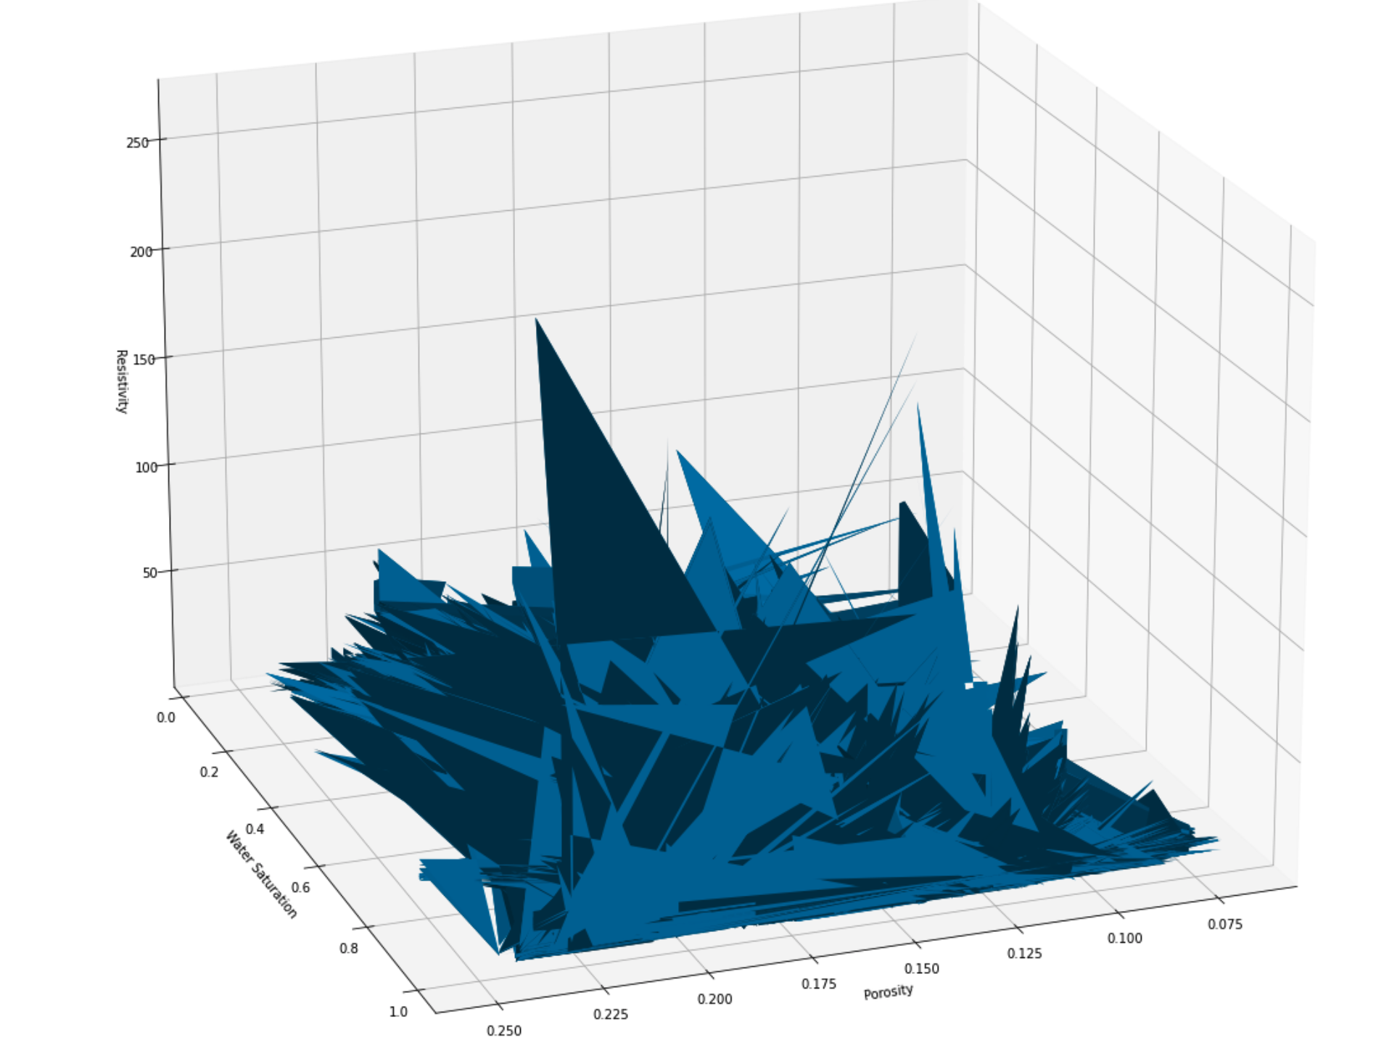
3D Cube model.It helps us to correctly interpret the data.

Slide 7
Possible models strategy
Solution
Combined Solution
Machine Learning
Physics modeling
Models from ML
Equation simpl.
Ensemble Models
Deep Learning Models
Regression Models
Archie Law
Double Water
CatBoost, XGB Boost
Feed Forward Net,LSTM net
Linear reg, Ridge reg
Variations
Variations

