Slide 1
BASE PROJECT 2 FOOTBALL TOURNAMENT MANAGEMENT APPLICATION
Students: Tran Van Thanh Student code: 20CE044
Tran Van Vu 20CE049
Instructor: Ths. Nguyen Thi Huyen Trang

Slide 2
TABLE OF CONTENTS
01
03
02
04
THE PROBLEM
SYSTEM DESIGN
SYSTEM ANALYSIS
CONCLUSION

Slide 3
01
THE PROBLEM

Slide 4
1.1 DESCRIBE THE PROBLEM
About football tournament organizations

Slide 5
1.2 FOOTBALL COMPETITION MANAGER
Update match schedule
Update match results
Achievement Management

Slide 6
1.3 SYSTEM FUNCTIONS
System Functional Diagrams
Description of functions

Slide 7
SYSTEM ANALYSIS
02

Slide 8
02 SYSTEM ANALYSIS
Class diagram
Activity diagram
State Diagram
Sequence Diagram

Slide 9
03
SYSTEM DESIGN

Slide 10
03 SYSTEM DESIGN
DESIGN TOOLS
DATABASE DESIGN
APPLICATION INTERFACE
Java programming language
Connect database to SQL Server

Slide 11
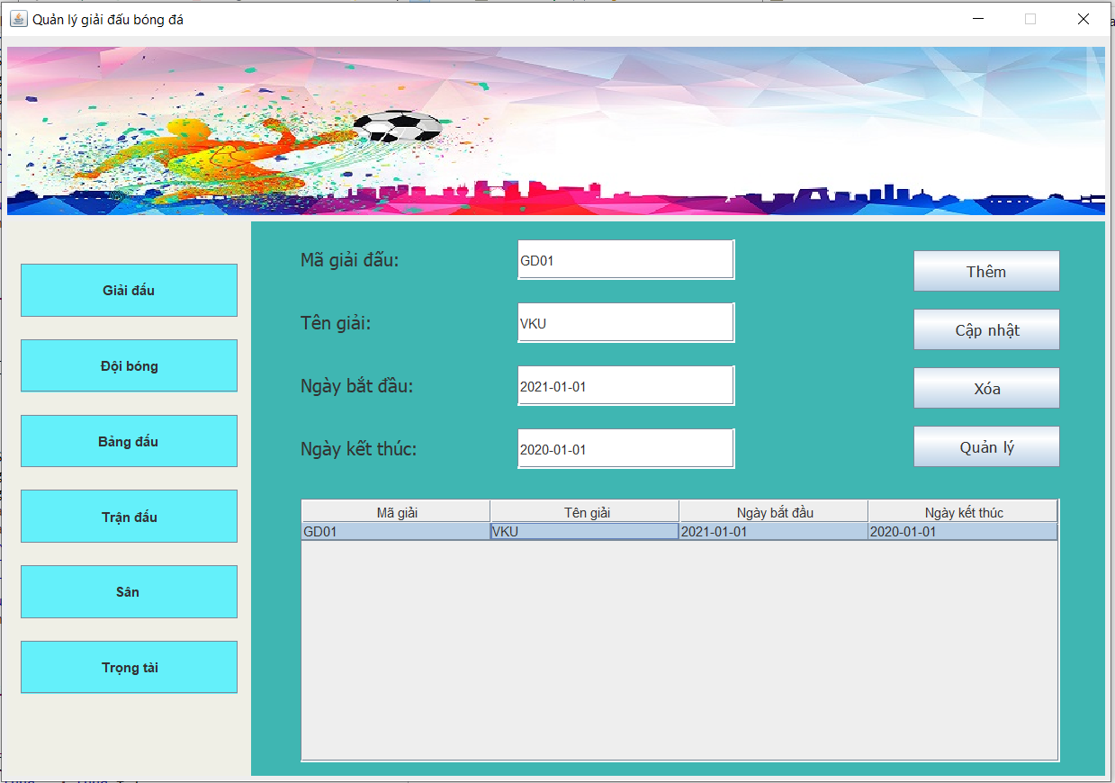
Tournament management interface

Slide 12
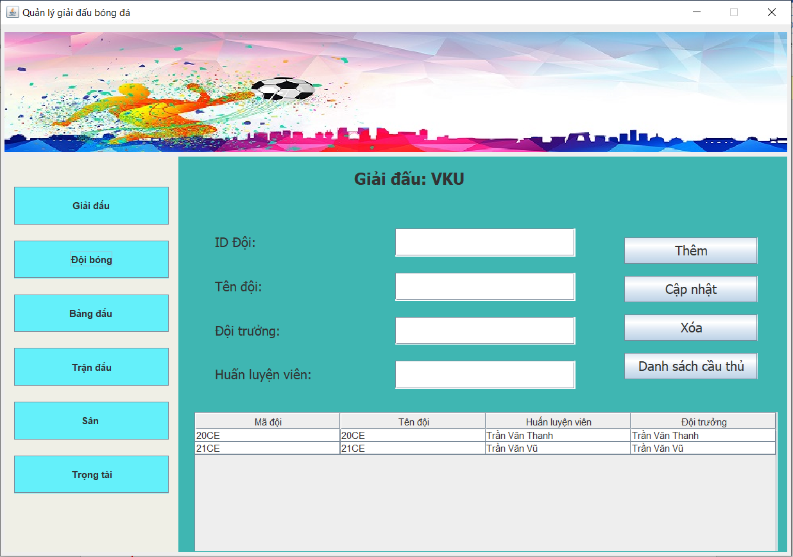
Team management interface

Slide 13
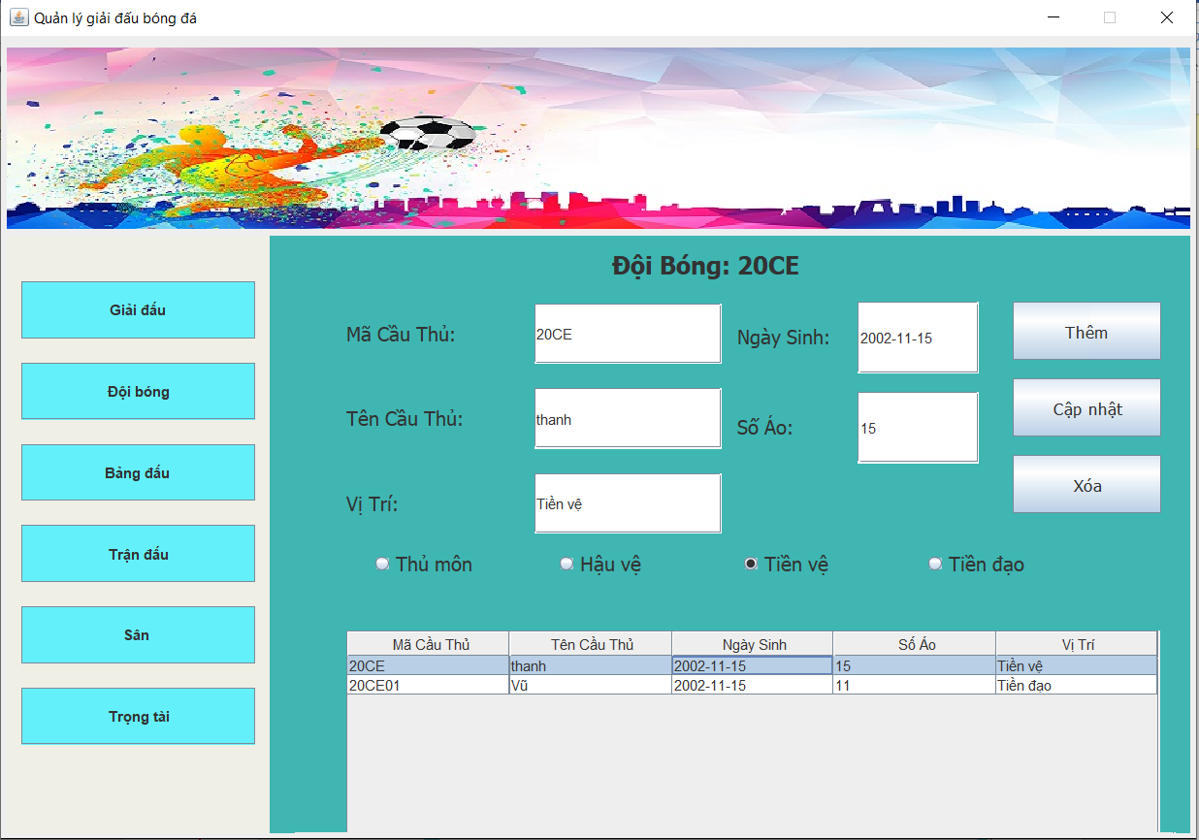
Player management interface

Slide 14
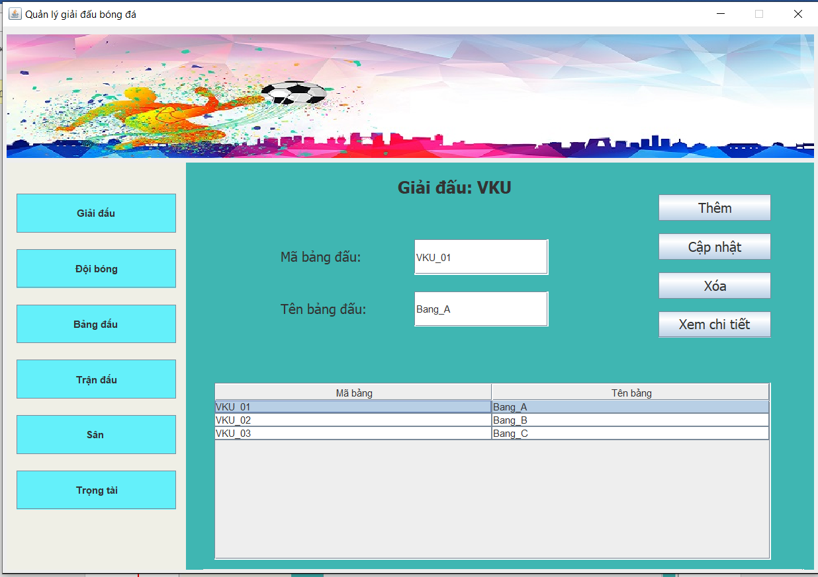
Match table interface

Slide 15
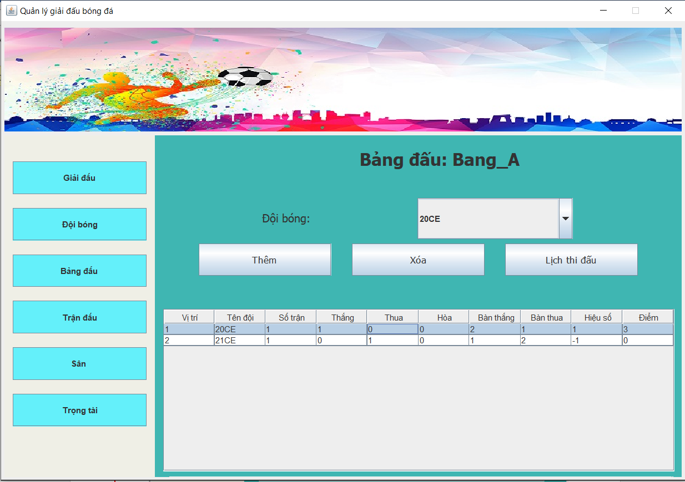
The detailed management interface of the match table

Slide 16
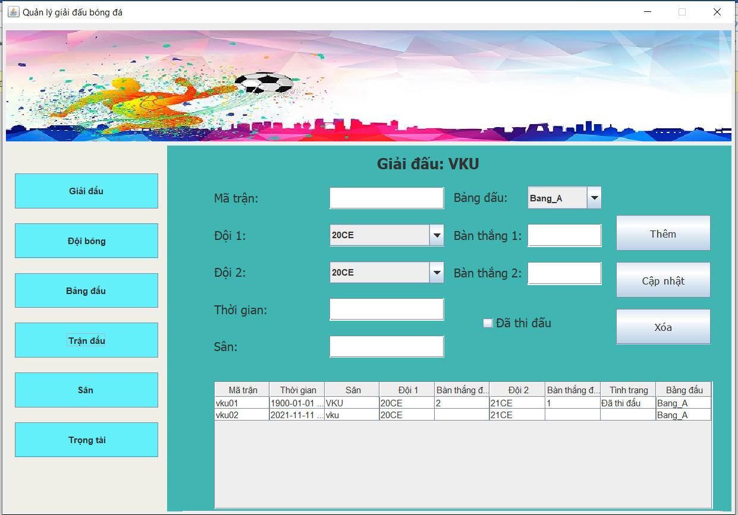
Match management interface

Slide 17
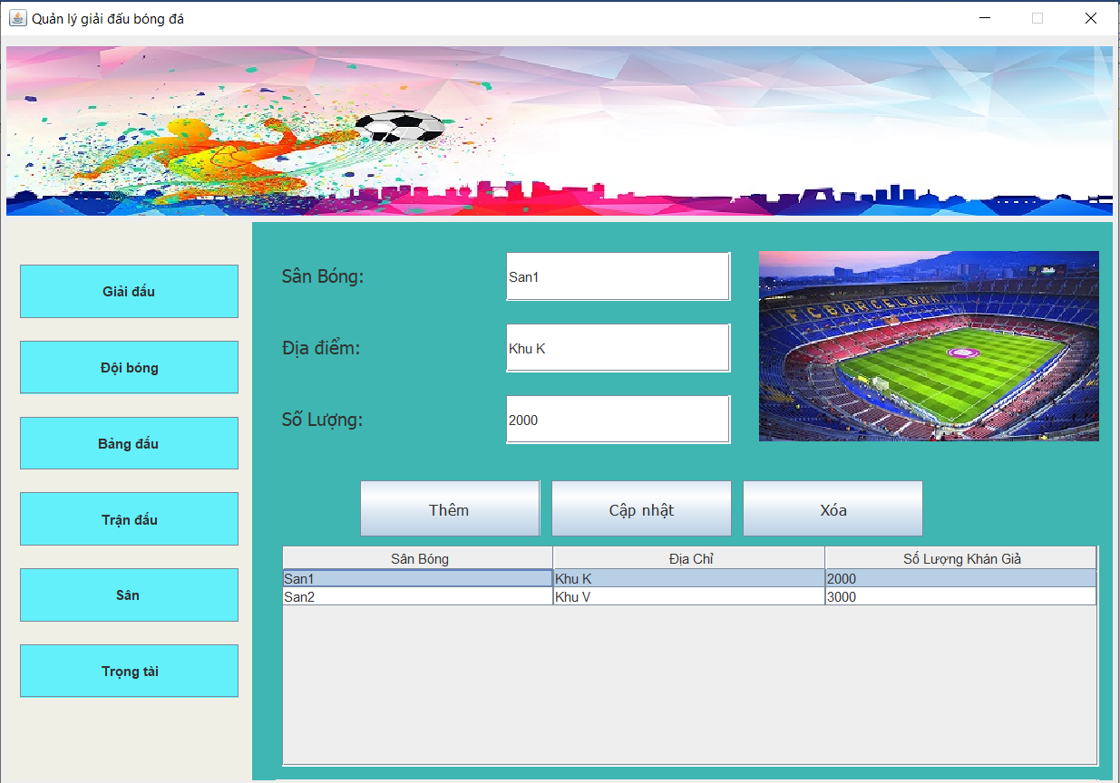
Course management interface

Slide 18
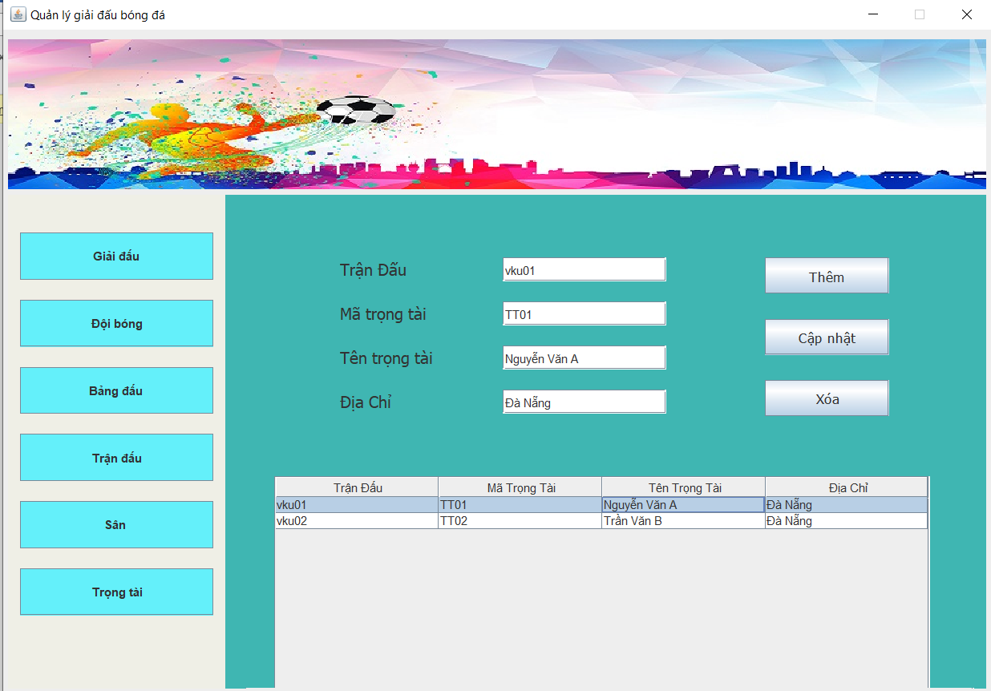
Arbitration management interface

Slide 19
04 CONCLUSION
Achievements
Research direction
About Skills
About knowledge
About project results
Develop more functions for the application.
Research network programming to develop further for the application.

Slide 20

This Photo by Unknown Author is licensed under CC BY

