Slide 1
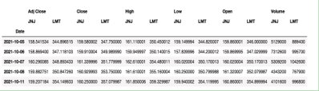
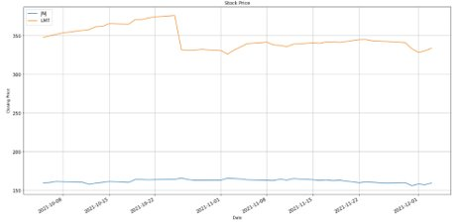
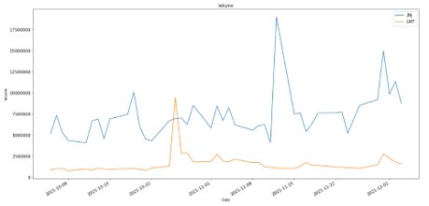
Fig A
The Fig B illustrate the selected stock's closing price using the line graph.
X axis depicts the timeline of the 60 days.
Y axis depicts the closing price of the stocks.
Fig B
The fig A shows the following
Adj Close(Adjusted Closing price)
Close (Final Closing price)
High (Highest for the day)
Low (Lowest for the day)
Open (Stock's opening price)
Volume (Stock total volume)
For the last 60 days
Fig C
The Fig C depicts the selected stock's Volume measure using the line graph.​
X axis depicts the timeline of the 60 days.​
Y axis depicts the numerical value.​ ​

