Slide 1
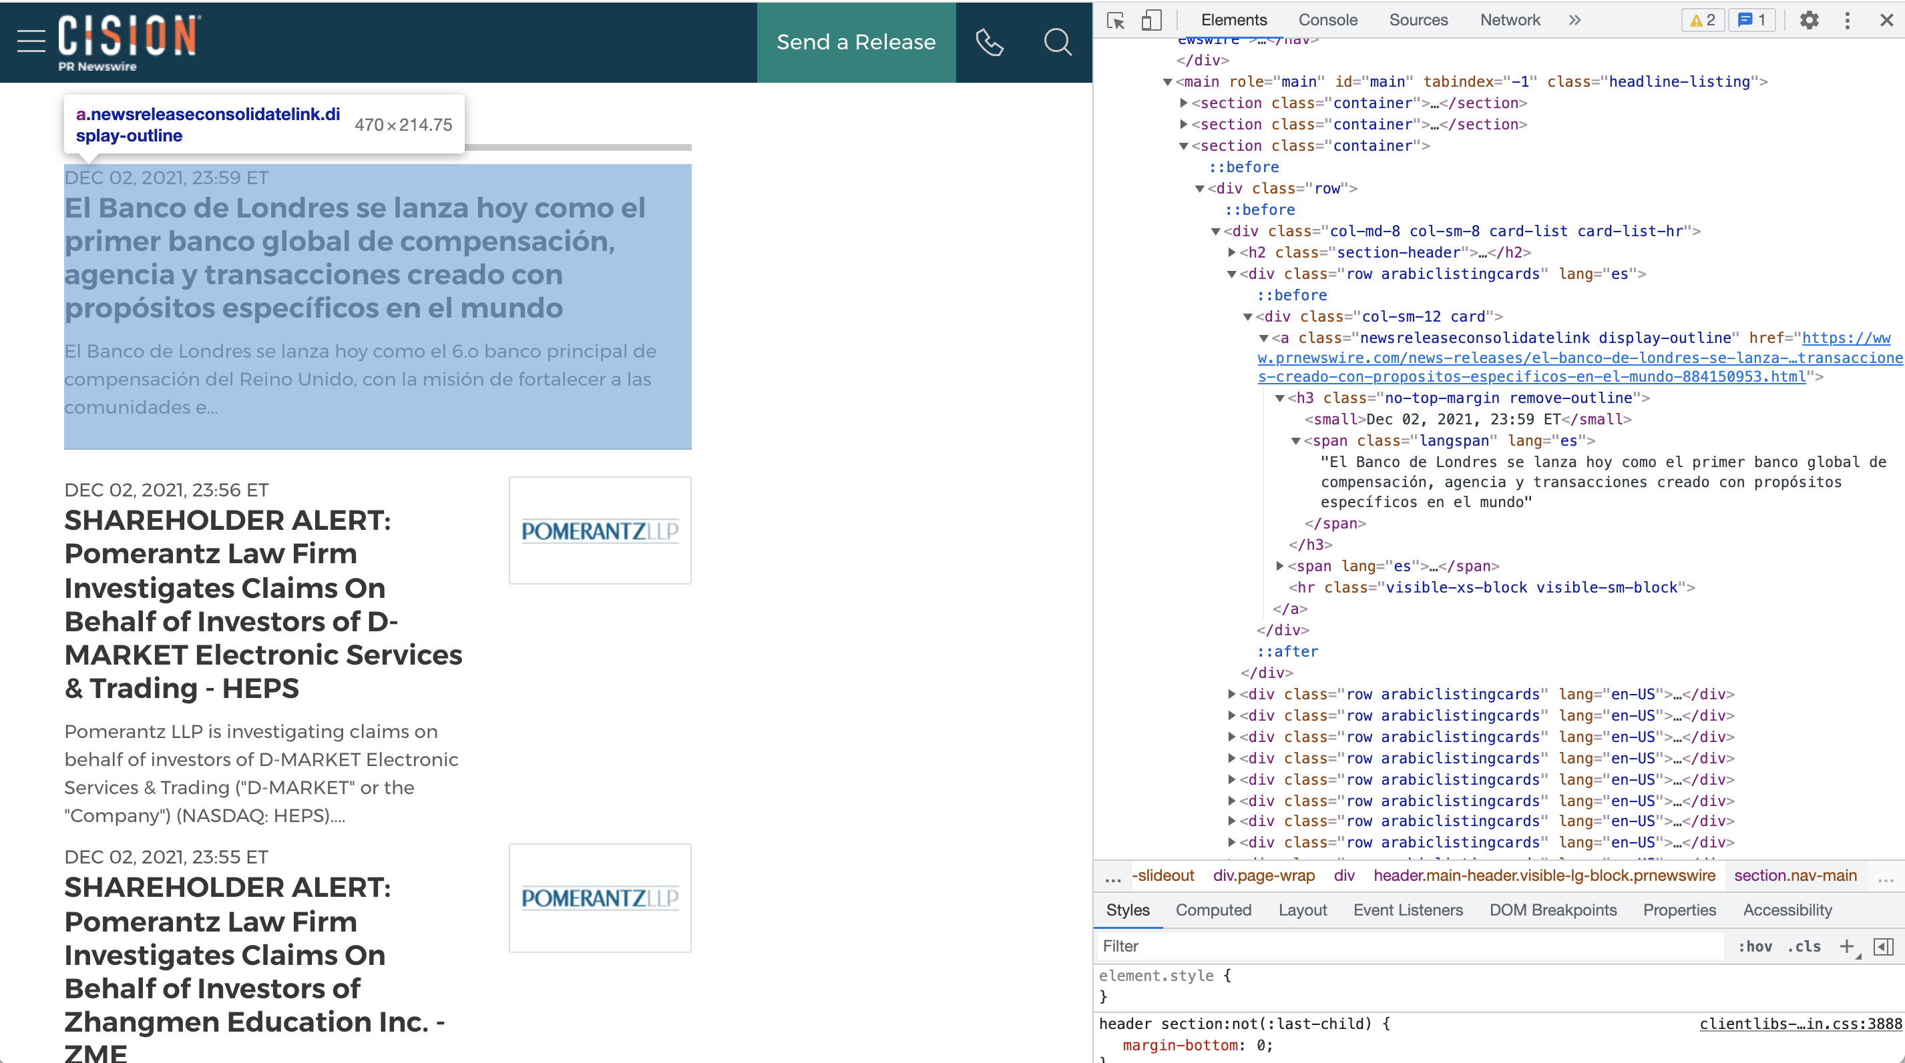
Data Extraction
Extracting data from the website – The process is called Web scarping
How to do Web scraping in Python?
1. Make an HTTP request to access content of a webpage
Import Requests library of Python
Pass webpage URL as a parameter to requests.get(url:) -> requests.Response() object
2. Parse HTML content
There are many libraries available. We would be using BeautifulSoup.
Import BeautifulSoup library of Python
Get an instance of BeautifulSoup(html_content, ‘html.parser’).
Here html_content would be Response().content
Specify the elements for which content needs to be extracted
By Element Id / Class name / Content /Tags
To do this inspect the html structure of the page
For eg.
child1Html = parentHtml.find_all('a’, class_='newsreleaseconsolidatelink’)
child2Html = child1Html.h3.text
Notes while Web scarping:
Don’t scrape frequently.
Cache the content so that it’s only downloaded once.
Don’t extract non-public data

