Slide 1

Windows PowerShell
System administration and automation in a Windows environment
-Active Directory module -
Karin De Maertelaere, Jochen Mariën

Slide 2
Active Directory module
Before 2008R2:
ADSI via VBScript
ADSI via PowerShell
With .Net Directory Services Classes
With Type accelerator [ADSI]
With Quest Active Directory cmdlets
Now
Active Directory Module of Windows PowerShell
Cmdlets
Provider
Interaction between cmdlets and a web service on a DC
Notes:
$

Slide 3
Installing the module
RSAT tools on client PC
Google “RSAT windows ” + version
Doesn’t work on home version
Activate the Windows features you need
Active Directory WebServices (ADWS) on one of the DC’s of each domain
Installed automatically since server 2008R2 when promoted to a DC
Install manually for older DC’s
Afterwards, checking out the new cmdlets:
Get-Command -Module active*
Notes:
New-PSDrive -name AD -PSProvider activedirectory -root "" -server "10.100.165.10" -Credential $cred
Only works after
Import-module ActiveDirectory
(or after New-ADUSer, that fails but loads the model…)
Contacting a AD UC while not in domain:
runas /netonly /user:Admin@cursusdom.local "mmc %SystemRoot%\system32\dsa.msc“
(right click domain, connect to, enter domainname)

Slide 4
Checking RSAT
Has RSAT installed succesfully?
Get-Module –listavailable
Import-Module ActiveDirectory
Get-PSProvider
Get-PSDrive
What about the connection between my computer and the domain controller?
Opened and closed with every command
For a persistent connection: create a PSDrive
Notes:
http://blogs.msdn.com/b/adpowershell/archive/2009/03/11/the-drive-is-the-connection.aspx

Slide 5
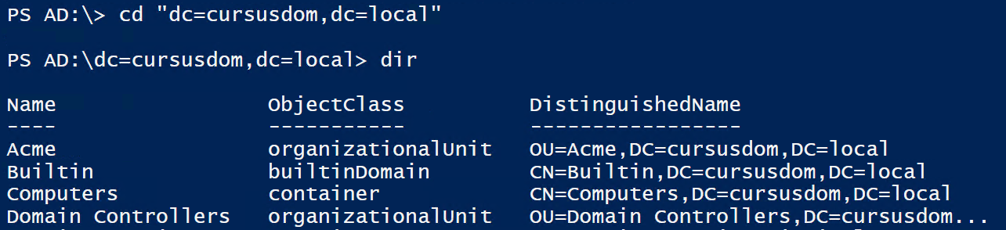
Navigation
There is a PS-provider for AD
…so you can navigate using “get-childitem”
Or DIR, CD and DEL

Slide 6
Object in Directory Service
distinguishedName = identifies the object in a unique way in the directory service
Example
cn=karin,ou=medew,ou=Gebruikers,dc=edu,dc=khk,dc=be
cn=morgan.freeman,OU=Users,OU=acme,dc=cursusdom,dc=local
cn = Common Name
ou = Organizational Unit
dc = Domain Component

Slide 7
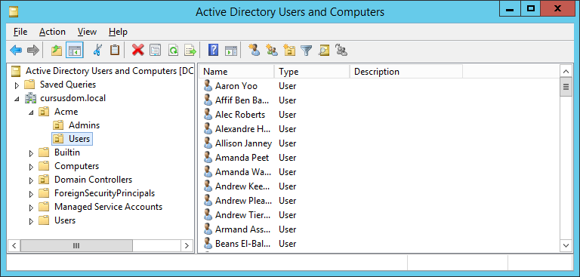
Browsing AD
Active Directory Users and Computers

Slide 8
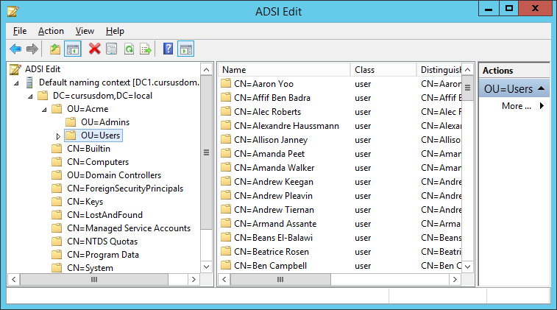
Browsing AD
ADSI Edit

Slide 9
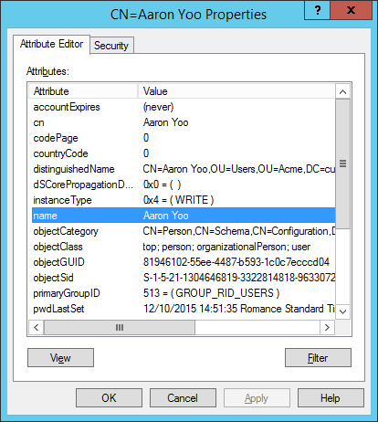
Browsing AD
AD Users and computers
Looks nice
Daily management of AD
ADSI edit
Screenshot
Looks less nice
Gives all and correct information

Slide 10
WinNT vs LDAP
LDAP provider
LDAP://cn=karin,ou=medew,ou=Gebr,dc=edu,dc=khk,dc=be
Doesn’t work for local users
Has a lot more functions than WinNT
WinNT provider
WinNT://edu/torricelli/Karin,User
Works with AD and local users
Is more limited
AD-cmdlets always use LDAP

Slide 11
WinNT example
Creating a local user:
Or, starting from PS 5.0:
$Computer = [ADSI]"WinNT://$Env:COMPUTERNAME,Computer"
$LocalAdmin = $Computer.Create("User", "LocalAdmin")
$LocalAdmin.SetPassword("Password01")
$LocalAdmin.SetInfo()
$LocalAdmin.FullName = "Local Admin by Powershell"
$LocalAdmin.SetInfo()
New-LocalUser -Name LocalAdmin -AccountNeverExpires

Slide 12
Getting users: navigation model
Use Get-Item when in the drive:
But:
You have to use ldap filters
You can only find objects when looking in the correct folders
The resulting object is an “ADObject”, not an ADUser
On the other hand
You can use ldap filters
You can find any type of object (comparable to Get-ADObject)
Set-Location AD:
Get-ChildItem -Filter 'Name=Morgan*' -Recurse

Slide 13
Getting users: AD cmdlets
Use Get-AD… when anywhere:
But:
Only available when the RSAT is installed
Which is also the case with Get-Item for AD, by the way
I haven’t found any downsides yet, but needed to keep the formatting of the previous slide
On the other hand:
Filters are nicer (although LDAP filter are still possible)
Resulting object is of the right type
Get-ADUser -Filter 'Name -like "Morgan*"'
Get-ADOrganizationalUnit -Filter 'Name -eq "Users"'
Get-ADComputer -Filter *
Get-ADObject -Filter *

Slide 14
Properties
Get-ADUser "Morgan.Freeman" |
Get-Member -MemberType Properties |
Measure-Object
Results in 10
Not very much…
Result is 106
By default, not all properties are loaded
If you want a certain property, you have to select is
Get-ADUser "Morgan.Freeman" -Properties * |
Get-Member -MemberType Properties |
Measure-Object

Slide 15

New User
New-ADUser
Required:
Name
SamAccountName (and UserPrincipalName)
Very useful:
Path
AccountPassword
ConvertTo-SecureString "pwd" -AsPlainText -Force
Enabled
Nice:
DisplayName
Givenname
Surname
Description
Company
OtherAttributes
Hashtable with existing property names

Slide 16

A lot of new users
The new users come to you in a CSV-file
A good CSV-file:
Importing?
Immediately set password and activate?
Import-Csv "c:\file" | New-ADUser
Import-Csv "c:\file" |
New-ADUser -PassThru |
Set-ADAccountPassword -PassThru -Reset -NewPassword $passw |
Enable-ADAccount

Slide 17

A lot of new users
The new users come to you in a CSV-file (continued)
A bad CSV-file:
Importing?
$pathInAD = "ou=Admins,ou=Acme,dc=cursusdom,dc=local"
Import-Csv "c:\file" |
foreach-object { new-aduser -Path $pathInAD `
-SamAccountName $_.first.replace(' ','.') `
-UserPrincipalName $_.first.replace(' ','.') `
-DisplayName ($_.first + " " + $_.last) `
-Initials ( $_.first.Substring(0,1) + $_.last.Substring(0,1)) `
-AccountPassword (convertto-securestring -asplaintext $_.password -force) `
-enabled $true }

Slide 18
Copy AD user
First, save the user you want to copy in a variable
Make sure to select all properties you want to copy!
The, create the new user, using the –instance parameter
Overwrite any properties you want to change
Not automatically transferred:
Group membership
Location (OU)
$m = Get-ADUser -Filter { name -eq "Morgan Freeman" } -Properties MemberOf, StreetAddress
New-ADUser -Name "New Morgan" -SamAccountName "New.Morgan" `
-Instance $m -AccountPassword (..)
$m.MemberOf | ForEach-Object { Add-ADGroupMember -Identity $_ -Members "New.Morgan" }

Slide 19
Changing users: Set-ADUser
Use -identity or piping to select a user
Use the parameters to set default properties
-City, -Company, -Country, …
Use –Add, –Replace, –Remove and –Clear for all the other parameters
Set-ADUser "Morgan.Freeman" -city Mol -GivenName Morgan `
-Add @{url="www.khk.be","toledo.khk.be“} `
-Replace @{description="Directeur Marketing Benelux"} `
-Remove @{sn = "Lisa" } `
-Clear department

Slide 20
Group membership
Add-ADGroupMember
-Identity (or pipe in) is the group that receives members
-Members are the group(s) and/or user(s) that will be joining
“Members” is plural: an array, a list, …
Add-ADPrincipalGroupMembership
-Identity (or pipe) is the object that will become a member
-MemberOf is the group the object will become member off
“MemberOf” is singular: one distinguished name, identity, SID, …

Slide 21
Organizational Units
$ou = Get-ADOrganizationalUnit -Filter "Name -like 'Acme'"
New-ADOrganizationalUnit -Path $ou.DistinguishedName -Name "tempOU"
Get-ADOrganizationalUnit -Filter "Name -like 'tempOU'" |
Remove-ADOrganizationalUnit # but confirmation is still required
Removing without confirmation:
Is correct, but the accidental deletion checkbox is still checked…
Get-ADOrganizationalUnit -Filter "Name -like 'tempOU'" |
Remove-ADOrganizationalUnit -Recursive -Confirm:$false
Get-ADOrganizationalUnit -Filter "Name -like 'tempOU'" |
Set-ADOrganizationalUnit -ProtectedFromAccidentalDeletion $false

Slide 22
Removing objects
Most remove cmdlets don’t have a Filter or Name parameter
They do have an “Identity”-parameter
This is the full name of the object or the SamAccountName (for users)
If you don’t feel like typing that full name
Or
OU=tempOU,OU=Acme,DC=cursusdom,DC=local
$var = Get-ADObject -Filter "..."
Remove-ADObject -Identity $var.DistinguishedName
Get-ADObject -Filter "..." | Remove-ADObject

Slide 23
Searching and filtering
Filter: about_ActiveDirectory_Filter
SearchBase and SearchScope
Do performance optimization!
Different types:
-LDAPFilter: LDAP syntax
-Filter: PowerShell syntax
Simpler
Follows expression syntax

Slide 24
Filtering objects (examples)
Using the –Filter parameter:
Beware: DistinguishedName is a “constructed attribute” and can’t be filtered on using anything but -eq
Get-ADObject -Filter {ObjectClass -like "*"}
Get-ADObject -Filter {CN -like "*chris*"}
Get-ADUser -Filter {badpwdcount -ge 5}
Get-ADUser -Filter { Email -like "*" -and Surname -eq "smith" }
Get-ADUser -Filter { Email -like "*" -and sn -eq "smith" }
Get-ADUser -Filter { Email -notlike "*" }
$date = Get-Date "1/1/2010"
Get-ADUser -Filter { LastLogon -le $date }
Get-ADGroup -filter { GroupCategory -eq "Security" }
Get-ADOrganizationalUnit -Filter { name -eq "Users" } |
Where-Object DistinguishedName -NotLike "*Acme*"

Slide 25
SearchBase and SearchScope
-SearchBase: start of the search operation
-SearchBase "ou=marketing,ou=pscursus,dc=cursusdom,dc=local”
-SearchScope: the borders of the search operation
Base: the object itself is searched
OneLevel: the child objects of the search base are searched, but no sublevels
SubTree: recursive search below the search base. This is the default value. The searchBase object itself is also searched.

Slide 26
Search performance optimization
Prefer one search string that provides several attributes of an object to separate search strings to fetch the different attributes
Start the search operation in the container you wish to search
Limit the scope to one level, if possible
Use filters to limit the search operation
Prefer to use the attribute objectCategory (single value field) to the attribute objectClass (multi-valued field)
Also, objectCategory is replicated to the Global Catalog.
You can use the wildcard * in filters, but still pay attention to limit the search operation
Combine filters to narrow your search string

Slide 27
The global catalog
Global catalogs can cache information from other (trusted) domains
If not all DC’s are GC, the infrastructure master can’t be a GC
So, make all DC’s a GC
GC-binding: connecting to the GC-role of a domain controller
By default you connect to the DC-role
So you are saying…?
When binding to a GC, only the inter-domain replicated properties for a user are available

Slide 28
$server = (Get-ADDomainController).Hostname
$cred = Get-Credential CD\Administrator
$domainRoot = "dc=cursusdom,dc=local"
Set-ADUser Morgan.freeman -Add @{PhysicalDeliveryOfficeName="G102"}
#GC binding vs DC binding
New-PSDrive -PSProvider ActiveDirectory -name ADnormal -Server $server `
-root $domainRoot -Credential $cred
cd ADnormal:
$DC = Get-ADUser Morgan.freeman -properties *
New-PSDrive -PSProvider ActiveDirectory -name ADGCbind -Server ($server + ":3268") `
-root $domainRoot -Credential $cred
cd ADGCbind:
$GC = Get-ADUser Morgan.freeman -properties *
# what properties are only available on non-GC's?
$propsGC = $GC | Get-Member -MemberType Properties | Select-Object -ExpandProperty Name
$propsDC = $DC | Get-Member -MemberType Properties | Select-Object -ExpandProperty Name
Compare-Object -ReferenceObject $propsDC -DifferenceObject $propsGC

Slide 29
General domain management
We’ve focused on daily administration, but most other AD-tasks have a corresponding cmdlet
Get-ADDomain: general information on the domain, domain fsmo’s
Get-ADForest: information on the forest, forest fsmo’s
Get-ADRootDSE: the root of a Directory Server information tree
Move-ADDirectoryServerOperationMasterRole
New-ADReplicationSite: create a new site
Move-ADDirectoryServer: move a DC to a site
Set-AD[Domain-Forest]Mode: raise or lower the domain functional mode
Missing (for now): Force replication between sites/DCs…
Notes:
Replication:
https://itfordummies.net/2014/11/05/trigger-active-directory-replication-powershell/
MSDN, and not with Get-ADDomainController…

Slide 30
And an afterthought
Invoke-GPUpdate
… but only when RSAT for AD is installed…

Slide 31
