Slide 1

Git for Version Control

Slide 2

About Git
(Git)
Created by Linus Torvalds, creator of Linux, in 2005
Came out of Linux development community
Designed to do version control on Linux kernel
Goals of Git:
Speed
Support for non-linear development (thousands of parallel branches)
Fully distributed
Able to handle large projects efficiently

Slide 3

Centralized VCS
In Subversion, CVS, Perforce, etc. A central server repository (repo) holds the "official copy" of the code
the server maintains the sole version history of the repo
You make "checkouts" of it to your local copy
you make local modifications
your changes are not versioned
When you're done, you "check in" back to the server
your checkin increments the repo's version

Slide 4
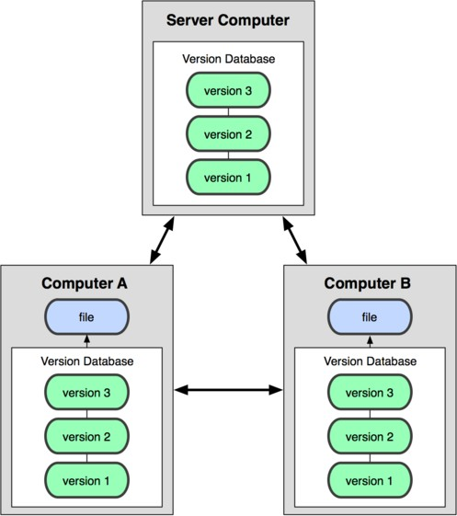
Distributed VCS (Git)
In git, mercurial, etc., you don't "checkout" from a central repo
you "clone" it and "pull" changes from it
Your local repo is a complete copy of everything on the remote server
yours is "just as good" as theirs
Many operations are local:
check in/out from local repo
commit changes to local repo
local repo keeps version history
When you're ready, you can "push" changes back to server

Slide 5
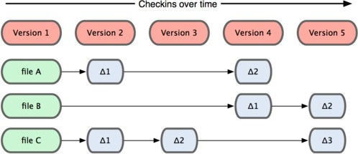
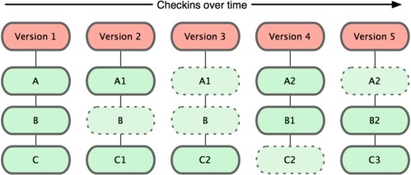
Git snapshots
Centralized VCS like Subversion track version data on each individual file.
Subversion
Git keeps "snapshots" of the entire state of the project.
Each checkin version of the overall code has a copy of each file in it.
Some files change on a given checkin, some do not.
More redundancy, but faster.
Git

Slide 6

A Git Sample
1. A new git is initialized as a remote repository
John Remote repository Peter
master
C0

Slide 7
A Git Sample
2. John and Peter clone the git repository
John
Remote repository
Peter
master
master
master
C0
C0
C0

Slide 8
A Git Sample
3. John does a commit
John | Remote repository | Peter
master | master | master
C1 C0 | C0 | C0

Slide 9
A Git Sample
4. John does a push
John
Remote repository
Peter
master
master
master
C1
C1
C0
C0
C0

Slide 10
A Git Sample
5. Peter does a pull
John
Remote repository
Peter
master
master
master
C1
C1
C1
C0
C0
C0

Slide 11
A Git Sample
6. John does a commit & push
John | Remote repository | Peter
master | master | master
C2 | C2 | C1
C1 C0 | C0 C0 | C0

Slide 12
A Git Sample
7. Peter does a commit
John
Remote repository
Peter
master
master
master
C2
C2
C3
C1
C1
C1
C0
C0
C0

Slide 13
A Git Sample
8. Peter does a pull (fetch & merge)
John
Remote repository
Peter
master
master
master
C2
C2
C4
C1
C1
C2
C3
C0
C0
C1
C0

Slide 14
A Git Sample
9. Peter does a push
John
Remote repository
Peter
master
master
master
C2
C4
C4
C1
C2
C3
C2
C3
C0
C1
C1
C0
C0

Slide 15
A Git Sample
10. John does a pull
John
Remote repository
Peter
master
master
master
C4
C4
C4
C2
C3
C2
C3
C2
C3
C1
C1
C1
C0
C0
C0

Slide 16
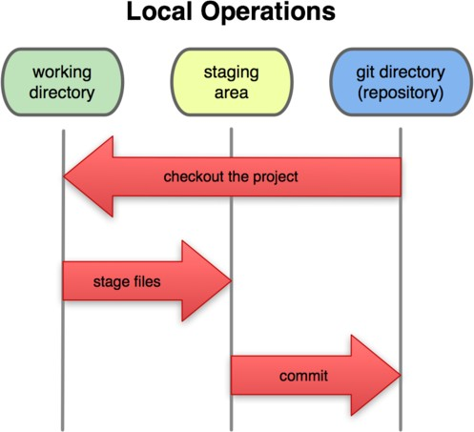
Local git areas
In your local copy on git, files can be:
In your local repo
(committed)
Checked out and modified, but not yet committed
(working copy)
Or, in-between, in a "staging" area
Staged files are ready to be committed.
Unmodified/modified Files
Staged Files
Committed Files
A commit saves a snapshot of all staged state.

Slide 17
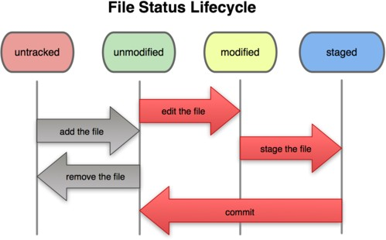
Basic Git workflow
Modify files in your working directory.
Stage files, adding snapshots of them to your staging area.
Commit, which takes the files in the staging area and stores that snapshot permanently to your Git directory.

Slide 18
Initial Git configuration
Set the name and email for Git to use when you commit:
git config --global user.name ""
git config --global user.email @gmail.com

Slide 19
Creating a Git repo
Two common scenarios: (only do one of these)
To create a new local Git repo in your current directory:
git init
This will create a .git directory in your current directory.
Then you can commit files in that directory into the repo.
git add filename
git commit –m "commit message"
To clone a remote repo to your current directory:
git clone url localDirectoryName
This will create the given local directory, containing a working copy of the files from the repo, and a .git directory (used to hold the staging area and your actual local repo)

Slide 20
Git commands
command | description
git clone url [dir] | copy a Git repository so you can add to it
git add file | adds file contents to the staging area
git commit | records a snapshot of the staging area
git status | view the status of your files in the working directory and staging area
git diff | shows diff of what is staged and what is modified but unstaged
git help [command] | get help info about a particular command
git pull | fetch from a remote repo and try to merge into the current branch
git push | push your new branches and data to a remote repository
others: init, reset, branch, checkout, merge, log, tag

Slide 21
Add and commit a file
The first time we ask a file to be tracked, and every time before we commit a file, we must add it to the staging area:
git add Hello.java Goodbye.java
Takes a snapshot of these files, adds them to the staging area.
To move staged changes into the repo, we commit:
git commit –m "Fixing bug #22"
To undo changes on a file before you have committed it:
git reset HEAD -- filename
git checkout -- filename
(unstages the file) (undoes your changes)
– All these commands are acting on your local version of repo.

Slide 22
Viewing/undoing changes
To view status of files in working directory and staging area:
git status or
To see what is modified but unstaged:
git diff
To see a log of all changes in your local repo:
git log or git log --oneline (shorter version)
1677b2d Edited first line of readme 258efa7 Added line to readme 0e52da7 Initial commit
git log -5 (to show only the 5 most recent updates), etc.

Slide 23
Branching and merging
Git uses branching heavily to switch between multiple tasks.
To create a new local branch:
git branch name
To list all local branches: (* = current branch)
git branch
To switch to a given local branch:
git checkout branchname
To merge changes from a branch into the local master:
git checkout master
git merge branchname

Slide 24
Interaction w/ remote repo
Push your local changes to the remote repo.
Pull from remote repo to get most recent changes.
– (fix conflicts if necessary, add/commit them to your local repo)
To fetch the most recent updates from the remote repo into your local repo, and put them into your working directory:
git pull origin master
To put your changes from your local repo in the remote repo:
git push origin master

Slide 25

What is Git & Github ?
Git is an example of version control
Version control is a system that records changes to a file or set of files and helps us recall specific versions later if needed. E.g. Subversion (SVN), CVS etc
It allows you to :
Revert files or the whole project to an earlier state
Compare changes over time
See who modified what?
Control modifications by collaborators with the permission of admin/owners
it is a version control tool that will allow you to perform all kinds of operations to fetch data from the central server or push data to it whereas GitHub is a core hosting platform for version control collaboration. GitHub is a company that allows you to host a central repository in a remote server.

Slide 26
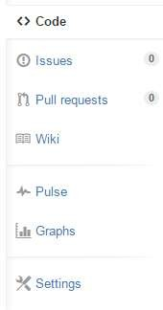
Github Structure
Personal user account
Organization account
REMOTE REPOSITORY
PUBLIC
PRIVATE
PUBLIC
PRIVATE
Unlimited public repositories and collaborators on all plans
Limited Private repositories
Ability to add unlimited
repository collaborators
Public repositories are open to view and copy but not commit changes.
Organizations are great for that need multiple owners & admins.
Limited private repositories (> Personal)
Team-based access
permissions
Unlimited owners, admins, & collaborators using teams
SYNC
CLONE TO GET LOCAL REPOSITORY

Slide 27
Important Concepts for Github Users
Creating a repo
Creating a repository for multiple people to work together
Master in a repository
This is the final version that is considered ready to use by anybody in the team or outside if repository is public.
Creating a Branch
Create a branch in your project, for an environment where you can try out new ideas.
Changes you make on a branch don't affect the master unless pull request is accepted.
Changes committed to branch reflects for you to keep track of different versions
Adding Commits
Keeps track of your progress as you work on a branch or master.
Creates a transparent history that others can follow to understand what you've done and why.
Forking a repository
It creates a copy for you to work on independently without any changes to theirs.
Submit a pull request to owner so that the owner can incorporate changes.

Slide 28

Concepts for Github Users ..
Pull requests
Pull Requests initiates discussion about your commits or changes made to a code.
See exactly what changes would be merged if pull request is accepted.
Use GitHub's @mention system in your Pull Request message to ask for feedback from specific people or teams, or for someone to review your work
Issues
Highlight bugs or issues with codes that need rectification.
Issues remain open unless resolved.
Can be filtered, Can be labeled as bug/enancement/ question/help wanted etc
@mention can be used to notify someone
Markdown syntax
Markdown is a way to style text on the web.
Available in descriptions and comments of Issues and Pull Requests. These include @mentions as well as references to SHA-1 hashes, Issues, and Pull Requests
Watch and Star
Watch notifies us of all conversations over and above your @mentions, commits,
comments on discussion. Star will favorite it but not show on your dashboards like watch

Slide 29
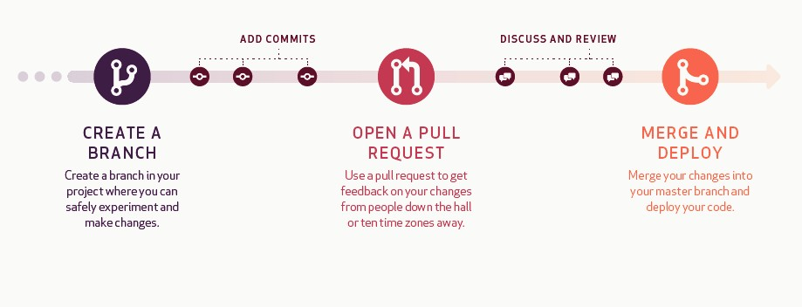
Understanding Github Workflow
*Deploying the code is for development projects
Commit
Comment on Pull request
Close Pull request
Compare
Sync or Push to branch
Add Issues/ Resolve Issues Mention Individuals

Slide 30
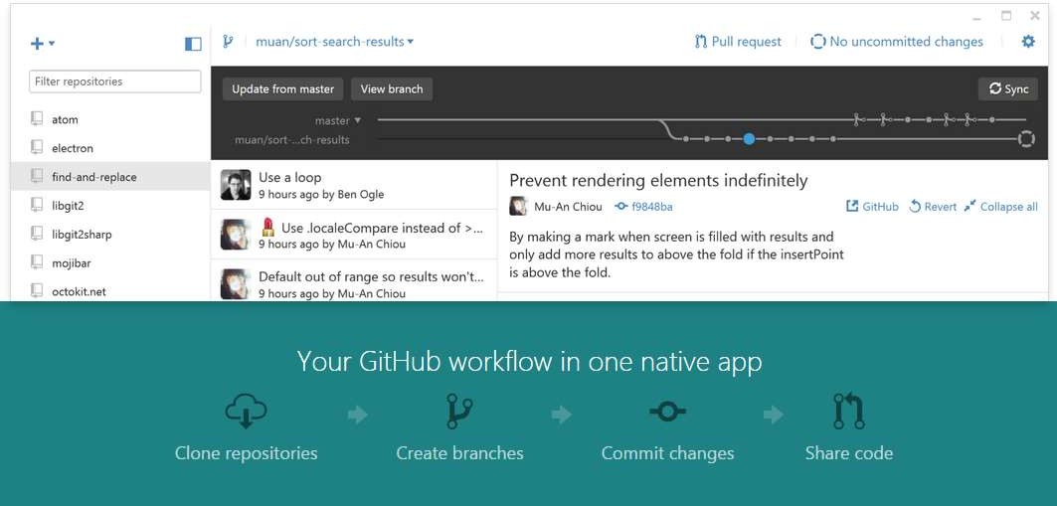
Github Desktop Demo
Link to download Github Desktop : https://desktop.github.com/

Slide 31
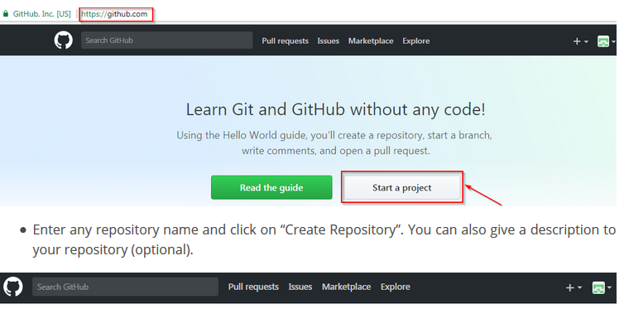

Slide 32
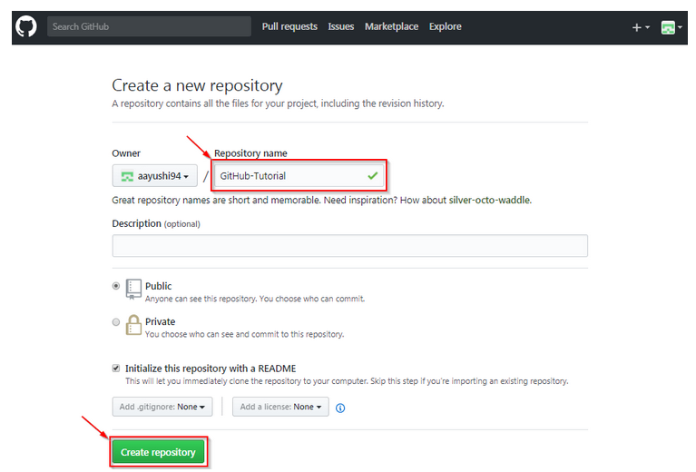

Slide 33
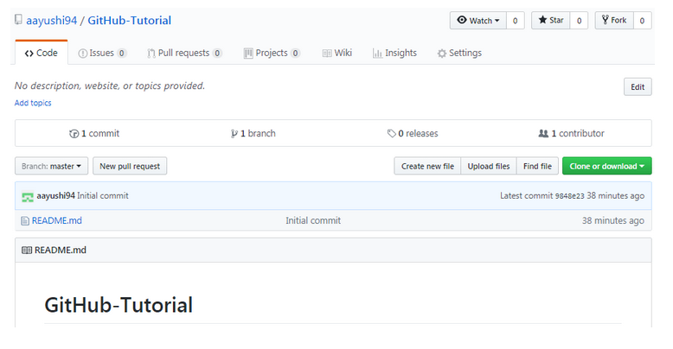

Slide 34
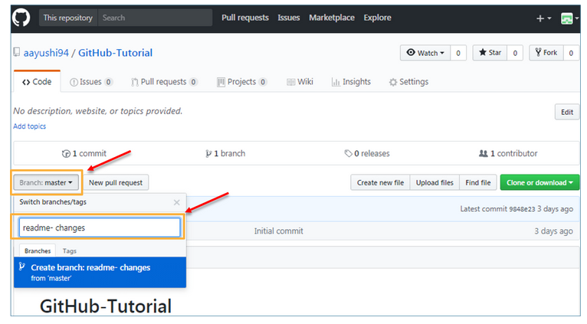

Slide 35
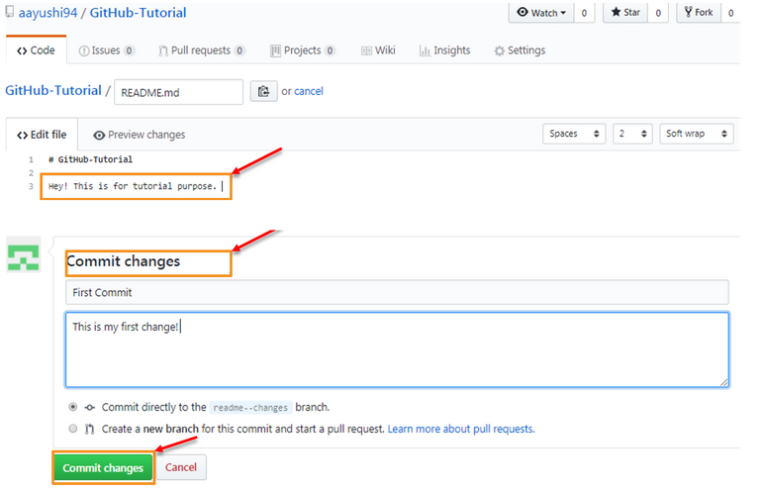

Slide 36
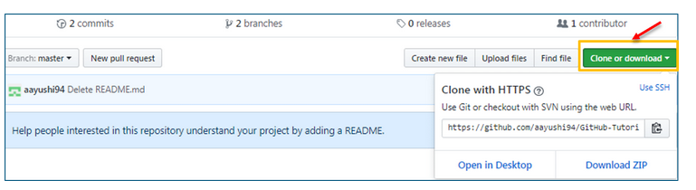
you want to use some code which is present in a public repository, you can directly copy the contents by cloning or downloading.

