Slide 1
Using Finesse to Model Mode-Mismatch in aLIGO

Slide 2
The Setup
Start with aLIGO standard .kat file
  Includes all main optics
  Added tunable squeezing (10db) + a filter cavity
  Added ideal mode-matching optics between SRC and OFI

Slide 3
The Big Questions
We’ve seen SR3 and SRM RoC changes affect the mode-matching of the IFO:
  How do those changes affect the h(t) w/ and w/o squeezing?
  If we vary the mode of the SRC, but keep the Arms and OMC mode-matched, how does that effect h(t)?
    If the negative effect of changing the SRC mode is small, it could allow us to use SRM as a mode-matching actuator.

Slide 4
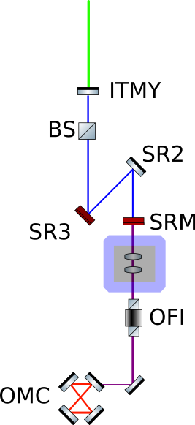
The Modified Cavities
1. Vary the SRM OR SR3 RoC
2. Use the Mode Matching Telescope to keep the ARM and OMC overlap at 100% while changing the SRM Roc.
3. Find the ARM, SRC, and OMC modes at the BS to measure the overlaps between any two modes.
4. Output the QM-limited h(t) to see how badly an SRC mismatch hurts us.
q_ARM
q_SRCY
q_SRCY
Mode Matching Telescope
q_OMC

Slide 5
Sensitivity Outputs
Changing SR3 curvature by up to 2cm
  It’s clear to see that that mode-mismatching SR3 hurts us, especially in the Squeezed IFO

Slide 6
Sensitivity Outputs
Changing SRM curvature by up to 50cm (this is huge!)
  Not terrible for either squeezed or non-squeezed.

Slide 8
Checking Ourselves
Setting the SRM Trans to 1:
  We should see no effects when varying the curvature as long as we include sufficient higher order modes.

Slide 9
WS Space

Slide 10
Next Steps
Look to see how mode-mismatch affects other cavities and the guoy phase relation between actuators:

Slide 11
Extra Slides: Finesse+Pykat
Advantages
  A full aLIGO Fourier domain analyses
  Output a QM-limited sensitivity
  You can add optics as needed for design purposes
Disadvantages
  Complexity (multiple cavities & a lot of code)
  Need careful consideration of higher order modes
    The larger the mismatches, the more coupling to HOMs, the more computationally expensive it is to run this analysis.

