Slide 1
Software Architecture Project Defense
Frederik Goovaerts (r0256551)
Thomas Vochten (r0300128)

Slide 2
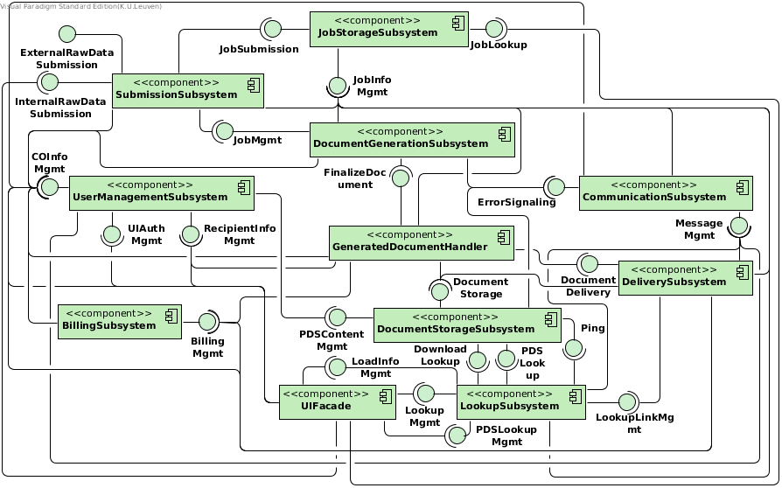
Primary client-server view
Notes:
F

Slide 3
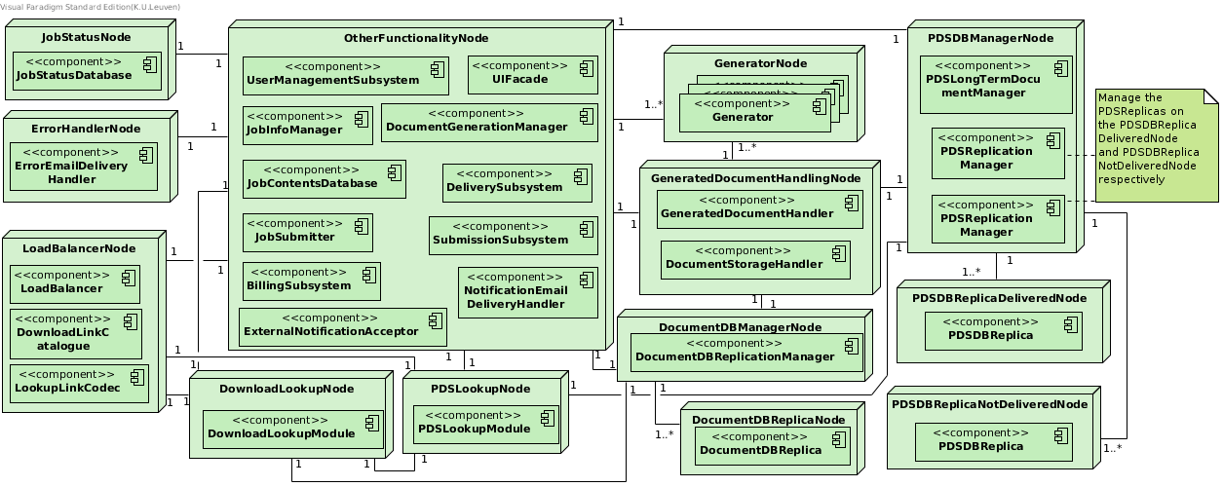
Deployment Diagram
Notes:
F

Slide 4
Deployment Diagram
P3
Av1 & P1
Av2
Av1 & Av2
P2
P2
P2
Av2 & P2
Av2 & P2
Notes:
T

Slide 5
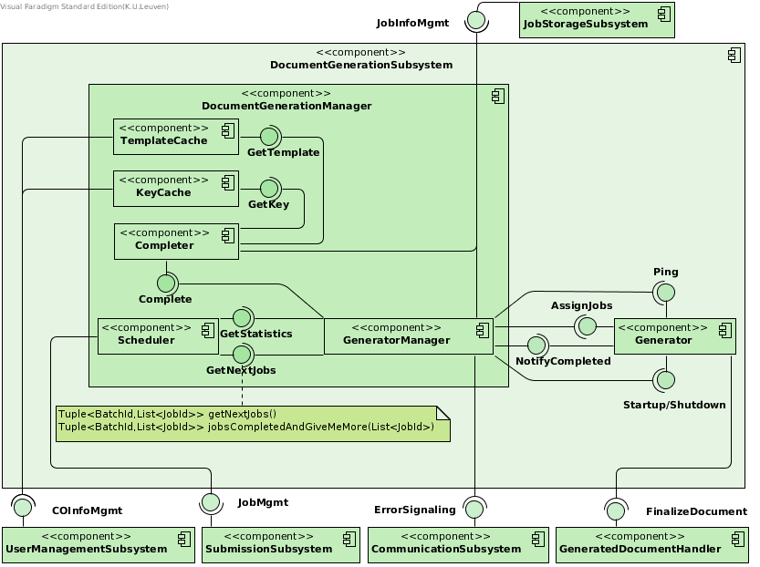
Document Generation Subsystem

Slide 6
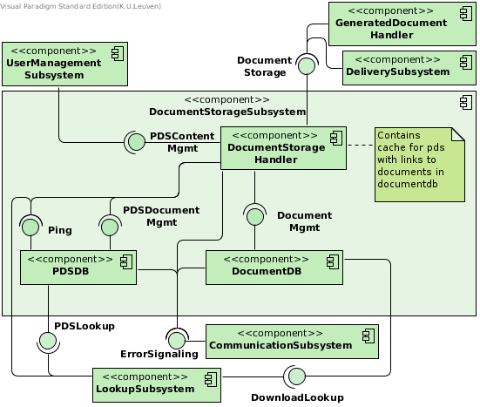
Document Storage Subsystem

Slide 7
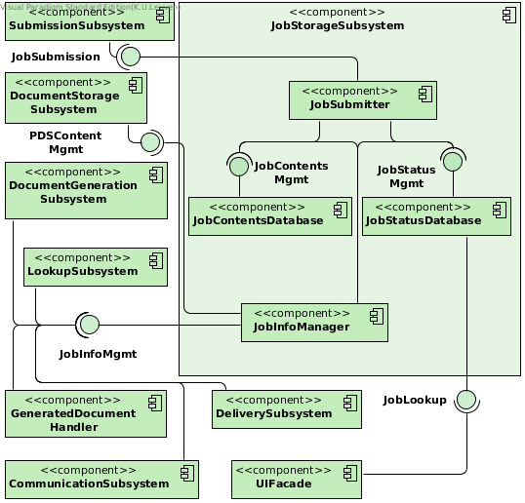
Job Storage Subsystem

Slide 8
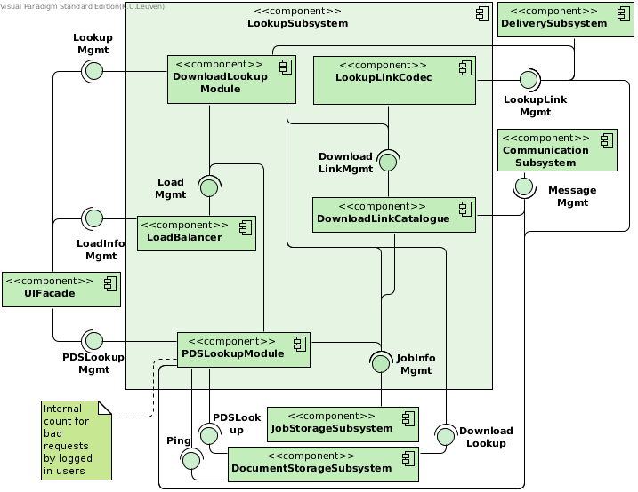
Lookup Subsystem

Slide 9
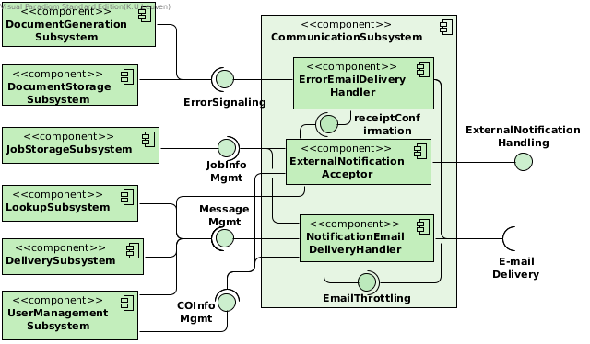
Communication Subsystem

Slide 10
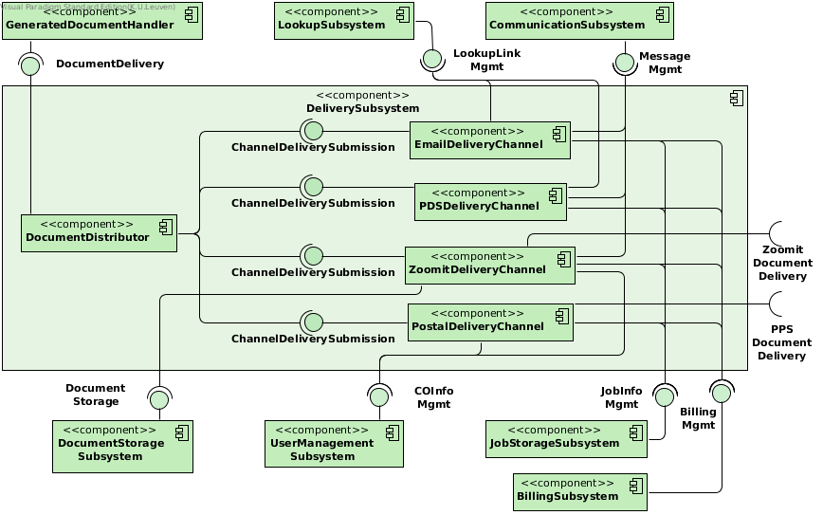
Delivery Subsystem

Slide 11
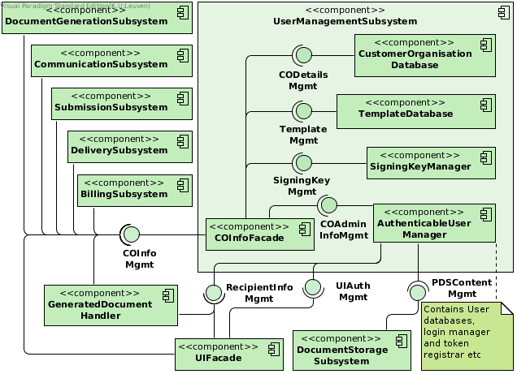
User Management Subsystem

Slide 12
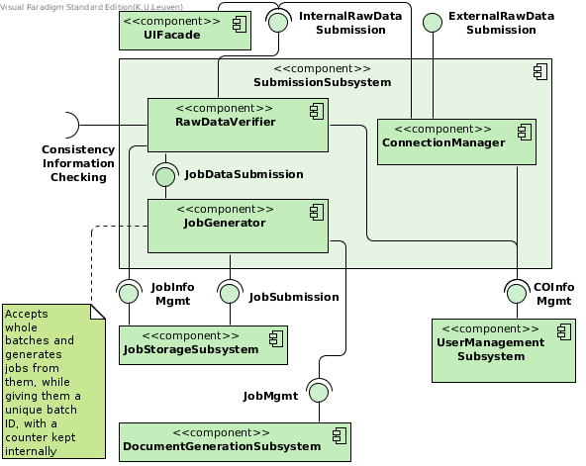
Submission Subsystem

Slide 13
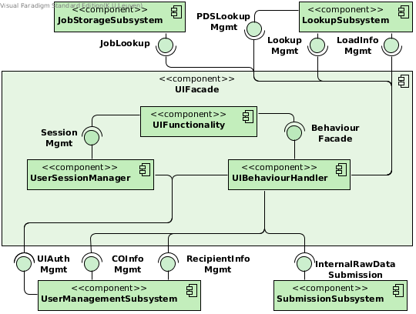
UI Facade

Slide 14
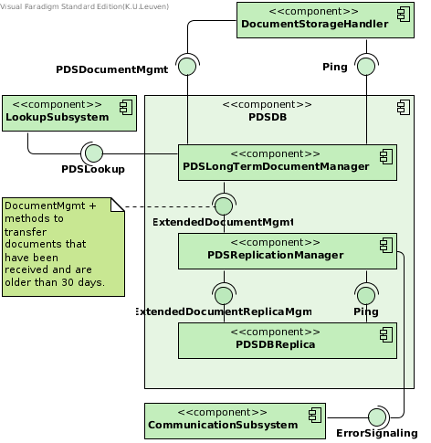
Document Storage Subsystem > PDSDB

Slide 15
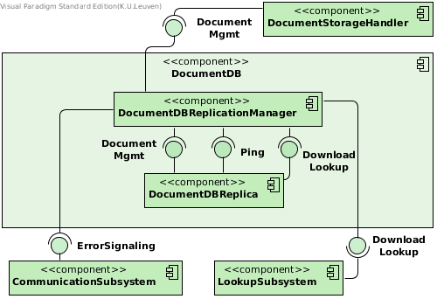
Document Storage Subsystem > DocumentDB

Slide 16
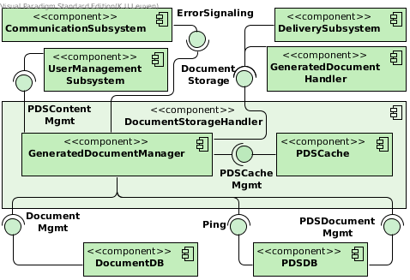
Document Storage Subsystem > DocumentStorageHandler

Slide 17
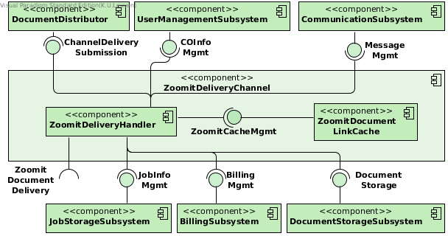
Delivery Subsystem > ZoomitDeliveryChannel

Slide 18
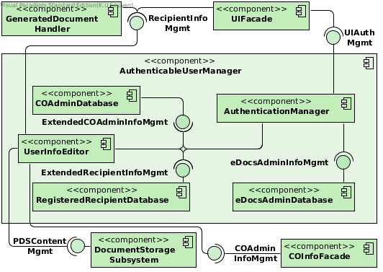
User Management Subsystem > AuthenticableUserManager

Slide 19
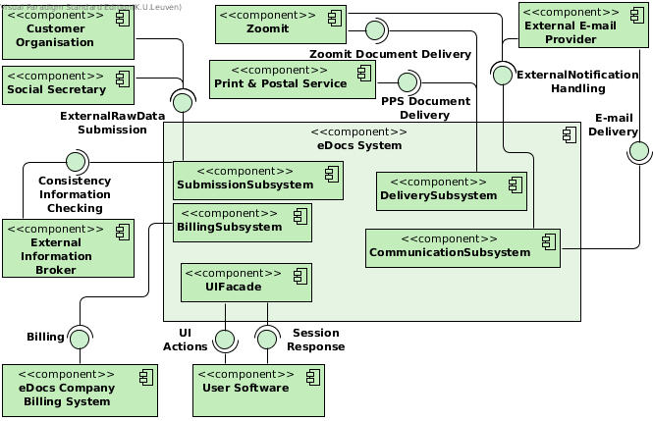
Client-server Context Diagram

Slide 20
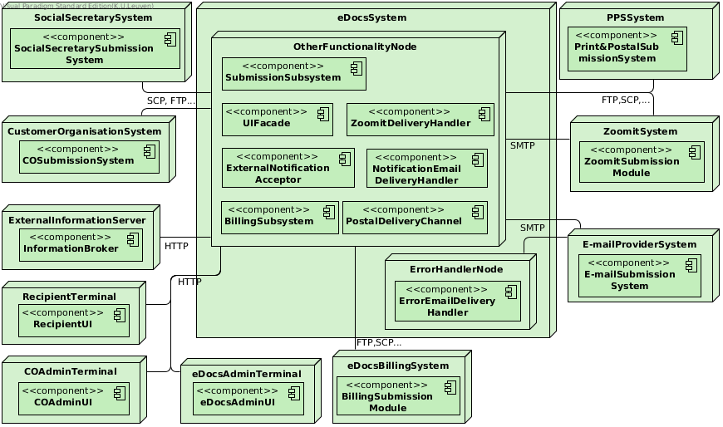
Deployment Context Diagram

