Slide 1
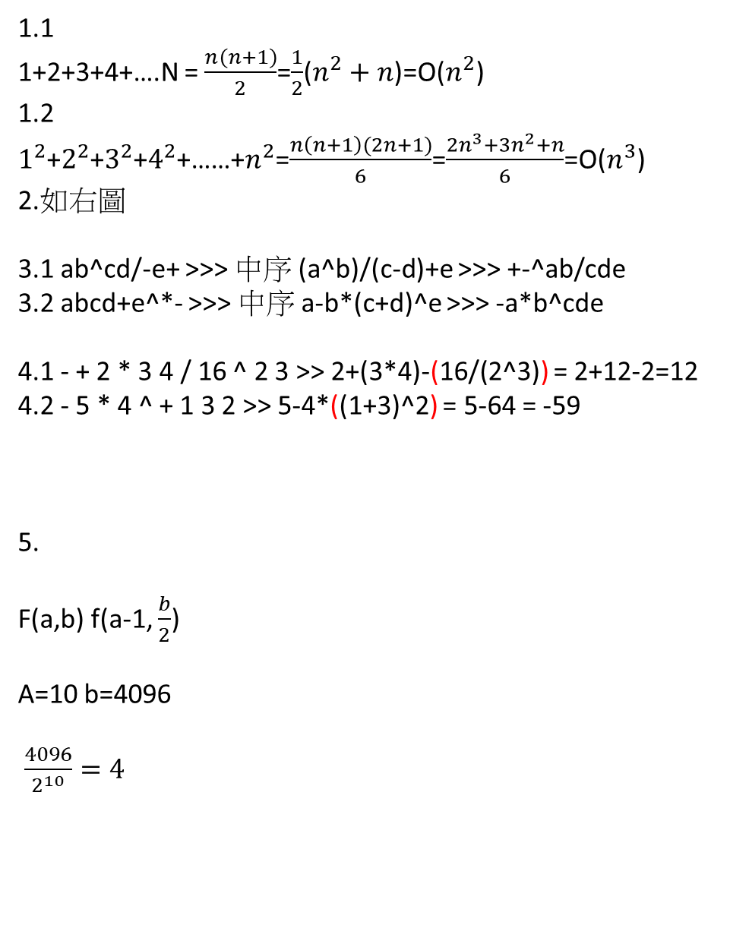
1.1
1+2+3+4+….N = $\frac{n\left(n+1\right)}{2}$=$\frac{1}{2}$($n^{2}+n$)=O($n^{2}$)
1.2
$1^{2}$+$2^{2}$+$3^{2}$+$4^{2}$+……+$n^{2}$=$\frac{n\left(n+1\right)(2n+1)}{6}$=$\frac{{2n}^{3}+{3n}^{2}+n}{6}$=O($n^{3}$)
2.如右圖
3.1 ab^cd/-e+ >>> 中序 (a^b)/(c-d)+e >>> +-^ab/cde
3.2 abcd+e^*- >>> 中序 a-b*(c+d)^e >>> -a*b^cde
4.1 - + 2 * 3 4 / 16 ^ 2 3 >> 2+(3*4)-(16/(2^3)) = 2+12-2=12
4.2 - 5 * 4 ^ + 1 3 2 >> 5-4*((1+3)^2) = 5-64 = -59
5.
F(a,b) f(a-1, $\frac{b}{2}$)
A=10 b=4096
$\frac{4096}{2^{10}}=4$

