Slide 1
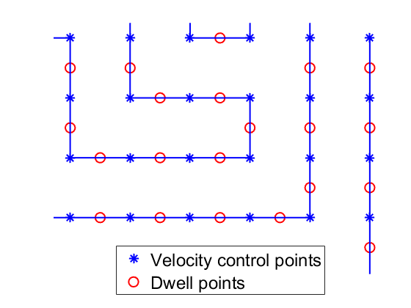
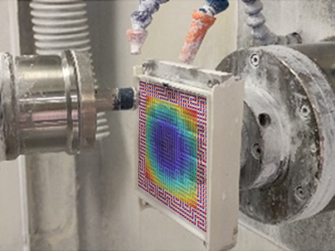
















$$t_{x,y}^{j−1}$$
$$v_{x}^{j−1}$$
$$p_{x}^{j−1}$$
$$C_{x,y}^{j}$$
$$dt$$
y
$$t_{x,y}^{j}$$
$$v_{x}^{j}$$
$$p_{x}^{j}$$
y
x
$$dt$$
x
$$p_{x}^{i−1}$$
$$C_{x,y}^{i}$$
$$p_{x}^{i}$$
$$v_{x}^{i−1}$$
$$v_{x}^{i}$$
$$t_{x,y}^{i−1}$$
$$t_{x,y}^{i}$$

Slide 2
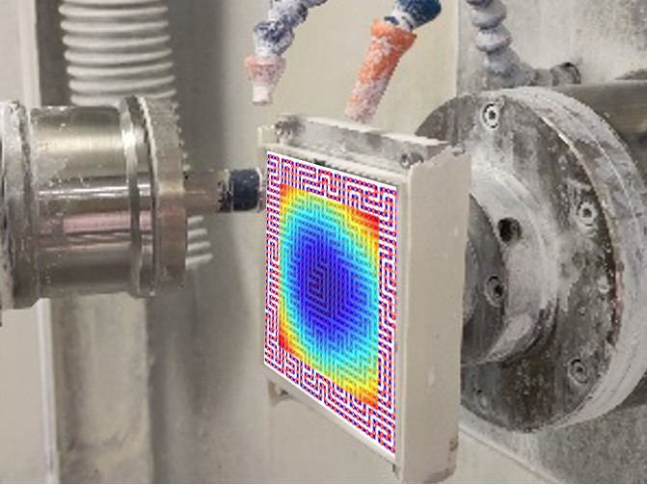
















$$t_{x,y}^{j−1}$$
$$v_{x}^{j−1}$$
$$p_{x}^{j−1}$$
$$C_{x,y}^{j}$$
$$dt$$
y
$$t_{x,y}^{j}$$
$$v_{x}^{j}$$
$$p_{x}^{j}$$
y
x
$$dt$$
x
$$p_{x}^{i−1}$$
$$C_{x,y}^{i}$$
$$p_{x}^{i}$$
$$v_{x}^{i−1}$$
$$v_{x}^{i}$$
$$t_{x,y}^{i−1}$$
$$t_{x,y}^{i}$$

