Slide 1



(c)
v
Constant acceleration mode
(a)
P₃
V_{k}
P₂
V_{k-1}
P₄
P₁
t
(d)
$$p_{i}=a_{i}t_{i}^{3}+b_{i}t_{i}^{2}+{c_{i}t}_{i}+d_{i}$$
PVT mode
p
(b)
P₃
t
P₂
$$v_{i}={3a}_{i}t_{i}^{2}+2b_{i}t_{i}+c_{i}$$
v
P₄
t
P₁
$${acc}_{i}={6a}_{i}t_{i}+2b_{i}$$
a
t

Slide 2
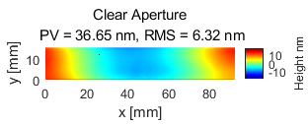
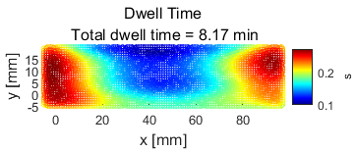
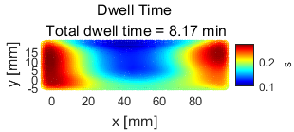
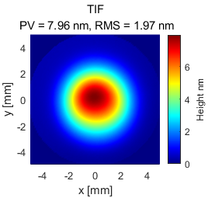
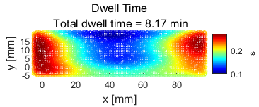
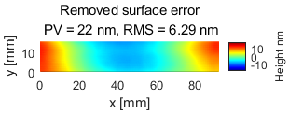
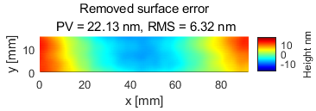
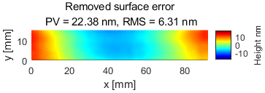
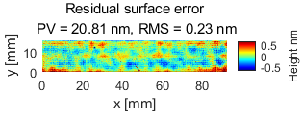
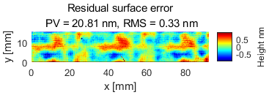
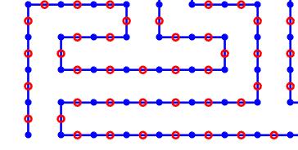
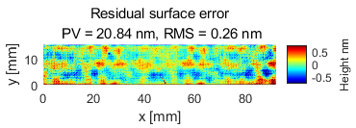
Surface & TIF
PVT scheduler
Const-acc scheduler
Position mode: UDO
Dwell points & Path points
dwell points
path points

