Slide 1








(a)
Velocity
(b)
Acceleration
15
0.4
PVT
PVT
Constant acc
Constant acc
10
v [mm/s]
0
a [mm/s²]
5
-0.4
1.0
2.0
3.5
5.0
1.0
2.0
3.5
5.0
$$p_{0}$$
$$p_{1}$$
$$p_{2}$$
$$p_{3}$$
$$p_{0}$$
$$p_{1}$$
$$p_{2}$$
$$p_{3}$$
x [mm]
x [mm]

Slide 2
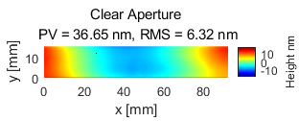
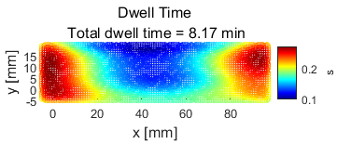
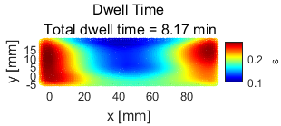
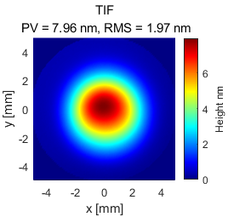
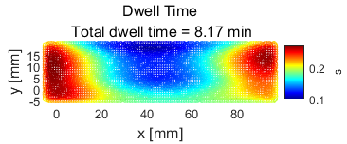
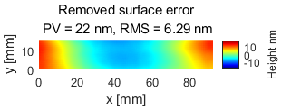
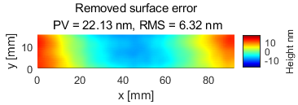
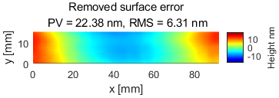
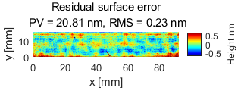
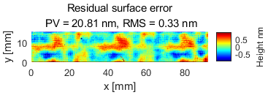
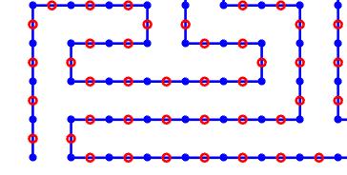
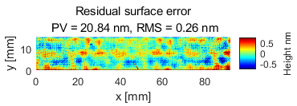
Surface & TIF
PVT scheduler
Const-acc scheduler
Position mode: UDO
Dwell points & Path points
dwell points
path points

