Slide 1
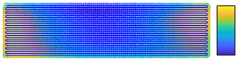
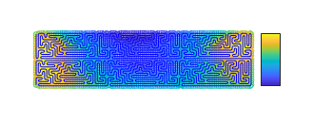
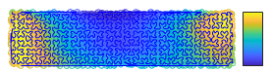




(b)
Feed rate in x direction
raster
maze
rap
(a)
Raster, Total t = 8.15 min
[s]
0.3
$$v_{max}^{x}$$
16 mm
0.1
102 mm
0
Maze, Total t = 8.15 min
[s]
0.3
$${−v}_{max}^{x}$$
16 mm
0.1
(c)
Feed rate in y direction
102 mm
$$v_{max}^{y}$$
RAP, Total t = 8.15 min
[s]
0.3
16 mm
0
0.1
102 mm
$${−v}_{max}^{y}$$

