Slide 1
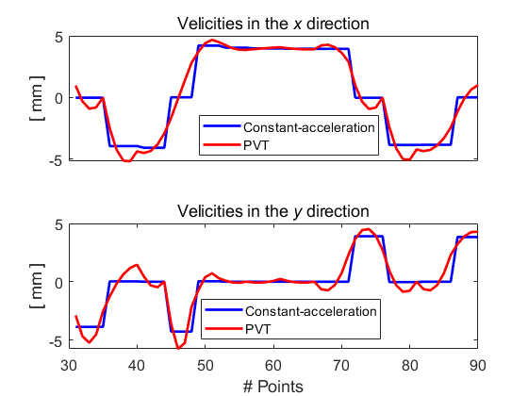
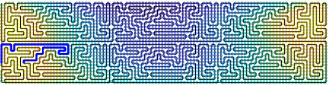
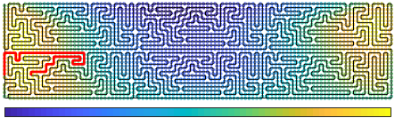
(c)
(a)
Path up-sampled with constant acceleration
26 mm
102 mm
(b)
Path up-sampled with PVT
(d)
0.1
[ s ]
0.3
Total dwell time = 8.17 min

Slide 2
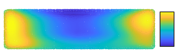






(b)
Feed rate in x direction
$$v_{max}^{x}$$
0
$$v^{x}$$
(a)
Total dt = 8.17 min
[s]
0.3
$${−v}_{max}^{x}$$
26 mm
(c)
Feed rate in y direction
Const-acc
0.1
102 mm
PVT
$$v_{max}^{y}$$
0
$$v^{y}$$
$${−v}_{max}^{y}$$
Feed rate points

Slide 3



(a)
Total dwell time = 8.17 min
[s]
0.3
26 mm
-0.1
102 mm
(b)
Feed rate in x direction
Vx
Vx
0
150
0
Feed rate points
8.5$\text{×}{10}^{3}$
Const-acc
(c)
PVT
Feed rate in y direction
Vy
0
Feed rate points
8.5$\text{×}{10}^{3}$

