Slide 1
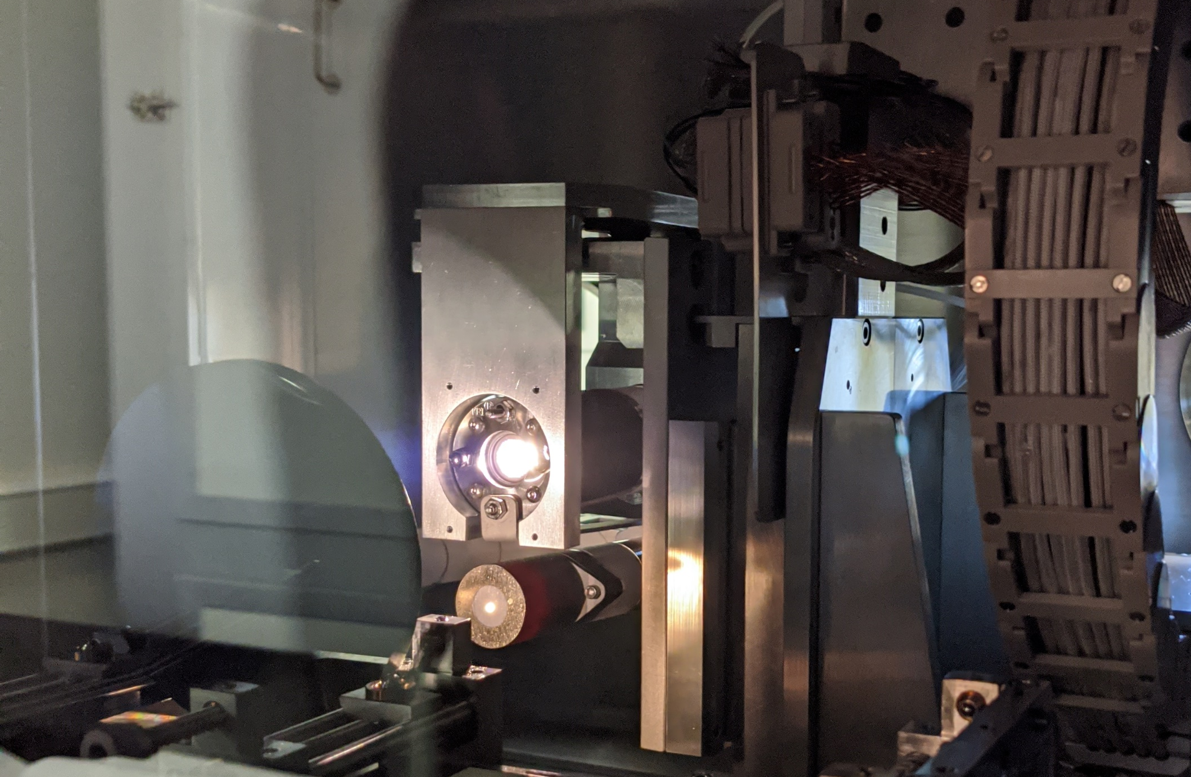
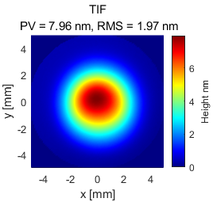
(a)
IBF TIF
FWHM = 4 mm
(b)
[nm]
8
10 mm
0
10 mm

