Slide 1
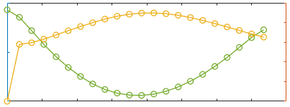
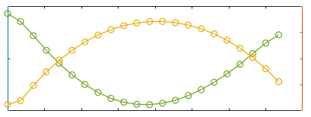
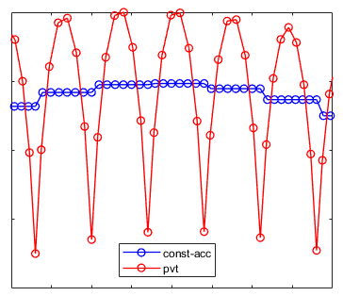
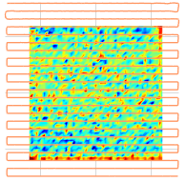
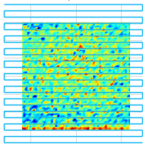










(a)
Dwell time vs. feed rate: PVT model
(b)
Dwell time vs. feed rate: Const-acc model
$$dt$$
$$v_{x}$$
$$dt$$
$$v_{x}$$
$$x$$
(c)
$$x$$
Comparison in federate simulation
PVT model
Const-acc model
$$v_{x}^{s}$$
(d)
$$x$$
Comparison in acceleration
$$a_{x}^{s}$$
$$x$$

Slide 2
(a)
Dwell time vs. feed rate: PVT model
(b)
Dwell time vs. feed rate: Const-acc model
Dwell time
Dwell time
Feed rate
Feed rate
X-axis
X-axis
(c)
Comparison in federate simulation
PVT model
Const-acc model
Feed rate
X-axis
(d)
Comparison in acceleration
Accelerate
X-axis

Slide 3








(a)
Velocity
(b)
Acceleration
15
0.4
PVT
PVT
Constant acc
Constant acc
10
v [mm/s]
0
a [mm/s²]
5
-0.4
1.0
2.0
3.5
5.0
1.0
2.0
3.5
5.0
$$p_{0}$$
$$p_{1}$$
$$p_{2}$$
$$p_{3}$$
$$p_{0}$$
$$p_{1}$$
$$p_{2}$$
$$p_{3}$$
x [mm]
x [mm]

Slide 4
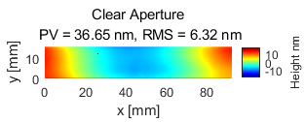
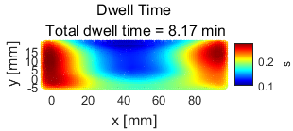
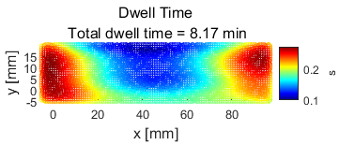
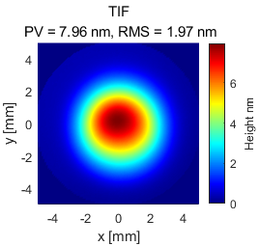
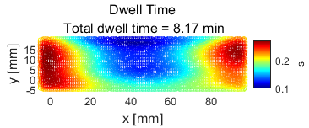
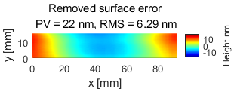
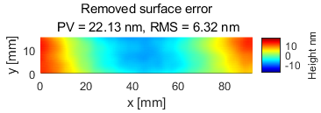
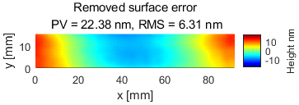
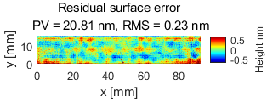
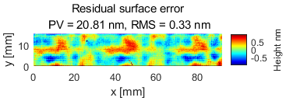
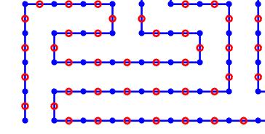
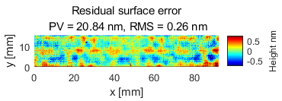
Surface & TIF
PVT scheduler
Const-acc scheduler
Position mode: UDO
Dwell points & Path points
dwell points
path points

