Slide 1
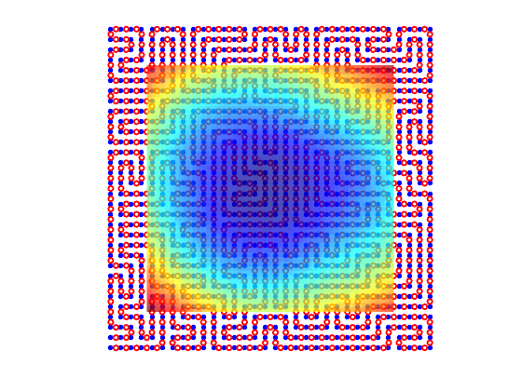
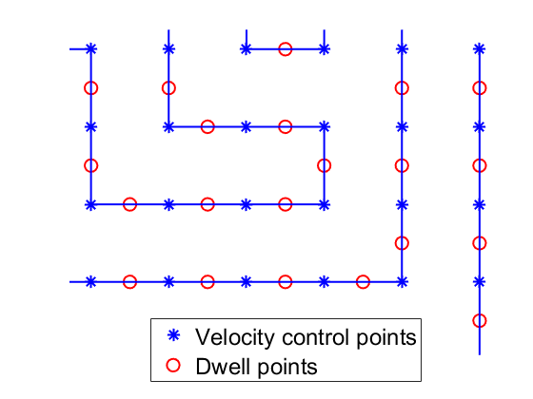
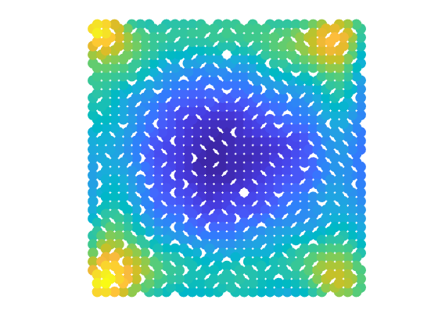
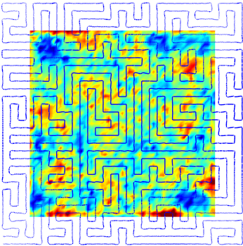

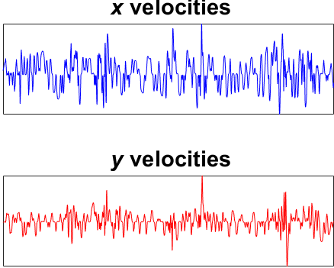
(a)
(b)
Defined tool path
Dwell time
1) Dwell time optimization
2) Velocity scheduling
(e)
(d)
Estimated residual
Up-sampled tool path
(c)
4) Convolution
3) Up-sampling

Slide 2
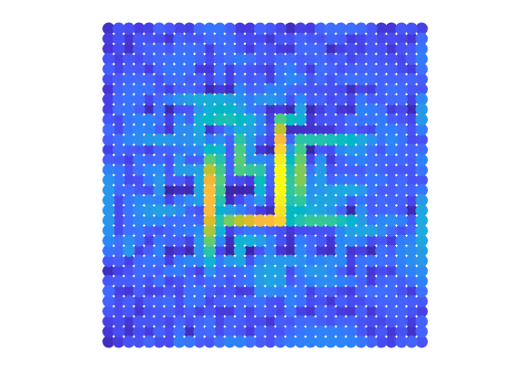
(a)
(b)
Defined tool path
Dwell time
1) Dwell time optimization
2) Velocity scheduling
(e)
(d)
(c)
Estimated residual
Calculated tool path
Velocities
4) Estimation
3) Sampling

Slide 3
