Slide 1
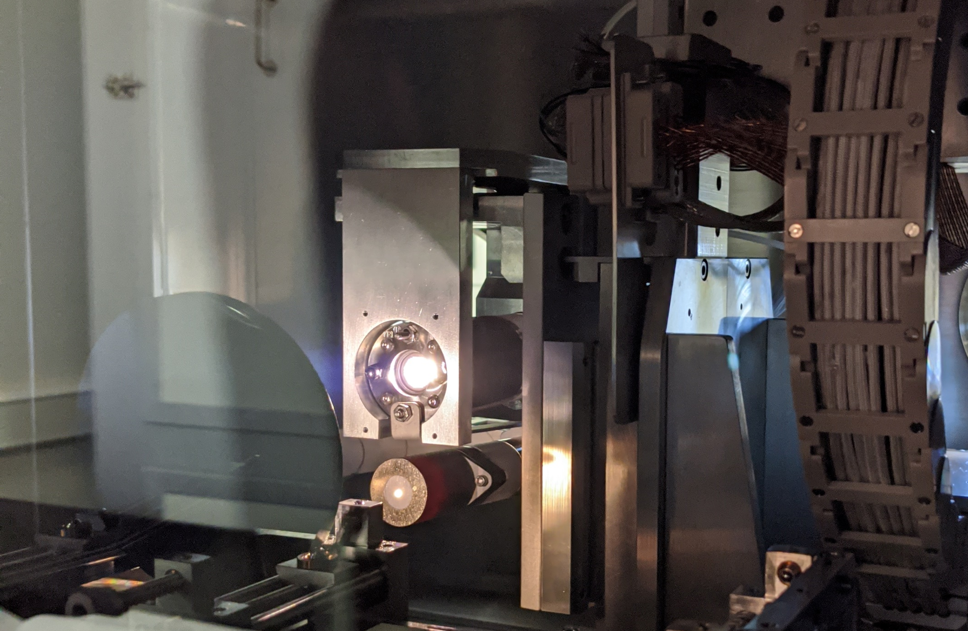
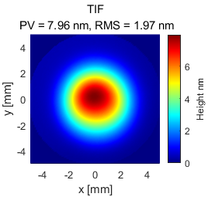
IBF TIF
FWHM = 4 mm
[nm]
8
10 mm
0
10 mm

