Slide 1
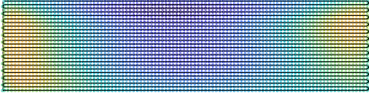
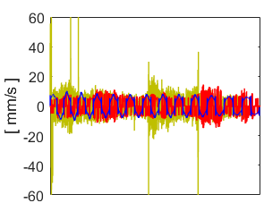
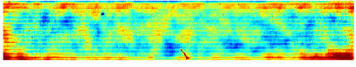
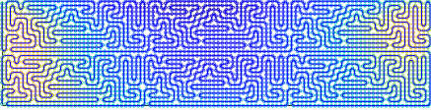
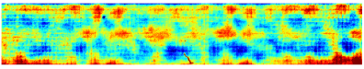
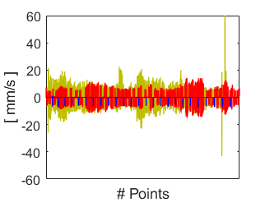
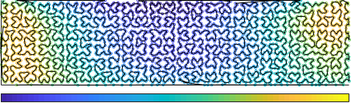
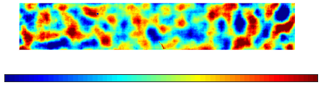
(a)
Raster path, total dwell time = 8.15 min
Raster path, residual RMS = 0.20 nm
(e)
(d)
Velocities in x direction
26 mm
16 mm
92 mm
102 mm
(b)
Maze path, total dwell time = 8.17 min
Maze path, residual RMS = 0.22 nm
(f)
Raster
Maze
RAP
Velocities in y direction
(c)
RAP, total dwell time = 7.64 min
RAP, residual RMS = 0.52 nm
(g)
Raster
Maze
RAP
0.1
[ s ]
0.3
-0.5
[ nm ]
0.5

