Slide 1
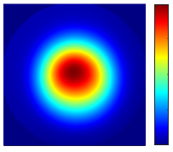
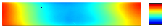
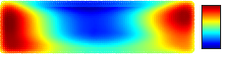
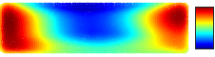
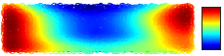
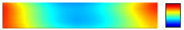
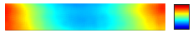
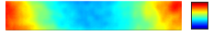
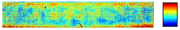
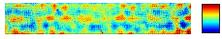
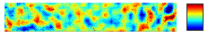
(a)
(b)
TIF, FWHM = 4 mm
Target removal map in CA
RMS = 6.32 nm
8
10
10 mm
[nm]
16mm
[nm]
92 mm
-10
10 mm
0
(c)
(d)
(e)
Raster path
Maze path
RAP path
25
25
25
[mm]
102
[mm]
102
[mm]
102
Dwell time
Total dwell time = 8.15 min
Dwell time
Total dwell time = 8.15 min
Dwell time
Total dwell time = 8.15 min
[s]
[s]
[s]
0.3
0.3
0.3
25
0.1
25
0.1
25
0.1
[mm]
102
[mm]
102
[mm]
102
Removed surface error
PV = 22.43 nm, RMS = 6.31 nm
Removed surface error
PV = 22.38 nm, RMS = 6.31 nm
Removed surface error
PV = 23.70 nm, RMS = 6.34 nm
[nm]
[nm]
[nm]
16
10
16
10
16
10
-10
[mm]
92
-10
[mm]
92
-10
[mm]
92
Residual surface error
PV = 20.99 nm, RMS = 0.20 nm
Residual surface error
PV = 20.84 nm, RMS = 0.26 nm
Residual surface error
PV = 20.40 nm, RMS = 0.51 nm
[nm]
[nm]
[nm]
16
0.5
16
0.5
16
1.0
[mm]
92
-0.5
[mm]
-0.5
[mm]
92
-1.0
92

