Slide 1

Introduction to Linux and High Performance Computing
Gloria Nakabiri, David Twesigomwe, Ian Wasukira
ABI Summer School June 2026

Slide 2

What is Linux?
Linux is a free open-source derivative of the Unix Operating System (OS).
Unix
Linux
Original family of operating systems—often proprietary and commercially licensed
Distributions: IBM AIX, HP-UX, Sun Solaris
Open source OS based on Unix.
It runs on computers, servers, mobile phones and a wide range of other devices
Distributions: Ubuntu, Redhat, Fedora, Debian, Android
ABI Summer School, June 2026

Slide 3
Importance of Linux
Offers high security and stability, making it ideal for servers and development work – supporting safe data storage & multi-user systems
Fully open-source and free to use, modify, and distribute.
Highly flexible and customisable to suit different user and industry needs – portability
Supported by a large global community and a vast software ecosystem

Slide 4
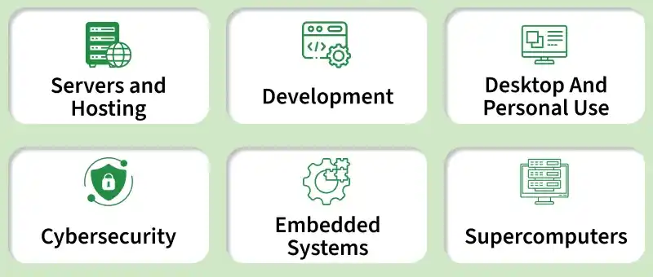
Where is Linux used?
ABI Summer School June 2026
https://www.geeksforgeeks.org/linux-unix/architecture-of-linux-operating-system/

Slide 5
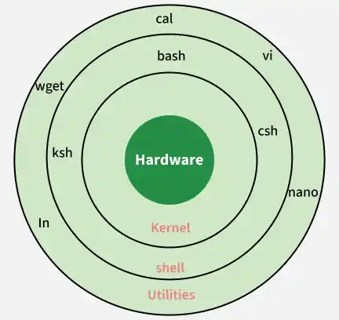
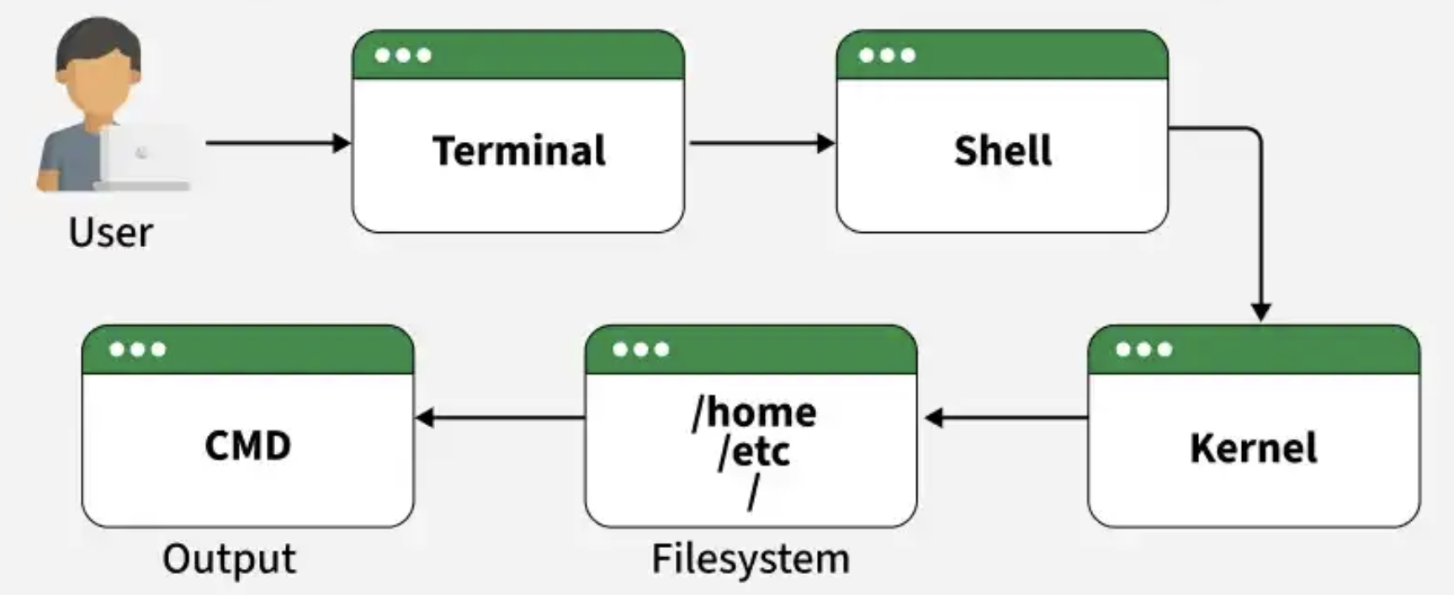
Basic Linux Architecture
ABI Summer School, June 2026
https://www.geeksforgeeks.org/linux-unix/architecture-of-linux-operating-system/

Slide 6
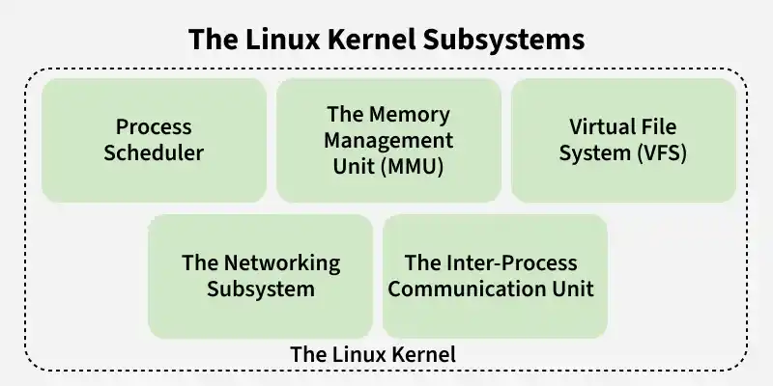
Basic Linux Architecture
ABI Summer School, June 2026
https://www.geeksforgeeks.org/linux-unix/architecture-of-linux-operating-system/

Slide 7
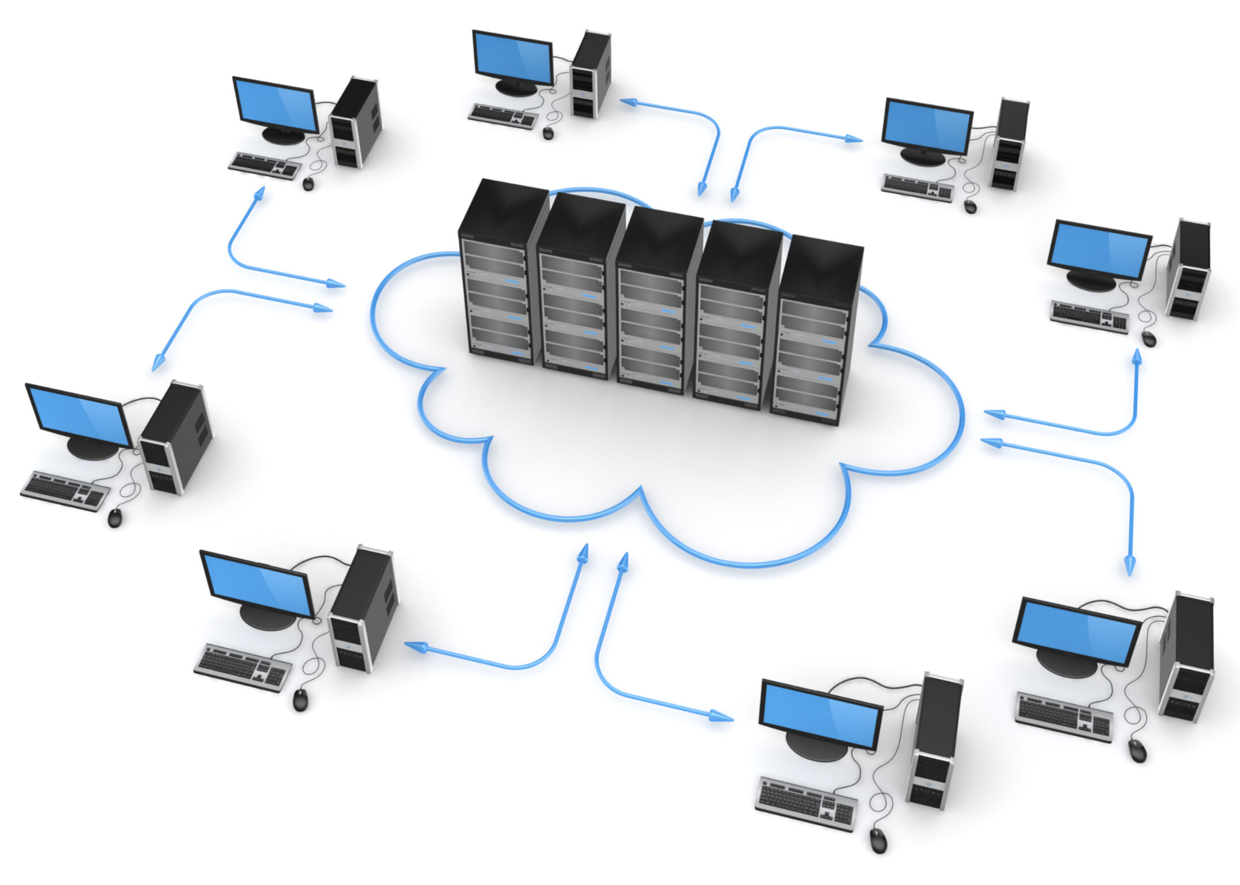
What is high-performance computing (HPC)?
Technology that uses clusters of powerful processors that work in parallel to process massive, multidimensional data sets and solve complex problems at extremely high speeds.
ABI Summer School, June 2026
https://www.weka.io/learn/hpc/hpc-applications/

Slide 8
Importance of high performance computing
Speed: Reduces processing times for large genomic datasets (through parallelisation and fast networks across elements)
Scalability: Scales to meet the growing demand for data storage and processing.
Accuracy: Improves the reliability of results through efficient data standardisation
ABI Summer School, June 2026

Slide 9
Use cases of high performance computing
Large Scale Genome Assembly and Read Alignment
Large-scale Variant Calling and Annotation e.g. in population genetics and pathogen surveillance
Pathogen genomics and Microbiome studies
Protein Structure Prediction and Molecular Dynamics
Machine Learning Integration to detect complex patterns within omic datasets
ABI Summer School, June 2026

Slide 10
Challenges in high performance computing
Cost: The cost of the hardware, software, and energy consumption is enormous, making HPC systems exceedingly expensive to create and operate. Additionally, the setup and management of HPC systems require qualified workers, which raises the overall cost.
Scalability: HPC systems must be made scalable so they may be modified or expanded as necessary to meet shifting demands.
Data Management: Large volumes os data must be stored securely and accessed using sophisticated networking analysis infrastructure
ABI Summer School, June 2026

Slide 11
Challenges in high performance computing
Programming: It might be challenging for developers to learn how to create and optimise algorithms for parallel processing.
Support for software and tools: HPC systems need specific software and tools to function efficiently — not all software and tools are created to function with HPC equipment.
Power consumption and cooling: To maintain the hardware functioning at its best, specialised cooling technologies are needed for HPC systems' high heat production. Furthermore, HPC systems consume a lot of electricity
ABI Summer School, June 2026

Slide 12
Practical 1
Generating ssh keys
Logging into the ACE-Uganda HPC cluster
Basic cluster architecture
Login node(s) vs worker nodes
Directory structure on shared systems, shared storage
ABI Summer School, June 2026

Slide 13
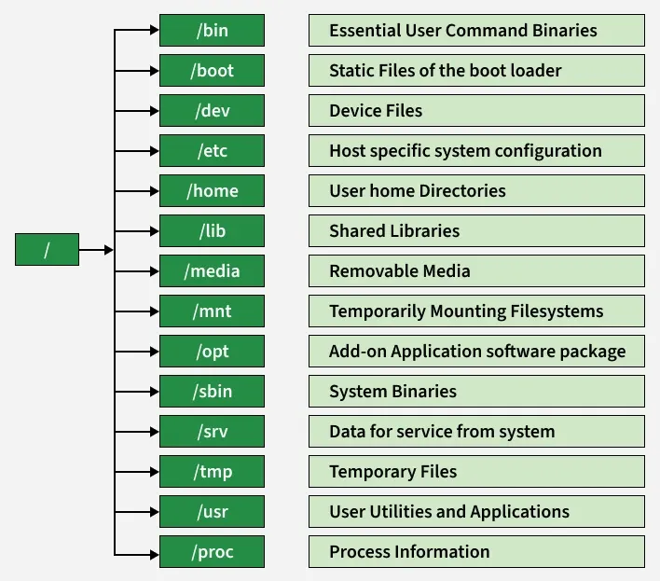
Linux / HPC
file structure
Root
ABI Summer School, June 2026
https://www.geeksforgeeks.org/linux-unix/

Slide 14
Practical 1: continued
Task 1: Explore the ACE cluster filesystem, check available modules (module avail), load one (conda), and observe how the environment changes.
ABI Summer School, June 2026

