Slide 1
Agenda:
Biblical Word Study
Social Psychology

Slide 2
Biblical Word Study
2 John 1:6 (NIV)
⁶And this is love: that we walk in obedience to his commands. As you have heard from the beginning, his command is that you walk in love.
Walk – Gr. περιπατέω (peripateō) – to tread about, walk about, and generally, to walk, to be walking; to make one's way, make progress; to frequent, stay in, a place; to regulate one's life, to conduct one's self, of the standard to which one governs his life; denoting either the state in which one is living, or the virtue or vice to which he is given

Slide 3
Biblical Word Study
Questions to ask those you live and work with:
What is my effect on you?
What am I like to live with? Work with?
What is something that is difficult for you to bring up with me?
A question to ask your self:
Who am I in relationship with others?
Questions like these can open the space to explore fear, worthlessness, shame and isolation, and can reveal strengths, gratitude, peace, joy, benefits, and maturity.

Slide 4
True or False?
T F 1. Compared with people in Western countries, those in East Asian cultures are more sensitive to situational influences on behaviour.
T F 2. To change people’s racist behaviours, we first need to change their racist attitudes.
T F 3. Chimps are more likely to yawn after observing another chimp yawn.
T F 4. Most people would refuse to obey an authority figure who told them to hurt an innocent person.
T F 5. Studies of college and professional athletic events indicate that home teams win about 6 in 10 games.

Slide 5
T F 6. Individuals pull harder in a team tug-of-war than when they pull in a one-on-one tug-of-war.
T F 7. The higher the morale and harmony of a social group, the more likely are its members to make a good decision.
T F 8. Researchers project that, other things being equal, global warming of 4 degrees Fahrenheit (or about 2 degrees centigrade) would induce more than 50,000 additional assaults and murders in the United States alone.
T F 9. From research on liking and loving, it is clear that opposites do attract.
T F 10. We are less likely to offer help to a stranger if other bystanders are present.

Slide 6

An Introduction to Psychological Science
Third Canadian Edition
Chapter 13
Social Psychology
Copyright © 2021 Pearson Canada, Inc.
Notes:
If this PowerPoint presentation contains mathematical equations, you may need to check that your computer has the following installed:
1) MathType Plugin
2) Math Player (free versions available)
3) NVDA Reader (free versions available)

Slide 7

Modules
13.1: The Power of the Situation: Social influences on Behaviour
13.2: Social Cognition
13.3: Attitudes, Behaviour, and Effective Communication
Sundry Photography/Shutterstock

Slide 8
13.1 Learning Objectives
Know the key terminology associated with social influence.
Understand why individuals conform to others’ behaviours.
Understand how individuals and groups can influence behaviours.
Apply your knowledge of being a passive bystander or active altruist to understand your own likeliness to help.
Analyze whether people who harm others are fundamentally hurtful, mean people or if their behaviour is the product of social influences.
Notes:
Know the key terminology associated with social influence.
See the bold, italicized terms below.
Understand why individuals conform to others’ behaviours.
At its most basic level, conforming begins with mimicry, in which people simply imitate others’ behaviours. Mimicry seems to help form social bonds and encourages prosocial behaviour. Conformity usually describes the way an individual’s more complex beliefs and behaviours evolve to become like the group’s. This change often happens unconsciously; in fact, we are said to have a bias blind spot that prevents us from seeing how our beliefs are shaped by group membership.
Understand how individuals and groups can influence behaviours.
In addition to conformity, behaviours can be changed through persuasion techniques. The two-step procedures of the foot-in-the-door and door-in-the-face techniques are applied by an individual who is intending to persuade or convince another person. In addition, unintentional phenomena exist. For example, in groupthink, the excitement of a group’s progress leads individuals to think alike and to be overconfident in their group’s decisions.
Apply your knowledge of being a passive bystander or active altruist to understand your own likeliness to help. behaviours.
People are least likely to help if they don’t feel personally responsible for taking action, if they are unsure what to do to help, or if they are unsure whether the situation is a genuine emergency. Thus, you can best ensure that others will help you if you make very clear that it’s an emergency and you need help, if you make a specific person responsible for helping, and if you tell that person exactly what he or she needs to do. Additionally, some people just tend to be more altruistic than others.
Analyze whether people who harm others are fundamentally hurtful, mean people or if their behaviour is the product of social influences.
The evidence from social psychological research clearly shows that individuals can change their behaviours drastically to fit a role, to comply with what the rest of the group is doing, and to follow instructions from authority figures. When all of these social influences are in play, it would not be at all unusual for a person to behave much differently—even more cruelly—than the individual ever believed he or she could.

Slide 9
The Person and the Environment
Kurt Lewin (1936): Behaviour is a function of the Person and the Environment
B = f(P,E)
Notes:
1) Much of our behaviour depends more on where we are than on who we are. To try to fully understand social reality, social psychologists study the interaction between the person and the environment. Kurt Lewin (1936), one of the founders of social psychology, expressed this insight as B = f(P,E). Behaviour is a function of the Person and the Environment.

Slide 10
Mimicry, Norms, and Roles (1 of 2)
Mimicry (p. 495)
Important social and functional reasons for doing so
Social Norms (p. 495)
Unwritten guidelines for how to behave in social contexts
Ostracism (p. 496)
Powerful form of social pressure
Notes:
1) We often use other people as a source of information about how to behave.
Mimicry (p. 495) refers to taking on for ourselves the behaviours, emotional displays, and facial expressions of others.
i) This can be a very useful skill, such as when visiting a foreign country.
a) You can watch others to see how things are done.
b) If you want to ride a train, do people buy tickets before boarding or once aboard?
2) Social norms influence everything from the manners we use (e.g., compare the jokes you tell to your friends or to your grandparents), to the amount of alcohol we drink, the food we eat and clothes we wear, and even our beliefs and attitudes. Norms govern much of our behaviour, even when we don’t realize it.
Social norms (p. 495) the (usually unwritten) guidelines for how to behave in social contexts.
3) One very important motivator for going along with norms is social approval. Individuals who don’t appear “normal” are often subject to all kinds of unpleasantness. Ostracism is a powerful form of social pressure.
Ostracism (p. 496) refers to being ignored or excluded from social contact.
i) Being left out of a simple game of catch may sound trivial, but, across dozens of studies, researchers have found striking effects, including anger and sadness, temporarily lowered self-esteem, self-confidence, and even a reduced sense of a meaningful existence.

Slide 11
Mimicry, Norms, and Roles (2 of 2)
The Stanford Prison Study (Zimbardo)
Social roles (p. 496)
Notes:
1) One of the most famous psychological studies, the Stanford Prison Study, depicts the power that social roles have over our behaviour.
Social roles (p. 496) are guidelines that apply to specific positions within the group.
i) Participants were pre-screened to establish they were psychologically healthy and then were randomly assigned to play the role of either prisoner or prison guard.
ii) The role playing began as soon as the prisoners were “arrested” and brought to the basement of the Stanford University psychology building, where they were incarcerated in a made-up prison.
iii) Some guards became quite hostile and abusive. Many of the “prisoners” became helpless and submissive.
2) The study was terminated before the planned two-week period. Zimbardo explained (though some participants have refuted this) that the study had gotten out of hand; the role-playing exercise became its own reality and the prisoners were starting to show extreme duress.
i) People placed into situations change their behaviour. Sometimes the change is intentional, but often it is not a conscious act. Sometimes the change is minor, but the situation can also demand enormous changes.

Slide 12
Group Dynamics: Social Loafing and Social Facilitation
Social loafing (p. 497)
When individuals put less effort into tasks when working with others
Social facilitation (p. 498)
When one’s performance is affected by the presence of others
Notes:
1) Do groups produce better work, making the most out of individuals’ ideas and encouraging their best effort? Or do they produce poorer outcomes, limiting people’s creativity and encouraging them to slack off?
Social loafing (p. 497) occurs when an individual puts less effort into working on a task with others.
i) There are several reasons for social loafing.
a) Low efficacy beliefs: if tasks are too difficult or complex, so people don’t know where to start.
b) Believing that one’s contributions are not important to the group: this occurs if people can’t see how their own input matters to the group.
c) Not caring about the group’s outcome: this occurs when a person is not personally identified with the group, perhaps feeling socially rejected from the group or perceiving the group as unsuccessful or unimportant.
d) Feeling like others are not trying very hard: people loaf if they feel others are loafing.
2) Social facilitation contrasts with social loafing.
Social facilitation (p. 498) occurs when one’s performance is affected by the presence of others.
i) For example, in probably the first social psychology experiment ever published, Norman Triplett (1898) found that cyclists ride faster when racing against each other rather than when trying to beat the clock. Many other researchers have found similar effects, even in animals.
ii) The presence of others doesn’t always improve performance, however. The presence of others is likely to interfere with our performance when our skills are poor or the task is difficult.
iii) There are many mechanisms that explain the social facilitation effect. One of the most important is that the presence of others is (emotionally) arousing, and arousal tends to strengthen our dominant responses. Similarly, the presence of others occupies our attention, reducing our ability to consciously direct out behaviour. For both reasons, when the task is simple, our dominant responses are the right ones. But when the task is very complex, we need to be able to pay more attention and control our responses more carefully, and then arousal decreases performance.

Slide 13
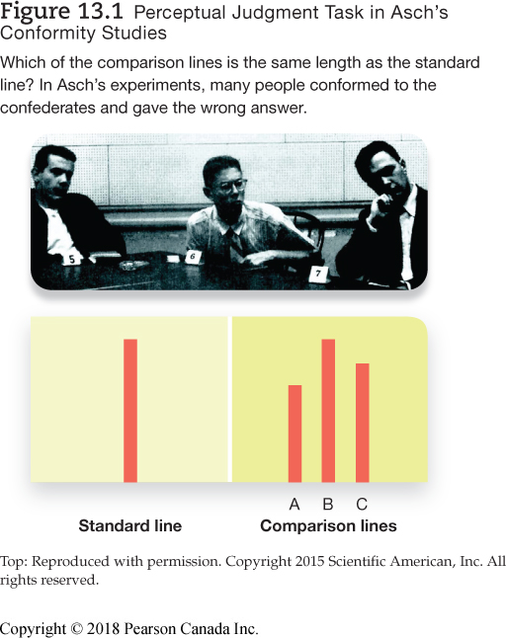
The Asch Experiments: Conformity (1 of 2)
Notes:
1) Conformity refers to a change in behaviour to fit in with a group. Unlike the chameleon effect, conformity is usually a conscious decision.
2) One of first scientific studies of conformity was performed by Solomon Asch.
i) A participant came into a room where there were five other people.
a) These other people were confederates who were told what to say ahead of time.
b) This group was meant to be a way of applying social pressure.
ii) Everyone was shown three lines and asked which line matched the standard line.
a) The confederates all purposefully picked the same wrong line.
b) The question is whether the participant will conform and pick the line s/he knows is wrong.
iii) Approximately 75% of these perfectly intelligent participants conformed to the group and gave the wrong answer at least once during the testing.
a) Approximately 25% conformed regularly.
iv) After the study, participants said they conformed because they thought they misunderstood the test, thought there was an optical illusion involved, or wanted to avoid making a scene.
a) There are a number of reasons why people conform or go against the grain.
3) This experiment showed that conformity can happen through either normative influence or informational influence.
Normative influence (p. 538) is the result of social pressure to adopt a group’s perspective in order to be accepted, rather than rejected, by the group.
Informational influence (p. 538) occurs when people feel the group is giving them useful information.

Slide 14
The Asch Experiments: Conformity (2 of 2)
Table 13.1 Personal and Situational Factors Contribute to Conformity
People Tend to Be Less Likely to Conform When . . . | People Tend to Be More Likely to Conform When . . .
Only one other person is in the vicinity | There is a larger group in the vicinity
There are only strangers in the room | There are friends, family, or acquaintances in the vicinity
There are extremely clear and simple tasks | The task is unclear or ambiguous
There is one other nonconformist in the room | Others conform first
Responses are made anonymously | Responses are made publicly
Notes:
1) There are a number of reasons why people conform or go against the grain (see Table 13.1). Both normative and informational influences seemed to be occurring in Asch’s studies.
i) For example, some of the conforming participants said afterwards that they thought they had misunderstood something, or that there was some sort of “trick” the others picked up on that they didn’t, because surely the others couldn’t all be wrong if they were all saying the same thing.
ii) Other people reported that they didn’t want to stand out or make a scene by being the disagreeable person, so they just went along with the group.
iii) In everyday contexts, both types of influence are often at work, making us easily swayed by other people. We will be especially vulnerable to social influence when we are uncertain about the situation, although as Asch showed us, social influence is powerful enough to make us doubt ourselves even when the situation is pretty clear and unambiguous.

Slide 15
Groupthink
Groupthink (p. 499)
When group members tend toward the same ideas to minimize conflict
Notes:
1) When individuals are not able to express their true perspectives and focus more on maintaining harmony in the group, there is a stifling of diversity referred to as groupthink.
Groupthink (p. 499) is a decision-making problem in which group members avoid arguments and strive for agreement.
i) There are three main problems associated with groupthink.
a) First, group members may minimize or ignore potential problems and risks in the ideas they are considering.
b) Second, they may apply social pressure to influence people who are not fully in support of an idea in an effort to get them to conform.
c) Third, the group often becomes overconfident and fails to think carefully or critically about its conclusions and decisions.
ii) Some groups are more susceptible to groupthink than others. Laboratory research revealed that when groupthink occurs, there is often a strong or “directive” leader—specifically, an individual who suppresses dissenters and encourages the group to consider fewer alternative ideas.

Slide 16
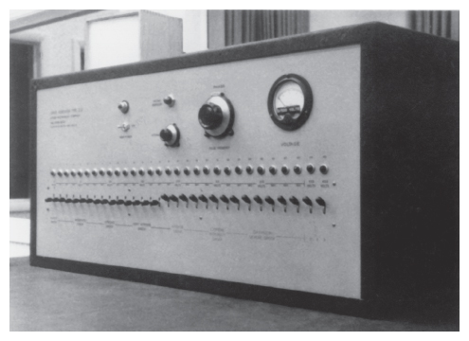
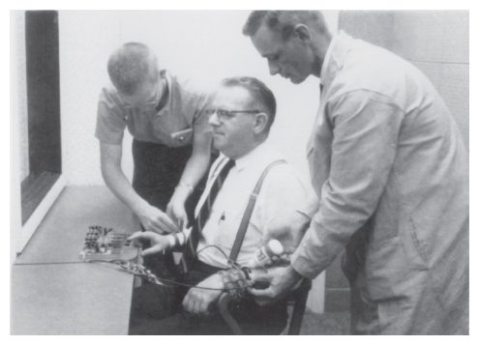
Obedience to Authority: The Milgram Experiment (1 of 3)
Obedience (Milgram)
The “shock generator” that the teacher operated, purportedly to punish the learner.
The “learner” gets set up to participate in the experiment. He is being hooked up to the device that the teacher believes will deliver a shock.
From the film Obedience © 1968 by Stanley Milgram, © renewed 1993 by Alexandra Milgram, and distributed by Penn State Media Sales.
From the film Obedience © 1968 by Stanley Milgram, © renewed 1993 by Alexandra Milgram, and distributed by Penn State Media Sales.
Notes:
1) One of the most direct forms of social influence is authority. Obedience involves complying with instructions or orders from an individual who is in a position of authority.
i) Authority comes from a combination of social roles and social context.
a) Individuals tend to obey authority figures such as parents, bosses, and police officers.
b) You are also likely to obey your physician who asks you to undress at the office, but not if s/he asked this of you when you bumped into each other at the grocery store.
2) To explore just how far people will go to obey authority figures, psychologist Stanley Milgram conducted what is now known as a classic study on obedience.
i) A recruit shows up at the psychologist’s lab. Another man is already there, and the two men draw slips of paper to find out who is the teacher and who will be the learner.
a) In this case, the recruit is assigned to be the teacher.
ii) The teacher is told to read a series of word pairs to the learner, who is in a separate room. When given one word, the learner is asked to repeat its pair.
a) The learner is hooked up to an electrical shock apparatus. If the learner cannot remember the words, the teacher is to administer an electric shock.
iii) Each time the learner gets the answer wrong, the teacher is to go one step higher on the electric shocks.
a) Each switch increases the voltage of the shock, all the way up to where it says 450 volts.
iv) At the first shock, the learner protests. With each increase in voltage, the learner’s response becomes stronger and stronger.
a) He cries out, screams in pain, says his heart is bothering him, demands to leave the study, and eventually falls silent.
v) If along the way the teacher becomes concerned about harming the learner, the psychologist-experimenter simply says either “Please continue” or “The experiment requires that you continue.”
3) A group of psychiatrists and psychologists made predictions about how far the teacher would go on the voltage meter and what kind of person would go all the way.
i) They predicted a small percentage of the population would obey the experimenters’ instructions to continue.
ii) Those who went all the way would have psychological problems; they would have to be sadistic or antisocial.
4) Most of the subjects in Milgram’s study—approximately 65%—continued administering the shocks past the points where the participant screamed and begged to leave the study.
i) However, footage of the participants shows them in distress.

Slide 17
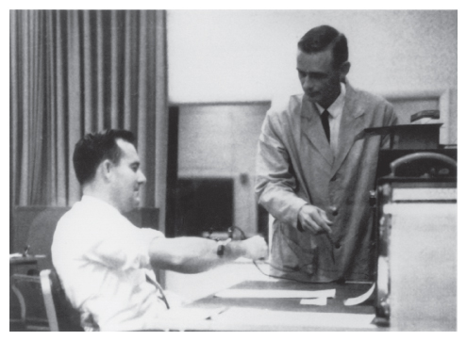
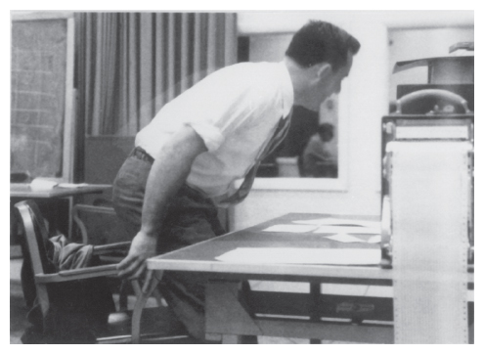
Obedience to Authority: The Milgram Experiment (2 of 3)
Obedience (Milgram)
The experimenter explains to the “teacher” what the experimental procedure entails and how to use the shock generator.
Although most subjects were highly obedient, some, such as this person, refused to continue complying with the experimenter’s orders.
From the film Obedience © 1968 by Stanley Milgram. © renewed 1993 by Alexandra Milgram, distributed by Penn State Media Sales.
From the film Obedience © 1968 by Stanley Milgram. © renewed 1993 by Alexandra Milgram, distributed by Penn State Media Sales.
Notes:
1) One of the most direct forms of social influence is authority. Obedience involves complying with instructions or orders from an individual who is in a position of authority.
i) Authority comes from a combination of social roles and social context.
a) Individuals tend to obey authority figures such as parents, bosses, and police officers.
b) You are also likely to obey your physician who asks you to undress at the office, but not if s/he asked this of you when you bumped into each other at the grocery store.
2) To explore just how far people will go to obey authority figures, psychologist Stanley Milgram conducted what is now known as a classic study on obedience.
i) A recruit shows up at the psychologist’s lab. Another man is already there, and the two men draw slips of paper to find out who is the teacher and who will be the learner.
a) In this case, the recruit is assigned to be the teacher.
ii) The teacher is told to read a series of word pairs to the learner, who is in a separate room. When given one word, the learner is asked to repeat its pair.
a) The learner is hooked up to an electrical shock apparatus. If the learner cannot remember the words, the teacher is to administer an electric shock.
iii) Each time the learner gets the answer wrong, the teacher is to go one step higher on the electric shocks.
a) Each switch increases the voltage of the shock, all the way up to where it says 450 volts.
iv) At the first shock, the learner protests. With each increase in voltage, the learner’s response becomes stronger and stronger.
a) He cries out, screams in pain, says his heart is bothering him, demands to leave the study, and eventually falls silent.
v) If along the way the teacher becomes concerned about harming the learner, the psychologist-experimenter simply says either “Please continue” or “The experiment requires that you continue.”
3) A group of psychiatrists and psychologists made predictions about how far the teacher would go on the voltage meter and what kind of person would go all the way.
i) They predicted a small percentage of the population would obey the experimenters’ instructions to continue.
ii) Those who went all the way would have psychological problems; they would have to be sadistic or antisocial.
4) Most of the subjects in Milgram’s study—approximately 65%—continued administering the shocks past the points where the participant screamed and begged to leave the study.
i) However, footage of the participants shows them in distress.

Slide 18
Obedience to Authority: The Milgram Experiment (3 of 3)
Variants of the experiment
Change of clothing
Different location
Proximity of experimenter and “learner”
Confederate dissenters
Notes:
1) There were numerous variations of Milgram’s experiment. For example, in one, the experimenter wore street clothes instead of a lab coat. In another, the study was done in a warehouse instead of at prestigious Yale University. In another, the experimenter wasn’t in the same room as the subjects but delivered his orders over the telephone; subjects had to watch the poor teacher writhe in pain instead of just hearing him shouting from another room. In some cases, subjects even had to physically force the learner’s hand onto a shock plate. An alarming number of participants obeyed in all variants.
2) Another experiment looked at whether it is easier for a group to resist the experimenter, pitting the power of the group against the power of authority. In this experiment, there were three teachers making decisions collectively. Two of the teachers were confederates, pretending to be real subjects; the other teacher was the actual subject.
i) When the two confederate teachers made the decision to not continue with the experiment, 90% of subjects (still not 100%) also refused.
ii) This particular variation is important because it illustrates again the power of dissent. As in the Asch study, if even a couple of people are courageous enough to fight for what is “right,” they make it much easier for others to do the same.

Slide 19
The Bystander Effect (1 of 2)
The bystander effect (p. 503)
Diffusion of responsibility (p. 503)
Notes:
1) The Kitty Genovese story launched an important line of research on the bystander effect. (It must be noted that sensationalism in reporting has exaggerated many of the details in this story.)
i) In the middle of the night on March 13, 1964, a young woman, Kitty Genovese, was attacked outside an apartment complex in New York City. She screamed and made enough noise that many people (38, it was later revealed), came to their windows to try to see what was going on. One person shouted through his window, which scared the attacker off, and Kitty stumbled around the corner of the building, out of sight of most of the residents. Kitty’s attacker came back and attacked her again, stabbing and sexually assaulting her. In total, her ordeal lasted more than half an hour. When the police were finally called, it was too late to save Kitty’s life. A couple of weeks later, the New York Times published a front-page article, with the headline, “37 Who Saw Murder Didn’t Call the Police. Apathy at Stabbing of Queens Woman Shocks Inspector.” People were shocked and outraged that so many people could have watched a young woman get assaulted, and not lift a finger to help her. How is it possible that not a single person could have intervened? Have we become so selfish and disconnected from our neighbours that we don’t want to get involved even when their life is on the line?
Bystander effect (p. 503) is the observation that an individual is less likely to help when they perceive that others are not helping.
Diffusion of responsibility (p. 503) refers to the reduced personal responsibility that a person feels when more people are present in a situation (Figure 13.2).
ii) Imagine that you are sitting in a room filling out questionnaires, when you notice smoke wafting into the room from a vent. What do you do? If you are by yourself, you probably will quickly get up to investigate, look for the experimenter, or even leave the building. But what if you are sitting in the room with other people? In this case, you might not want to embarrass yourself by jumping up right away; after all, maybe the “smoke” is just mist from a broken air conditioner or something equally benign. So, in this situation, you pause, considering what to do, looking out of the corner of your eyes at the others in the room. But everyone else isn’t doing much either, just filling out their questionnaires, perhaps occasionally looking around as well. Nobody gives any indication that they are worried, so you conclude there’s nothing to be worried about. So, nobody takes action because nobody takes action.

Slide 20
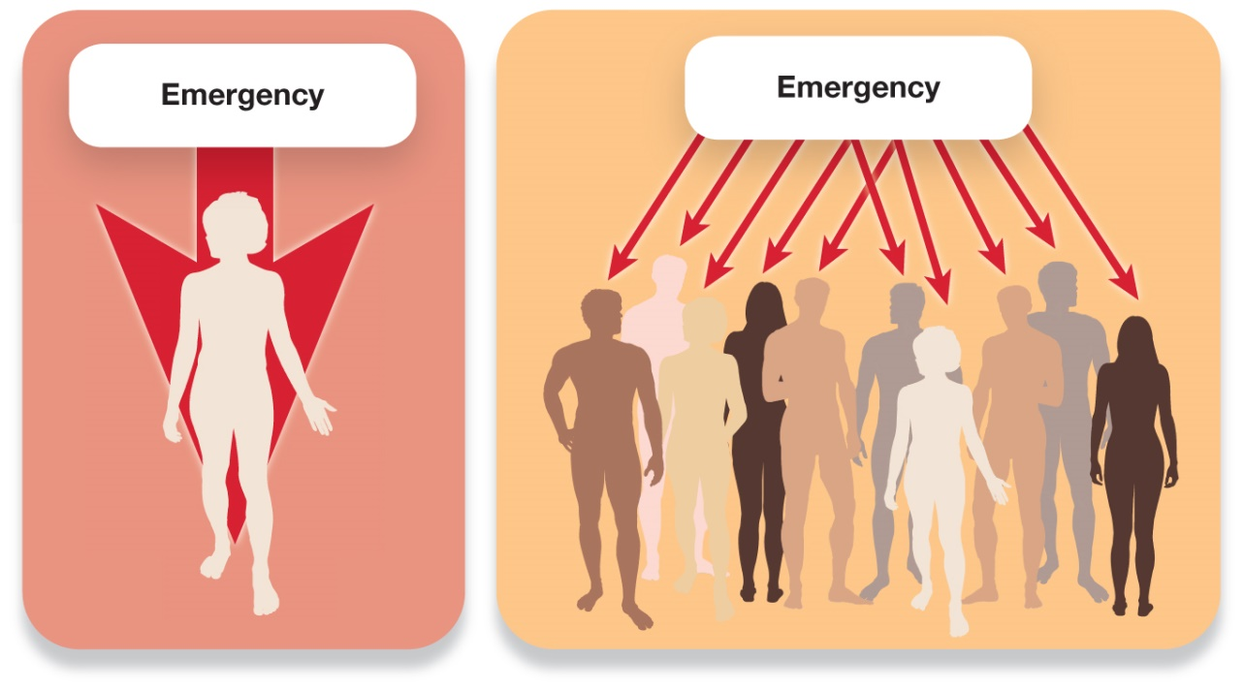
The Bystander Effect (2 of 2)
Figure 13.2 Diffusion of Responsibility
If one person witnesses an emergency, it is as if 100% of the responsibility for helping falls on that person. If 10 people witness an emergency, that responsibility is diffused, so it is as if each person feels only 10% of the responsibility—which may not be enough to motivate a person to act.
Notes:
1) The Kitty Genovese story launched an important line of research on the bystander effect. (It must be noted that sensationalism in reporting has exaggerated many of the details in this story.)
i) In the middle of the night on March 13, 1964, a young woman, Kitty Genovese, was attacked outside an apartment complex in New York City. She screamed and made enough noise that many people (38, it was later revealed), came to their windows to try to see what was going on. One person shouted through his window, which scared the attacker off, and Kitty stumbled around the corner of the building, out of sight of most of the residents. Kitty’s attacker came back and attacked her again, stabbing and sexually assaulting her. In total, her ordeal lasted more than half an hour. When the police were finally called, it was too late to save Kitty’s life. A couple of weeks later, the New York Times published a front-page article, with the headline, “37 Who Saw Murder Didn’t Call the Police. Apathy at Stabbing of Queens Woman Shocks Inspector.” People were shocked and outraged that so many people could have watched a young woman get assaulted, and not lift a finger to help her. How is it possible that not a single person could have intervened? Have we become so selfish and disconnected from our neighbours that we don’t want to get involved even when their life is on the line?
Bystander effect (p. 503) is the observation that an individual is less likely to help when they perceive that others are not helping.
Diffusion of responsibility (p. 503) refers to the reduced personal responsibility that a person feels when more people are present in a situation (Figure 13.2).
ii) Imagine that you are sitting in a room filling out questionnaires, when you notice smoke wafting into the room from a vent. What do you do? If you are by yourself, you probably will quickly get up to investigate, look for the experimenter, or even leave the building. But what if you are sitting in the room with other people? In this case, you might not want to embarrass yourself by jumping up right away; after all, maybe the “smoke” is just mist from a broken air conditioner or something equally benign. So, in this situation, you pause, considering what to do, looking out of the corner of your eyes at the others in the room. But everyone else isn’t doing much either, just filling out their questionnaires, perhaps occasionally looking around as well. Nobody gives any indication that they are worried, so you conclude there’s nothing to be worried about. So, nobody takes action because nobody takes action.
Long Description:
The first illustration shows a vertical downward arrow running through the silhouette of a woman. The arrow starts from the word “Emergency.”
The second illustration shows many arrows pointing downward, each pointing to a person in a large group. The arrows start from the word “Emergency.”

Slide 21
Working the Scientific Literacy Model: The Bystander Effect (1 of 2)
What do we know about the bystander effect?
How can science study the bystander effect?
Latané & Darley (1968)
Normative influences
Informational influences
Diffusion of responsibility
Notes:
1) What do we know about the bystander effect?
i) Although the Kitty Genovese story was exaggerated in the news, it is an example of the bystander effect. There are many more stories that tell of similar events.
2) How can science study the bystander effect?
i) In one of the first studies of the bystander effect, an individual volunteer was ushered into a small room with an intercom under the premise that they would be conversing with other participants (who were actually research confederates) waiting in similar rooms down the hall.
a) As the conversation began, one confederate reported being prone to seizures and subsequently asked for help as a seizure apparently began. The researchers could then observe if the participant helped and if so, how long they waited before acting.
b) It turns out that the more confederates there were, the longer it took the true participant to react to the calls for help (Latané & Darley, 1968).
ii) Why does the presence of others reduce the tendency to help?
a) First, there are normative influences. When one person sees another in need of help, they may ask themselves, What happens if I try to intervene and wind up embarrassing myself?
b) Second, there are informational influences. The bystander is likely to wonder: What if the others know something I don’t? Am I blowing this out of proportion?
c) Latané and Darley also observed diffusion of responsibility: if everybody thinks someone else will take on the responsibility of helping, nobody will do anything.

Slide 22
Working the Scientific Literacy Model: The Bystander Effect (2 of 2)
Can we critically evaluate this evidence?
Bystander effects do happen
But, often, people do help, even when it puts them at risk
Why is this relevant?
Programs to encourage helping
Notes:
1) Can we critically evaluate this evidence?
i) The shocking nature of bystander effects can easily lead to exaggeration and overly emotional thinking. A critical examination reveals that, yes, it does happen, but probably not as often as we think. Often, people do help.
ii) Researchers should also study why people do help, even when it puts them at risk.
2) Why is this relevant?
i) A substantial number of assualts begin at parties and clubs where the victims and perpetrators are presumably surrounded by peers. What if those peers intervened when they noticed one of their friends was behaving aggressively with a woman? Or took a friend home when her judgment had been affected by alcohol so much that she was unaware of a threat?
ii) There are a number of programs designed to reduce the incidence of these types of assaults by educating students and encouraging them to get involved.

Slide 23
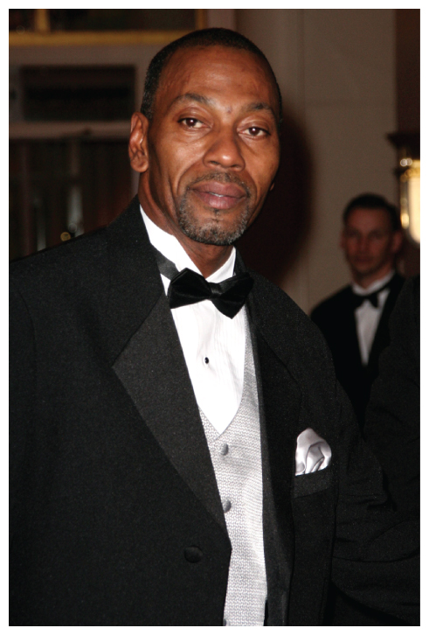
When People Decide to Act (1 of 2)
Altruism (p. 504)
Figure 13.3 Acts of Altruism
(Left) Wesley Autrey, a construction worker in New York City, leapt in front of a subway train to save a complete stranger, Cameron Hollopeter. Hollopeter had fallen on the tracks in the course of having a seizure. As another onlooker held Autrey’s daughters in safety, he literally covered Hollopeter and held him still between the tracks as the train cars rolled just inches above his body. It was such a close call that Autrey emerged with grease from the train’s undercarriage on his hat. Autrey’s act was an amazing example of altruism, as he could not have possibly considered any benefit to himself at the moment of his brave act.
Steve Mack/Alamy Stock Photo
Notes:
1) The world is filled with human beings who have acted bravely to help others who have been hurt or threatened.
Altruism (p. 504) refers to helping others in need without receiving or expecting reward for doing so.
i) The capacity for empathy—understanding what another’s situation feels like and what its implications might be—is a prerequisite for helping others; the more empathy an individual reports on personality scales, the more likely the person is to help.

Slide 24
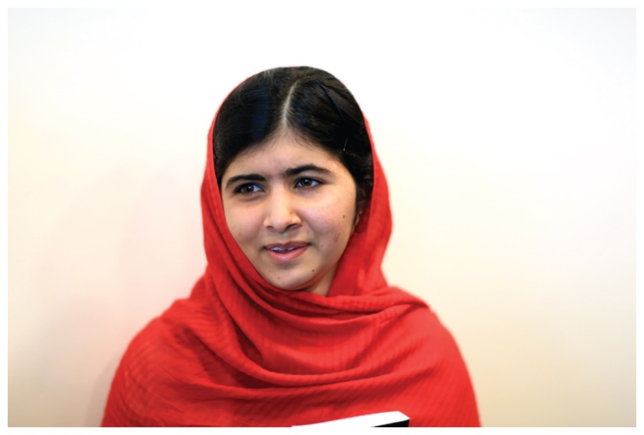
When People Decide to Act (2 of 2)
Altruism (p. 504)
Figure 13.3 Acts of Altruism
(Right) As a teenager in Pakistan, Malala Yousafzai had clear orders from an all-powerful authority—one far more threatening than in any social psychological study—and yet she made the choice to disobey. The Taliban had established a police state in her village and, among other things, forbade girls from getting an education. However, Malala insisted on going to school and, for this, she was shot in the face by a Taliban gunman. She miraculously survived and is now an international advocate for women’s and girls’ rights—and the recipient of a Nobel Peace Prize.
Paul Pickard/Alamy Stock Photo
Notes:
1) The world is filled with human beings who have acted bravely to help others who have been hurt or threatened.
Altruism (p. 504) refers to helping others in need without receiving or expecting reward for doing so.
i) The capacity for empathy—understanding what another’s situation feels like and what its implications might be—is a prerequisite for helping others; the more empathy an individual reports on personality scales, the more likely the person is to help.

Slide 25
13.2 Learning Objectives
Know the key terminology associated with social cognition.
Understand how we form first impressions and how these impressions influence us.
Apply your knowledge of attributions and biases to better understand how you tend to perceive yourself and others.
Analyze whether people who commit discriminatory acts are explicitly prejudiced.
Notes:
Know the key terminology associated with social cognition.
See the bold, italicized terms below.
Understand how we form first impressions and how these impressions influence us.
We quickly form impressions. These impressions can be surprisingly accurate, but they can also affect our behaviour in ways that tend to confirm our initial impressions. In other words, they can lead to self-fulfilling prophecies.
Apply your knowledge of attributions and biases to better understand how you tend to perceive yourself and others.
We have a strong tendency to split the world into Us and Them, and we are motivated to see Us more positively than how we see Them. Understanding these dynamics gets right to the heart of why there is so much intergroup hostility in the world.
Analyze whether people who commit discriminatory acts are explicitly prejudiced.
Regardless of prejudice, stereotypes are absorbed from the larger culture, and these can function as interpersonal schemas that can guide how we see things and how we implicitly process information. This can cause us to behave in a discriminatory fashion without us intending to.

Slide 26
Two Types of Cognitive Process
Explicit processes (p. 507)
Implicit processes (p. 507)
Dual-process models (p. 507)
Notes:
1) Social-cognitive psychology includes the cognitions (perceptions, thoughts, and beliefs) an individual may have about social contexts (other people, groups, or situations).
i) To understand the research in this field, it is important to understand the two types of cognitive process.
a) One is quick, just seems to “pop” into mind, and would actually take a lot of effort to control it.
b) The other is slower, takes effort, and usually takes place one step at a time.
Explicit processes (p. 507) correspond roughly to “conscious” thought, are deliberative, effortful, relatively slow, and generally under our intentional control.
Implicit processes (p. 507) comprise our “unconscious” thought; they are intuitive, automatic, effortless, very fast, and operate largely outside of our intentional control.
ii) These two sets of processes work together to regulate our bodies, continually update our perceptions, infuse emotional evaluations and layers of personal meaning to our experiences, and affect how we think, make decisions, and self-reflect. They also can influence each other.
a) For example, explicit processes influence implicit processes when our beliefs (e.g., my friend Bob is a kind person!) influence how we process information (e.g., how much attention we pay to Bob’s positive and negative behaviours).
b) On the other hand, implicit processes can influence explicit processes, such as when our automatic tendency to categorize a person into a stereotyped group influences the judgments we make about that person.
iii) In social-cognitive psychology, models of behaviour that account for both implicit and explicit processes are called dual-process models (p. 507).
Implicit processes precede deliberation.
a) For example, let’s say an employee is trying to control his/her temper at work because s/he feels s/he is the only one doing his/her job. Then a co-worker gets promoted before him/her. Implicit processes, or an automatic impulse, would be to go yell at the boss and co-worker. Then deliberative thought begins and reminds him/her that doing so might mean losing the job.

Slide 27
Person Perception
Person perception (p. 507)
Schemas
Thin slices of behaviour (p. 507-508)
Notes:
Person perception (p. 507) refers to the processes by which individuals categorize and form judgments about other people.
1) The power of first impressions can be explained by the automatic side of social cognition.
i) When we first encounter someone, we have very little information on which to evaluate him or her, so we rely on schemas (Module 7.3). Schemas are clusters of knowledge and expectations about individuals and groups.
a) The person’s gender, race, and style of dress all activate schemas, and these schemas bring certain traits to mind automatically.
2) Although first impressions are formed very quickly, they are often accurate.
Thin slices of behaviour (p. 507-508) are very small samples of a person’s behaviour.
3) To study first impressions, researchers have participants judge other’s personal qualities based “thin slices” of behaviour (short video clips or still photos) and compare these judgments to those who have known the person for much longer.
i) Participants who watched 30 seconds of a college lecture (without sound) gave instructor ratings that were remarkably similar to the end-of-semester ratings of that same class.
ii) Additional research has shown even higher levels of agreement when rating high school teachers and using even thinner slices—even as short as 6 seconds!
iii) We make judgments of trustworthiness, competence, likeability, and aggressiveness in as little as half a second of exposure to a photograph.
4) Research by Nicholas Rule from the University of Toronto, has shown that we can tell surprising things about people given incredibly little information. For example, people can assess a male’s sexual orientation (i.e., gay vs. straight) after viewing his photograph for a mere 1/20th of a second. Americans can accurately guess whether other people tend to vote Republican or Democrat merely by looking at a photograph of their face; interestingly, Republicans are viewed as having more powerful faces, but Democrats are seen as warmer.

Slide 28
Self-Fulfilling Prophecies and Other Consequences of First Impressions
Self-fulfilling prophecy (p. 508)
e.g., teachers’ expectations of students
Notes:
1) First impressions have a big impact on our social behaviours.
i) For example, one study asked participants to act as jurors and evaluate evidence against a defendant.
a) Participants were less likely to find a defendant guilty when shown a photograph of a person who simply appeared more trustworthy.
ii) Another study found that 70% of election outcomes were made on judgments of how competent candidates’ faces looked.
2) An individual’s impression of others can also lead to a self-fulfilling prophecy.
Self-fulfilling prophecy (p. 508) occurs when a first impression (or an expectation) affects one’s behaviour, and then that affects other people’s behaviour, leading one to “confirm” the initial impression or expectation.
i) Research has found that when teachers have high expectations of a student, they behave differently toward that student.
a) They tend to spend less time addressing behaviour (especially for boys), present more challenging work, and give more reinforcement and constructive criticism than students with less promise.
b) This finding holds true whether teachers form their own impressions or researchers give randomly assigned high or low achievement test scores for the students.
c) The self-fulfilling prophecy is complete when the low-expectations students receive lower grades from their teachers and on standardized tests because of this differential treatment.

Slide 29
The Self in the Social World
Projecting the self onto others: False consensus and naïve realism (p. 509)
Self-serving biases (p. 510)
These arise out of a need to feel good about ourselves
Notes:
1) Much of the time, we look out at the social world through the lens of our own self-concepts.
i) False consensus: One way in which our self-concept affects our social perceptions is that we tend to project our self-concepts onto the social world; this means that the qualities we see in ourselves and the attitudes and opinions that we hold, we tend to assume are similar for society at large. If we are sports fans, we assume that sports is generally important for other people as well.
False consensus effect (p. 509) refers to tendency to project the self-concept onto the social world.
ii) Naïve realism: We also tend to assume that the way we see things is the way that they are, that our perceptions of reality are accurate. Of course we want to believe that we make sense. By extension, this means that people who differ from us are not only a little weird, they are wrong as well.
Naïve realism (p. 509) refers to our assumption that our perceptions of reality are accurate, that we see things the way they are.
2) We strive to maintain our positive self-feelings through a host of self-serving biases, which are ways of processing self-relevant information in biased ways that enhance our positive self-evaluation.
Self-serving biases (p. 510) are biased ways of processing self-relevant information to enhance our positive self-evaluation.

Slide 30
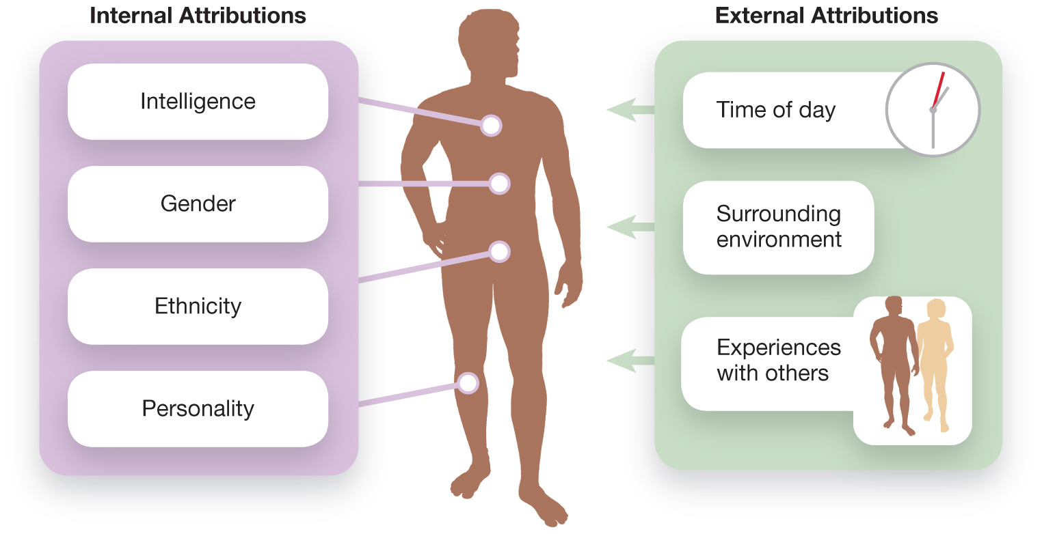
Attributions (1 of 2)
Figure 13.4 Internal and External Attributions
Internal attributions are based on qualities or actions of the individual, whereas external attributions focus on the context in which the individual is situated.
Notes:
1) All people are “armchair psychologists;” they like to explain behaviour in an intuitive (unscientific) way.
i) We tend to value the reason for someone’s behaviour more than the behaviour itself.
a) For example, who would be more likely to forgive someone who bumped into you on accident than on purpose?
2) Attributions are the explanations we make about the causes of behaviour.
i) Much like first impressions, attributions tend to be automatic, intuitive explanations.
3) There are two main types of attributions: internal and external (Figure 13.4).
Internal attribution (p. 510) (also known as a dispositional attribution), is applied when the observer explains the behaviour of an actor in terms of some innate quality of that person.
i) For example, a fellow driver who cuts you off is an aggressive jerk or a bad driver.
External attribution (p. 510) (also known as a situational attribution), is applied when the observer explains the actor’s behaviour as the result of the situation.
ii) For example, maybe your waiter was rude because s/he just found out s/he has cancer and she’d rather be home with family but needs the money.
Long Description:
The chart shows two halves.
One half titled “Internal Attributions” shows the silhouette of a man. The chart points to the body of the man and lists the following.
Intelligence
Gender
Ethnicity
Personality
The other half labelled “External Attributions” lists the following with appropriate icons.
Time of day
Surrounding environment
Experiences with others

Slide 31
Attributions (2 of 2)
Fundamental attribution error (p. 510)
Cultural phenomenon
Ingroups and outgroups (p. 511)
Ingroup bias (p. 511)
Notes:
1) Most behaviours are a complex blend of dispositional and situational factors; however, we have a clear bias in the attributions we use to explain other’s behaviours.
Fundamental attribution error (p. 510): a tendency to over-emphasize internal (dispositional) attributions and under-emphasize external (situational) factors when explaining other people’s behaviour.
i) For example, when someone suddenly swerves at us while we’re driving, we’re most likely to think that person is hostile, lacking intelligence, etc.
a) However, if we took time to think about it, we might consider that maybe that driver had a blown-out tire.
2) When explaining our own behaviour, our attributions are much more generous.
i) For example, if we swerve into the adjacent lane while driving, we are more likely to blame an object in the road than the fact we are horrible drivers.
a) We use external attributions so that we don’t have to put the blame on ourselves.
ii) However, if we successfully avoid an accident, we are likely to attribute the credit to our alertness and driving skill (internal attributions).
iii) In other words, we tend to explain our own behaviour based on which type—internal or external—makes us feel good about ourselves.
3) The fundamental attribution error is largely a cultural phenomenon.
i) We are more likely to see examples of this in individualistic cultures (e.g., Canada) than collectivist cultures (e.g., East Asia) where people are more likely to consider the situation when making attributions.
ii) In fact, people from Japan may even exhibit the opposite trend.
a) They may attribute successes to the support and assistance from family and peers while downplaying the role of personality, intelligence, or talent.
4) Groups we feel positively towards and identify with are our in-groups, including our family, home team, group of best friends, etc. In contrast, out-groups are those ‘other’ groups that we don’t identify with.
Ingroups (p. 511) are groups we feel positively toward and identify with.
Outgroups (p. 511) are those “other” groups that we don’t identify with.
i) Perhaps the most strikingly meaningless exercise was conducted by Richard Sorrentino at Western University and Gordon Hodson at Brock University, who simply randomly assigned people to “Group X” or “Group Y.” Amazingly, even these completely meaningless ways of categorizing people into ingroups and outgroups are enough to drive prejudice and discrimination; for example, if people are asked to distribute money between the two groups, they consistently give more to their new ingroup members.
Ingroup bias (p. 511): occurs when positive biases toward the self get extended to include one’s ingroups and people become motivated to see their ingroups as superior to their outgroups.

Slide 32
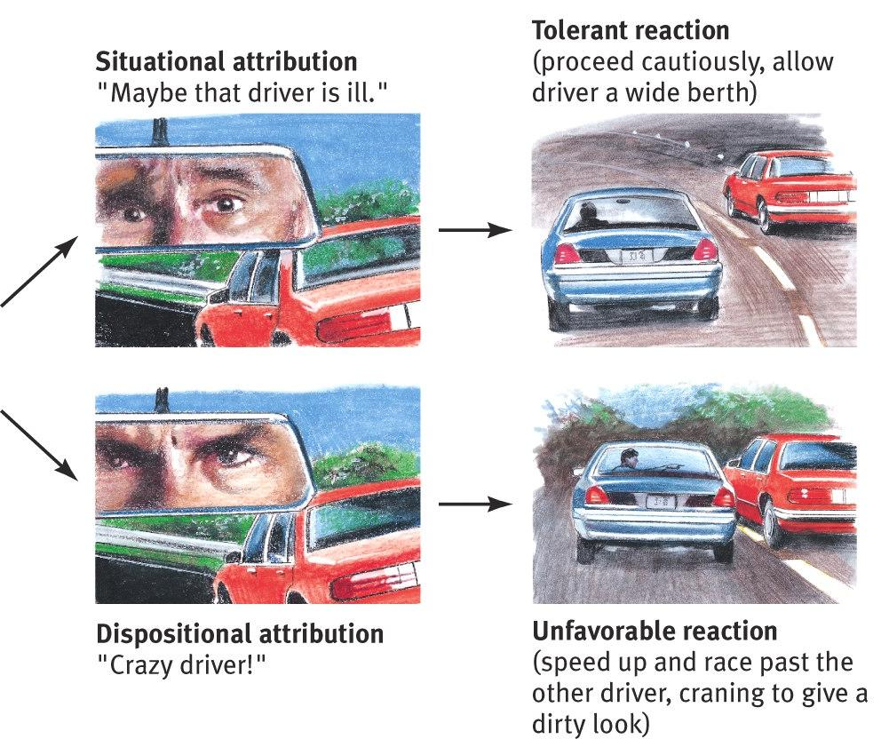
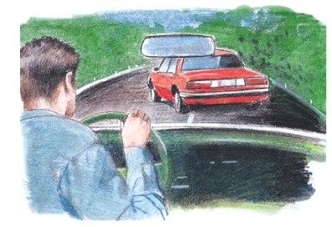
Emotional Effects of Attribution
Social Thinking
Problematic behavior: someone cuts in front of us.
How we explain someone’s behavior affects how we react to it.
Notes:
Optional slide
Click to reveal sequence of graphics.
This effect is somewhat tangential to the social psych concept, but connects to the topic of attitude coming up.

Slide 33
Stereotypes, Prejudice, and Discrimination
Stereotype (p. 512)
Prejudice (p. 512)
Discrimination (p. 512)
Notes:
Stereotype (p. 512) is a cognitive structure, a set of beliefs about the characteristics that are held by members of a specific social group; these beliefs function as schemas, serving to guide how we process information about our social world.
1) Stereotypes may be viewed as a type of schema, as a combination of ideas and opinions.
i) With stereotypes in place, individuals are likely to experience prejudice, which might lead to discrimination.
Prejudice (p. 512) is an affective, emotionally laden response to members of outgroups, including holding negative attitudes and making critical judgments of other groups.
Discrimination (p. 512) is behaviour that disfavours or disadvantages members of a certain social group.

Slide 34
Prejudice in a Politically Correct World?
Political correctness
Is it a neutral term?
Prejudice is still prevalent
Implicit vs. explicit processes in prejudice
Notes:
1) In recent decades, norms have changed greatly in terms of what is appropriate to say about other people. This increased sensitivity to social diversity and equality, such as society’s greater acceptance of LGBTQ expressions of sexuality, or belief in gender and ethnic equality, is sometimes disparagingly referred to as “political correctness.” The label carries the suggestion that the battles for equality are basically over, and now if people in disadvantaged groups raise concerns about how they are treated in our society, they are just looking for excuses, such as when people say someone is “playing the race card” as though they are using their ethnicity merely as a tool with which to try to take advantage of society.
2) Prejudice is still prevalent. Outgroup stereotypes are pervasive and seem to thrive in times of hardship.
i) For example, during economic slumps, an outgroup is often targeted for taking jobs from the ingroup or for draining resources from the local economy.
a) People tend to overvalue the qualities of their ingroup and undervalue the qualities of other groups.
b) Today, young African Americans and Latinos are more likely to obtain diplomas and higher education degrees, as well as live longer, than they were just a generation ago.
c) They are also more likely to achieve middle-class status, with a comfortable income and home ownership.
3) People in North America are increasingly concerned about whether they appear prejudiced and are more likely than ever to say that racism is a problem.
i) Some may be disguising their true feelings and other may be unaware of their own subtle prejudices.
a) For example, researchers have found subtle but very reliable differences in facial expressions and brain activity when participants (both Black and White) looked at Black versus White faces, even among those who express little or no prejudice.
4) Over 30 years of records of police encounters show that police use more aggressive techniques on minority suspects than White suspects.
i) In fact, Black suspects have historically been five times more likely to die in police confrontations than White suspects.
5) In sum, even if one abhors prejudice, he or she may implicitly hold the stereotypes that lead to prejudice and discrimination.
i) Even stereotypes that sound nice on the surface can simply cover up subtle forms of discrimination.
6) Prejudice research has examined explicit and implicit prejudice.
i) Measures of brain activity reveal the battle between implicit and explicit processes. Over very short amounts of time, exposure to White or Black faces activates implicit processes such as described above, indicating a racially biased pattern of processing. However, over longer periods of time, such as 30 seconds, brain activity shifts, showing heightened activity in the prefrontal cortex. This area relates to the control of emotions and abstract thinking, consistent with a neurological effort to bring values into one’s mind in order to control emotional reactions.

Slide 35
MYTHS IN MIND: Are Only Negative Aspects of Stereotypes Problematic?
“Well-intended” stereotypes
Gender
Hostile sexism
Benevolent sexism
Notes:
1) The first examples that come to mind when stereotyping a group are usually based on negative characteristics.
i) However, there are also “well-intentioned” stereotypes.
2) Psychologists have pointed out that even well-intended stereotypes place restrictions on an individual’s behaviour.
i) For example, there is a dated saying that women are “the fairer sex."
a) Because women are considered “virtuous,” they are held to different sexual standards than men, and they may be seen as dependent on men for money and protection.
b) Further, women may be hindered in careers that call for assertive and sometimes aggressive behaviours (e.g., running a major corporation) because the “fairer sex” stereotype is pervasive in the organization.

Slide 36
Working the Scientific Literacy Model: Explicit Versus Implicit Measures of Prejudice (1 of 5)
What do we know about measuring prejudice?
Explicit prejudice
Implicit prejudice
How can science study implicit prejudice?
The I A T (p. 514)
Notes:
1) What do we know about measuring prejudice?
i) Some people may conceal their prejudice to be politically correct and others may harbor prejudice but not realize it. Explicit prejudice occurs when individuals confess to or openly demonstrate their stereotypes. Implicit prejudice includes forms of stereotyping and prejudice that are kept silent, either intentionally or because individuals are unaware of their own prejudices.
a) To help measure each of these possibilities, psychologists have distinguished between measures of explicit and implicit prejudice.
b) Measuring implicit prejudice is trickier.
2) How can science study implicit prejudice?
i) One means of measuring implicit prejudice is the Implicit Associations Test (IAT) (p. 514).
ii) The IAT measures how fast people respond to images or words flashed on a computer screen using two fingers and two computer buttons (Figure 13.5).
a) In round I, one key represents two ideas: Caucasians and positive words (e.g., “peace”) and the other key represents: Black individuals and negative words (e.g., “pain” or “war”).
b) With these associations, it takes an average of 800 milliseconds (four-fifths of a second) to press the correct button.
c) Round II rearranges the associations: White and bad vs. Black and good.
d) In this situation, subjects took 1015 milliseconds to press the correct button, or more than one-fifth of a second longer than in round 1.
iii) Researchers reason that our racial schemas associate more negativity with Blacks than with Whites, which would explain why it takes people longer to respond to Black/positive than Black/negative pairings.
a) Thus, even if those associations are implicit—even if the individual is not aware of those associations—they still affect the participants’ responses.

Slide 37
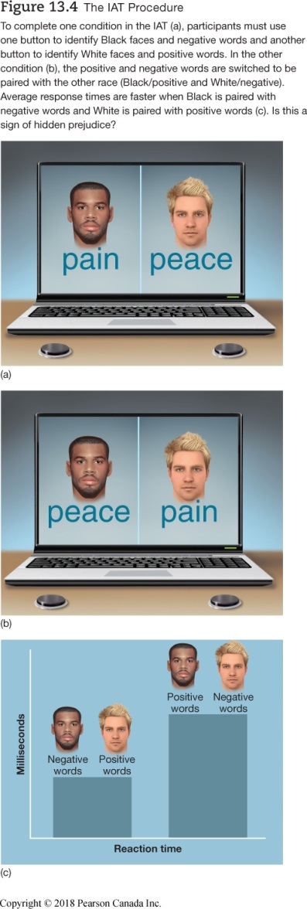
Working the Scientific Literacy Model: Explicit Versus Implicit Measures of Prejudice (1 of 2)
What do we know about measuring prejudice?
Explicit prejudice
Implicit prejudice
How can science study implicit prejudice?
The IAT
Notes:
1) What do we know about measuring prejudice?
i) Some people may conceal their prejudice to be politically correct and others may harbor prejudice but not realize it. Explicit prejudice occurs when individuals confess to or openly demonstrate their stereotypes. Implicit prejudice includes forms of stereotyping and prejudice that are kept silent, either intentionally or because individuals are unaware of their own prejudices.
a) To help measure each of these possibilities, psychologists have distinguished between measures of explicit and implicit prejudice.
b) Measuring implicit prejudice is trickier.
2) How can science study implicit prejudice?
i) One means of measuring implicit prejudice is the Implicit Associations Test (IAT) (p. 559).
ii) The IAT measures how fast people respond to images or words flashed on a computer screen using two fingers and two computer buttons (Figure 13.4).
a) In round I, one key represents two ideas: Caucasians and positive words (e.g., “peace”) and the other key represents: Black individuals and negative words (e.g., “pain” or “war”).
b) With these associations, it takes an average of 800 milliseconds (four-fifths of a second) to press the correct button.
c) Round II rearranges the associations: White and bad vs. Black and good.
d) In this situation, subjects took 1015 milliseconds to press the correct button, or more than one-fifth of a second longer than in round 1.
iii) Researchers reason that our racial schemas associate more negativity with Blacks than with Whites, which would explain why it takes people longer to respond to Black/positive than Black/negative pairings.
a) Thus, even if those associations are implicit—even if the individual is not aware of those associations—they still affect the participants’ responses.

Slide 38
Working the Scientific Literacy Model: Explicit Versus Implicit Measures of Prejudice (2 of 2)
Can we critically evaluate this evidence?
Validity of results
Knowledge of stereotypes vs. personal stereotypes
Why is this relevant?
Stereotypes about every social status
Notes:
1) Can we critically evaluate this evidence?
i) Although the IAT produces reliable results, some psychologists question the validity.
a) Its developers point to the repeated findings that show consistent trends indicating favoritism toward the ingroup and bias against the outgroup.
b) Others argue the IAT is actually measuring what an individual knows about stereotypes rather than what he or she believes is true.
ii) However, just knowing about a stereotypes doesn’t mean an individual believes it, uses it to judge people (prejudice), or uses the stereotype to discriminate.
2) Why is this relevant?
i) The IAT has fostered a great deal of research and has been applied to at least a dozen forms of stereotyping, including stereotypes of social classes, sexual orientation, and fraternity and sorority members.
ii) The results of these test suggest that implicit prejudice is more prevalent than what people are willing to express in explicit tests.
iii) The IAT has also been used in clinical settings to predict how much alcohol someone is likely to consume, even when explicit measures fail to do so.

Slide 39
PSYCH @ The Law Enforcement Academy
Video simulations
Mistaken shootings of innocent Black people
Amadou Diallo
Mistakenly shot to death
Police training
Shoot/do not shoot decisions
Notes:
1) Researchers have used video-game-like tasks to put participants in situations where they had to decide to shoot or not shoot.
i) These are split second decisions, much like the IAT.
ii) In these video simulations, a Figure will suddenly appear, perhaps holding a weapon or perhaps just wielding a cell phone.
a) It turns out that the split second of indecision in the IAT corresponds to more mistaken shootings of the innocent Black people than the innocent Whites.
2) It is easy to imagine the stress of a real confrontation, combined with the complexity of a real-world situation, leads to an even higher chance of a mistaken shooting occurring.
i) For example, in 1999, four New York City plainclothes police officers were patrolling a Bronx neighborhood in search of a rape suspect when they saw a lone man behaving suspiciously.
a) The man ducked into a vestibule of an apartment building, reaching for the door with one hand and putting the other into his pocket.
b) Officers feared he was reaching for a gun. One officer opened fire on the man, and the other three followed, firing a total of 41 shots, 19 of which hit the man and killed him on the spot.
c) The victim was a peaceful, friendly, and unarmed 24-year-old named Amadou Diallo from Guinea, West Africa.
3.) To combat any implicit influence of race on an officer’s decision to shoot, most law enforcement agencies require extended training of their employees.
i) For example, Denver police cadets must complete 72 hours of training related to shoot/do not shoot decisions.
a) Other programs use a combination of walkthrough sets, where cardboard Figures suddenly appear, and other situations with actors, some of whom are armed with foam pellet guns.
ii) The data show that extensive training works for police officers.
a) Even student volunteers in the lab can be trained to reduce shooting errors through such means.

Slide 40
Improving Intergroup Relations
How do we overcome implicit processes?
Reprogramming through practice
Contact hypothesis (p. 516)
Notes:
1) How do we overcome implicit processes?
i) Reprogramming through practice: Research in Kerry Kawakami’s lab has shown that people’s implicit networks can be “reprogrammed” through practice. For example, people can be trained to make situational attributions for negative behaviours by stereotyped group members, thereby overcoming the fundamental attribution error; this helps to prevent people from thinking of others in stereotypic ways (Stewart et al., 2010).
ii) The contact hypothesis (p. 516) predicts that social contact between members of different groups is extremely important to overcoming prejudice (Allport, 1954; Pettigrew & Tropp, 2006), especially if that contact occurs in settings in which the groups have equal status and power, and ideally, in which group members are cooperating on tasks or pursuing common goals.

Slide 41
13.3 Learning Objectives
Know the key terminology in research on attitudes, behaviour, and effective communication.
Understand how behaviours influence attitudes in terms of cognitive dissonance theory.
Apply your knowledge of cognitive dissonance to see how well your beliefs match your behaviours.
Analyze the difficulties communicators face in trying to convince the public to take action on important social and political issues.
Notes:
Know the key terminology in the study of attitudes, behaviour and effective communication.
See the bold, italicized terms below.
Understand how behaviours influence attitudes in terms of cognitive dissonance theory.
When people hold cognitions that conflict with each other, such as when they are aware that they have behaved in a way that runs counter to their beliefs or attitudes, they experience an uncomfortable state of arousal, known as cognitive dissonance. In order to reduce this dissonance, they need to change one of their conflicting cognitions, which often results in changing their attitudes in order to reflect the behaviour they just performed. In this way, behaviours and attitudes influence each other.
Apply your knowledge of cognitive dissonance to see how well your beliefs match your behaviours.
The attitudes scale in Table 13.2 was designed to illustrate how cognitive dissonance arises along with the cognitive reactions that seem to reduce the dissonance. Complete the exercise to see how well your behaviour matches your ideals.
Analyze the difficulties communicators face in trying to convince the public to take action on important social and political issues.
It is a great challenge to develop persuasive messages. Consider the example of climate change. Traditionally, the environmental movement has framed its messages in ways that run counter to predominant North American values, making many people wary of environmental messages or at least likely to see them as not relevant to themselves. Furthermore, climate change is experienced as psychologically distant from the public, with consequences that people feel are generally going to be experienced by people in other parts of the world, and future generations. Climate change information is also highly technical and complex, and is abstract and statistical in nature, given that climate change is a global phenomenon that doesn’t easily boil down to specific stories about specific people. There is also inherent uncertainty in scientific research, which has made it difficult to express climate change information in a way that would seem “certain” to the public.

Slide 42
Changing People’s Behaviours
How can we address climate change?
Technological
Legal
Economic
Social
Notes:
1) The technological approach focuses on making the desired behaviour as easy as possible through changing the technologies and structures that influence the person. For example, people will have a smaller carbon footprint if there are alternative energy technologies widely available; similarly, people will be less likely to throw their litter on the ground if there are easily accessible garbage cans nearby. The idea is to get the technology right, and people will behave in the desired way.
2) The legal approach focuses on policy change -- get the laws right and people will behave in the desired way.
3) The economic approach focuses on financial incentives and penalties, generally through taxes and pricing -- make the ‘right’ thing to do cheaper, and the ‘wrong’ thing to do more expensive, and people will behave in the desired way.
4) The social approach focuses on information -- get the information right, educate everybody, and people will behave in the desired way.

Slide 43
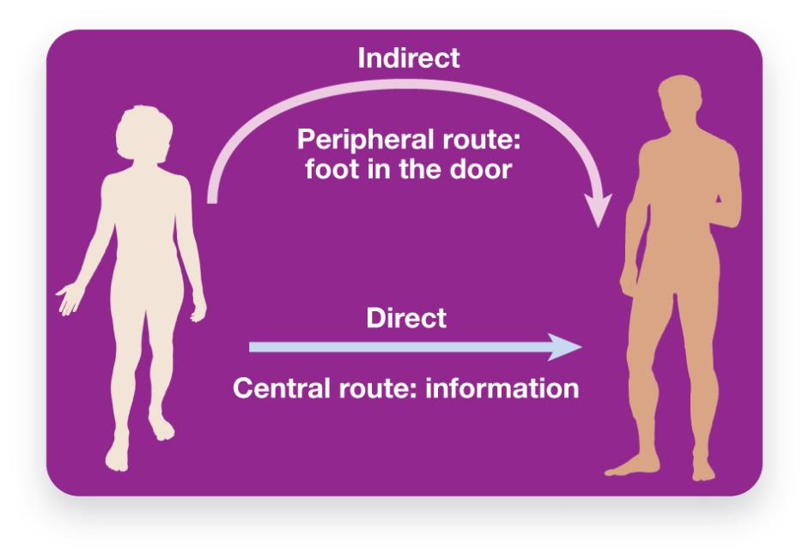
Persuasion: Changing Attitudes through Communication
Elaborative Likelihood Model (E L M) (p. 519)
Figure 13.7 Central and Peripheral Routes to Persuasion
There are two ways that communications can persuade people. In the central route people are persuaded by the content of a message, while in the peripheral route they are influenced by the way the content is presented, the style over the substance.
Notes:
1) If you are preparing a persuasive message, understanding what is likely to connect with and have an impact on your audience is extremely important. These factors are explored by the elaboration likelihood model of persuasive communication.
Elaborative Likelihood Model (ELM) (p. 519) is a dual-process model of persuasion that predicts whether factual information or other types of information will be most influential.
i) According to the ELM, two factors are important: motivation and time. When audiences have interest in the topic, they are more motivated to think rationally about it. When audiences have time to make a decision, they will also be more rational. However, if they lack either of these—motivation or time—then they almost certainly will react more intuitively. Information can appeal to people through two general routes: the central route and the peripheral route (Figure 13.7).
a) The Central route to persuasion (p. 519) is all about substance; it focuses on facts, logic, and the content of a message in order to persuade. If the message is sufficiently compelling, people will be convinced, internalizing the message as something they believe in. As a result, any attitude or belief change which occurs through the central route is usually strong and long-lasting.
b) The Peripheral route to persuasion (p. 519) focuses on features of the issue or presentation that are not factual. When taking the peripheral route it’s all about style, not substance. Although persuasion is typically not as powerful through the peripheral route, it is nevertheless often a superior route through which to reach people, in part because it’s so much easier. Even though people may not be paying much attention or may not really care about your issue, they can be convinced through the peripheral route.
Long Description:
The illustration shows the silhouettes of a man and a woman. The persuasion routes explained are as follows.
Central route (information): A straight arrow labelled “Direct” from the woman to the man
Peripheral route (foot in the door): A curved arrow labelled “Indirect” from the woman to the man

Slide 44
Using the Central Route Effectively
Make it personal
Construal-level theory (p. 520)
Value Appeals
Notes:
1) Getting your audience to pay close attention to your argument is essential; in order to do that, you have two key factors to work with: motivation and opportunity. People will be more likely to process information through the central route when they are highly motivated, and when they have the knowledge or expertise to understand the information. The central route is also more effective when people have sufficient time and freedom from distraction, and when the information is not overwhelmingly complex relative to their knowledge.
2) Make it personal: Interestingly, it can be very easy to make information self-relevant, as simple as shifting from describing something to a person to getting them to imagine themselves in the situation. Compare the following two statements: “Making a message self-relevant is very important…blah blah blah.” versus “Imagine for a moment that your friend has some juicy, scandalous gossip….” Crafting effective communications involves a subtle consideration of nuances such as this rewording that can make a message more personally engaging.
Construal Level Theory (p. 520) describes how information affects us differently depending on our psychological distance from the information.
Information that is specific, personal, and described in terms of concrete details feels more personal, or closer to us, whereas information that is more general, impersonal, and described in more abstract terms feels less personal, or more distant. Importantly, distance depends on geography (people or places that are farther away are less personal), temporal factors (distant future or past times feel less personal), social factors (people or groups that are further removed from one's identity are less personal), how abstract the information is (abstractions are less personal than things that are specific), and the level of certainty one feels about an outcome (outcomes that are less certain are less personal).
3) Value Appeals: Audiences are much more likely to listen to a message that is framed in such a way that it seems relevant to their values. Interestingly, pro-environmental behaviours have often been framed in ways that go against people’s self-interest, involving trade-offs between the economy or the environment, jobs or trees, comfort and convenience or personal sacrifice. And as noble as it might be to sit in the dark, shivering through the winter, and eating only locally grown root vegetables while having two-minute showers once a week, these are unlikely to be the next hot behaviour trends.

Slide 45
Working the Scientific Literacy Model: The Identifiable Victim Effect (1 of 2)
What do we know about communicating about tragedy and danger?
How can science explain the identifiable victim effect?
The experiential system (p. 522)
The analytic system (p. 522)
Notes:
1) What do we know about communicating about tragedy and danger?
i) Many experiments have shown that information about tragedies has much more impact if it focuses on specific, concrete events and people’s experiences than if it tries to convey the sheer number of people affected and the full scope of the tragedy. This can be seen in terms of how willing people are to provide help when faced with tragic information.
Identifiable victim effect (p. 521) describes how people are more powerfully moved to action by the story of a single suffering person than by information about a whole group of people.
2) How can science explain the identifiable victim effect?
i) To understand why this occurs, psychologists rely upon dual-process models (see Module 15.2) of information processing, involving two systems in the brain that process information differently.
a) System 1 (Stanovich & West, 2000), the Experiential System (p. 522), operates more implicitly, quickly, and intuitively and is predominantly emotional.The Experiential System responds to personal experiences, images, stories, other people’s emotions, making snap judgments based on intuitive, affective reactions to images, stories, and other people’s emotions.
b) System 2, the Analytic System (p. 522), operates more at the explicit level of consciousness, is slower and more methodical, and uses logic and discursive thinking (i.e., reasoning using language) to try to understand reality. The analytic system specializes in understanding, whereas the experiential system specializes in intuition and feeling.

Slide 46
Working the Scientific Literacy Model: The Identifiable Victim Effect (2 of 2)
Can we critically evaluate this evidence?
Why is this relevant?
Connect issue to values of audience
Notes:
1) Can we critically evaluate this evidence?
i) Obviously, we cannot dispense with talking about statistical, abstract information if we are to communicate with each other about what is happening in the world. It therefore becomes extremely important to understand how the Experiential and Analytic systems can work together, and how to make the best use of them in crafting effective communication strategies.
2) Why is this relevant?
i) This research is highly relevant to the challenge of motivating people to take action on major societal issues such as climate change. The basic principle for communicating in a way that motivates behaviour change, is to personally engage the person, to reduce the psychological distance of the information.

Slide 47
Preaching or Flip-Flopping? One-Sided vs. Two-Sided Messages
Should you be ”preachy” or a “flip-flopper”?
Two-sided seen as more trustworthy
Attitude Inoculation (p. 523)
Notes:
1) Is it better to give a one-sided (potentially “preachy”) message, arguing for a specific position, or a two-sided (”flip-flopper”) appeal that acknowledges different perspectives?
i) You might think that the one-sided message is strongest, because it’s least likely to raise doubts in the audience’s mind, but research suggests otherwise. It is actually more persuasive if you acknowledge opposing arguments than if you just preach from your own soap-box, unless your audience is unlikely to ever hear information that counters your message. As well, by giving a two-sided message, you make it more likely that your audience will see you as trustworthy and honest. But you gain in another, sneakier way as well. By bringing up, and shooting down, opposing arguments, you help your audience resist those arguments in the future. This is called attitude inoculation.
Attitude inoculation (p. 523) is a strategy for strengthening attitudes and making them more resistant to change by first exposing people to a weak counter-argument and then refuting that argument.

Slide 48
Using the Peripheral Route Effectively
Authority
Liking
Social validation
Reciprocity
Door-in-the-face technique (p. 524)
Consistency
Foot-in-the-door technique (p. 524)
Notes:
To be an effective communicator, you can’t ignore the peripheral route. Half a century of social psychology research has identified several powerful factors of influence.
1) Authority: The use of experts and authority Figures to deliver a message can often enhance the impact of the message. Even people who look like experts but have no real authority on a subject can be used effectively.
2) Liking: Basically, we believe people we like. Communicators who ‘connect’ with their audience are going to get their message across more effectively. Liking can be influenced by numerous factors, including attractiveness.
3) Social validation: Because humans are such a social species, we use the behaviour of others as a guide to inform us what we should do. Conformity pressures can be a powerful tactic.
4) Reciprocity: All cultures have a strong social norm that obligates people to repay to others what they have received. If someone does you a favour you “owe them one.” This strong social norm is used by influence specialists all the time, and it can be so sneaky we often don’t realize it. Reciprocity is often used in a two-step manner called the door-in-the-face technique (p. 524), which involves asking for something relatively big, then following with a request for something relatively small. The logic is that once someone has scaled back their request, you are obligated to meet them part way.
5) Consistency: One of the most powerful influence techniques, especially for long-term behaviour change, is an old salesperson’s trick called the foot-in-the-door technique (p. 524), which involves making a simple request followed by a more substantial request. It’s powerful, because it makes use of a very strong motivation held by many people -- the need for psychological consistency.

Slide 49
The Attitude-Behaviour Feedback Loop
Cognitive Dissonance Theory (p. 525)
Doomsday cults
Lying for $1 vs. $20
Notes:
1) Groundbreaking work by Leon Festinger showed that we can also maintain a feeling of consistency by simply changing our beliefs to be consistent with our behaviour. Festinger (1957) proposed cognitive dissonance theory.
Cognitive dissonance theory (p. 525): when we hold inconsistent beliefs, this creates a kind of aversive inner tension, or “dissonance”; we are then motivated to reduce this tension in whatever way we can.
i) This sort of belief change can be observed in doomsday cults. If the cult leader predicts the end of the world and the world, in fact, does not end, an explanation may be offered that rewards the followers. Because of their faithfulness, the world didn’t end! With the resolution of cognitive dissonance, many followers may become even more evangelical.
ii) Festinger and Carlsmith (1959) asked participants to tell a “little white lie” for either $1 or $20.
a) Those who were paid $1 had more positive attitudes about what they’d done. Since they couldn’t attribute their lying to having made a good amount of money, they resolved the dissonance by concluding that the study was interesting.

