Slide 1
Agenda:
Chapter 9 – Intelligence Testing
Biblical Word Study Related to Ch. 8

Slide 2
Proverbs 2:6
⁶ For the LORD gives wisdom, and from his mouth come knowledge and understanding.

Slide 3
Greek Word Study
Wisdom – Gr. Σοφια (Sophia) (Noun) – wisdom in general, knowledge; ability; practical wisdom, prudence; learning, science; scientific skill; professed wisdom, human philosophy, superior knowledge and enlightenment; in N.T. divine wisdom, Christian enlightenment

Slide 4
Greek Word Study
Wise – Gr. Σοφοs (Sophos) (Adjective) – wise generally; shrewd, clever; learned, intelligent; in N.T. divinely instructed; furnished with Christian wisdom, spiritually enlightened

Slide 5
Greek Word Study
Intelligence – Gr. Συνεσιs (Synesis) (Noun) – pr. a sending together, a junction, as of streams; met. understanding, intelligence, discernment; the understanding, intellect, mind
Intelligent – Gr. Συνετοs (Synetos) (Adj.) – intelligent, discerning, wise, prudent (cautious; worldly wise; exercising sound judgment)

Slide 6
The Psychology of Wisdom
Difficult life dilemmas:
“A 15yearold girl wants to get married right away. What should one/she do and consider?”

Slide 7
The Psychology of Wisdom
Or, “Imagine a good friend of yours calls you up and tells you that she can’t go on anymore and has decided to commit suicide. What would one/you be thinking about? How would one deal with this situation?”
Or, “A 60 year old widow has recently completed a college degree and opened a business, only to learn that her son has been left alone with two small children to care for. What should she do?”

Slide 8

An Introduction to Psychological Science
Third Canadian Edition
Chapter 9
Intelligence Testing
Copyright © 2021 Pearson Canada, Inc.
Notes:
If this PowerPoint presentation contains mathematical equations, you may need to check that your computer has the following installed:
1) MathType Plugin
2) Math Player (free versions available)
3) NVDA Reader (free versions available)

Slide 9

Modules
9.1: Measuring Intelligence
9.2: Understanding Intelligence
9.3: Biological, Environmental, and Behavioural Influences on Intelligence
Leilani Muir, who passed away in Alberta in 2016.
The Canadian Press/Edmonton Journal.

Slide 10
9.1 Learning Objectives
Know the key terminology associated with intelligence and intelligence testing.
Understand the reasoning behind the eugenics movements and its use of intelligence tests.
Apply the concepts of entity theory and incremental theory to help kids succeed in school.
Analyze why it is difficult to remove all cultural bias from intelligence testing.
Notes:
Know the key terminology associated with intelligence and intelligence testing.
See the bold, italicized terms below.
Understand the reasoning behind the eugenics movements and its use of intelligence tests.
The eugenicists believed that abilities like intelligence were inborn, and thus, by encouraging reproduction between people with higher IQs, and reducing the birthrate of people with lower intelligence, the overall genetic pool of humankind could be improved.
Apply the concepts of entity theory and incremental theory to help kids succeed in school.
One of the key reasons that people stop trying to succeed, and then eventually drop out of school, is that they internalize a belief that their basic abilities, such as their intelligence, are fixed and not something they can change. By not trying, they guarantee that they will perform poorly, which then reinforces their tendency to not try very hard. By training young people to think of themselves as changeable, to think of the brain like a muscle that can be strengthened through exercise, people can improve their scores on intelligence tests. At the same time, they may become much more resilient to negative circumstances, and much better able to cope when life offers them challenges or setbacks.
Analyze why it is difficult to remove all cultural bias from intelligence testing.
There are many reasons why the process of intelligence testing contains cultural bias, resulting in inaccuracies when testing people from certain cultural groups: tests may contain content or knowledge that is more relevant to some cultures; the method of testing (e.g., paper and pencil multiple-choice questions) may be more familiar to people from some cultures; the environment of testing may make people from some cultures more comfortable; the presence of negative stereotypes about one’s group may interfere with test-taking abilities; and the internalization of self-defeating beliefs, such as entity theory beliefs, may further interfere with the ability of members of disadvantaged cultures to have the optimism to believe that they can make improve their performance.

Slide 11
Different Approaches to Intelligence Testing (1 of 2)
Sir Francis Galton
Anthropometrics (p. 329)
Alfred Binet
Intelligence (p. 330)
Mental age (p. 330)
Lewis Terman
Stanford-Binet Test (p. 330)
William Stern
Intelligence Quotient (IQ) (p. 330)
Notes:
1) In the mid-1800s, Sir Francis Galton observed that his family was full of intelligent people.
i) His immediate family included distinguished and successful businesspersons, and his extended family included Charles Darwin.
ii) He believed his family was genetically gifted.
a) He completely ignored the fact that the children were raised with privilege (e.g., good nutrition, fine schools, plenty of adult attention, etc.).
iii) Galton was the first to try to scientifically measure intelligence through anthropometrics (literally meaning the study of people).
Anthropometrics (p. 329) is a historical term referring to the method of measuring physical and mental variation in humans.
iv) He presented a series of perceptual tests to hundreds of people, but the tests did not seem to correlate with eminence as he had predicted.
2) Alfred Binet
i) In 1904, the French government created the Commission on the Education of Retarded Children.
ii) As part of this commission, Alfred Binet and Theodore Simon developed a method of assessing children’s academic achievement at school.
iii) The need for such a test arose out of a law requiring all children to attend school.
a) Some were very unprepared.
iv) Binet and Simon’s work resulted in an achievement test, which examined how well a child performed at various cognitive tasks relative to other children of his/her age.
a) Binet preferred to say the test measured mental age vs. intelligence.
Intelligence (p. 330): the ability to think, understand, reason, and adapt to or overcome obstacles
Mental age (p. 330): the average intellectual ability score for children of a specific age.
v) Under this system, a 7-year-old with a mental age of 7 was average.
a) A 10-year-old with a mental age of 8 scored as well as a typical 8-year-old.
vi) This information was used to determine which children needed extra help to bring their mental age up to their chronological age.
3) Lewis Terman at Stanford University modified the Binet-Simon test to assess high-achieving adults.
i) This new test was published in 1916 and called the Stanford-Binet Intelligence Scale.
Stanford-Binet test (p. 330) a test intended to measure innate intelligence.
4) William Stern developed the intelligence quotient (IQ).
Intelligence quotient (IQ) (p. 330) is a measure in which the mental age of an individual is divided by the person’s chronological age and then multiplied by 100.
i) For example, a 10-year-old with a mental age of 7 would have an IQ of 7/10*100 = 70.
ii) The IQ score replaced the idea of a mental age (something that reflects progress in school) with a number purporting to measure a person’s ability.
a) Mental age was something that could be worked on to improve, whereas IQ seems permanent.

Slide 12
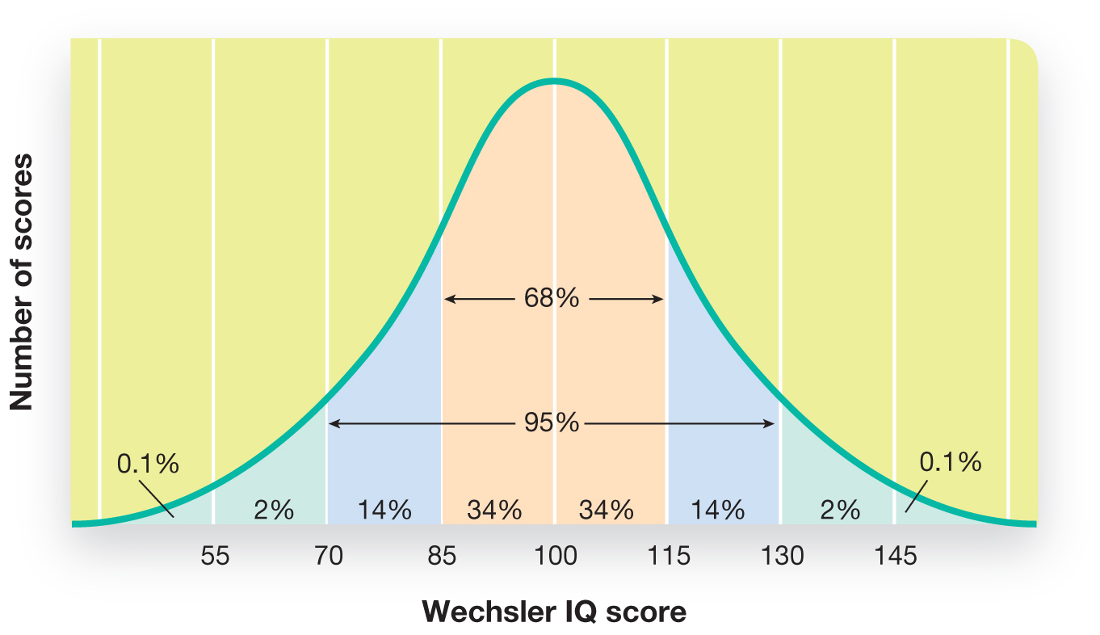
Different Approaches to Intelligence Testing (2 of 2)
Figure 9.1 The Normal Distribution of Scores for a Standardized Intelligence Test
Notes:
1) Neither Binet’s mental age or Stern’s IQ generalizes very well to adult populations because scores remain relatively consistent after about age 16. For that reason, psychologists began to use a different measure, deviation IQ, for calculating the IQ of adults.
Deviation IQ (p. 331) is calculated by comparing the person’s test score with the average score for people of the same age.
2) In order to calculate deviation IQs, a norm, or average, must be established for a population.
i) Psychologists do this by administering tests to huge numbers of people and use these scores to estimate the average for people of different ages. The averages are then used as baselines for comparison.
a) ”Average” is designed to be 100, with a standard deviation of 15 (Figure 9.1).
Long Description:
The horizontal axis shows “Wechsler IQ scores” from 55 to 145, in increments of 15. The vertical axis shows “Number of scores” The graph is a bell curve with the peak at a Wechsler IQ score of 100. The curve shows that about 68 percent of people have IQ scores between 85 and 115 and 14 percent of people each fall in the IQ score ranges of 70 to 85 and 155 to 130. That makes a total of around 95 percent falling in the range of 70 to 130 IQ scores. About 2 percent each fall in the ranges of 55 to 70 and 130 to 145 IQ scores. 0.1 percent each has IQ scores of below 55 of above 145.

Slide 13
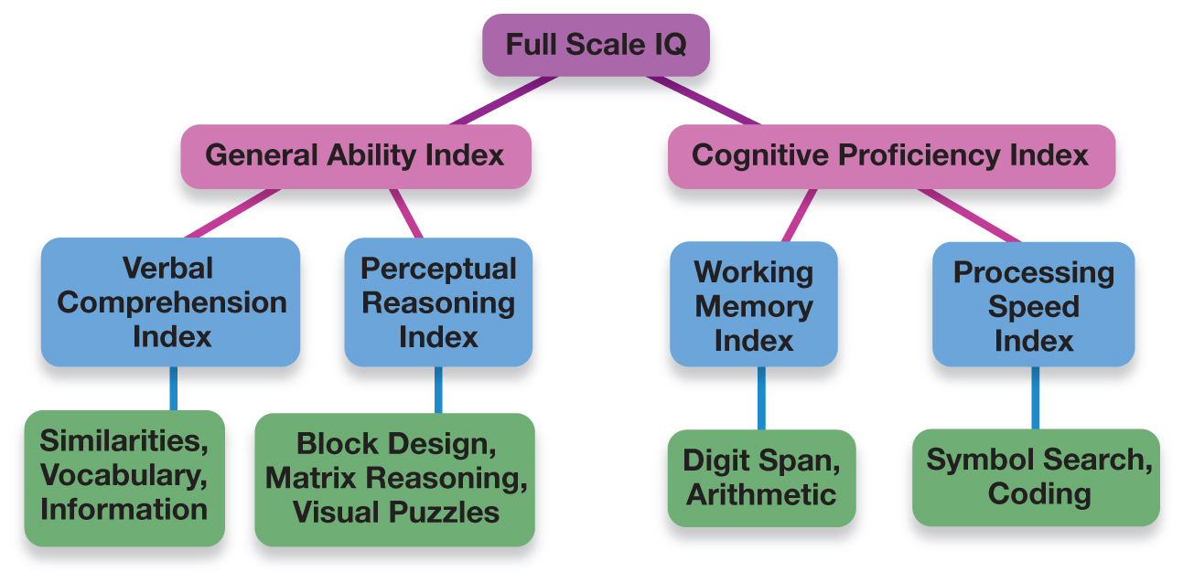
The Wechsler Adult Intelligence Scale (1 of 2)
Figure 9.2 Subscales of the Wechsler Adult Intelligence Scale
Notes:
Wechsler Adult Intelligence Scale (WAIS) (p. 331) is the most commonly used intelligence test used on adolescents and adults.
1) David Wechsler first developed this scale in 1955 and it is now in its fourth edition.
i) Point of interest: Wechsler was classified as “feeble minded” at nine-years-old when his family immigrated to the U.S. from Romania.
2) The WAIS provides an overall IQ score (Full Scale IQ) as well as two subscale scores: General Ability Index (GAI) and a Cognitive Proficiency Index (CPI) (Figures 9.2 & Figure 9.3).
i) The GAI is computed from scores on the Verbal Comprehension and Perceptual Reasoning indices.
a) These measures tap into a person’s intellectual abilities without placing so much emphasis on how fast s/he can solve the problems and make decisions.
ii) The CPI is based on Working Memory and Processing Speed.
a) More cognitive resources devoted to reasoning and problem solving reflect a higher IQ.
Long Description:
“Full scale IQ test” at the top branches out into two – “General ability index” and “Cognitive proficiency index.”
“General ability index” in turn, branches into two indices – “Verbal comprehension index” and “Perceptual reasoning index.” Similarly, “Cognitive proficiency index” branches into two – “Working memory index” and “Perceptual speed index.”
“Verbal comprehension index” includes “Similarities, Vocabulary, and Information.”
“Perceptual reasoning index” includes “Block design, Matrix reasoning, and Visual puzzles.”
“Working memory index” includes “Digit span” and “Arithmetic.”
“Perceptual speed index” includes “Symbol search” and “Coding.

Slide 14
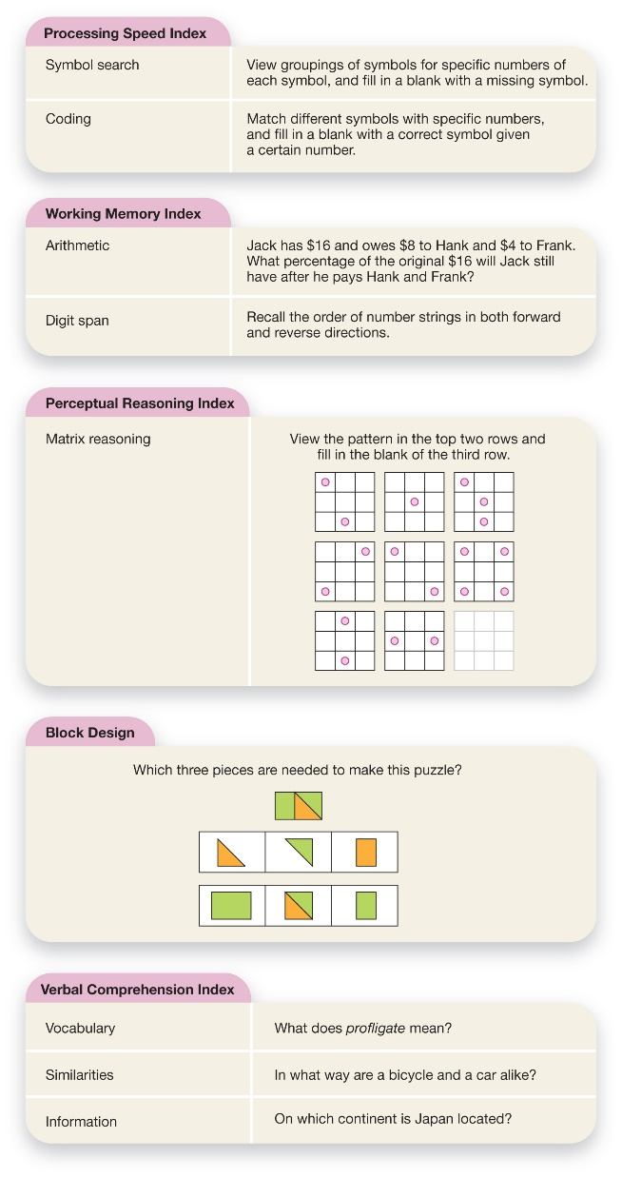
The Wechsler Adult Intelligence Scale (2 of 2)
Figure 9.3 Types of Problems Used to Measure Intelligence
These hypothetical problems are consistent with the types seen on the Wechsler Adult Intelligence Scale.
Notes:
Wechsler Adult Intelligence Scale (WAIS) (p. 331) is the most commonly used intelligence test used on adolescents and adults.
1) David Wechsler first developed this scale in 1955 and it is now in its fourth edition.
i) Point of interest: Wechsler was classified as “feeble minded” at nine-years-old when his family immigrated to the U.S. from Romania.
2) The WAIS provides an overall IQ score (Full Scale IQ) as well as two subscale scores: General Ability Index (GAI) and a Cognitive Proficiency Index (CPI) (Figures 9.2 & Figure 9.3).
i) The GAI is computed from scores on the Verbal Comprehension and Perceptual Reasoning indices.
a) These measures tap into a person’s intellectual abilities without placing so much emphasis on how fast s/he can solve the problems and make decisions.
ii) The CPI is based on Working Memory and Processing Speed.
a) More cognitive resources devoted to reasoning and problem solving reflect a higher IQ.
Long Description:
The figure shows the following examples to test different indices.
Processing speed index
Symbol search: View groupings of symbols for specific numbers of each symbol, and fill in a blank with a missing symbol.
Coding: Match different symbols with specific numbers, and fill in a blank with a correct symbol given a certain number.
Working memory index
Arithmetic knowledge: Jack has $16 and owes $8 to Hank and $4 to Frank. What percentage of the original $16 will Jack still have after he pays Hank and Frank?
Digit span: Recall the order of number strings in both forward and reverse directions.
Perceptual Reasoning Index
Matrix reasoning: A pattern of dots is presented in two rows of 3 square grids each. The third row has 2 grids with dots, while the third grid is blank. The participant has to “View the pattern in the top two rows and fill in the blank of the third row.”
Block design: Participants are shown a completed colour-coded puzzle. Individual colour-coded pieces that comprise the puzzle are presented in two rows, each containing 3 pieces. The participant has to answer the question “Which three pieces are needed to make this puzzle?”
Verbal Comprehension Index
Vocabulary: What does profligate mean?
Similarities: In what way are a bicycle and a car alike?
Information: On which continent is Japan located?

Slide 15
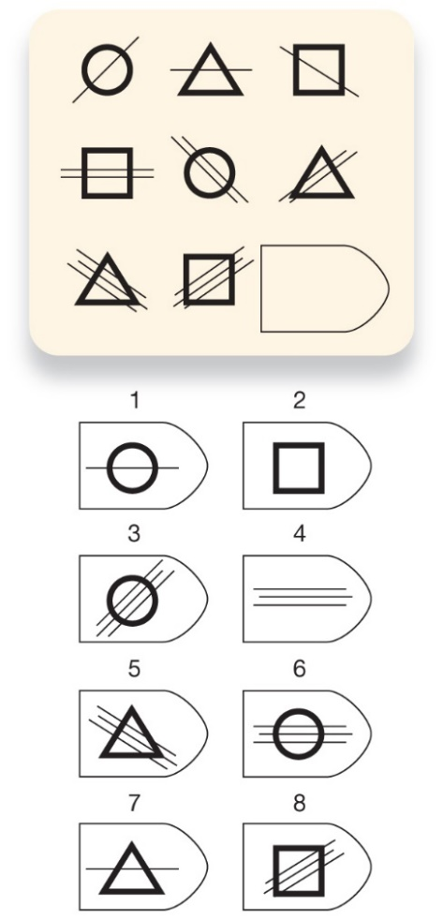
Raven’s Progressive Matrices
Figure 9.4 Sample Problem from Raven’s Progressive Matrices
Which possible pattern (1–8) should go in the blank space? Check your answer at the end of the source line, below.
Source: “Sample Problem from Raven’s Progressive Matrices,” NCS Pearson, 1998. Answer to Figure 9.4: Pattern 6.
Notes:
1) Many intelligence tests required knowledge of the test developer’s culture and language.
i) This put those from other cultures at an unfair disadvantage.
2) In the 1930s, John Raven developed the Raven’s Progressive Matrices as a more fair, “culture-free” test.
Raven’s Progressive Matrices (p. 333) is an intelligence test that is based on pictures, not words, thus making it relatively unaffected by language or cultural background.
i) The main tasks of this test measure the extent to which test takers can see patterns in the shapes and colors within a matrix and then determine which shape or color would complete the pattern (Figure 9.4).
ii) With this test, intelligence was measured by identifying and extracting important information (deductive reasoning) and then applying it to new situations (reproductive reasoning).
iii) Scores on this test correlate with the performance elements of the WAIS.
Long Description:
The figure shows a matrix (3 rows and 3 columns) that consist of different shapes (such as a diagonal line across a circle, a diagonal line across a triangle, a diagonal line across a square, the same figures with two or three diagonal lines, etcetera) with one in the last row left blank. The individuals are given 8 options to choose which pattern should go in the blank space.

Slide 16
The Checkered Past of Intelligence Testing
IQ Testing and Eugenics
Historical context
Social Darwinism
Eugenics
Notes:
Historical Context
1) The end of the 19th and beginning of the 20th centuries was a remarkable time in human history. A few centuries of European colonialism had spread Western influence through much of the world. The industrial revolution, which was concentrated in the West, compounded this, making Western nations more powerful militarily, technologically, and economically. And in the sciences, Darwin’s paradigm-shattering work on the origin of species firmly established the idea of evolution by natural selection.
2) The “social Darwinism” that emerged gave rise to one of the more ugly social movements of recent times―eugenics, which means “good genes”. The history of eugenics is intimately intertwined with the history of intelligence testing. In fact, Francis Galton himself, a cousin of Charles Darwin, made an extensive study of the heritability of intelligence, and it was he who coined the term “eugenics.”

Slide 17
The Race and IQ Controversy
Racial differences in IQ scores
Problems with the racial superiority interpretation
Culturally biased test content
Culturally biased test process
Stereotype threat (p. 336)
Notes:
Racial Differences in IQ Scores
1) The root of this issue about “race and IQ” is that there is a clear and reliable hierarchy of IQ scores across different ethnic groups. This was first discovered in the early 1900s, and by the 1920s, the United States passed legislation making it standard to administer intelligence tests to new immigrants arriving at Ellis Island for entry into the country. The result was that overwhelming numbers of immigrants were officially classified as “morons” and “feebleminded.” Some psychologists suspected that these tests were unfair, and that the low scores of these minority groups might be due to language barriers and a lack of knowledge of American culture.
2) Nevertheless, as intelligence tests were developed that were increasingly culturally sensitive―such as Raven’s Progressive Matrices―these differences persisted. Specifically, Asian people tended to score the highest, followed by Whites, followed by Latinos and Blacks; this has been found in samples in several parts of the world, including Canada.
Problems with the Racial Superiority Interpretation
1) In many ways, the simplest critique of the racial superiority interpretation of these test score differences is that the tests themselves are culturally biased. This critique was lodged against intelligence tests from the time of Terman and, as we discussed earlier, a considerable amount of research focused on creating tests that were not biased due to language and culture. But in spite of all this work, the test score differences between ethnic groups remained.
2) A more subtle critique was that it wasn’t necessarily the tests that were biased, but the very process of testing itself. If people in minority groups are less familiar with standardized tests, if they are less motivated to do well on the tests, or if they are less able to focus on performing well during the testing sessions, they will be more likely to produce lower test scores. This indeed seems to be the case; researchers have found that cultural background affects many aspects of the testing process including how comfortable people are in a formal testing environment, how motivated they are to perform well on such tests, and their ability to establish rapport with the test administrator.
3) Research has also indicated that the IQ differences may be due to a process known as stereotype threat (p. 336), which occurs when negative stereotypes about a group cause group members to underperform on ability tests. In other words, if a Black person is reminded of the stereotype that Black people perform more poorly than White people on intelligence tests, she may end up scoring lower on that test because she was afraid of living up to that stereotype.

Slide 18
Working the Scientific Literacy Model: Beliefs About Intelligence (1 of 3)
What do we know about the kinds of beliefs that may affect test scores?
Entity theory (p. 336)
Incremental theory (p. 336)
How can science test whether beliefs affect performance?
Notes:
1) What do we know about the kinds of beliefs that may affect test scores?
i) Psychologist Carol Dweck’s research has found some interesting conclusions in that there seem to be two influential beliefs about the nature of intelligence.
First is entity theory (p. 336), the belief that intelligence is a fixed characteristic and relatively difficult (or impossible) to change.
Second is incremental theory (p. 336), the belief that intelligence can be shaped by experiences, practice, and effort.
ii) According to Dweck and colleagues, beliefs based on entity theory and incremental theory have different effects on academic performance.
2) How can science test whether beliefs affect performance?
i) In experiments by Dweck and her colleagues, students were identified as holding either entity theories or incremental theories. The students had the chance to answer 476 general knowledge questions dealing with topics such as history, literature, math, and geography. They received immediate feedback on whether their answers were correct or incorrect. Those who held entity theories were more likely to give up in the face of highly challenging problems, and they were likely to withdraw from situations that resulted in failure. These individuals believe that successful people were born that way, so why keep punishing yourself if you simply do not have the ability to succeed? By comparison, people with incremental views of intelligence were more resilient.

Slide 19
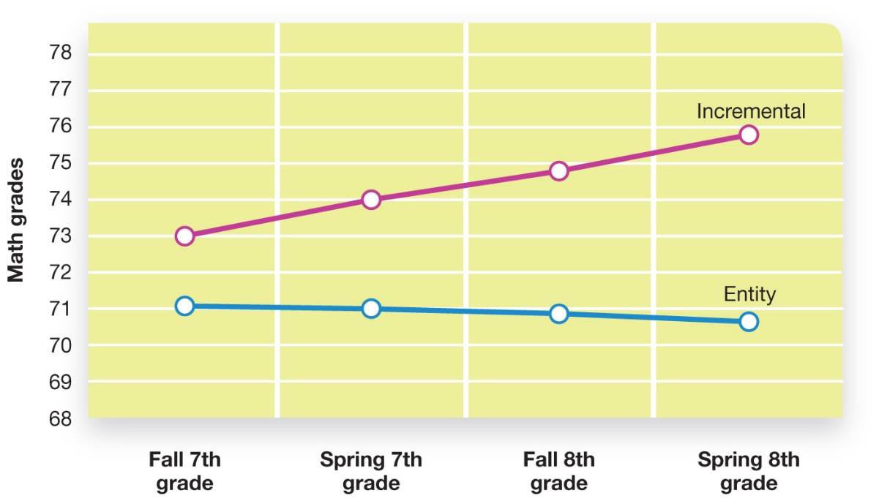
Working the Scientific Literacy Model: Beliefs About Intelligence (2 of 3)
How can science test whether beliefs affect performance?
Figure 9.5 Personal Beliefs Influence Grades
Students who held incremental views of intelligence (i.e., the belief that intelligence can change with effort) show improved grades in math compared to students who believed that intelligence was an unchanging entity (Blackwell et al., 2007).
Notes:
2) How can science test whether beliefs affect performance?
i) In experiments by Dweck and her colleagues, students were identified as holding either entity theories or incremental theories. The students had the chance to answer 476 general knowledge questions dealing with topics such as history, literature, math, and geography. They received immediate feedback on whether their answers were correct or incorrect. Those who held entity theories were more likely to give up in the face of highly challenging problems, and they were likely to withdraw from situations that resulted in failure. These individuals believe that successful people were born that way, so why keep punishing yourself if you simply do not have the ability to succeed? By comparison, people with incremental views of intelligence were more resilient.
Long Description:
The horizontal axis shows different time periods in a school year. The vertical axis shows “Math grades” from 68 to 78.
One line indicates the grades of students who held incremental views on intelligence (the belief that efforts can change the intelligence). It shows upward slope. The line begins at 73 percent in “Fall Seventh Grade,” rises to 74 percent in “Spring Seventh Grade” and to 75 percent in “Fall Eighth Grade”, ending at 76 percent in “Spring Eighth Grade.”
The other line indicates the grades of students who believed that intelligence is an unchanging entity. The line shows a gentle downward slope. It begins at 71 percent in “Fall Seventh Grade,” falls to around 69.8 percent in “Spring Seventh Grade” and to 69.55 percent in “Fall Eighth Grade”, ending at 70.8 percent in “Spring Eighth Grade.”

Slide 20
Working the Scientific Literacy Model: Beliefs About Intelligence (3 of 3)
Can we critically evaluate this research?
Why is this relevant?
Notes:
1) Can we critically evaluate this research?
i) These findings suggest that any time a belief about intelligence or ability can be changed to become more incremental, then that change should probably be made.
ii) One unanswered question raised by this research, however, is whether this is indeed always for the best. What if, in some situations, it is true that no matter how hard a person tries, he or she is unlikely to succeed?
2) Why is this relevant?
i) This research has huge potential to be applied in schools and to become a part of standard parenting practice. Teaching people to adopt the view that intelligence and other abilities are trainable skills will give them a greater feeling of control over their lives; it may improve their grades in the process.

Slide 21
9.2 Learning Objectives
Know the key terminology related to understanding intelligence.
Understand why intelligence is described as a hierarchy.
Understand intelligence differences between males and females.
Apply your knowledge to identify examples that reflect fluid vs. crystallized intelligence.
Analyze whether teachers should spend time tailoring lessons to each individual student’s learning style.
Notes:
Know the key terminology related to understanding intelligence.
See the bold, italicized terms below.
Understand why intelligence is described as a hierarchy.
Some types of intelligence are nested within others. We have an overarching general intelligence, which is made up of a small number of sub-abilities, each of which is made up of a large number of specific abilities that apply to individual tasks.
Understand intelligence differences between males and females.
Males and females generally show equal levels of overall intelligence, as measured by standard intelligence tests. However, men do outperform women on some tasks, particularly spatial tasks such as mentally rotating objects, whereas women outperform men on other tasks, such as perceiving emotions. Although there are some male-female differences in specific abilities, such as math, it is not yet clear whether these reflect innate differences between the sexes, or whether other factors are responsible, such as reduced enrollment of women in math classes and the presence of stereotype threat in testing sessions.
Apply your knowledge to identify examples that reflect fluid vs. crystallized intelligence.
Students should be able to read scenarios and identify whether the task taps into fluid or crystallized intelligence – does it require ‘figuring things out’ or ‘knowing what to do from past experience’?
Analyze whether teachers should spend time tailoring lessons to each individual student’s learning style.
Certainly, no one would want to discourage teachers from being attentive to the unique characteristics that each student brings to the classroom. However, large-scale reviews of research suggest that there is little basis for individualized teaching based on learning styles (e.g., auditory, visual, tactile).

Slide 22
Intelligence as a Single, General Ability (1 of 3)
Spearman’s general intelligence
General intelligence factor, “g” (p. 340)
Notes:
1) In the early 20th century, Charles Spearman proposed that there is a general intelligence.
i) Those who rate high in general intelligence should do well at all sorts of tasks (e.g., math, language, mechanics, etc.).
ii) Spearman developed techniques (e.g., factor analysis) to examine correlations among measures of mental abilities.
a) For example, measures such as vocabulary, reading comprehension, and verbal reasoning might overlap enough to form a “language ability” factor.
2) Spearman found that schoolchildren’s grades in different school subjects were positively correlated, even though the content of the different topics (e.g., math vs. history) was very different. This led Spearman to hypothesize the existence of a general intelligence factor.
General intelligence Factor (“g”) (p. 340): represents a person’s “mental energy,” reflecting Spearman’s belief that some people’s brains are simply more “powerful” than others.
ii) This has greatly influenced psychologists up to the present day, cementing within the field the notion that intelligence is a basic cognitive trait comprising the ability to learn, reason, and solve problems, regardless of their nature. Spearman’s concept of g is apparent today with a wide range of intelligence tests administered by psychologists.

Slide 23
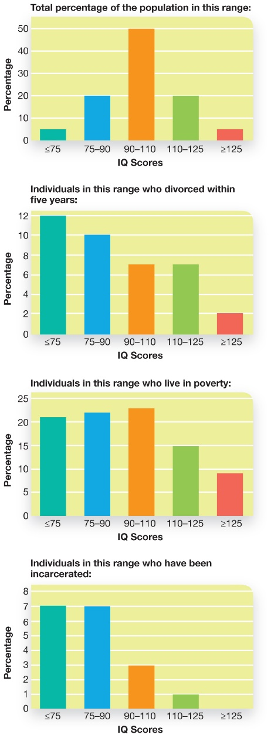
Intelligence as a Single, General Ability (2 of 3)
Figure 9.6 General Intelligence Is Related to Many Different Life Outcomes
General intelligence (g) predicts not just intellectual ability, but also psychological well-being, income, and successful long-term relationships.
Notes:
3) General intelligence is related to a number of outcomes (Figure 9.6).
Long Description:
All four graphs show “IQ score” ranges on the horizontal axis and “Percentage” on the vertical axis.
The first graph shows “Total percentage of population in a range” of IQ scores as summarized below:
• 75 or lesser: 5
• 75 to 90: 20
• 90 to 110: 50
• 110 to 125: 20
• 125 or greater: 5
The second graph shows “Individuals in this range who divorced within five years.” The IQ score ranges and percent are as follows:
• 75 or lesser: 12
• 75 to 90: 10
• 90 to 110: 7
• 110 to 125: 7
• 125 or greater: 2

Slide 24
Intelligence as a Single, General Ability (3 of 3)
Figure 9.6 General Intelligence Is Related to Many Different Life Outcomes
General intelligence (g) predicts not just intellectual ability, but also psychological well-being, income, and successful long-term relationships.
Source: Based on “General intelligence is related to various outcomes,” adapted from Herrnstein, R., & Murray, C. (1994). The bell curve: Intelligence and class structure in American life. New York: Free Press.; Gottfredson, L. (1997). Why g matters: Complexity of everyday life. Intelligence, 24, 79–132.
Notes:
3) General intelligence is related to a number of outcomes (Figure 9.6).
Long Description:
All four graphs show “IQ score” ranges on the horizontal axis and “Percentage” on the vertical axis.
The third graph shows “Individuals in this range who live in poverty.” The IQ score ranges and percent are as follows:
• 75 or lesser: 21
• 75 to 90: 22
• 90 to 110: 23
• 110 to 125: 15
• 125 or greater: 9
The fourth graph shows “Individuals in this range who have been incarcerated.” The IQ score ranges and percent are as follows:
• 75 or lesser: 7
• 75 to 90: 7
• 90 to 110: 3
• 110 to 125: 1
• 125 or greater: None

Slide 25
Intelligence as Multiple, Specific Abilities
Spearman’s General Intelligence
Does “g” tell us the whole story?
Spearman
Two factors: “g” and “s”
Thurstone
7 primary mental abilities
Hierarchical model of intelligence
Nesting
Notes:
1) Does “g” tell us the whole story?
i) We have to remember that correlation does not equal causation. It is possible that the effects of g are due to motivation—being motivated to succeed would lead to better grades, better IQ scores, and better performance.
ii) We should also ask whether g can explain everything about a person’s intelligence. A single number cannot possibly capture the kind of genius exhibited by the savants we discussed earlier.
1) Spearman hypothesized a second kind of ability that was specific to each task (i.e., each item on a test). And in a flurry of creativity, he chose the inspired name “s” to represent this specific-level, skill-based intelligence. His two-factor theory of intelligence was therefore comprised of g and s, where g represents our general, overarching intelligence, and s represents our skill or ability level for a given task.
2) Louis Thurstone examined Spearman’s techniques and scores on general intelligence tests and found seven different clusters that he termed primary mental abilities: word fluency, verbal comprehension, numeric abilities, spatial visualization, memory, perceptual speed, and reasoning.
i) Modern proponents of multiple intelligence types cite other evidence:
a) An individual with a head injury or stroke may lose one ability (e.g., language production) without any loss in other aspects of intelligence.
b) If intelligence was a single ability, savants wouldn’t exist.
3) Hierarchical model of intelligence
i) The general hierarchical model describes how our lowest level abilities (those relevant to a particular task, like Spearman’s s), are nested within a middle level that roughly corresponds to Thurstone’s primary mental abilities (although not necessarily the specific ones that Thurstone hypothesized), and these are nested within a general intelligence.

Slide 26
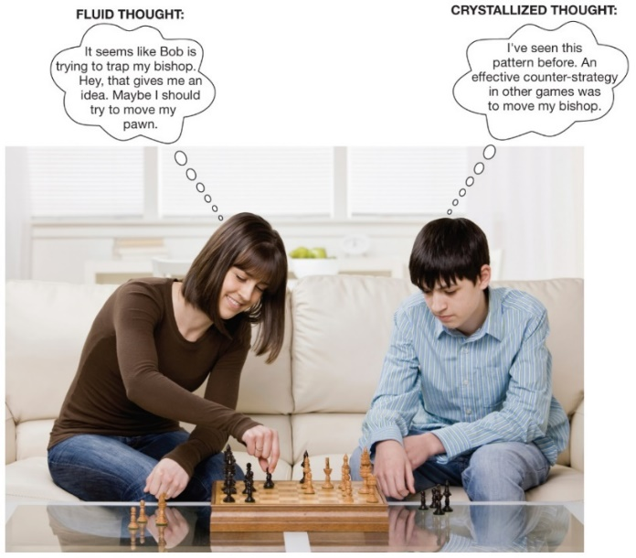
Working the Scientific Literacy Model: Testing for Fluid and Crystallized Intelligence (1 of 4)
How can science test whether beliefs affect performance?
Figure 9.7 Fluid and Crystallized Intelligence
Fluid intelligence is dynamic and changing, and may eventually become crystallized into a more permanent form.
AVAVA/Shutterstock
Notes:
1) What do we know about fluid and crystalized intelligence?
i) Intelligence appears to be divisible into at least two categories: fluid intelligence (Gf) and crystallized intelligence (Gc) (Figure 9.7).
Fluid intelligence (Gf) (p. 342-343) is a type of intelligence used in learning new information and solving new problems not based on knowledge the person already possesses.
a) Tests of Gf involve problems that do not require prior experience or specialized knowledge, such as pattern recognition and solving geometric puzzles (e.g., Raven’s Matrices, Module 9.1).
Crystallized intelligence (Gc) (p. 343) is a form of intelligence that draws upon past learning and experience.
b) Tests of Gc include vocabulary, similarity/difference, and reading comprehension.
Long Description:
The photo shows a young woman playing a game of chess with a boy.
The text bubble that shows “Fluid thought” of the woman reads: “It seems like Bob is trying to trap my bishop. Hey, that gives me an idea. Maybe I should try to move my pawn.”
The text bubble that shows “Crystallized thought” of the boy reads: “I've seen this pattern before. An effective counter-strategy in other games was to move my bishop.”

Slide 27
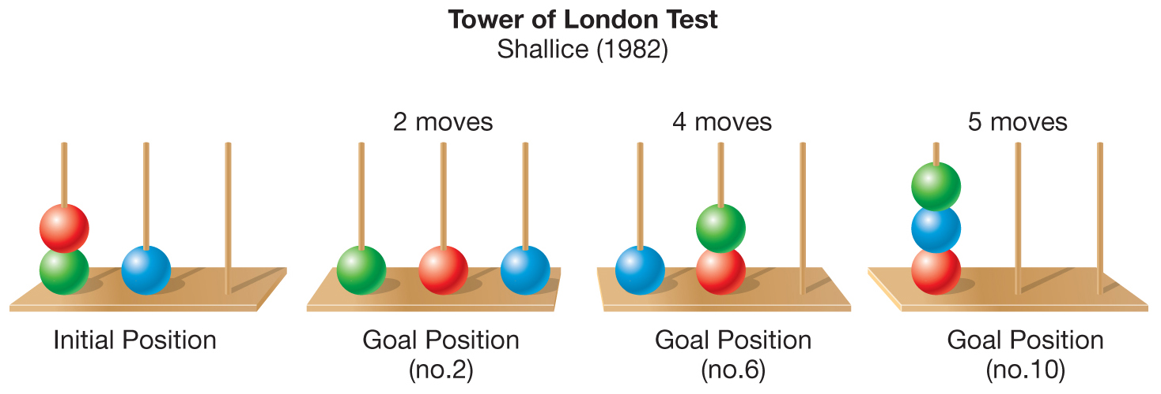
Working the Scientific Literacy Model: Testing for Fluid and Crystallized Intelligence (2 of 4)
How can science help distinguish between fluid and crystallized intelligence?
Figure 9.8 Measuring Fluid Intelligence
The Tower of London problem has several versions, each of which requires the test taker to plan and keep track of rules. For example, the task might involve moving the coloured beads from the initial position so that they match any of the various end goal positions.
Notes:
1) How can science help distinguish between fluid and crystallized intelligence?
i) To test the hypothesis that we have both Gf and Gc intelligence, scientists have examined how each changes over time.
ii) One study had 20 to 89-year-olds solve a variety of tasks, including the Tower of London puzzle, Block design, and tests of reaction time (Figure 9.8).
a) Performance on Gf tests peaks in early to middle adulthood and declines later in life.
b) Gc involves accumulated knowledge, so as long as an individual keep learning new information, Gc is less likely to decrease (Figure 9.9).
iii) Brain scans show regions associated with Gf tasks declines sooner than functioning of those regions supporting Gc tasks.
Long Description:
• The figure shows four different placements of three coloured beads on three rods.
The first image is the initial position that shows a green bead and a red bead on the first rod and a blue bead on the second rod. The third rod is empty.
• The second image indicates the goal position (Number 2) of the beads after two moves. It shows a green bead on the first rod, a red bead on the second road, and a blue bead on the third rod.
• The third image shows the goal position of the beads (Number 6) after 4 moves. It shows a blue bead on the first rod; and a red bead and green bead on the second rod. The third rod is empty.
• The fourth image indicates the goal position of the beads (Number 10) after 5 moves. It shows a red bead, a blue bead and a green bead on the first rod. The second and third rods are empty.

Slide 28
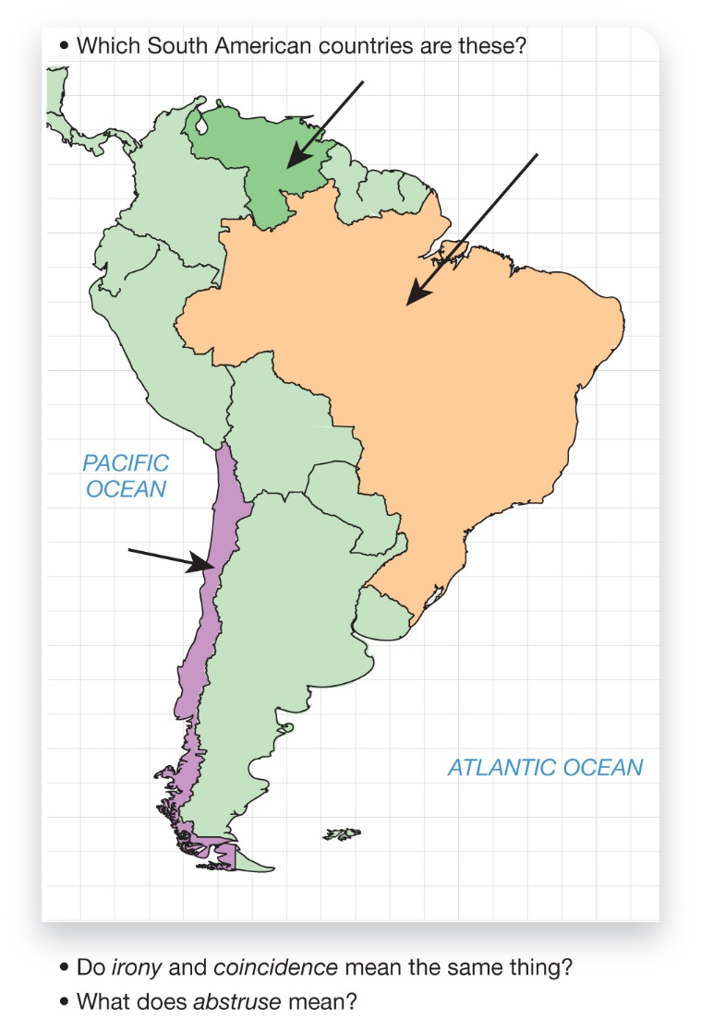
Working the Scientific Literacy Model: Testing for Fluid and Crystallized Intelligence (3 of 4)
How can science help distinguish between fluid and crystallized intelligence?
Figure 9.9 Measuring Crystallized Intelligence
Crystallized intelligence refers to facts, such as names of countries.
Notes:
1) How can science help distinguish between fluid and crystallized intelligence?
i) To test the hypothesis that we have both Gf and Gc intelligence, scientists have examined how each changes over time.
ii) One study had 20 to 89-year-olds solve a variety of tasks, including the Tower of London puzzle, Block design, and tests of reaction time (Figure 9.8).
a) Performance on Gf tests peaks in early to middle adulthood and declines later in life.
b) Gc involves accumulated knowledge, so as long as an individual keep learning new information, Gc is less likely to decrease (Figure 9.9).
iii) Brain scans show regions associated with Gf tasks declines sooner than functioning of those regions supporting Gc tasks.
Long Description:
The first is a colour-coded map of South America with three arrows that point to 3 countries along the north-eastern, northern and western boundaries, with the question “Which South American countries are these?”
The second question is: “Do irony and coincidence mean the same thing?”
The third question is: “What does abstruse mean?”

Slide 29
Working the Scientific Literacy Model: Testing for Fluid and Crystallized Intelligence (4 of 4)
Can we critically evaluate crystalized and fluid intelligence?
Gf is a blend of several different cognitive abilities
Gf and Gc are not entirely separable
Why is this relevant?
Stereotypes related to intelligence and age
Notes:
1) Can we critically evaluate crystalized and fluid intelligence?
i) Cognitive psychologists generally accept that fluid intelligence is a blending of several different cognitive abilities. If Gf is simply a statistical creation that reflects the integration of these different processes, perhaps researchers would be better off focusing their attention on these systems, rather than the more abstract construct Gf.
ii) Another critique is that fluid and crystallized intelligence are not, after all, entirely separable.
2) Why is this relevant?
i) Recognizing the distinctness of Gf and Gc can help reduce stereotypes and expectations about intelligence in older age.
ii) The notion of general intelligence may not fully capture the complex ways people express their cognitive skills.

Slide 30
Multiple Intelligences (1 of 2)
Table 9.1 Gardner’s Proposed Forms of Intelligence
Verbal/linguistic intelligence | The ability to read, write, and speak effectively
Logical/mathematical intelligence | The ability to think with numbers and use abstract thought; the ability to use logic or mathematical operations to solve problems
Visuospatial intelligence | The ability to create mental pictures, manipulate them in the imagination, and use them to solve problems
Bodily/kinesthetic intelligence | The ability to control body movements, to balance, and to sense how the body is situated
Musical/rhythmical intelligence | The ability to produce and comprehend tonal and rhythmic patterns
Notes:
1) Howard Gardner (1999) proposed the concept of multiple intelligences (Table 9.1).
Multiple intelligences (p. 345) a model claiming that that there are seven (now updated to at least nine) different forms of intelligence, each independent from the others.
i) Critics have pointed out that few of Gardiner’s intelligences can be accurately and reliably measured, making his theory unfalsifiable and difficult to research.
a) Creating operational definitions of the intelligences has been difficult and has held back empirical work on Gardner’s theory.
b) These challenges highlight the need for better ways of measuring intelligence.

Slide 31
Multiple Intelligences (2 of 2)
Table 9.1 Gardner’s Proposed Forms of Intelligence
Interpersonal intelligence | The ability to detect another person’s emotional states, motives, and thoughts
Self/intrapersonal intelligence | Self-awareness; the ability to accurately judge your own abilities, and identify your own emotions and motives
Naturalist intelligence | The ability to recognize and identify processes in the natural world—plants, animals, and so on
Existential intelligence | The tendency and ability to ask questions about purpose in life and the meaning of human existence
Source: The Nine Types of Intelligence by Gardner, H. (2006). Multiple Intelligences: New Horizons in Theory and Practice. New York: Basic Books.
Notes:
1) Howard Gardner (1999) proposed the concept of multiple intelligences (Table 9.1).
Multiple intelligences (p. 345) a model claiming that that there are seven (now updated to at least nine) different forms of intelligence, each independent from the others.
i) Critics have pointed out that few of Gardiner’s intelligences can be accurately and reliably measured, making his theory unfalsifiable and difficult to research.
a) Creating operational definitions of the intelligences has been difficult and has held back empirical work on Gardner’s theory.
b) These challenges highlight the need for better ways of measuring intelligence.

Slide 32
Myths in Mind: Learning Styles
Visual learners should learn more with visual materials?
Lack of supporting evidence
Focus on learning the meaning
Notes:
1) A number of educational practices that have used the notion of multiple intelligences to promote the idea of learning styles. Some have hypothesized that in educational settings different people process information better through specific modalities. If this is true, then it suggests that people have different learning styles and therefore, educators would be more effective if they tailor their lesson plans to the learning styles of their students, or at least ensure that they appeal to a variety of learning styles.
i) Common sets of learning styles include divisions such as visual, auditory, and kinesthetic/tactile.
2) Learning styles can be tested scientifically with a simple hypothesis:
i) Individuals should learn and retain more information learned through their preferred learning style than through the other styles.
3) However, dozens of studies have failed to show any benefit for studying according to an individual’s learning style.
i) This result probably occurs because regardless of how you encounter something (e.g., reading, tactile, etc.), you still need to store the meaning of the information to retain it over the long term.
ii) As a result, it makes more sense for a teacher to tailor their instructional styles to fit the material instead of individual learning styles.

Slide 33
P S Y C H @ The N H L
Head injuries in the N H L
Chronic traumatic encephalopathy
I m P A C T
Regular testing checks for declines on specific abilities
Notes:
1) Even with helmets, NHL players suffer head injuries at an estimated rate of 80 concussions per season.
i) Knocks and bumps can add up over time, leading to chronic traumatic encephalopathy (CTE), a degenerative brain condition associated with memory loss, dementia, mood disorders, suicidality.
2) CTE develops over time and early detection would allow for smarter, more informed decisions about when and if the player should return to the sport.
i) To track cognitive abilities, many leagues and teams now require baseline cognitive testing with a computer-based testing package called ImPACT. Players complete the test once each year, before pre-season training.
a) Because head injuries tend to affect only a few cognitive skills, sports testing keeps the tests separate.
b) Following a head injury, players can be tested again to see if there are declines in any specific abilities.

Slide 34
The Battle of the Sexes?
Differences in intelligence?
No sex differences found
Male scores have greater variability
Do males and females have unique cognitive abilities?
Females: verbal, memory, emotions
Males: visuospatial
Stereotype threat
Notes:
1) One of the most conclusive studies on sex differences in intelligence was conducted in 2007, using 42 different tests of mental abilities to compare males and females. What they found were almost no sex differences in intelligence at all.
i) Some research has found that although males and females have the same average IQ score, there is much greater variability in male scores, which suggests that there are more men with substantial intellectual challenges, as well as more men who are at the top of the brainpower heap.
2) Do males and females have unique cognitive abilities?
i) Females are, on average, better at verbal abilities, some memory tasks, and the ability to read people’s basic emotions, whereas males have the advantage on visuospatial abilities, such as mentally rotating objects or aiming at objects.
ii) Stereotype threat is a particularly pernicious problem when comparing the abilities of people from different groups, such as comparing math scores of men and women. Stereotype threat occurs when there exists a negative stereotype about a group, such as the common belief that females are not quite as capable as males at math. When placed in a testing situation (e.g., a math test), this stereotype can undermine females’ performance, so that they do underperform males on the test

Slide 35
9.3 Learning Objectives
Know the key terminology related to heredity, environment, and intelligence.
Understand different approaches to studying the genetic basis of intelligence.
Apply your knowledge of environmental and behavioural effects on intelligence to understand how to enhance your own cognitive abilities.
Analyze the belief that older children are more intelligent than their younger siblings.
Notes:
Know the key terminology related to heredity, environment, and intelligence.
See bold, italicized terms below.
Understand different approaches to studying the genetic basis of intelligence.
Behavioural genetics typically involves conducting twin or adoption studies. Behavioural genomics involves looking at gene-behaviour relationships at the molecular level. This approach often involves using animal models, including knockout and transgenic models.
Apply your knowledge of environmental and behavioural effects on intelligence to understand how to enhance your own cognitive abilities.
Students should be able to different identify strategies that are good bets for enhancing the cognitive abilities that underlie their own intelligence.
Analyze the belief that older children are more intelligent than their younger siblings.
Reviews of intelligence tests show that the oldest child in a family tends to have slightly higher IQs than their younger siblings. This difference is not due to the genetic superiority of the older siblings; rather, it is likely related to the fact that older children often spend time teaching things to their younger siblings.

Slide 36
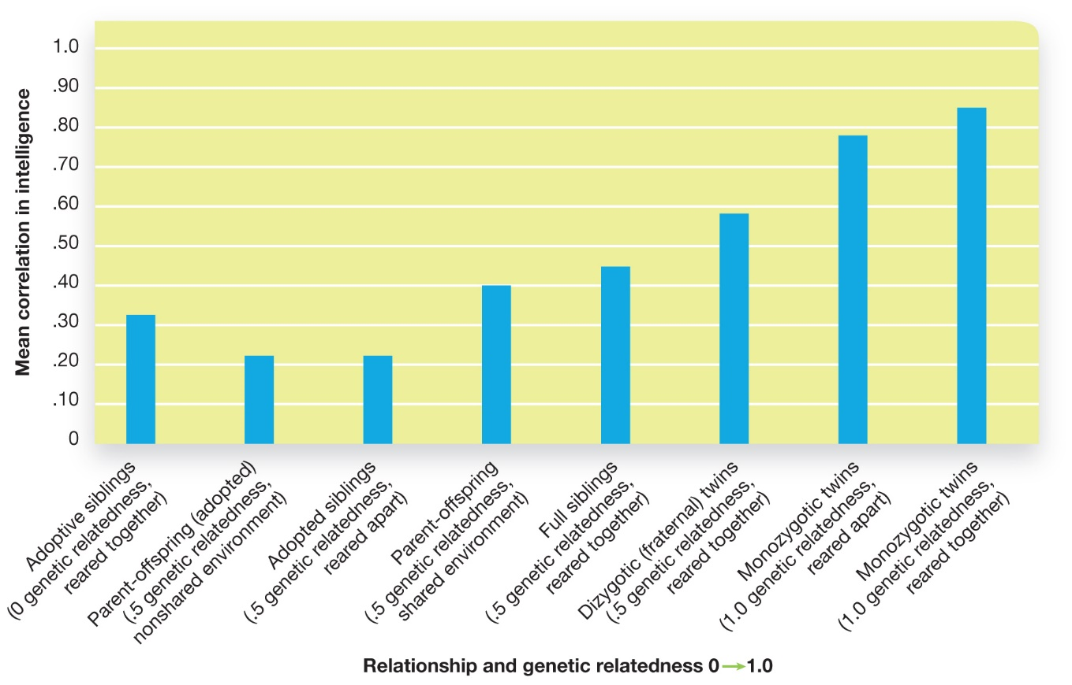
Biological Influences on Intelligence
The genetics and heritability of intelligence
Figure 9.11 Intelligence and Genetic Relatedness
Several types of comparisons reveal genetic contributions to intelligence (Plomin & Spinath, 2004). Generally, the closer the biological relationship between people, the more similar their intelligence scores.
Notes:
Twin and Adoption Studies
1) Decades of research on families, adopted children, and twins has shown that genetic similarity contributes to intelligence scores (Figure 9.11).
i) As genetic relatedness increases, so does similarity in IQ scores.
ii) The correlation in intelligence scores between parents and their children and between siblings are around .40 and .50.
iii) Identical twins are more alike in intelligence than fraternal twins.
a) Identical twins have a correlation of .85 when raised together and .80 when raised apart.
iv) However, it is important to note that environment also plays a role.
Behavioural Genomics
1) To search for specific genes related to intelligence, researchers use behavioural genomics, a technique that examines how specific genes interact with the environment to influence behaviours, including those related to intelligence.
i) This area of study focuses on identifying genes that are related to increases or decreases in certain types of learning and problem solving.
ii) Current research in this area suggests individuals inherit a collection of genes that pool together in influence general cognitive ability.
2) Researchers have developed mouse models of intelligence using gene knockout (KO).
Gene knockout (KO) (p. 353) studies involve removing a specific gene and comparing the characteristics of animals with and without that gene.
i) In one of the first KO studies, researchers discovered that removing one particular gene disrupted the ability for mice to learn spatial layouts.
ii) Scientists are also able to add a gene, creating mice referred to as transgenic animals.
a) They have engineered better than average learning mice.
Long Description:
The horizontal axis shows “Relationship and genetic relatedness” on a scale of “0 to 1.0” and the vertical axis shows “Mean correlation intelligence” from 0 to 1.0, in increments of 0.10.
The “Mean correlation intelligence”, by genetic relatedness is summarized below:
• Adoptive siblings (0 genetic relatedness, reared together): 0.32
• Parent-offspring (adopted) (.5 genetic relatedness, nonshared environment): 0.22
• Adopted siblings (.5 genetic relatedness, reared apart): 0.22
• Parent-offspring (.5 genetic relatedness, shared environment): 0.4
• Full siblings (.5 genetic relatedness, reared together): 0.45
• Dizygotic (fraternal) twins (.5 genetic relatedness, reared together): 0.59
• Monozygotic twins (1.0 genetic relatedness, reared apart): 0.79
• Monozygotic twins (1.0 genetic relatedness, reared together: 0.85

Slide 37
Working the Scientific Literacy Model: Brain Size and Intelligence (1 of 3)
What do we know about brain size and intelligence?
Once believed brain size was related to intelligence
Contributed to prejudice
Notes:
1) What do we know about brain size and intelligence?
i) It was originally believed that brain size was related to intelligence.
a) Scientists would take the skulls of the deceased, fill them with fine metal pellets, and then measure the volume.
b) This contributed to racial prejudice. The studies were highly flawed and inevitably led to conclusions that Caucasian males (those doing the studies) had the largest skull sizes and therefore were considered the smartest of the human race.

Slide 38
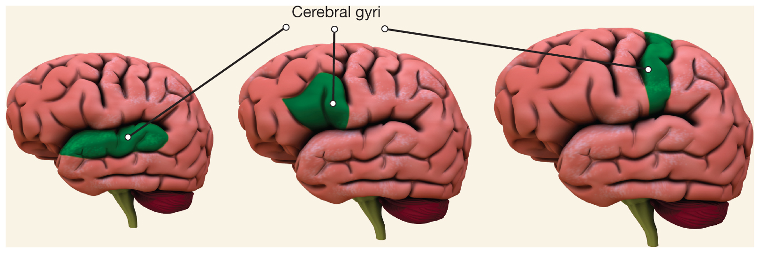
Working the Scientific Literacy Model: Brain Size and Intelligence (2 of 3)
How can science explain the relationship between brain size and intelligence?
Figure 9.12 Does Intelligence Increase with Brain Size?
While the size of the brain may have a modest relationship to intelligence, the convolutions or “gyri” along the surface of the cortex are another important factor: Increased convolutions are associated with higher intelligence test scores.
Notes:
2) How can science explain the relationship between brain size and intelligence?
i) One study had 100 brains from deceased individuals as well as their scores on the WAIS.
a) Overall, about 36% of the variation in verbal intelligence scores was accounted for by the size of the cortex.
ii) The convoluted surface of the brain (called gyri) composes the outer part of the cerebral cortex (Figure 9.12).
a) The number and size of these gyri is greater in species that have complex cognitive and social lives (e.g., elephants, dolphins, and primates).
b) Differences in gyri have also been found in humans, with the degree of convolutions accounting for roughly 25% of the variability in WAIS scores.
Long Description:
The “Cerebral gyri” (ridges on the cerebral cortex, that create a folded appearance) of the 3 brains are highlighted. The cerebral gyrus of the smallest-sized brain is horizontal with several convolutions. The mid-sized brain shows a gyrus with a triangular fold that does not show many convolutions. The largest of the 3 brains shows a vertical gyrus that extends to the top of the cortex.

Slide 39
Working the Scientific Literacy Model: Brain Size and Intelligence (3 of 3)
Can we critically evaluate the issue?
Which abilities underlie the correlation?
Third-variable problem
Why is this relevant?
Brain size and IQ used to understand clinical conditions
Prolonged anorexia nervosa and alcohol abuse
Notes:
1) Can we critically evaluate the issue?
i) IQ scores could be measuring a number of things including working memory, processing speed, ability to pay attention, or even motivation to perform well on the test. Therefore, when studies show that brain size can account for 25% of the variability in IQ scores, it is not always clear what ability (or abilities) are underlying these results.
ii) There is also the third-variable problem; even if brain size and performance on intelligence tests are correlated with each other, it might be the case that they are both related to some other factor, like stress, nutrition, physical health, environmental toxins, or the amount of enriching stimulation experienced during childhood
2) Why is this relevant?
i) The relation between brain size and IQ can be used to better understand clinical conditions.
a) For example, those with anorexia nervosa or prolonged periods of alcohol abuse appear to lose brain mass along with certain cognitive skills.

Slide 40
Environmental Influences on Intelligence
Nutrition
Socioeconomic Status (S E S)
Stress
Birth Order
Education
Notes:
Nutrition
1) Diet and lifestyle factors influence intelligence.
i) Research has shown that diets high in saturated fat quickly lead to sharp declines in cognitive functioning in both animal and human subjects. In contrast, diets low in such fats and high in fruits, vegetables, fish, and whole grains are associated with higher cognitive functioning.
a) This correlation is not surprising when comparing people living at the extremes of income. However, this relationship holds even after influences of socioeconomic status are removed from the analysis.
Socioeconomic Status (SES)
1) Children of affluent parents tend to have higher IQs than children living below the poverty level.
i) Higher SES homes are much more enriching and supportive of children’s intellectual development—high SES parents talk to their children more; have more books, magazines, and newspapers in the home; give them more access to computers; take them to more learning experiences outside the home and are less punitive toward their children.
Stress
1) High levels of stress in economically poor populations is a major factor in explaining the rich–poor IQ gap. People living in poverty are exposed to high levels of stress through many converging factors, (e.g. higher levels of environmental noise and toxins, more family conflict and community violence, less economic security, fewer employment opportunities).
i) Stresses increase the amounts of stress hormones such as cortisol in their bodies, which in turn is related to poorer cognitive functioning.
ii) High levels of stress also interfere with working memory and the ability to persevere when faced with challenging tasks.
iii) Effects of chronic stress show up in the brain as well, damaging the neural circuitry of the prefrontal cortex and hippocampus.
Birth Order
1) First born children tend to have higher IQs.
i) First born children get the most one-on-one, motivated interaction with parents during the first years of life.
ii) Older children are also likely to tutor their younger siblings, which helps with their own intellectual development.
Education
1) Research on education and school shows that children’s IQ scores are significantly lower if they are not attending school.
i) This relation has been observed over long summer breaks from school: IQ drops for most children.

Slide 41
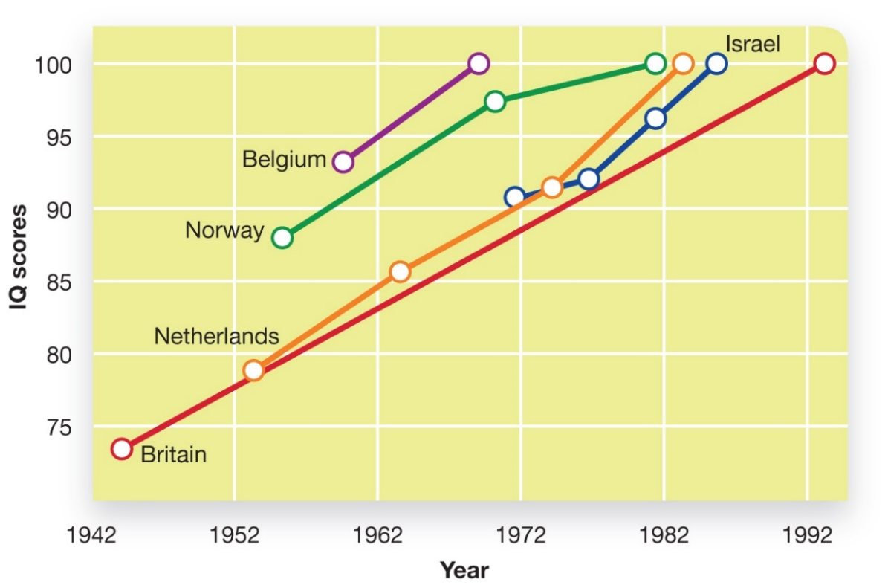
The Flynn Effect: Is Everyone Getting Smarter?
Figure 9.13 The Flynn Effect
Throughout the 20th century, there had been a general trend toward increasing IQ scores. This trend, called the Flynn effect, seems to have slowed, or maybe even reversed in the 2000s.
Source: Flynn, J. R. (1999). Searching for justice: The discovery of IQ gains over time. American Psychologist, 54, 5–20.
Notes:
1) Performance on standardized intelligence tests has been improving at a steady pace for decades.
i) For example, the Dutch and French militaries administer the Raven’s Progressive Matrices test (Module 9.1) to all newly enlisted adults.
a) From the 1950s to the 1980s, the scores increased 21 points from a mean to 100 to 121 for the Dutch.
b) The French saw a greater increase of about 10 points per decade.
ii) Other studies examining standardized tests reported similar findings.
a) One test was normed to have an average of 100 in 1953; in theory the same people taking that text 25 years later with a newer version of the same test should score the same. However, individuals’ scores averaged 8 points higher on the old test.
iii) James Flynn examined studies from 1932 to 2007 and estimated that averages increase about 1 point every three years (Figure 9.13).
Flynn effect (p. 357) refers to the steady population level increases in intelligence test scores over time.
2) The increase in scores has been explained in a number of ways.
i) Some say the scores are due to improved nutrition, healthcare, and early childhood educational programs.
a) However, the Dutch scores increased 7 points per decade meaning today’s group would score 135 on the 1950 test, which is unlikely.
ii) Others argue that newer generations are better at taking tests.
a) Students often take the test more than once, increasing their scores.
b) Wealthy countries have increased their use of standardized tests, which gives students practice that may have added up over time.
c) But the Flynn Effect holds for intelligence tests designed for infants, who have not had prior testing experience.
iii) Another explanation involves technological advances.
a) Increased use could be related to individuals’ ability to handle visualization tasks.
b) Flynn has documented the most substantial gains on tests that measure speed of processing, visualization, and the like.
Long Description:
The horizontal axis shows “Year” from 1942 to 1992, in increments of 10. The vertical axis shows “IQ scores” from 75 to 100, in increments of 5.
The graph shows “IQ scores” of 5 countries over the years.
The line depicting “Britain” steadily slopes upward over the years. It begins at a score of 74 in 1942, rises to 78, 83, and 88 in 1952, 1962, and 1972 respectively, touches a score of 94 in 1982, and ends at 100 in 1992.
The line depicting “Netherlands” also shows upward slope; it begins at a score of 79 in 1953, rises to 86 and 90 in 1963 and 1973 respectively, and ends at 100 in 1993.
The line depicting “Israel” begins at a score of 90 in 1971, rises to 96 in 1982, and ends at 100 in 1985.
The line depicting “Norway” begins at a score of 88 in 1955, rises to 97 in 1971, and ends at 100 in 1982.
The line depicting “Belgium” begins at a score of 94 in 1960 and touches 100 in 1969.

Slide 42
Behavioural Influences on Intelligence
Brain training programs
Nootropic drugs (p. 358)
Notes:
Brain Training Programs
1) The first technique is the use of "brain training" programs designed to improve working memory and other cognitive skills. Until recently, people generally believed this would not work, that although we can increase the amount of information we have in our heads, we can't change the actual functioning of the brain systems that make us "intelligent."
Nootropic Drugs
1) Another behaviour that many people believe improves their cognitive functioning is the use of certain drugs.
Nootropic substances (meaning “affecting the mind”) (p. 358) are substances that are believed to beneficially affect intelligence.
i) Nootropics can work through many different mechanisms, from increasing overall arousal and alertness, to changing the availability of certain neurotransmitters, to stimulating nerve growth in the brain.
ii) Boosting the brain, however, does not come without risk. For example, the long-term effects of such drugs are poorly understood and potential side effects can be severe.

