Slide 1
Agenda
Spiritual Orientations
Health, Stress, and Coping
What is creating stress in your life?

Slide 2
Spiritual Orientations
Performance-Based
I must do right to be accepted
If people knew what I was really like they wouldn’t like me
Life is based in fear
Need external praise
Can’t accept criticism
Always have to be busy
Have to be in control and have it together
Always wants rules
Trust-Based
I am accepted because of who I am
I know that I’m a good person, if people knew me they’d like me
Life is based in love
Internally secure
Welcome criticism
Enjoys rest
Observes and appreciates the use of multiple talents
Delights in freedom

Slide 3
True or False?
T F 1. The polygraph has proved to be extremely effective in detecting lies.
T F 2. Some emotional responses involve no conscious thinking.
T F 3. Introverts are superior to extraverts at reading others’ emotions.
T F 4. Facial expressions associated with emotions such as happiness and fear are the same the world over.
T F 5. Occasionally blowing off steam seems to reduce anger and aggression in the long run.

Slide 4
T F 6. Kidney dialysis patients report being just as happy as healthy non-patients.
T F 7. Compared with others, pessimists are more than twice as likely to develop heart disease.
T F 8. Writing about personal traumas in a diary reduces stress and the likelihood of health problems during ensuing months.
T F 9. Those who do not exercise are twice as likely as exercisers to report being not “too happy.”
T F 10. Religious faith and health show a strong positive correlation.

Slide 5

An Introduction to Psychological Science
Third Canadian Edition
Chapter 14
Health, Stress, and Coping
Copyright © 2021 Pearson Canada, Inc.
Notes:
If this PowerPoint presentation contains mathematical equations, you may need to check that your computer has the following installed:
1) MathType Plugin
2) Math Player (free versions available)
3) NVDA Reader (free versions available)

Slide 6
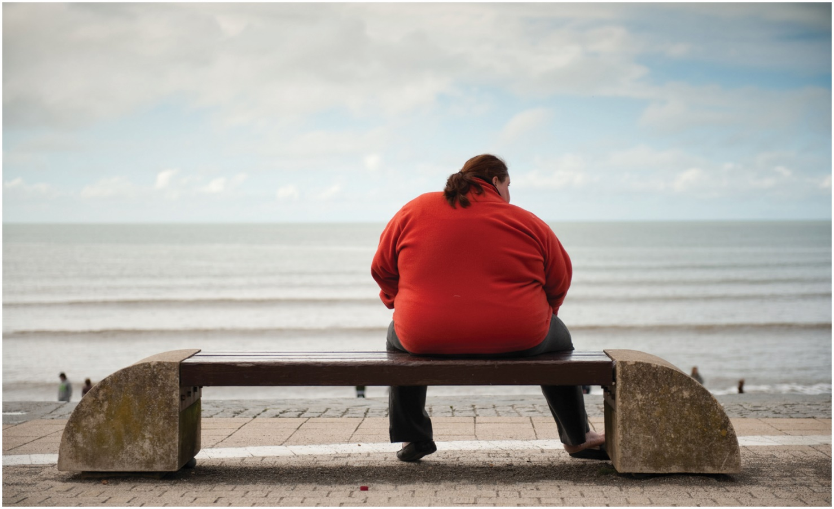
Modules
14.1: Behaviour and Health
14.2: Stress and Illness
14.3: Coping and Well-Being
Stock_wales/Alamy Stock Photo

Slide 7
14.1 Learning Objectives
Know the key terminology related to health psychology.
Understand how genetic and environmental factors influence obesity.
Apply your beliefs about obesity to better understand sources of prejudice and stereotyping.
Analyze whether media depictions of smoking affect smoking in adolescents.
Notes:
Know the key terminology related to health psychology.
See the bold, italicized terms below.
Understand how genetic and environmental factors influence obesity.
Twin and adoption studies indicate that inheritance plays a strong role as a risk factor for obesity (or, for that matter, as a predictor of healthy body weight). Furthermore, environmental influences on weight gain are abundant. Cultural, family, and socioeconomic factors influence activity levels and diet, even in very subtle ways, such as through social contagion.
Apply your beliefs about obesity to better understand sources of prejudice and stereotyping.
Stereotypes and prejudicial attitudes are commonly directed at people who are overweight or obese. Bacon and colleagues (2001) created a fat phobia scale as a metric for measuring thoughts about people who are obese. Students can complete the scale (found on page 539). Considering your own beliefs and thoughts about people who are overweight or obese can be an important step toward reducing prejudicial attitudes toward others, and toward recognizing negative stereotypes expressed by others.
Analyze whether media depictions of smoking affect smoking in adolescents.
Correlational trends certainly show that smoking in popular movies is positively related to smoking among adolescents (e.g., increased exposure is related to increased incidence of smoking). Controlled laboratory studies suggest a cause-and-effect relationship exists between identification with story protagonists who smoke and smoking behaviour by young viewers.

Slide 8
Health Psychology
Health psychologists
Tobacco use, alcohol, obesity, inactivity
Notes:
1) Health psychologists study both positive and negative impacts that humans’ behaviour and decisions have on their health, survival, and well-being.
i) The need for this field has increased considerably over the 20th century, as most premature deaths are attributable to lifestyle factors.
a) People are now much more likely to die from tobacco use, alcohol use, obesity, and inactivity. In fact, more than half of all deaths in Canada in 2009 were caused by heart disease, cancer, stroke, and diabetes; although genetics plays a role in these diseases, they have also been linked to unhealthy behaviours such as a poor diet and smoking.

Slide 9
Smoking (1 of 2)
Table 14.1 Health Costs of Tobacco Use
Tobacco use causes an estimated 5 million deaths worldwide each year.
Cigarette smoking is the leading preventable cause of death in North America.
One in five Canadian deaths is due to cigarette smoking.
Close to 1000 Canadians die each year as a result of second-hand smoke.
Source: Based on CDC, 2009a; Rehm et al., 2006; Statistics Canada, 2012a.
Notes:
1) The life expectancy of the average smoker is between 7 and 14 years shorter than that of a nonsmoker (Table 14.1).
i) Health problems include lung, mouth, and throat cancer; heart disease; and pulmonary diseases (e.g., emphysema).
ii) This number depends upon how much, and for how long, a person smoked. Quitting by the age of 30 greatly reduces the likelihood that a person will die of smoking-related cancers, a statistic that is quite relevant to university students.
2) Efforts to prevent smoking:
i) Provincial and municipal laws are reducing the risks posed by secondhand smoke exposure by banning smoking in many public places—especially restaurants and public buildings. As mentioned at the beginning of the Module, steep taxes applied to unhealthy products such as tobacco also act as a deterrent against their use. Not only does such a policy tend to reduce the number of smokers, but it also raises funds for health care and anti-smoking campaigns.
ii) In the 1990s, several countries added written warnings to cigarette packages (e.g., “Smoking seriously harms you and others around you”) in an attempt to reduce smoking rates. Unfortunately, these labels have had relatively little effect. However, in 2001, Canada became the first country to require companies to include graphic pictorial warnings on cigarette packages. These images included rotting teeth, black lungs, diseased hearts, and sick children; they were also paired with a verbal message. Researchers found that the image-based warnings were much more likely to be noticed by both smokers and non-smokers than were text-only messages.

Slide 10
Smoking (2 of 2)
Efforts to prevent smoking
Non-smoking laws
Warnings on packages
Notes:
1) The life expectancy of the average smoker is between 7 and 14 years shorter than that of a nonsmoker (Table 14.1).
i) Health problems include lung, mouth, and throat cancer; heart disease; and pulmonary diseases (e.g., emphysema).
ii) This number depends upon how much, and for how long, a person smoked. Quitting by the age of 30 greatly reduces the likelihood that a person will die of smoking-related cancers, a statistic that is quite relevant to university students.
2) Efforts to prevent smoking:
i) Provincial and municipal laws are reducing the risks posed by secondhand smoke exposure by banning smoking in many public places—especially restaurants and public buildings. As mentioned at the beginning of the Module, steep taxes applied to unhealthy products such as tobacco also act as a deterrent against their use. Not only does such a policy tend to reduce the number of smokers, but it also raises funds for health care and anti-smoking campaigns.
ii) In the 1990s, several countries added written warnings to cigarette packages (e.g., “Smoking seriously harms you and others around you”) in an attempt to reduce smoking rates. Unfortunately, these labels have had relatively little effect. However, in 2001, Canada became the first country to require companies to include graphic pictorial warnings on cigarette packages. These images included rotting teeth, black lungs, diseased hearts, and sick children; they were also paired with a verbal message. Researchers found that the image-based warnings were much more likely to be noticed by both smokers and non-smokers than were text-only messages.

Slide 11
Working the Scientific Literacy Model: Media Exposure and Smoking (1 of 2)
What do we know about media influences on smoking?
Smoking in movies has declined, but still present
How can science help us analyze the effects of smoking in the movies?
Notes:
1) What do we know about media influences on smoking?
i) Whether they become a smoker is influenced by family and local culture, personality characteristics, and socioeconomic status. People may smoke because this behaviour is associated with certain traits or societal roles, such as attractiveness, rebelliousness, and individualism.
ii) One influential factor that health psychologists study is the prevalence of smoking in movies and entertainment.
a) Although smoking in films has declined over the past decade, there are still numerous popular movies in which the characters smoke.
2) How can science help us analyze the effects of smoking in the movies?
i) In one study, researchers conducted a random-digit-dialing survey of 6,522 U.S. adolescents from all major geographic regions and socioeconomic groups.
a) The adolescents reported their age and indicated whether they smoked and were asked to identify whether they had seen specific popular movies that featured smoking.
b) The more exposure teens had to these movies, the more likely they were to have tried smoking.
c) This relation persisted even after controlling for socioeconomic status, personality, and parental and peer influences on smoking.
d) However, this study only shows us the correlation; it does not tell us why the correlation exists.
ii) An experimental study suggests that how people identify with smokers may influence their decision to smoke.
a) Adolescents who had positive responses to a protagonist who smoked were much more likely to associate smoking with their own identities.
b) This correlation was observed in adolescents who already smoked and those who did not.

Slide 12
Working the Scientific Literacy Model: Media Exposure and Smoking (2 of 2)
Can we critically evaluate this evidence?
Correlations exist
Number of explanations
Why is this relevant?
Cigarette-related illnesses
Notes:
1) Can we critically evaluate this evidence?
i) It is very difficult to establish that exposure to movies with characters that smoke actually causes adolescents to smoke.
ii) For example, researchers tracked the amount of smoking featured in popular movies from 1990 to 2007.
a) They found that as the smoking in movies rose, smoking among adolescents increased after a short period of time.
b) When smoking in movies decreased, a decline in adolescent smoking followed.
iii) However, multiple explanations could explain such correlations.
a) It could be that people who are already willing to smoke are more attracted to movies that feature smoking.
2) Why is this relevant?
i) Cigarette-related illness imposes a major societal burden in terms of lost work productivity and rising health care costs.
a) There are serious concerns about the health and well-being of those who start smoking at an early age.
ii) Movies are just one influence, but they are easier to control than other factors, such as peer pressure.
a) Group such as Smoke Free Movies and the National Association of Attorneys General use this research to argue against smoking in movies.
iii) After peaking in the middle of the past decade, the number of films including smoking is on the decline (Polansky, 2016). The number of “tobacco incidents” in PG-13 movies specifically targeted to teens increased from 565 in 2010 to 1155 in 2012; therefore, the curtain hasn’t fallen on this issue.

Slide 13
Obesity
“Freshman 15”
24% of Canadians are obese
Defining healthy weights and obesity
Body mass index (BMI) (p. 534)
Weight gain
Positive energy balance
Notes:
1) The lifestyle changes that students face during college affect physical health.
i) Many have heard of the “freshman 15," that most first-year students put on 15 pounds, but research shows students actually average an extra 6 pounds.
a) This is most likely due to increased food intake, decreased physical activity, and, for many students, increased levels of alcohol consumption.
ii) Six pounds is not a lot of weight, but the habits formed can be hard to break.
2) Obesity is a significant problem in Canada
i) 24% of Canadians are obese.
ii) Obesity is associated with detrimental health consequences, such as cardiovascular disease, diabetes, osteoarthritis (degeneration of bone and cartilage material), and some forms of cancer.
3) BMI is used to screen people for weight categories that indicate whether they are considered normal weight, underweight, overweight, or obese.
Body mass index (BMI) (p. 534) is a statistic commonly used for estimating a healthy body weight that factors in an individual’s height.
4) Weight is gained because of a positive energy balance, meaning that too many calories come in and not enough are expended (Module 11.1).
i) In addition to overeating, genetic, lifestyle, and social variables contribute to obesity.

Slide 14
Genetics and Body Weight
Genetic contribution to weight
50-90%
Set point (p. 534)
10-20% range in weight
Theory challenged
Notes:
1) Twin, family, and adoption studies all suggest that genes account for between 50% and 90% of the variation in body weight.
2) Some researchers suggest that genes contribute to development of a set point.
i) That is, your initial set point is controlled by genetic mechanisms, but your actual weight can be modified by environmental factors (e.g., how much you eat).
Set point (p. 534) is a hypothesized mechanism that serves to maintain body weight around a physiologically programmed level.
ii) The set point is a relatively small range encompassing 10% to 20% of one’s weight.
iii) According to this theory, if an individual gains 10% of his body weight (e.g., going from 150 to 165 pounds) his set point would make a corresponding shift upward—the body acts as though its normal weight is now the larger 165 pounds.
a) Metabolism slows correspondingly, such that this person now requires additional energy expenditure to take the weight off.
b) This process also explains why people can shed excess weight relatively easily but find it overwhelmingly difficult to continue losing weight once they reach an initial weight goal.
3) Set point theory has a long tradition in nutrition, but its validity is challenged by research suggesting that weight gain and loss are unrelated to a physiological set point.
i) Rather, it appears that physical activity is a stronger determinant of who succeeds at losing weight and keeping it off.
a) People who gain weight expend less energy in their normal day-to-day activities, making it difficult to lose weight.

Slide 15
The Sedentary Lifestyle
How we spend our time
Television
Home entertainment = sitting and snacking
Children indoctrinated into this lifestyle
Notes:
1) Research shows us that how you spend your time can have a large effect on your waistline.
i) Although there are number of activities that could increase the likelihood of someone being obese, data from the 2007 Canadian Community Health Survey (CCHS) suggest that television is the biggest culprit (see Figure 14.2).
ii) Home entertainment has evolved into activities that include sitting and snacking (e.g., TV, video games).
2) Many children are indoctrinated into this lifestyle, contributing to the drastically rising childhood obesity rates.
i) This leads to an even greater variety of sedentary activities.
a) Researchers have found that the amount of time that children spend playing video games is positively correlated with levels of obesity.
b) Some remain optimistic about new video games that involve physical activity, but these options claim only a small proportion of the overall market.

Slide 16
Social Factors
Children influenced by parents
Media
Notes:
1) What children eat is largely based on what their parents provide and allow them to eat.
i) Eating patterns developed in childhood are generally carried through into adulthood.
2) Media have also been found to influence eating.
i) After watching a commercial for buttery microwave popcorn, you might be tempted to rummage through your pantry to your own last bag of popcorn.
a) If you don’t have any popcorn, you are still more likely to snack on something.
ii) Children who see food commercials while watching a 30-minute cartoon program consume 45% more snack food than do children who view nonfood commercials.
a) The researchers estimated that this difference could lead to an additional 10 pounds of extra weight gained each year.

Slide 17
Psychology and Weight Loss
Positive emotion
Challenges for maintaining weight loss
Cues
Dieting reinforces cravings
Notes:
1) A recent study from the University of Waterloo suggests that thinking positively about oneself can promote healthy weight loss. In the first part of the study, participants wrote about either self-defining values that made them feel positively about themselves (e.g., friendships, religious beliefs, relationships) or about other values. At a follow-up session two-and-a-half months later, the self-defined value group weighted less, had lower body-mass indices, and had smaller waistlines. It is likely that the positive emotion manipulation reduced the participants stress regarding dieting. Given that stress leads to an increase in the number of calories consumed (see Module 11.1), reducing stress would likely lead to a reduction in the amount of food consumed.
2) There are a number of challenges involved with this.
i) First, obese individuals pay more attention to food cues and find them more rewarding than non-obese people.
ii) Additionally, the drive to eat and the perceived value of food increase as more time passes since the last meal; this makes it difficult to remove snacks from one's routine.
iii) Several studies have shown that girls and adolescents who attempt to diet are heavier later in life. The restraint involved in dieting—especially avoiding certain highly reinforcing foods—may actually make the foods even more reinforcing in the long run.

Slide 18
Poverty and Discrimination
Less access to healthcare
Lack of control
Magnified by stress
Poorer diets
Discrimination
Uncontrollable and unpredictable
Increased blood pressure
Unhealthy behaviours
Notes:
1) People who live in affluent communities enjoy better access to health care, have a greater sense of control over their environment, and have the resources needed to maintain the lifestyle they want.
i) Others lack this sense of control and live in circumstances that compromise their health.
a) Those in poverty experience discrimination and other social stressors, which leads to higher rates of depression, anxiety, and other mental health problems.
ii) Health problems are magnified by stress.
a) Heart disease is prevalent in socioeconomically disadvantaged populations.
iii) Those in poverty also tend to have poorer diets.
2) Discrimination is another stressor that can compromise both physical and mental health.
i) It is uncontrollable and unpredictable.
a) This can lead to people constantly being on “alert."
ii) Being a target of prejudice and discrimination is linked to increased blood pressure, heart rate, and secretions of stress hormones.
a) Over time, this can compromise physical health.
b) For example, when individuals perceive they are target of racism, their blood pressure remains elevated throughout the day, and it recovers poorly during sleep.
iii) Targets of discrimination are at a greater risk for engaging in unhealthy behaviours (e.g., smoking and substance abuse).
iv) One only needs to perceive being a target (vs. actually being a target) to put the body on sustained alert against threats, which can have negative long-term effects (Module 16.2).

Slide 19
Family and Social Environment
Interpersonal relationships
Social Resilience (p. 537)
Social isolation
As great a risk as smoking, obesity, and high blood pressure
Married couples tend to live longer
Men enjoy more health benefits
Marriage is also a large source of stress
Children
Notes:
1) Our close, interpersonal relationships have a major impact on health.
Social resilience (p. 537) is the ability to keep positive relationships and to endure and recover from social isolation and life stressors.
i) Social resilience can protect individuals from negative health consequences of loneliness and social isolation.
ii) Chronic social isolation is as great a mortality risk as smoking, obesity, and high blood pressure.
iii) Married couples tend to live longer and have better mental and physical health than do unmarried adults.
a) Married couples enjoy the benefits of social support, combined resources, and they tend to have better health habits.
2) Men appear to enjoy greater health benefits in heterosexual marriages.
i) Unmarried women have a 50% higher mortality rate than do married women
a) Unmarried men have a 250% higher mortality.
b) A possible reason for this difference is the greater role that women take in recognizing and supporting healthy behaviours in others.
3) Marriage can also be a considerable source of stress.
i) Married couples who are experiencing ongoing problems with their relationship are more depressed and suffer from greater incidences of physical illness than happily married couples.
ii) Children’s emotional and physical health can also be affected during a divorce.
a) Younger children are especially affected by problematic periods of a marriage.
b) Adolescents are at a slightly higher risk of engaging in delinquent behaviours.
c) However, high-quality parenting during marital discord can help offset these negative effects on children.

Slide 20
Social Contagion
Social contagion (p. 538)
Food consumption
Weight loss
Smoking
National Heart Institute
1948 study tracking 15,000
Notes:
1) Many of our health and lifestyle choices are influenced by what others around us are doing.
i) We tend to eat when we see others eat, even if we’re not hungry.
a) This can lead to serious weight gain within a social group.
b) Conversely, if all of your friends are losing weight, you are more likely to lose weight as well.
ii) The same even appears to happen with smoking—either starting or quitting.
Social contagion (p. 53) the often subtle, unintentional spreading of a behaviour as a result of social interactions.
2) The National Heart Institute began this ongoing study in 1948 to track 15,000 residents of Framingham, Massachusetts.
i) Participants made regular visits to their doctors, who recorded important health statistics such as heart rate, body weight, and other standard physical measures.
ii) Scientists began to notice clusters of people becoming increasingly similar in certain characteristics.
a) This included body weight increases or decreases, starting or quitting smoking, and even levels of happiness.
iii) It turns out that the groups who showed similar patterns in their health statistics were also friends with one another.

Slide 21
14.2 Learning Objectives
Know the key terminology associated with stress and illness.
Understand the physiological reactions that occur under stress.
Understand how the immune system is connected to stress responses.
Apply a measure of stressful events to your own experiences.
Analyze the claim that ulcers are caused by stress.
Notes:
Know the key terminology associated with stress and illness.
See the bold, italicized terms below.
Understand the physiological reactions that occur under stress.
When a person encounters a stressor, the hypothalamus stimulates the sympathetic nervous system to act, triggering the release of epinephrine and norepinephrine from the adrenal medulla. This reaction is often referred to as the fight-or-flight response. Another part of the stress response system is the HPA axis, in which the hypothalamus stimulates the pituitary gland to release hormones that in turn stimulate the adrenal cortex to release cortisol, which prepares the body to deal with stressful situations.
Understand how the immune system is connected to stress responses.
Cortisol suppresses the immune system, leaving people more vulnerable to illness and slowing recovery time from illness and injury.
Apply a measure of stressful events to your own experiences.
Students should be able to complete the life stressor inventory in Table 14.2 and compare their scores to a larger sample.
Analyze the claim that ulcers are caused by stress.
Ulcers are damaged areas of the digestive tract often caused by infection with the bacterium Helicobacter pylori. Stress and other factors, such as diet and alcohol consumption, can worsen the condition of ulcers, but stress alone does not cause them.

Slide 22
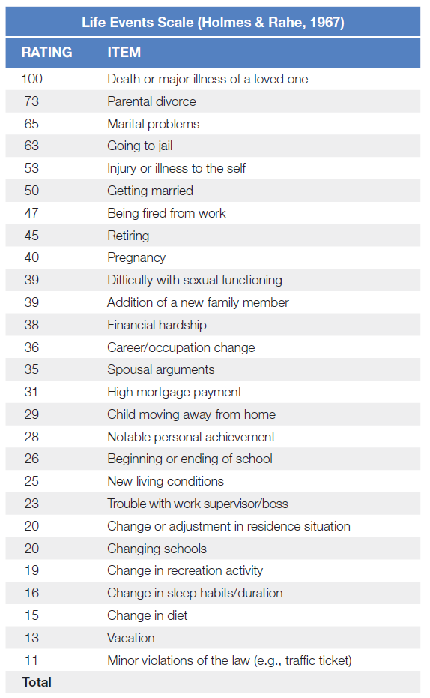
Stress
Table 14.2 Life Stress Inventories for the General Adult Population and for University Students
Source: Based on Holmes, T. H. & Rahe, R. H. (1967). The social readjustment rating scale. Journal of Psychosomatic Research, 11(2), 213–221.
Notes:
1) Stress refers to both events (stressors) and experiences in response to these events (the stress response).
i) Stress can come from acute events (e.g., giving a speech) as well as chronic events (e.g., marital problems, illness).
Stress (p. 541) is a psychological and physiological reaction that occurs when perceived demands exceed existing resources to meet those demands.
2) Psychologists have ranked stressful events according to their magnitude, as can be seen in the Life Stress Inventory (Table 14.2).
i) This scale includes positive and negative events.
a) For example, the highest-stress events include death of a spouse and divorce, whereas holidays and traffic tickets are at the lower end of the spectrum.
ii) According to the developers of the scale, the more points one accumulates, the greater the chance of becoming ill.
iii) Certain stress events tend to be age specific, which has resulted in stress inventories developed for university students.
Long Description:
The ratings for various items are as follows:
100, Death or major illness of a loved one
73, Parental divorce
65, Marital problems
63, Going to jail
53, Injury or illness to the self
50, Getting married
47, Being fired from work
45, Retiring
40, Pregnancy
39, Difficulty with sexual functioning
39, Addition of a new family member
38, Financial hardship
36, Career/occupation change
35, Spousal arguments
31, High mortgage payment
29, Child moving away from home
28, Notable personal achievement
26, Beginning or ending of school
25, New living conditions
23, Trouble with work supervisor/boss
20, Change or adjustment in residence situation
20, Changing schools
19, Change in recreation activity
16, Change in sleep habits/duration
15, Change in diet
13, Vacation
11, Minor violations of the law (e.g., traffic ticket)

Slide 23
What Causes Stress? (1 of 2)
Individual differences in stress response
Appraisal (p. 541)
Primary appraisal
Secondary appraisal
Notes:
1) To attempt to explain why and how people differ, psychologists Richard Lazarus and Susan Folkman developed a cognitive appraisal theory of stress (Figure 14.3).
i) Here, the term appraisal (p. 541) refers to the cognitive act of assessing and evaluating the potential threat and demands of an event. These appraisals occur in two steps.
a) First, the individual perceives a potential threat and begins the primary appraisal by asking herself, “Is this a threat?” Threats can be physical (e.g., someone trying to harm you) or psychosocial (e.g., trying to study for two exams on the same day or trying to deal with interpersonal conflicts). If the answer is no, then she will not experience any stress. But, if the answer is yes, she will experience a physiological stress reaction (perhaps a racing heart beat and sweaty palms) as well as an emotional reaction (perhaps anxiety and fear).
b) As these events unfold, the secondary appraisal begins—she must determine how to cope with the threat. During the secondary appraisal, she may determine that she knows how to cope with the stressor (e.g., studying for the exams over the course of several days); in this case, she will not feel much stress. However, if she believes that the stressor goes beyond her ability to cope, the physiological and emotional reactions to the stress will continue.

Slide 24
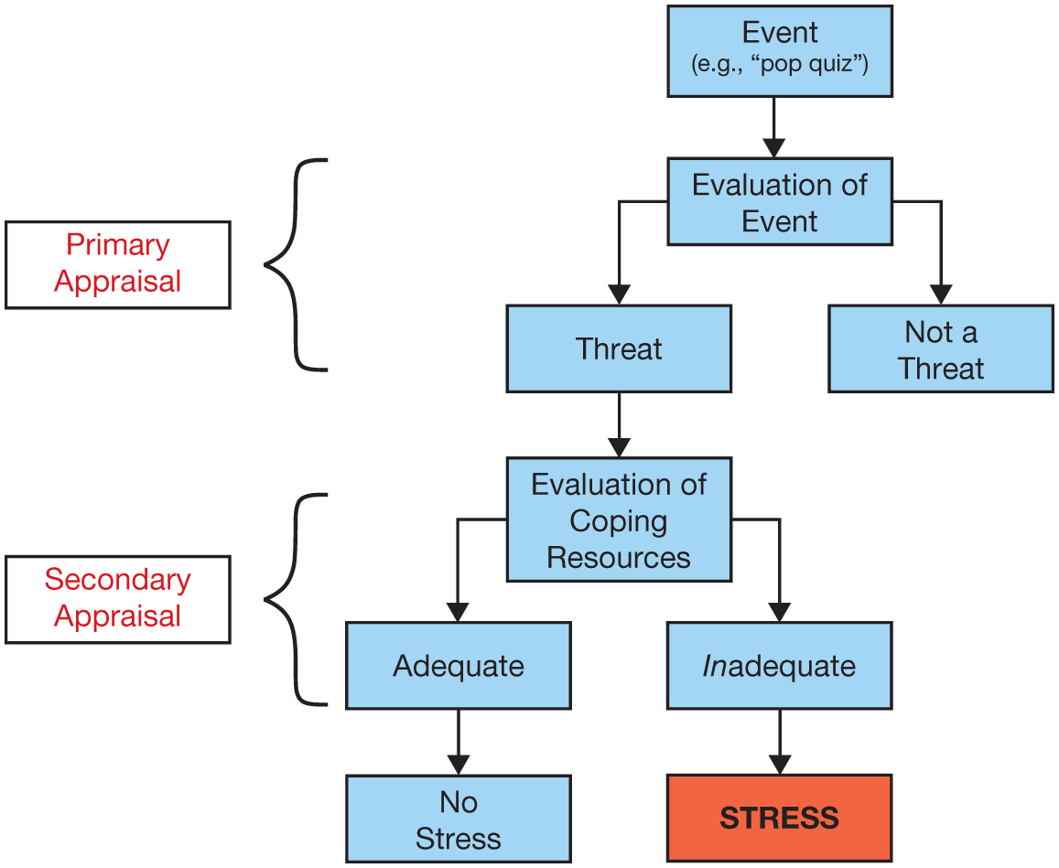
What Causes Stress? (2 of 2)
Figure 14.3 The Cognitive Appraisal Theory of Stress
The cognitive appraisal theory of stress involves two steps: (1) an evaluation of whether a stimulus or event is a threat, and (2) whether you have the resources to cope with that threat.
Notes:
1) To attempt to explain why and how people differ, psychologists Richard Lazarus and Susan Folkman developed a cognitive appraisal theory of stress (Figure 14.3).
i) Here, the term appraisal (p. 541) refers to the cognitive act of assessing and evaluating the potential threat and demands of an event. These appraisals occur in two steps.
a) First, the individual perceives a potential threat and begins the primary appraisal by asking herself, “Is this a threat?” Threats can be physical (e.g., someone trying to harm you) or psychosocial (e.g., trying to study for two exams on the same day or trying to deal with interpersonal conflicts). If the answer is no, then she will not experience any stress. But, if the answer is yes, she will experience a physiological stress reaction (perhaps a racing heart beat and sweaty palms) as well as an emotional reaction (perhaps anxiety and fear).
b) As these events unfold, the secondary appraisal begins—she must determine how to cope with the threat. During the secondary appraisal, she may determine that she knows how to cope with the stressor (e.g., studying for the exams over the course of several days); in this case, she will not feel much stress. However, if she believes that the stressor goes beyond her ability to cope, the physiological and emotional reactions to the stress will continue.
Long Description:
The flowchart is as follows.
• Event (e.g. ‘pop quiz’)
• Evaluation of Event
• Threat
• Evaluation of Coping Resources
• Adequate
• No Stress
• Inadequate
• STRESS
• Not a Threat
The figure labels the set of flowchart steps into “Primary Appraisal” and “Secondary Appraisal” as follows.
Primary Appraisal
• Evaluation of Event
• Threat
• Not a Threat
Secondary Appraisal
• Evaluation of Coping Resources
• Adequate
• Inadequate

Slide 25
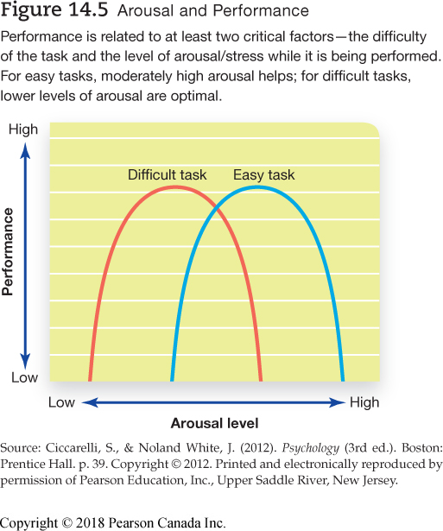
Stress and Performance
Notes:
1) Some level of stress can be helpful.
i) Without some stress, our motivation to perform can decline.
ii) However, too much stress taxes cognitive resources, resulting in poorer performance in certain situations.
a) Generally, higher levels of arousal facilitate solving relatively simple problems, while complex tasks are better performed under lower levels of arousal (Figure 14.4).
2) Importantly, the stress levels associated with these graphs are not the same for everyone. Some people seem to thrive under intense stress while others do not. It appears that almost everyone has an individual zone of optimal functioning.
Individual zone of optimal functioning (IZOF) (p. 543): a range of emotional intensity in which he or she is most likely to perform at his or her best.
Long Description:
The x-axis of the chart shows “Arousal” levels. Its values range from “Low” to “High.” The y-axis shows “Performance.” Its values also range from “Low” to “High.” The chart shows two inverted “U” shaped curves labelled “Difficult task” and “Easy task.” The curves are of the same size and overlap. The “Difficult task” curve is to the left of the “Easy task” curve. Both curves start and end on the x-axis.

Slide 26
Physiology of Stress
Fight-or-flight response (p. 543)
General adaptation syndrome (GAS) (p. 543)
Alarm reaction
Resistance
Exhaustion
Notes:
1) We tend to have a general response to stress, regardless of the type of stress.
i) Walter Cannon described this as a fight-or-flight response.
Fight-or-flight response (p. 543) is a set of physiological changes that occur in response to psychological or physical threats.
2) Hans Selye looked beyond the immediate fight-or-flight response and saw a larger pattern of responding to stress he termed GAS (Figure 14.5).
General adaptation syndrome (GAS) (p. 543) is a theory of stress responses involving stages of alarm, resistance, and exhaustion.
i) A stressful event (e.g., a shock if you are an animal, a quiz if you are a student) elicits an alarm reaction.
a) Alarm consists of your recognition of the threat and the physiological reactions that accompany it.
ii) The second part of the adaptive response, resistance, occurs as the stressful event continues.
a) This is characterized by coping with the event (freezing for the rat, and for you gathering your thoughts and mentally preparing for the quiz).
iii) The final stage of GAS is exhaustion.
a) The experience depletes your physical resources and your physiological response declines.

Slide 27
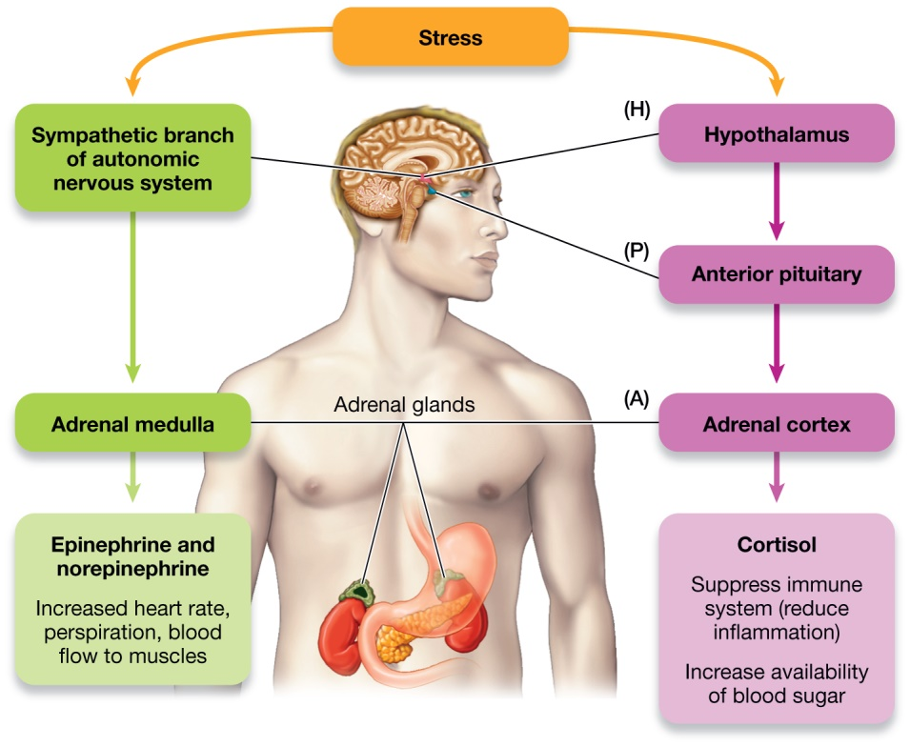
The Stress Pathways
Figure 14.6 Stress Pathways of the Body
The stress pathways of the body include the autonomic nervous system and the HPA axis. Both systems converge on the adrenal glands. The autonomic response involves stimulation of the adrenal medulla by the sympathetic nervous system, resulting in the release of epinephrine and norepinephrine—chemicals that stimulate the fight-or-flight response. Activity of the HPA axis results in stimulation of the adrenal cortex, which releases cortisol into the bloodstream.
Notes:
1) The sensations of stress (e.g., racing heart, sweaty palms, stomach in knots) are the result of activity in the autonomic pathway, which originates in the brain and extends to the body where you feel stress the most.
i) The nervous system consists of the central nervous system (brain and spinal cord) and the peripheral nervous system, which includes the autonomic nervous system (Module 3.3).
ii) In response to stress, the hypothalamus stimulates the sympathetic nervous system, which then causes the adrenal glands to release epinephrine and norepinephrine, which then trigger bodily changes associated with the fight-or-flight response (Figure 14.6).
2) Another physiological system involved in the stress response is the HPA axis.
Hypothalamic-pituitary-adrenal (HPA) axis (p. 545) a neural and endocrine circuit that provides communication between the nervous system (the hypothalamus) and the endocrine system (pituitary and adrenal glands).
i) The sympathetic nervous system (through the release of epinephrine and norepinephrine) and the HPA axis (through the release of cortisol) function to prepare us to respond to stress.
a) When you perceive that you are in a stressful situation, the hypothalamus releases a substance called corticotrophin-releasing factor, which stimulates the pituitary gland to release adrenocorticotrophic hormone.
b) This hormone in turn stimulates the release of cortisol.
c) Cortisol may stimulate increased energy stores or lead to decreased inflammation.
Cortisol (p. 545) is a hormone secreted by the adrenal cortex that prepares the body to respond to stressful circumstances.
Long Description:
The illustration shows two pathways, autonomic nervous system and the “HPA” axis.
HPA Axis
Stress is shown to affect the hypothalamus (H) and the anterior pituitary (P) in the brain. It then affects the adrenal cortex (A) in the adrenal glands which releases cortisol. A note reads “Suppress immune system (reduce inflammation); Increase availability of blood sugar.”
Autonomic nervous system
Stress is shown to affect the sympathetic branch of the autonomic nervous system in the brain. It then affects the adrenal medulla in the adrenal glands which releases epinephrine and norepinephrine. A note reads “Increased heart rate, perspiration, blood flow to muscles.”

Slide 28
Oxytocin: To Tend and Befriend
Tend-and-befriend response
Oxytocin (p. 595)
More women than men
Notes:
1) Sometimes stress leads people to seek close contact and social support.
i) This phenomenon is called the tend-and-befriend response.
a) This reaction may be promoted by the release of oxytocin.
Oxytocin (p. 545) is a stress-sensitive hormone that is typically associated with maternal bonding and social relationships.
2) Oxytocin influences social bonding in both males and females, but women seem to rely more on this adaptation to cope with stress.
i) From an evolutionary standpoint, the responsibility to avoid harm and protect and care for offspring under stressful circumstances has survival advantages over fighting or running away.

Slide 29
Working the Scientific Literacy Model: Hormones, Relationships and Health (1 of 3)
What do we know about hormones, relationships and health?
Social events and relationships can bring joy, but also be very stressful
Oxytocin and vasopressin
How can scientists explains connections between hormones, relationships and health?
Notes:
1) What do we know about hormones, relationships and health?
i) Weddings, holidays, and family reunions can bring great joy, but can also be very stressful.
ii) Friendships and romantic relationships can also bring negative stress when there is conflict or when individuals feel misunderstood or disregarded.
a) This stress can affect performance at work or school as well as how the body responds to illness or injury.
iii) Two hormones, oxytocin and vasopressin, are involved in social behaviour and bonding.
a) Oxytocin is a stress-sensitive hormone that is typically associated with maternal bonding and social relationships (as discussed above).
b) People with high vasopressin levels also tend to report better relationship quality with their spouses.
c) Both hormones also interact with the immune system to reduce inflammation.
2) How can scientists explain connections between hormones, relationships and health?
i) A common way for measuring immunity and health is to see how quickly people recover from a minor wound.
ii) In one study, the effect of marital stress on wound healing was tested in a group of 37 married couples.
a) Each couple was asked to sit alone together and complete a series of marital interaction tasks, including a discussion of the history of their marriage and a task in which both spouses were instructed to discuss something they wished to change about themselves.
b) These interactions were videotaped and the researchers also took blood draws to measure oxytocin and vasopressin levels.
c) Each participant was given a minor wound, a suction blister, with a medical vacuum pump.
d) Couples who engaged their partner with positive responses (e.g., acceptance and support) had higher levels of oxytocin and vasopressin (see Figure 14.7).
e) Those who responded with hostility, withdrawal, and distress had lower levels.
f) In addition, the suction blister wounds healed more quickly over an 8-day period in individuals with high oxytocin and vasopressin levels.
iii) In another experiment, married couples were given either an intranasal solution of oxytocin or a placebo.
a) The couples then engaged in discussion about conflict within their marriage.
b) Those who received the oxytocin showed more positive, constructive behaviour.
c) Cortisol levels from saliva samples indicated that those in the oxytocin group had lower levels of this stress hormone.

Slide 30
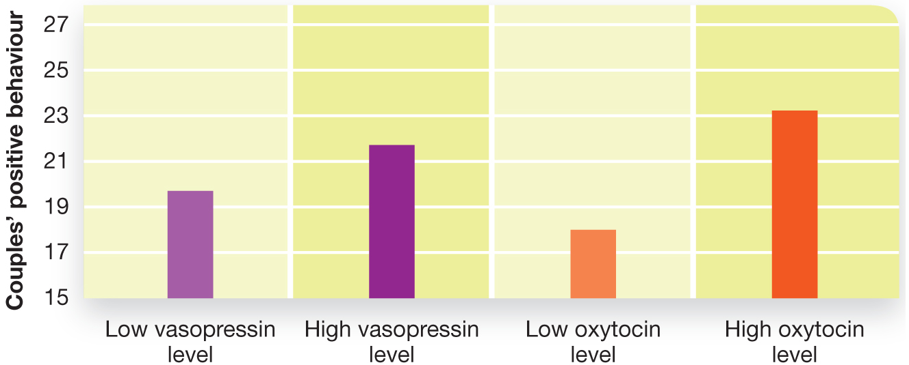
Working the Scientific Literacy Model: Hormones, Relationships and Health (2 of 3)
Figure 14.7 Relationship Quality Is Related to Physiological Responses
Higher oxytocin and vasopressin levels are associated with positive social interactions between married couples.
SOURCE: Republished with permission of Elsevier Science, Inc., from Gouin, J.-P., Carter, C. S.,Pournajafi-Nazarloo, H., Glaser, R., Malarkey, W. B., Loving, T. J., et al. (2010). Marital behavior, oxytocin, vasopressin, and wound healing. Psychoneuroendocrinology, 35(7):1082–1090. Permission conveyed through Copyright Clearance Center, Inc
Notes:
1) What do we know about hormones, relationships and health?
i) Weddings, holidays, and family reunions can bring great joy, but can also be very stressful.
ii) Friendships and romantic relationships can also bring negative stress when there is conflict or when individuals feel misunderstood or disregarded.
a) This stress can affect performance at work or school as well as how the body responds to illness or injury.
iii) Two hormones, oxytocin and vasopressin, are involved in social behaviour and bonding.
a) Oxytocin is a stress-sensitive hormone that is typically associated with maternal bonding and social relationships (as discussed above).
b) People with high vasopressin levels also tend to report better relationship quality with their spouses.
c) Both hormones also interact with the immune system to reduce inflammation.
2) How can scientists explain connections between hormones, relationships and health?
i) A common way for measuring immunity and health is to see how quickly people recover from a minor wound.
ii) In one study, the effect of marital stress on wound healing was tested in a group of 37 married couples.
a) Each couple was asked to sit alone together and complete a series of marital interaction tasks, including a discussion of the history of their marriage and a task in which both spouses were instructed to discuss something they wished to change about themselves.
b) These interactions were videotaped and the researchers also took blood draws to measure oxytocin and vasopressin levels.
c) Each participant was given a minor wound, a suction blister, with a medical vacuum pump.
d) Couples who engaged their partner with positive responses (e.g., acceptance and support) had higher levels of oxytocin and vasopressin (see Figure 14.7).
e) Those who responded with hostility, withdrawal, and distress had lower levels.
f) In addition, the suction blister wounds healed more quickly over an 8-day period in individuals with high oxytocin and vasopressin levels.
iii) In another experiment, married couples were given either an intranasal solution of oxytocin or a placebo.
a) The couples then engaged in discussion about conflict within their marriage.
b) Those who received the oxytocin showed more positive, constructive behaviour.
c) Cortisol levels from saliva samples indicated that those in the oxytocin group had lower levels of this stress hormone.
Long Description:
The chart shows the categories of “Low” and “High” levels on the x-axis and the performance scores on the y-axis. The approximate scores for various levels are as follows.
Vasopressin levels
Low: 19.5
High: 21.5
Oxytocin levels
Low: 18
High: 23

Slide 31
Working the Scientific Literacy Model: Hormones, Relationships and Health (3 of 3)
Can we critically evaluate this evidence?
Need better understanding of oxytocin and vasopressin
Why is this relevant?
Psychological stress involved with healing
Notes:
1) Can we critically evaluate this evidence?
i) We must be careful to avoid oversimplifying what these results mean.
ii) Scientists are still in the early stages of learning how oxytocin and vasopressin affect social behaviour in humans and how they relate to immune function.
a) We should not go out and buy homeopathic oxytocin remedies that claim to make us better in love, marriage, sex and so on.
2) Why is this relevant?
i) Current procedures for healing physical injury focus on repair to damaged areas and preventing infection.
a) It appears that managing psychological stress is also important for facilitating recovery from wounds.

Slide 32
Stress, Immunity, and Illness
Psychoneuroimmunology (p. 547)
Final exams and illness
Notes:
1) The immune system, which is responsible for protecting the body against infectious disease, has numerous connections with the nervous system, including the stress response.
Psychoneuroimmunology (p. 547) is the study of the relationship between immune system and nervous system functioning.
i) For example, many students get sick during or shortly after final exams.
a) In one study, medical students provided blood samples during the term and again during the final exam period.
b) Analysis of these blood samples showed reduced immune responses during the high-stress period at the end of the term.

Slide 33
Stress, Personality, and Heart Disease
Coronary heart disease (p. 547)
Chronic stress
Damage to arteries
Trigger inflammation
Stress increases inflammation
Type A and Type B personalities (p. 548)
Hostility and anger
Anxiety and depression
Notes:
1) High stress levels appear to put people at greater risk for developing coronary heart disease.
Coronary heart disease (p. 547) is a condition in which plaques form in the blood vessels that supply the heart with blood and oxygen, resulting in restricted blood flow.
i) One study followed 12,000 healthy males over nine years and found those who experienced chronic stress with family or work were 30% more likely to die from coronary heart disease.
2) Coronary heart disease begins when injury and infection damage the arteries of the heart.
i) This damage triggers the inflammatory response by the immune system—white blood cells travel to affected areas in an attempt to repair the damaged tissue.
a) Stress causes an increased release of those molecules that cause the inflammation.
ii) These cells gather cholesterol and form dangerous plaques, which can rupture, break off, and block blood flow.
3) Our stress responses are affected by our personalities. Cardiologists—Meyer Friedman and Ray Rosenman—who were conducting an eight-and-a-half year study of cardiovascular health, found that people who were prone to stress had poorer physical health. Importantly, a subset of these patients also had a particular group of personality traits that the researchers labeled as Type A.
Type A personality (p. 548) describes people who tend to be impatient and worry about time, and are easily angered, competitive, and highly motivated.
Type B personality (p. 548) describes people who are more laid back and characterized by a patient, easygoing, and relaxed disposition.
i) Studies revealed that people who fall in the Type A category are far more likely to have heart attacks than are Type B people.
ii) Some behavioural scientists and physicians believe that more specific qualities of one’s personality increase risks of health problems.
a) For example, people who are prone to hostility and anger are at greater risk for developing coronary heart disease.
b) Other personality characteristics linked to coronary heart disease include anxiety and depression.

Slide 34
Stress, Food, and Drugs
Preference for sweet and fatty foods when stressed
Link to cortisol
Other species
Dopamine reward system
Anticipatory?
Notes:
1) Research suggests people are drawn toward sweet and fatty foods when they are stressed.
i) In one experiment, female participants were given stress-inducing tasks to complete including solving a visuospatial puzzle, performing math calculations, and giving a speech in front of what they thought was an audience seated behind a one-way mirror. The women who had the highest levels of the stress hormone cortisol ate more sweet, high-fat snacks than did the less-stressed women.
ii) The relationship between stress and unhealthy food extends to other species as well. Low-status females in a colony of monkeys are often bullied and harassed by high-status females; researchers have noted that the low-status females ate more banana-flavoured pellets than their social superiors.
2) Why do some people (and monkeys) use food and drugs to deal with stress?
i) Although it is possible that these substances directly affect the hormones and brain areas associated with stress, most scientists agree that food (and drugs) influence the brain’s dopamine reward system (see Modules 5.3 and 6.2). Some research suggests that chronic stress suppresses the reward system (so stressed people would find less joy in things). It is possible that eating rewarding foods increases the activity in this system so that it is closer to normal levels.
ii) Additionally, as discussed in Module 11.1, people who are stressed are mobilizing the body’s resources in case action is required; eating fatty and sugary foods provides the body with extra calories in anticipation of the person having to use additional energy to deal with a stressor.

Slide 35
Stress, the Brain, and Disease
Acquired-immune deficiency syndrome (AIDS)
Stress impedes medicine
Can worsen conditions
Cancer
Stress affects progression
Notes:
AIDS
1) Acquired-immune deficiency syndrome (AIDS) is a disease caused by infection with the human immunodeficiency virus (HIV).
i) This disease saps the immunes system’s ability to fight off infections.
a) Even conditions that are relatively harmless to most of the population can be devastating to an individual with AIDS.
ii) Those living in industrialized countries with more medical options have a better prognosis than those living in impoverished areas.
a) Retroviral therapies have greatly increased longevity, health, and overall quality of life of patients.
b) However, people who are HIV positive need regular vaccination treatments.
c) Unfortunately, stress impedes the body’s ability to respond to vaccinations, making treatments less effective for those experiencing serious emotional distress.
iii) Stress-induced elevation of norepinephrine can also worsen the condition of the various illnesses associated with AIDS.
a) Patients who have elevated activity of the autonomic nervous system are slower to respond to antiretroviral therapies.
b) This increases their risks of developing certain types of cancer.
Cancer
1) Stress levels affect the progression of cancer.
i) The autonomic nervous system and HPA axis naturally respond to stress, but their reactions compromise who well an individual can fight cancer.
ii) It appears that norepinephrine supports cancer cell growth, and that cortisol magnifies this effect.
a) Hormones from the autonomic nervous system stimulate cells that reside in tumors, which ultimately results in these masses’ growth and proliferation.
iii) Managing one’s stress through assertiveness training and anger management has shown to reduce autonomic activity and hormonal activity associated with the HPA axis.
iv) Greater immune response can also be influenced by an optimistic outlook, coping by using humour, and having a positive outlook on the disease.

Slide 36
MYTHS IN MIND: Stress and Ulcers
Most ulcers caused by
Bacterium called Helicobacter pylori
Stress worsens symptoms
Slows healing
Notes:
1) There is a myth that those under extreme stress, such as police officers or air traffic controllers, develop ulcers.
i) These are open sores in the lining of the esophagus, stomach, and small intestine.
2) In actuality, most ulcers are caused by a bacterium, Helicobacter pylori, which can cause inflammation of the lining of various regions of the digestive tract.
i) This bacteria is rather common, and 10% to 15% of people exposed to it will develop an ulcer resulting from inflammation.
3) Thus, stress does not cause ulcers, but it can worsen the symptoms and slow healing.
i) Smoking, alcohol, pain relievers and a poor diet—anything that can irritate the digestive system—also increases problems associated with ulcers.
a) These factors are also related to stress.

Slide 37
14.3 Learning Objectives
Know the key terminology associated with coping and well-being.
Understand how control over the environment influences coping and outlook.
Understand positive and negative styles of coping.
Apply your knowledge of the beneficial effects of optimism to help you reframe stressful situations as positive opportunities.
Analyze whether activities such as relaxation techniques and meditation actually help people cope with stress and problems.
Notes:
Know the key terminology associated with coping and well-being.
See the bold, italicized terms below.
Understand how control over the environment influences coping and outlook.
Psychologists have discovered that people (and dogs) become more willing to allow unpleasant events to occur if they are exposed to a pattern of learning that their behaviour brings no change. Having at least some degree of control helps people with coping and outlook. When control is threatened, people use compensatory responses, such as detecting order within random images.
Understand positive and negative styles of coping.
Whether someone copes using a positive or negative style is related to personality (e.g., optimism versus pessimism). Positive coping includes the concept of resilience—the ability to recover from adversity, and even benefit from the experience, as is the case with post-traumatic growth. Coping via negative affectivity and pessimism can have both psychological and physiological disadvantages.
Apply your knowledge of the beneficial effects of optimism to help you reframe stressful situations as positive opportunities.
Analyze whether activities such as relaxation techniques and meditation actually help people cope with stress and problems.
Meditation and other relaxation methods have been found to be quite effective in reducing stress. Meditation has also shown to be effective in reducing blood pressure, which, in turn, reduces the potential for long-term problems with hypertension and cardiovascular disease. Although some training and practice may be necessary, these techniques are by no means inaccessible.

Slide 38
Coping
Coping (p. 552)
Coping approaches
Problem-focused
Emotion-focused
Notes:
Coping (p. 552) refers to the processes used to manage demands, stress, and conflict.
1) The type of coping approach we use will most likely depend on the situation.
i) For example, we might take a problem-focused coping approach to deal with our massive amounts of debt or use emotion-focused coping to deal with a loss of a loved one.
a) However, the two methods are also often combined.

Slide 39
Positive Coping Strategies
Positive psychology (p. 552)
Effects of positive emotions
Broaden attention
Autonomic nervous system
Notes:
1) One field of psychology focuses on what makes people thrive, even in the face of extreme stress.
Positive psychology (p. 552) uses scientific methods to study human strengths and potential.
2) Effects of positive emotions:
i) Researchers have shown that a negative mood narrows your focus of attention so that you attend to a small part of your environment, whereas positive moods cause the focus of your attention to expand.
ii) Researchers have found that when participants watched positive films after seeing a scary movie clip, their heart rate returned to normal faster than when participants viewed a sad or neutral film.

Slide 40
Optimism and Pessimism
Optimism (p. 552)
Pessimism (p. 552-553)
Pessimistic explanatory style (p. 553)
Negative affectivity (p. 553)
Correlations with health
Notes:
1) Optimism (p. 552), is the tendency to have a favourable, constructive view on situations and to expect positive outcomes. People who are optimistic tend to initially perceive situations in a positive way and are also more likely to find positive elements in situations.
2) In contrast, pessimism (p. 552-553) is the tendency to have a negative perception of life and expect negative outcomes. These individuals often have what is known as:
i) A pessimistic explanatory style (p. 553), which is the tendency to interpret and explain negative events as internally based (i.e., as being due to that person rather than to an external situation) and as a constant, stable quality.
ii) Pessimism is also often linked with negative affectivity (p. 553), the tendency to respond to problems with a pattern of anxiety, hostility, anger, guilt, or nervousness.
3) Optimism is correlated with better physical health than pessimism.
i) For example, scientists have shown that women who tend toward pessimism and test positive for the HPV virus (a papilloma virus known to cause cervical
cancer) have lower counts of white blood cells that fight disease than do optimistic women with the HPV virus.
ii) Long-term studies show similar effects of optimism. In the U.S. Veterans Affairs Normative Aging Study involving a large cohort of male participants, optimists had a lower incidence of coronary heart disease than did pessimists. Similarly, researchers at the Mayo Clinic administered personality tests assessing optimism and pessimism to patients who came into the clinic for general medical issues during the 1960s. Thirty years later, the data on optimism and pessimism were compared to
patient survival. The researchers found a 19% increase in mortality risk in people who were consistently pessimistic.
iii) There is, however, an alternative explanation for the results: Optimists and pessimists may simply have had different lifestyles (e.g., diet).

Slide 41
Resilience
Resilience (p. 554)
Viktor Frankl
Post-traumatic growth (p. 554)
Notes:
1) Resilience (p. 554) refers to the ability to effectively recover from illness or adversity.
2) One amazing example is that of Viktor Frankl, an early- and mid-20th-century Austrian psychiatrist. Frankl was already an influential physician and therapist when he, his wife, and family were forced into concentration camps during World War II. Frankl found himself in the role of helping people adjust to life in the concentration camp, even while he himself struggled to survive each day. He encouraged others to tap into whatever psychological re-sources they had left to cope with very bleak circumstances. Frankl found that one of the most critical parts of surviving in these camps was finding some sort of meaning in life. For some, this could be the desire to reunite with their family when the war eventually ended. For others, it was a love of poetry (astoundingly, some prisoners were able to write poetry in Auschwitz). But, if a prisoner seemed to lose this sense of meaningfulness in his life, Frankl could tell that this prisoner would soon die. As Frankl later noted, "Despair equals Suffering minus Meaning”.
3) Psychologists have long focused on the negative outcomes of stress, but stories such as Frankl’s demonstrate that stress and trauma can also lead people to recognize how strong they really are. In fact, psychologists describe the phenomenon of post-traumatic growth (p. 554), the capacity to grow and experience long-term positive effects in response to negative events.

Slide 42
Meditation and Relaxation
Meditation (p. 554)
Focused attention/open-monitoring
Mindfulness-based stress reduction (p. 555)
Integrated mind-body training
Notes:
1) Relaxation and meditation techniques are designed to calm emotional responses as well as physiological reactions to stress.
Meditation (p. 554) is any procedure that involves a shift in consciousness to a state in which an individual is highly focused, aware, and in control of mental processes.
i) Meditation comes in two general varieties:
a) Using a technique known as focused attention (FA) meditation, the individual focuses his or her attention on a chosen object, such as a point on the wall or a physical sensation like the feeling related to breathing. When distracting or negative thoughts enter into one’s awareness and interfere with meditation, people are taught to accept these thoughts in a nonjudgmental manner, and to then nudge their attention back to its original focus.
b) A second type of meditation is open monitoring (OM) meditation. This technique also uses focused attention to train the mind and to reduce the influence of distractions. After initial training with FA, people can transition into the use of OM styles of meditating. Here, meditators pay attention to moment-by-moment sensations without focusing on any particular object. A key feature of OM is to attempt to experience each sensation intensely, examining its rich sensory properties and emotional characteristics in great depth; however, these sensations should not become the sole focus of attention, preventing the meditator from responding to other sensations.
ii) Research suggests that meditation is very effective in reducing blood pressure.
a.) This, in turn, reduces the potential for long-term problems with hypertension and cardiovascular disease.
iii) Mindfulness-based stress reduction (MBSR) (p. 555) is a structured relaxation program based on elements of mindfulness meditation. The primary goal of MBSR is to help people to cope and to relax by increasing the link between one's body and one's mind.
2) A complex form of meditation called integrated mind-body training was developed from traditional Chinese medicine and studied with brain scans.
i) This method involves bodily interaction with thinking and emotion.
ii) Brain scans on students practicing this technique showed students’ increased ability to control bodily physiology.
a) A region of the mid-frontal cortex called the anterior cingulate was particularly relevant, as it was involved with various aspects of processing reward and emotion.
b) Activity within the anterior cingulate was associated with the participants’ increased control over parasympathetic nervous system responses.
c) This accounts for the heightened sense of relaxation experienced while meditating versus just using simple relaxation techniques.

Slide 43
PSYCH @ Church
Religious practice and life expectancy
Correlational
Many explanations
Coping and well-being
Notes:
1) Numerous studies have found that people who are very religious and are actively engaged with religious practices do live a bit longer than do people who are less religious or nonreligious.
i) This includes any combination of religious practices, depending on the specific nature of the faith: prayer, meditation, religious counseling, and social support from family and congregations.
2) However, these results are only correlational, and therefore we must consider alternative results.
i) For example, increased longevity is probably related to the greater self-control and self-regulation that are characteristic of many religious belief systems.
a) Many religions also tend to have negative views on criminal activity, drug abuse, and risky sexual behaviour.
3) How one uses religion to cope also affects well-being.
i) Those who use positive aspects of religion tend to show greater well-being and lower levels of depression.
a) This includes viewing stressors with benevolence or collaborating with others in solving problems.
ii) Those who adopt negative appraisals of their problems tend to have higher levels of depression.
a) They might believe their problems are a result of God’s punishment.

Slide 44
Exercise
Short-term effects on cognition
Brain-derived neurotrophic factor (BDNF) (p. 557)
Cardiovascular exercise
Long-term effects
Notes:
1) There are obvious physiological benefits to exercise; furthermore, exercise has short-term benefits on mental function.
i) For example, researchers in Germany asked college student participants either to do all-out sprints, to jog, or to do nothing.
a) Those who sprinted were able to learn 20% more items on a vocabulary list.
b) Participants were randomly assigned, so the difference is most likely due to a physiological process associated with the intense exercise.
c) The researchers discovered that the students who did intense exercising had increased levels of dopamine, epinephrine, and brain-derived neurotrophic factor (BDNF).
Brain-derived neurotrophic factor (BDNF) (p. 557) is a protein in the nervous system that promotes survival, growth, and formation of new synapses.
ii) Additional studies on college students also show that cardiovascular exercise provides immediate benefits in cognitive processing speed.
a) However, sedentary adults between 60 and 85 years of age show improved brain functioning and cognitive performance when they take up a weekly exercise program.
2) Exercise has also been shown to have long-term effects on cognitive functioning.
i) Findings from long-term studies indicate that a lifestyle that includes regular exercise helps preserve cognitive function and brain systems.
ii) People who are at genetic risk for developing Alzheimer’s disease and who show cognitive impairments can slow the rate of memory decline by exercising.
iii) Along with increasing levels of BDNF, exercise also supports the development of new nerve cells in the hippocampus, a critical area for memory and cognitive activity.

Slide 45
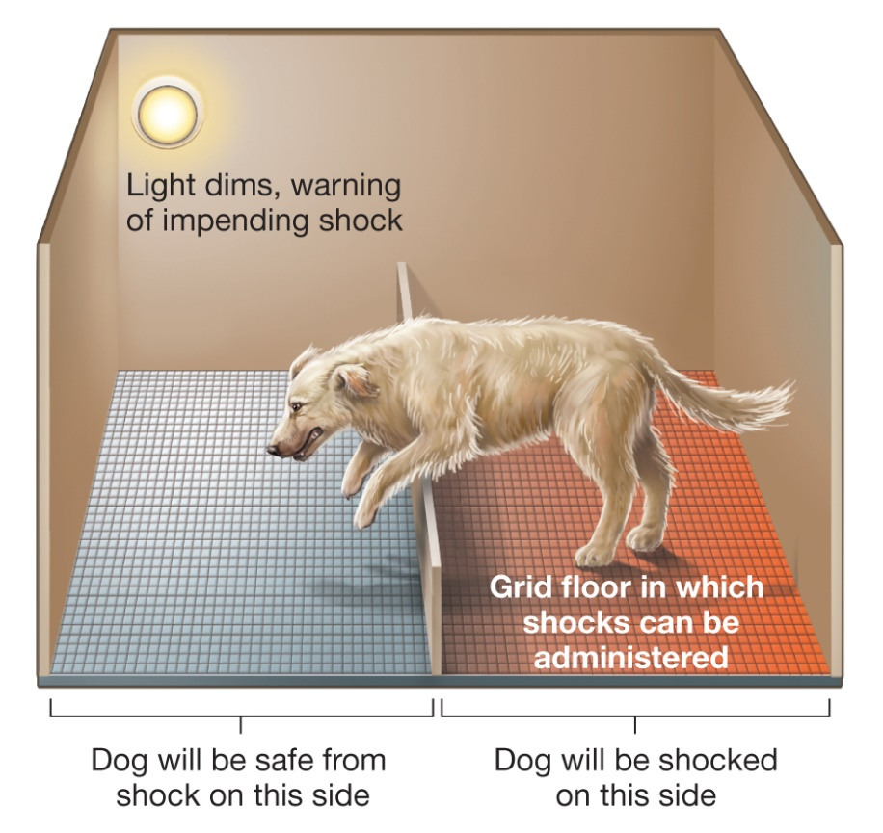
Perceived Control
Figure 14.9 The Learned Helplessness Procedure
In Seligman and Maier’s study, dogs that could avoid a painful shock would quickly learn to do so. Conversely, dogs that initially learned they could not avoid a shock remained passive when the opportunity to do so was given. The acquired failure to avoid or escape unpleasant circumstances that are perceived as uncontrollable is referred to as learned helplessness.
Notes:
1) To attempt to explain why and how people differ, psychologists Richard Lazarus and Susan Folkman developed a cognitive appraisal theory of stress (Figure 14.3).
i) Here, the term appraisal (p. 541) refers to the cognitive act of assessing and evaluating the potential threat and demands of an event. These appraisals occur in two steps.
a) First, the individual perceives a potential threat and begins the primary appraisal by asking herself, “Is this a threat?” Threats can be physical (e.g., someone trying to harm you) or psychosocial (e.g., trying to study for two exams on the same day or trying to deal with interpersonal conflicts). If the answer is no, then she will not experience any stress. But, if the answer is yes, she will experience a physiological stress reaction (perhaps a racing heart beat and sweaty palms) as well as an emotional reaction (perhaps anxiety and fear).
b) As these events unfold, the secondary appraisal begins—she must determine how to cope with the threat. During the secondary appraisal, she may determine that she knows how to cope with the stressor (e.g., studying for the exams over the course of several days); in this case, she will not feel much stress. However, if she believes that the stressor goes beyond her ability to cope, the physiological and emotional reactions to the stress will continue.
Long Description:
The figure shows a dog in a kennel. The kennel has a light. A note reads “Light dims, warning of impending shock.” The kennel floor is divided into 2 equal areas. One area has a grid. A note reads “Grid floor in which shocks can be administered.” A note on the side on which the grid is present reads “Dog will be shocked on this side.” A note on the other side reads “Dog will be safe from shock on this side.” A low-height partition separates the two sides. The illustration shows a dog jumping across the partition from the side where there is a grid to the other side.

Slide 46
Working Scientific Literacy Model: Compensatory Control and Health (1 of 3)
What do we know about how people cope with seemingly random events?
Randomness can create anxiety
Compensatory control (p. 558)
How can scientists explain compensatory control?
Notes:
1) What do we know about how people cope with seemingly random events?
i) The idea that randomness dictates worldly events can create anxiety in people.
a) Even those who believe that randomness is the rule might still try to find the meaning of life, as if events are determined by the will of individuals or God.
b) In other words, they try to give a sense of order to the randomness.
Compensatory control (p. 558) involves psychological strategies people use to preserve a sense of non-random order when personal control is compromised.
ii) For example, people who are skeptical of any divine purpose in the world may change their view in the wake of personal or societal tragedy.
2) How can scientists explain compensatory control?
i) It appears that when people feel that their sense of control is undermined, they compensate by heightening their search for structure in the world, to the point of calling upon their imagination.
a) For example, people become increasingly willing to believe in superstitious rituals and to endorse conspiracy theories when their sense of control is diminished.
ii) One study had participants identify which symbol on a screen correctly represented the concept the computer had chosen (e.g., colour of the symbol, its shape, etc.).
a) The computer provided correct feedback for half of the participants and random feedback for others (sometimes told them they were right when wrong and vice versa).
b) As expected, the participants in the random condition reported a lower sense of control.
c) Next, participants viewed pictures in which one had a hidden image of a horse and the other did not (Figure 14.10).
d) Participants in both conditions reported seeing faintly drawn figures, such as the horse; however, those who reported lowered self-control were more likely to report seeing patterns within completely random images.

Slide 47
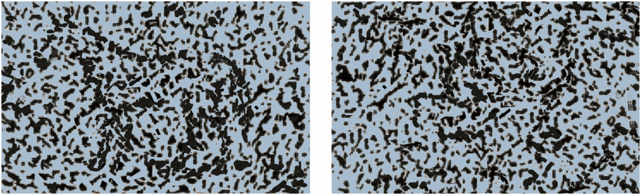
Working Scientific Literacy Model: Compensatory Control and Health (2 of 3)
Figure 14.10 Seeing Images Where There Are None
Do you see a figure in the image on the left? You may see a figure resembling a horse. What about on the right? There is no discernible image intended for this image. Psychologists have found that individuals who feel as though they lack control are more likely to detect patterns in the image at right than are people who feel a greater sense of control (Whitson & Galinsky, 2008).
Notes:
1) What do we know about how people cope with seemingly random events?
i) The idea that randomness dictates worldly events can create anxiety in people.
a) Even those who believe that randomness is the rule might still try to find the meaning of life, as if events are determined by the will of individuals or God.
b) In other words, they try to give a sense of order to the randomness.
Compensatory control (p. 558) involves psychological strategies people use to preserve a sense of non-random order when personal control is compromised.
ii) For example, people who are skeptical of any divine purpose in the world may change their view in the wake of personal or societal tragedy.
2) How can scientists explain compensatory control?
i) It appears that when people feel that their sense of control is undermined, they compensate by heightening their search for structure in the world, to the point of calling upon their imagination.
a) For example, people become increasingly willing to believe in superstitious rituals and to endorse conspiracy theories when their sense of control is diminished.
ii) One study had participants identify which symbol on a screen correctly represented the concept the computer had chosen (e.g., colour of the symbol, its shape, etc.).
a) The computer provided correct feedback for half of the participants and random feedback for others (sometimes told them they were right when wrong and vice versa).
b) As expected, the participants in the random condition reported a lower sense of control.
c) Next, participants viewed pictures in which one had a hidden image of a horse and the other did not (Figure 14.10).
d) Participants in both conditions reported seeing faintly drawn figures, such as the horse; however, those who reported lowered self-control were more likely to report seeing patterns within completely random images.

Slide 48
Working Scientific Literacy Model: Compensatory Control and Health (3 of 3)
Can we critically evaluate this evidence?
Real-world lack of control has greater consequences
Why is this relevant?
Sense of control affects outlook on world and affects well-being
OCD
Notes:
1) Can we critically evaluate this evidence?
i) Real-world lack of control (e.g., natural disaster) is obviously much different from that created in a laboratory in the previous experiment.
a) Natural disasters or a loss of a job have far greater consequences.
b) Therefore, there is a limit to the generalizability of the results.
ii) In real-world events, people are more likely to believe in a divine force, which helps buffer them from random events.
2) Why is this relevant?
i) Having a sense of control greatly affects how we think about and interpret the world, which can affect our well-being.
a) Those who believe they can predict and influence events and outcomes tend to have improved physical and mental health.
b) For example, patients about to undergo medical procedures have reduced anxiety if they are fully informed about the procedure before it occurs.
ii) People may also compensate for their lack of control by performing superstitious rituals, which can provide a sense of at least partial control over outcomes.
a) This can be seen in athletes as well as those with OCD (Module 13.3).

