Slide 1
LZW Compression
Shaun Holtzman – SHH117@pitt.edu
Travis Wise – TWW12@pitt.edu

Slide 2
Accomplishments
Wrote single-block dictionary & testbench
Wrote main controller for LZW compression
Completed decompression software
Reading compressed data from a BRAM in hardware
BRAM accessible in software using AXI-Stream

Slide 3
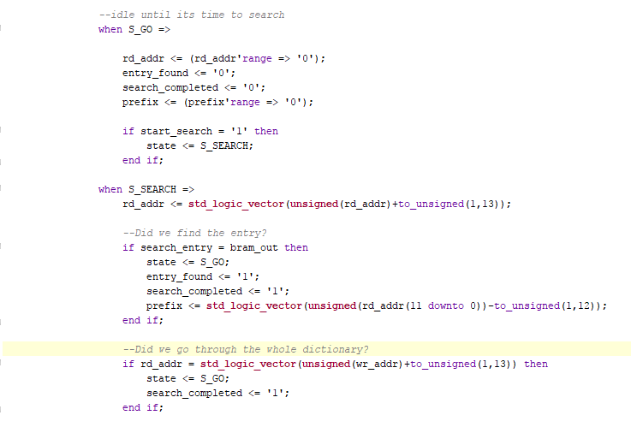
Dictionary
Searches through a 20x4096 BRAM for a specific entry
Returns the address, or prefix, of that entry
Testbench searches for all the initial entries, and creates new entries in the dictionary successfully

Slide 4
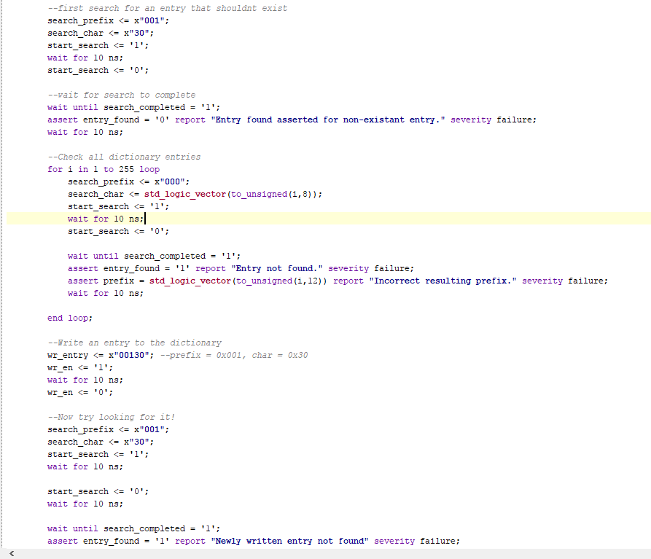
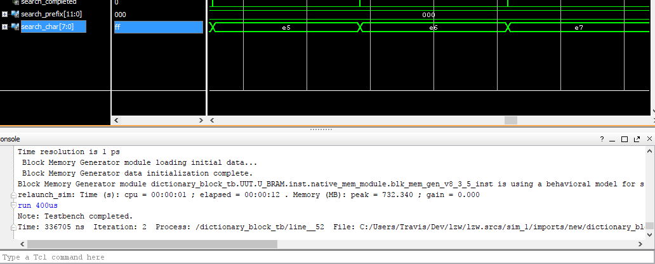
Dictionary Testbench results

Slide 5
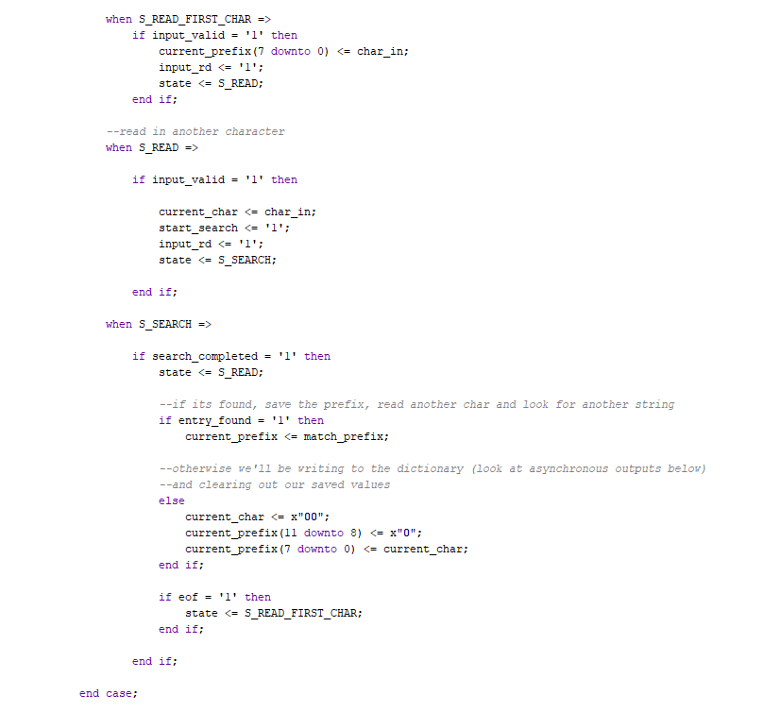
Lzw main controller
Controller orchestrates the dictionary and parses the input data
Outputs the compressed data
Testbench tests the overall design with a sample string and the result matches the software version

Slide 6
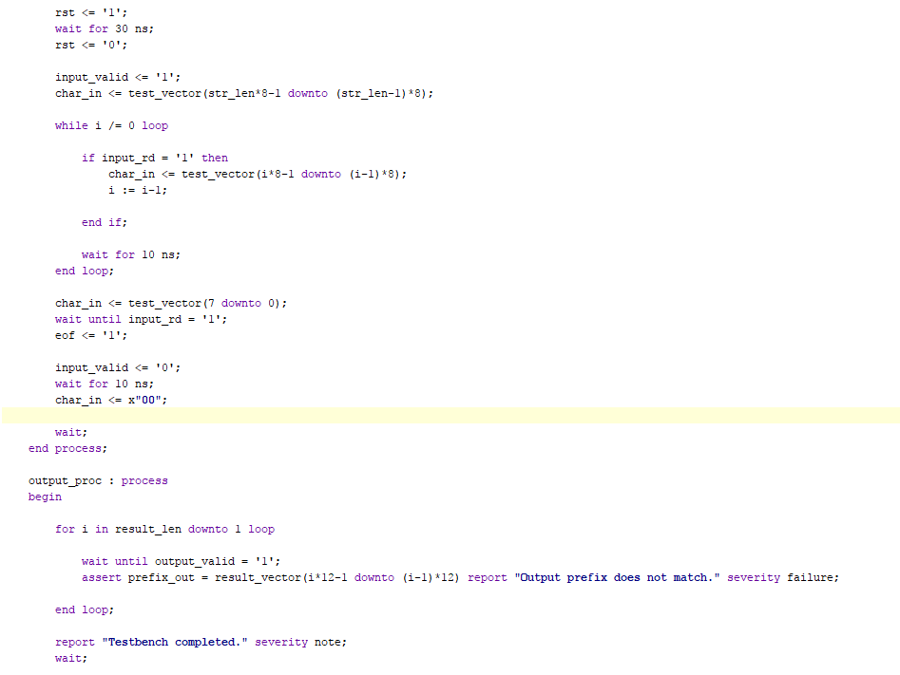
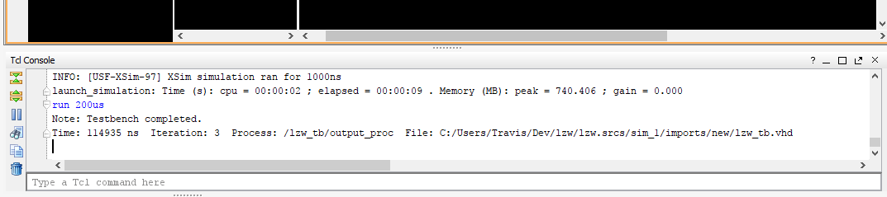
Lzw controller testbench

Slide 7
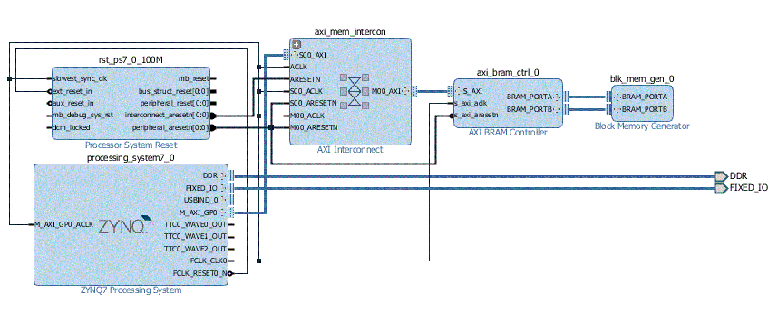
Software decompression
BRAM instantiated in hardware
Connected to processing system using AXI-Stream
Software reads in compressed data from BRAM
Currently outputs decompressed data to console

Slide 8
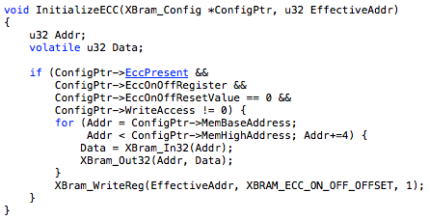
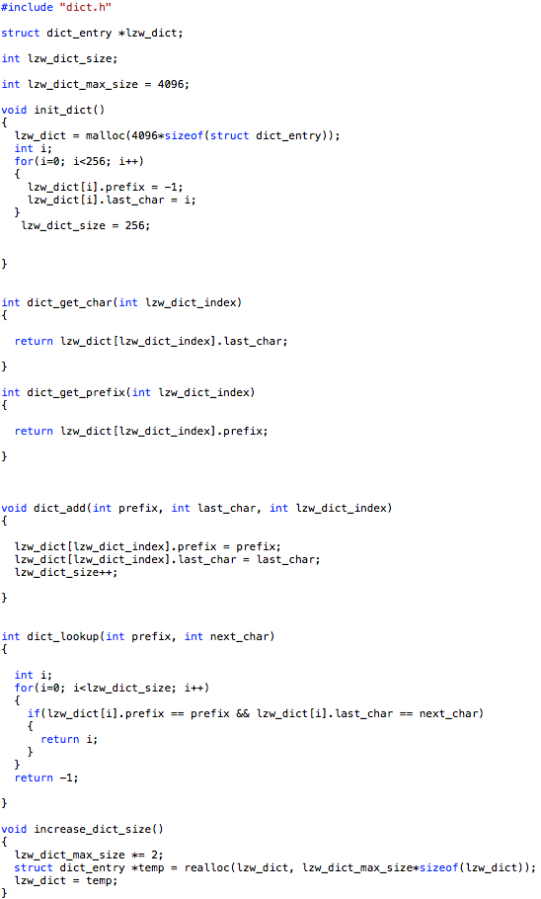
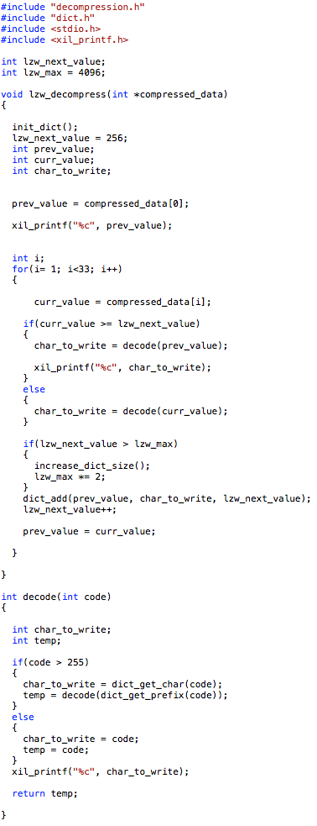
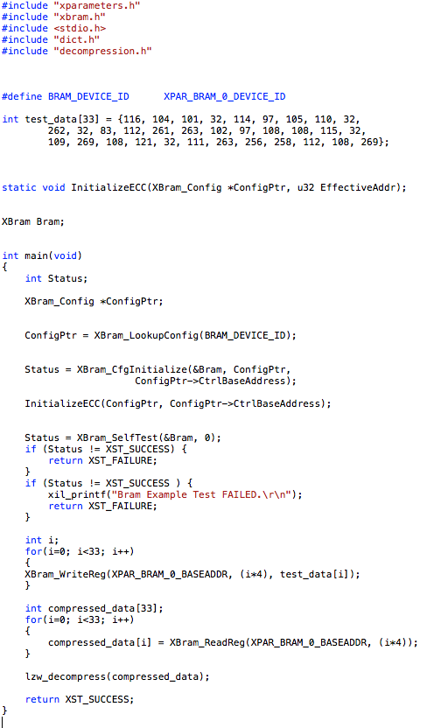
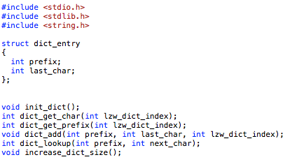
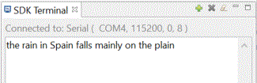
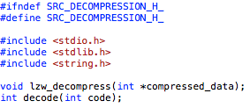
Software decompression

Slide 9
Schedule & Future Work
 |  |  |  |  | January |  |  |  | February |  |  |  | March |  |  |  | April
ID | Task | Who | Status |  | 9 | 16 | 23 | 30 | 6 | 13 | 20 | 27 | 6 | 13 | 20 | 27 | 3 | 10 | 17
1 | S/W Compression | Shaun | Done
2 | S/W Decompression | Shaun | Done
3 | Architectural H/W Design | Travis | Done
4 | Architectural S/W Design | Shaun | Done
5 | Testbench | Travis | Verified toplevel and LZW controller with testbench
6 | Dictionary HDL | Shaun | Done
7 | Toplevel HDL | Travis | Done
8 | Finalizing/Optimizing | Travis | Not started
9 | Communicate H/W Compression results with S/W | Shaun | Reading compressed data from BRAM
10 | S/W decoding on Board | Shaun | Done
11 | S/W Decompression on Board | Shaun | Done

Slide 10
Schedule & Future work
Create the hardware/software interface
Original data to be sent to h/w by the s/w for compression
Compressed data to be sent to s/w by h/w for decompression
Develop multi-block dictionary search
Optimization for faster compression speed in h/w

Slide 11
Questions?

