Slide 1
LZW Compression & Decompression
Shaun Holtzman – SHH117@pitt.edu
Travis Wise – TWW12@pitt.edu

Slide 2
Accomplishments
Wrote single-block dictionary & testbench
Wrote main controller for LZW compression
Decompression software completed
Decompressing data read from a BRAM in hardware
BRAM accessible in S/W using AXI-stream

Slide 3
Requirements Traceability Matrix
Test Cases
 |  | 1 | 2 | 3 | 4
A | Read in compressed data in S/W from H/W | Read in data from a simple BRAM to confirm H/W S/W communication | Read in data from a FIFO to more accurately match final design
B | Able to search for dictionary entries and create new entries | Search for non-existent entries to make sure there is no false-positives | Search for valid entries within BRAM | Write new entries to dictionary | Search for newly written entries
C | Decompressed data exactly matches original data | Compare initial data in S/W to the result the S/W gets by decompressing the data it reads in from the H/W compression | Make sure the decompressed data matches the initial data exactly and is of the same size
D | Able to start project from S/W | Have a simple register that waits for a signal to write a specified value and tie that signal to S/W. Send the signal from S/W and confirm the register has written the new specified value | Have signal that starts the LZW compression, write to that signal in S/W and wait for the compressed data to be available to read in from S/W
Requirements

Slide 4
Requirements Traceability Matrix
Test Cases
 |  | 1 | 2 | 3 | 4
E | Parallelize the Dictionary search | Search for non-existent entries to make sure there’s no false positives | Search for valid entries within BRAM. Check for cycle-count | Write new entries to dictionary | Search for newly written entries. Check for cycle-count reduction
F | Able to write original data to H/W from S/W to start compression | Connect a BRAM to S/W and write to it and read from it | Connect a FIFO to S/W and confirm we are able to read/write from it properly | Have LZW compression take place on data from FIFO that S/W has written the original data to
G | The compressed data is a smaller size than the original data | Compare the size of the original data | Confirm that the decompressed data matches the size of the original data
H | Compressed data from H/W matches the compressed data from our initial S/W implementation | Feed in the same input that we used for our software implementation and confirm that the compressed data matches
Requirements

Slide 5
Dictionary
Searches through a 20x4096 BRAM for a specific entry
Returns the address, or prefix, of that entry
Testbench (Requirement B)
Searches for non-existent entries to make sure there is no false-positives
Search for valid entries within BRAM
Write new entries to dictionary
Search for newly written entries

Slide 6
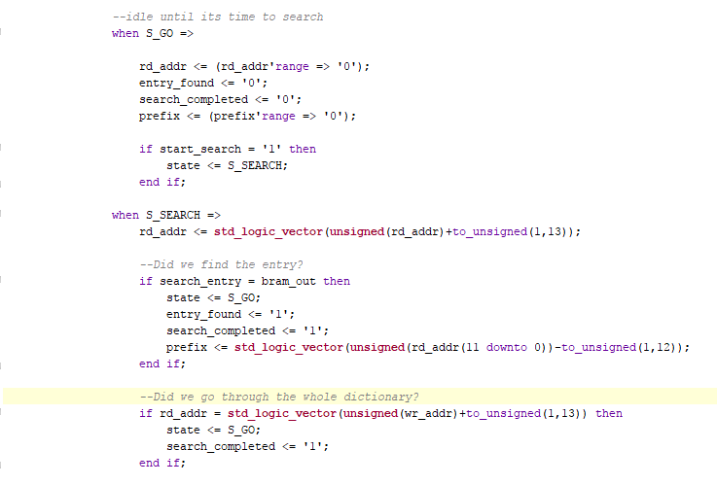
Dictionary FSM

Slide 7
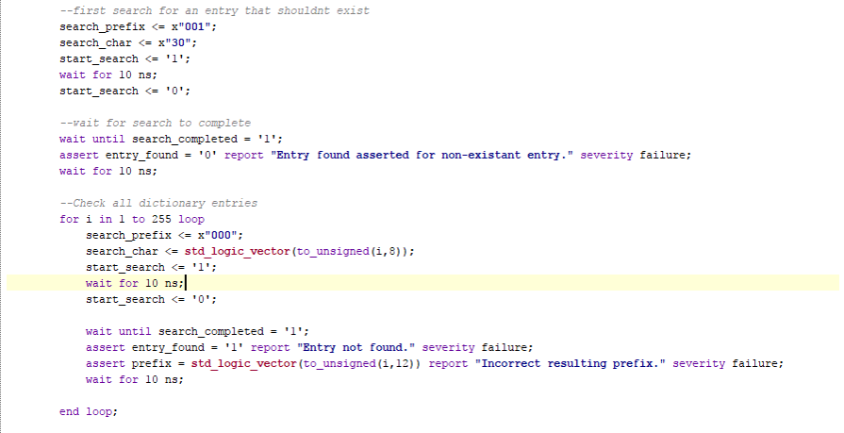
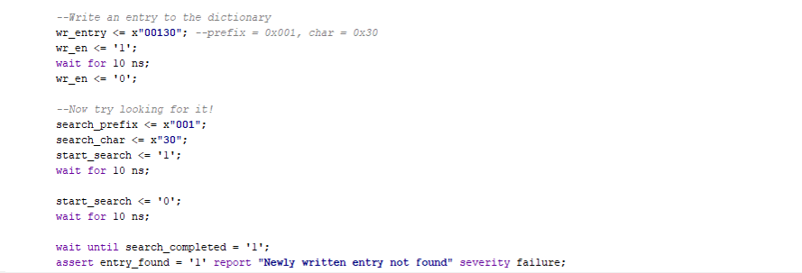
Dictionary Testbench

Slide 8
LZW Architecture
Controller orchestrates the dictionary and parses the input data
Outputs the compressed data
Testbench (Requirement H)
Uses a sample string as an input for compression
Compression results matches the initial software implementation of the compression algorithm

Slide 9
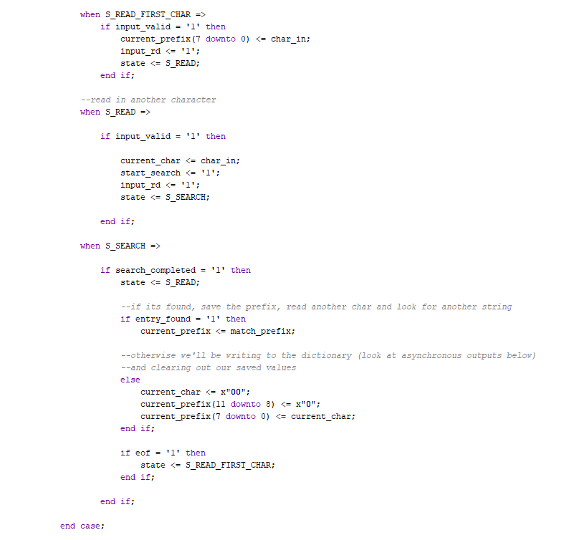
LZW Controller FSM

Slide 10
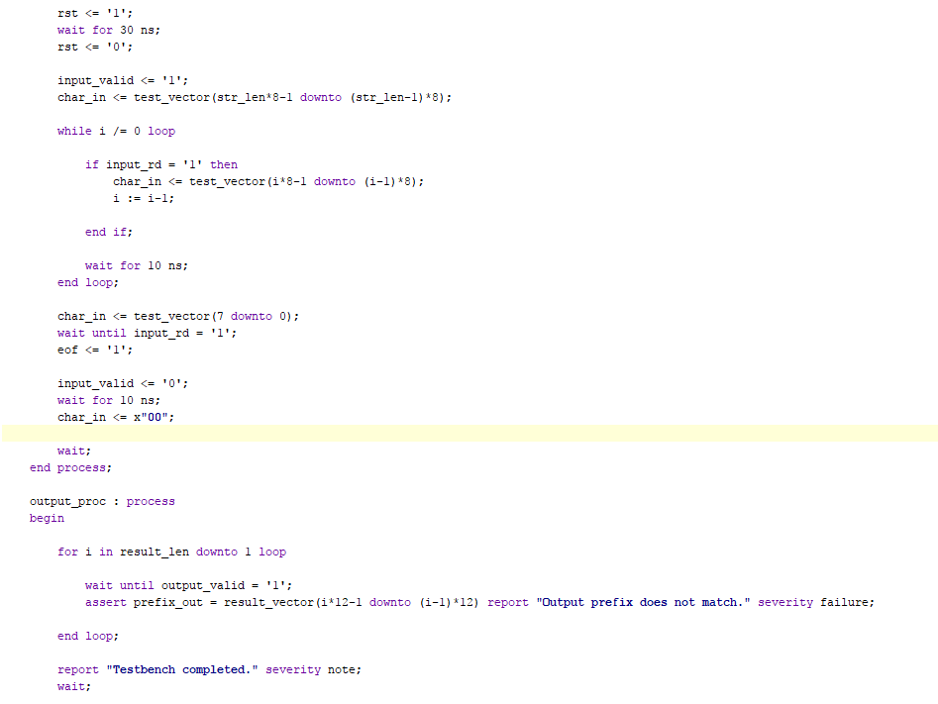
LZW Controller Testbench

Slide 11
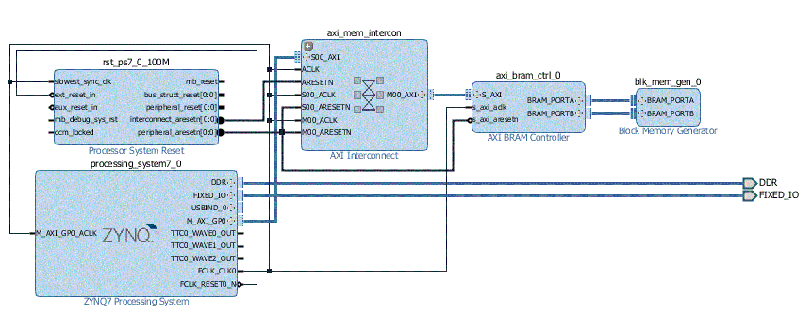
Software Decompression
BRAM instantiated in H/W
Connected to processing system using Axi-Stream
S/W reads in compressed data from BRAM
Outputs decompressed data to console

Slide 12
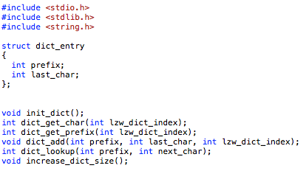
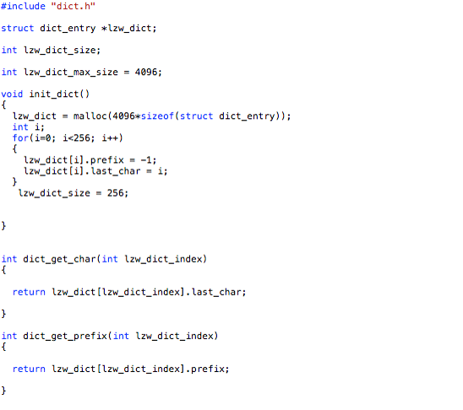
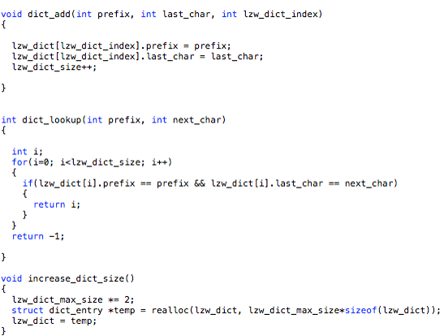
Software Decompression

Slide 13
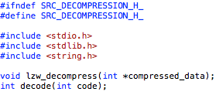
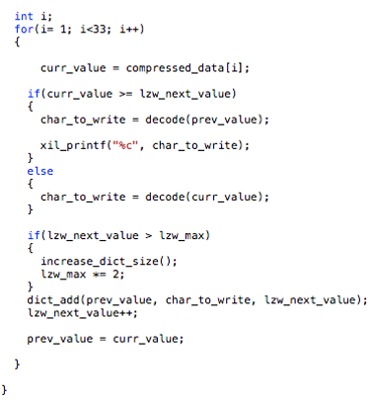
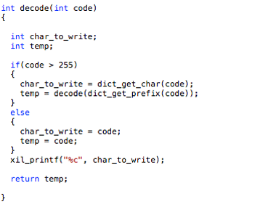
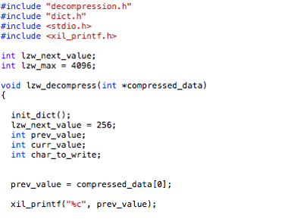
Software Decompression

Slide 14
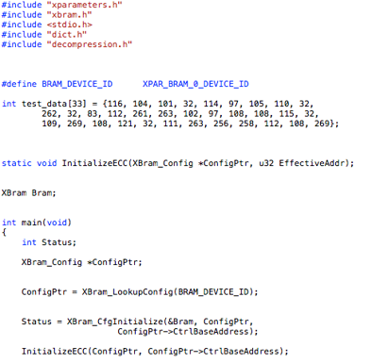
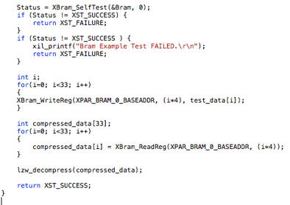
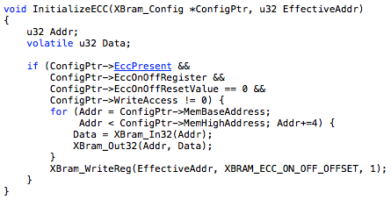
Software Decompression

Slide 15
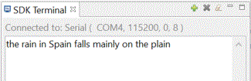
Software Decompression
Test Case 1 for requirement A was a success
Overlaps with Test Case 1 for requirement F
In the process of completing Test Case 2 for requirement A
This will also help with finishing the Test Cases for Requirements D & F
Confirmed that decompressed output matches what I expected with the given compressed input data

Slide 16
Schedule & Future Work
 |  |  |  |  | January |  |  |  | February |  |  |  | March |  |  |  | April
ID | Task | Who | Status |  | 9 | 16 | 23 | 30 | 6 | 13 | 20 | 27 | 6 | 13 | 20 | 27 | 3 | 10 | 17
1 | S/W Compression | Shaun | Done
2 | S/W Decompression | Shaun | Done
3 | Architectural H/W Design | Travis | Done
4 | Architectural S/W Design | Shaun | Done
5 | Testbench | Travis | Verified toplevel and LZW controller with testbench
6 | Dictionary HDL | Shaun | Done
7 | Toplevel HDL | Travis | Done
8 | Finalizing/Optimizing | Travis | Not started
9 | Communicate H/W Compression results with S/W | Shaun | Reading compressed data from BRAM
10 | S/W decoding on Board | Shaun | Done
11 | S/W Decompression on Board | Shaun | Done

Slide 17
Schedule & Future Work
Create hardware/software interface
Original data to be sent to H/W by the S/W for compression
Compressed data to be sent to S/W by the H/W for decompression
Develop multi-block dictionary search
Optimization for faster compression speed in H/W

Slide 18
Questions?

