Slide 1
LZW Compression & Decompression
Shaun Holtzman – SHH117@Pitt.edu
Travis Wise – TWW12@Pitt.edu

Slide 2
Accomplishments
Completed hardware/software interface
Input FIFO write enable and input data
Output FIFO read enable and output data
LZW Compression core file size and done signal
Connection made using an AXI wrapper and accessing addresses in software
Began multi-block dictionary search
Optimization to make the overall compression time run faster

Slide 3
Hardware Design
Input data put into input FIFO by software
Hardware decompresses data as it arrives in the input FIFO
Hardware compresses input data and places compressed output into the output FIFO
Software reads the compressed data from the output FIFO and decompresses the compressed data

Slide 4
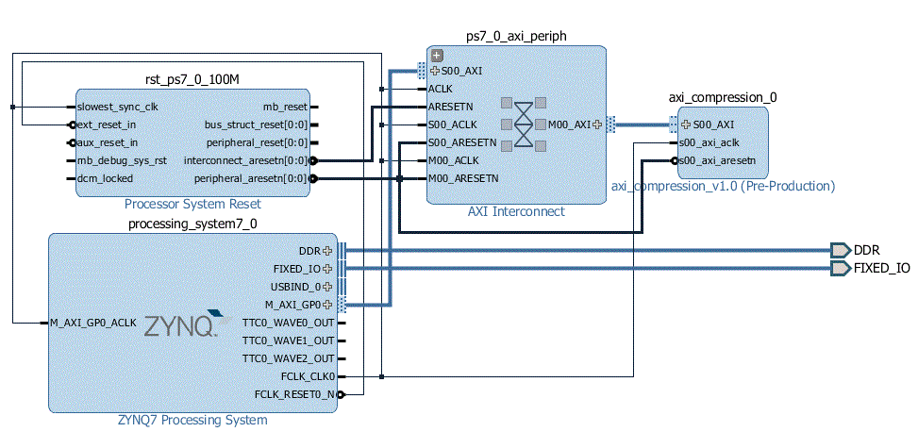
Hardware Design
Hardware/software connection done using AXI
Allows the software to access the addresses of desired signals

Slide 5
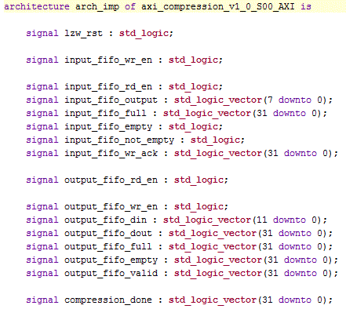
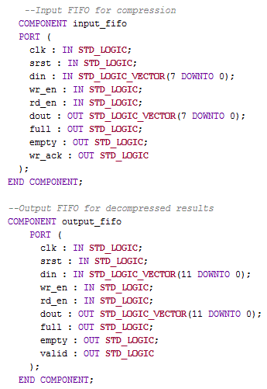
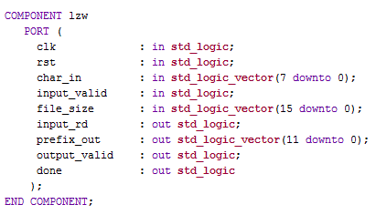
Hardware/Software Interface

Slide 6
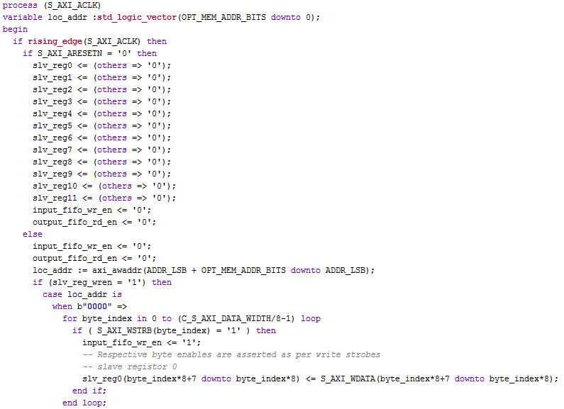
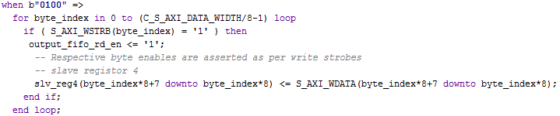
Hardware/Software Interface

Slide 7
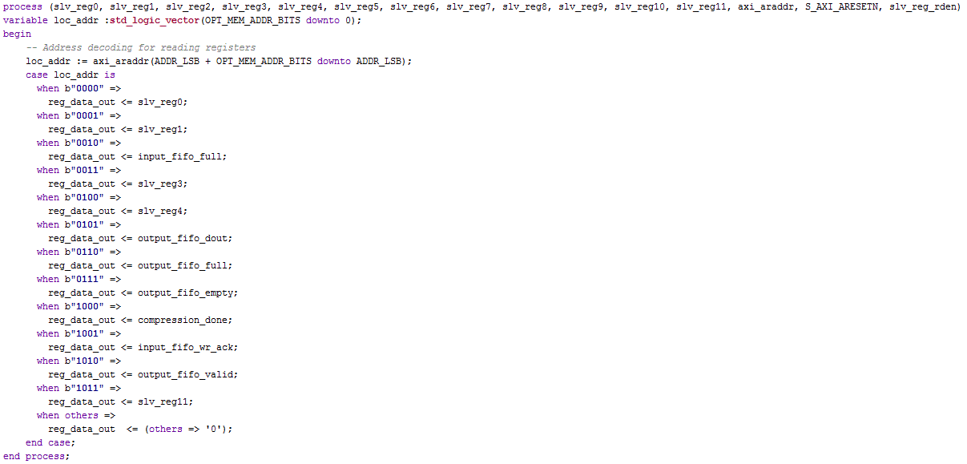
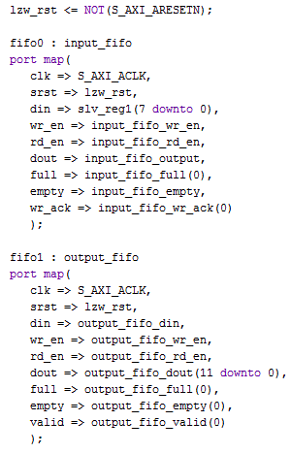
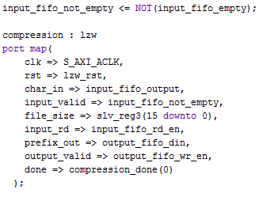
Hardware/Software Interface

Slide 8
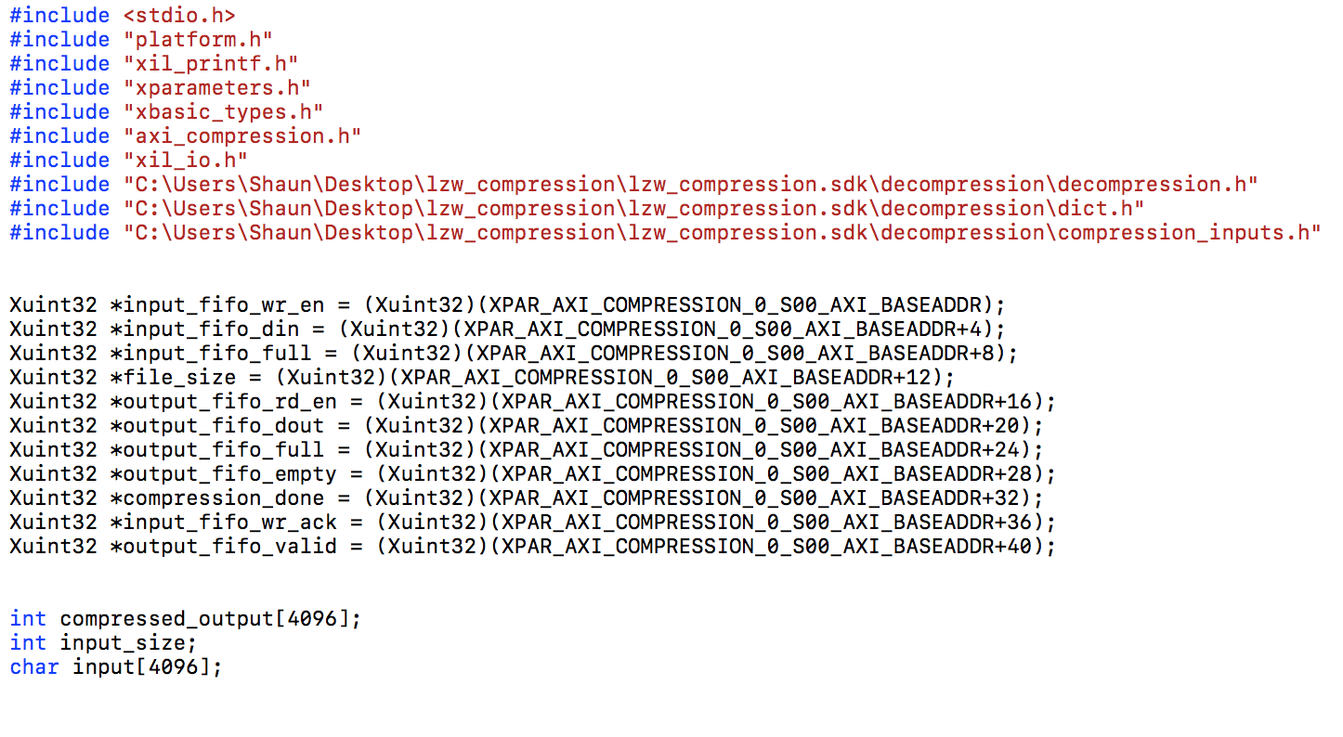
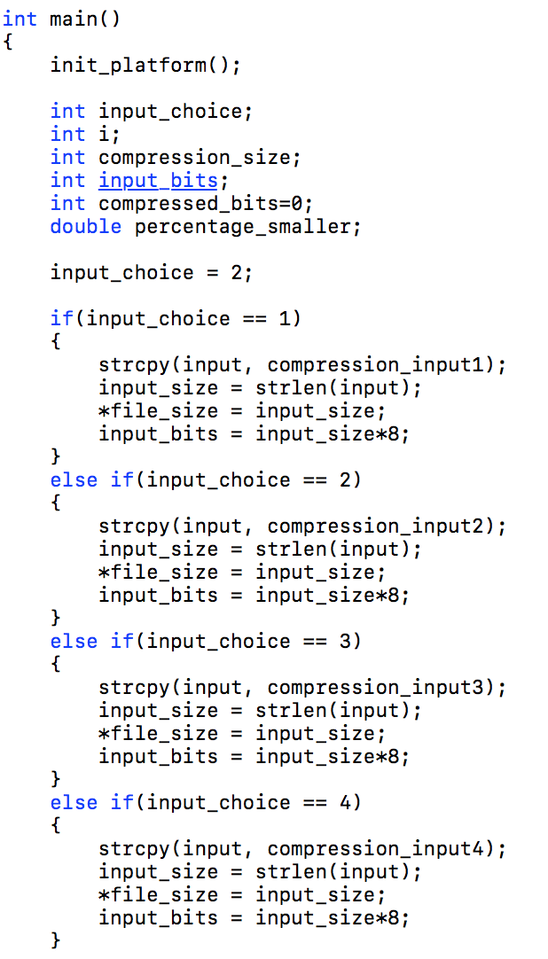
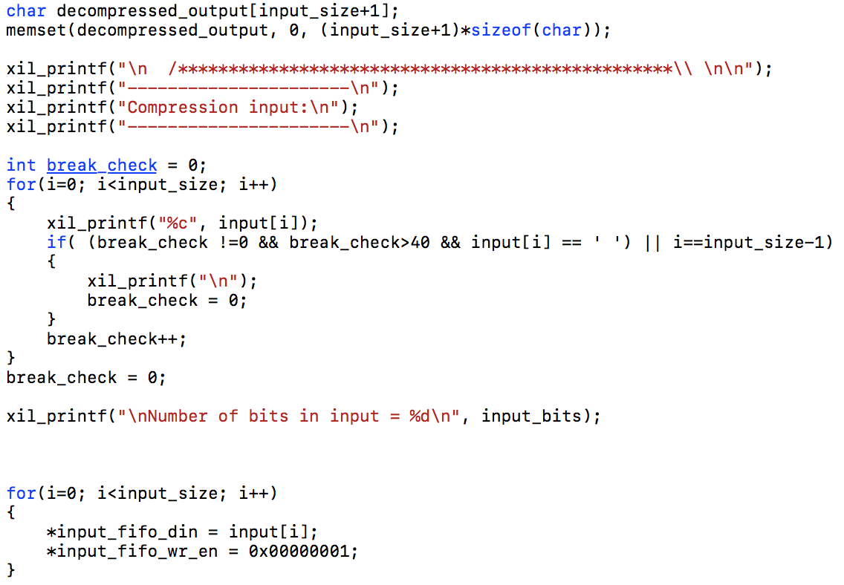
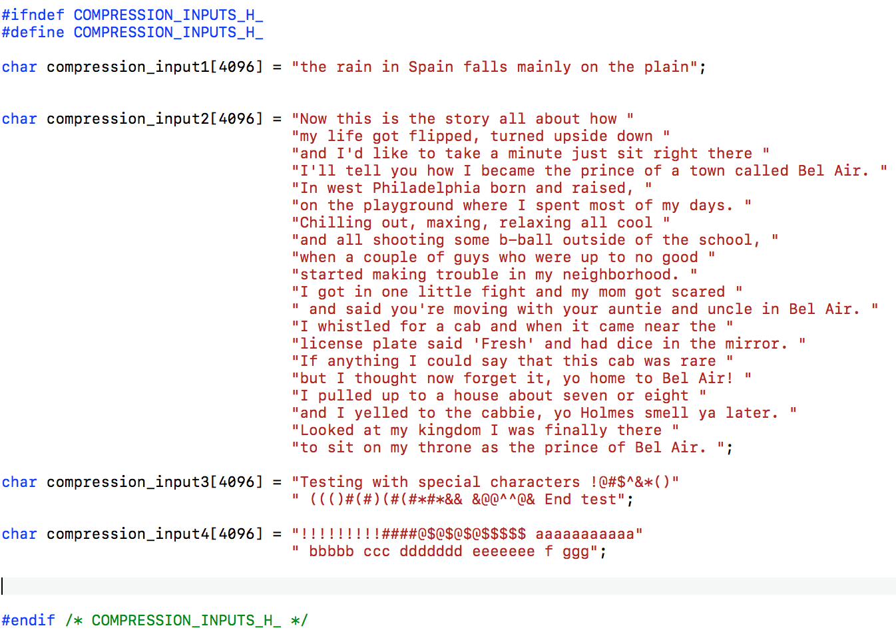
Software Initialization & Decompression

Slide 9
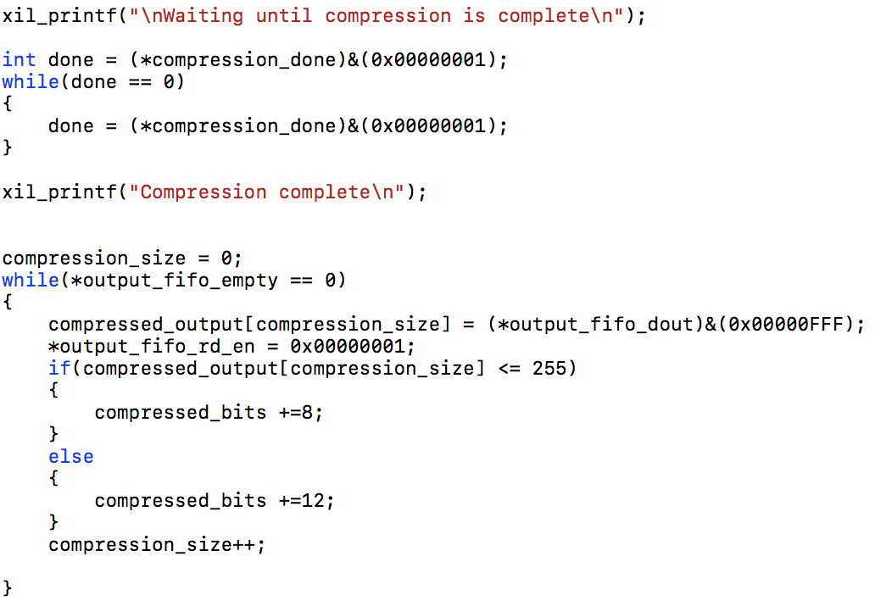
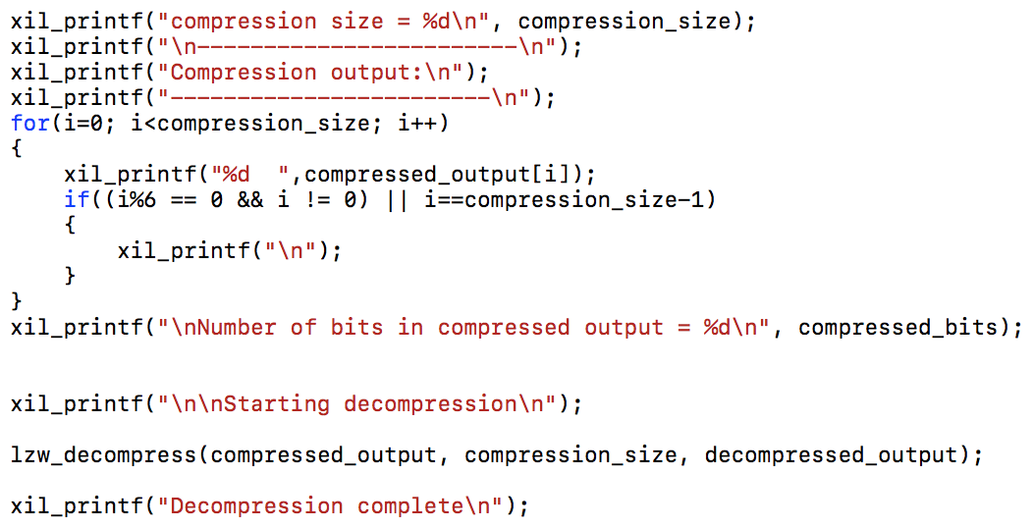
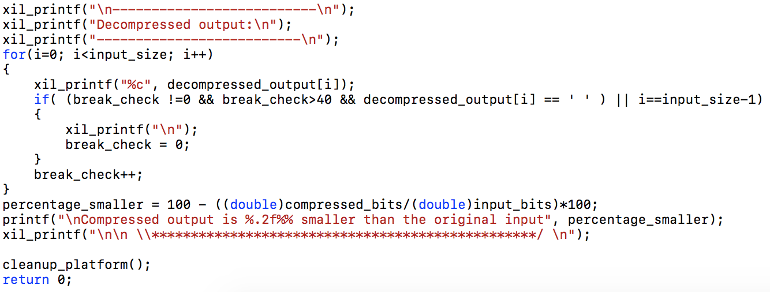
Software Initialization & Decompression

Slide 10
Demo
Demo using a ZedBoard
FPGA programmed with bit stream
Decompression done in software in bare-metal using Xilinx SDK

Slide 11
Future Work
Develop multi-block dictionary search
Decrease the overall time it takes to compress the data
Simulate and test multi-block dictionary search

Slide 12
Questions?

