Slide 1
ECE 2140 SoC Design Lempel-Ziv-Welch (LZW) Compression
1 min
SHAUN HOLTZMAN - SHH117@PITT.EDU TRAVIS WISE - TWW12@PITT.EDU

Slide 2
LZW Compression Overview
3 min
Universal lossless data compression algorithm
Potential for high throughput in a hardware implementation
Main benefits:
Represent data with a smaller amount of bits than the original data
Decompressing exactly represents the original data
Both compression and decompression can be done using only the default dictionary of the single 255 ASCII characters
No need to use additional dictionary entries added during compression in order to do decompression
Blocks in our design:
LZW Compression Controller
LZW Compression Dictionary
LZW Compression Dictionary Controller
LZW Compression Dictionary Block
LZW Decompression Software Block

Slide 3
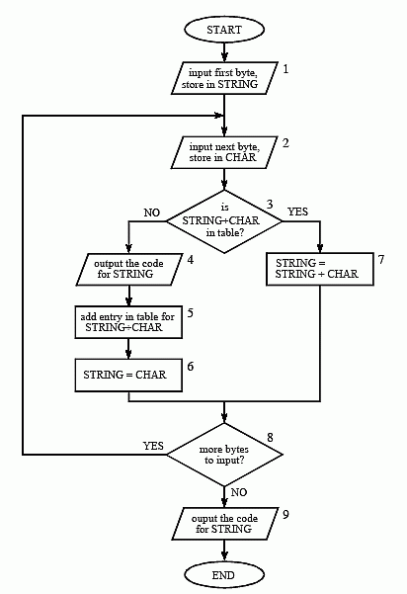
Compression Flowchart
1 min
Start with first byte stored in STRING
Input next next into CHAR
Check if STRING+CHAR in dictionary
Yes: Make STRING = STRING + CHAR
No: Output STRING, add STRING+CHAR to dictionary, set STRING=CHAR
Go back to 2 while there is still data to be read

Slide 4
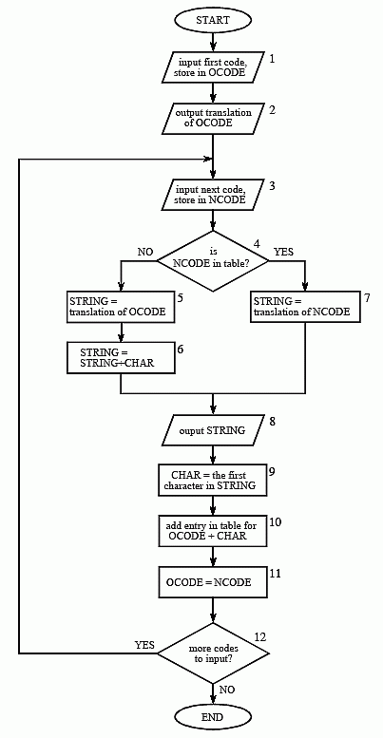
Decompression Flowchart
1 min
Read in first code into OCODE and translate its output
Read in next code into NCODE
Is NCODE in the dictionary?
Yes: set STRING = translation of NCODE
No: set STRING = translation of OCODE + CHAR
Output STRING
Set CHAR = first character in STRING
Add OCODE + CHAR to dictionary
Set OCODE = NCODE
Go back to 2 if there is still data left to be decompressed

Slide 5
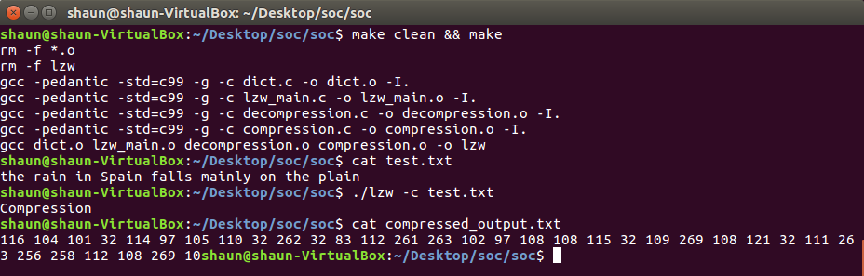
Simple Compression Example
1 min
Original input: 43 characters, 8-bits each
43x8 = 344 bits
Compressed output: 27 numbers using 8-bits, 8 numbers using 12-bits
(27x8) + (8x12) = 312 bits
9% less bits used
Notes:
Shaun

Slide 6
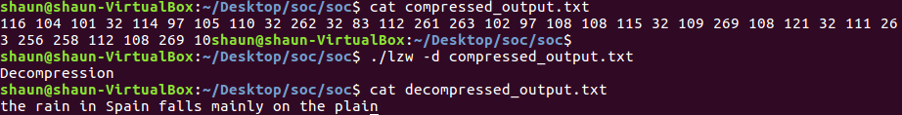
Simple Decompression Example
1 min
Decompressed output exactly matches original data that was compressed
Decompression uses the same base dictionary of the 256 ASCII characters
Notes:
Shaun

Slide 7
Architecture/Model
1 min

Slide 8
Architecture/Model
2 min

Slide 9
Schedule and Status
2 min
 |  |  |  |  | January |  |  |  | February |  |  |  | March |  |  |  | April
ID | Task | Who | Status |  | 9 | 16 | 23 | 30 | 6 | 13 | 20 | 27 | 6 | 13 | 20 | 27 | 3 | 10 | 17
1 | S/W Compression | Shaun | Done
2 | S/W Decompression | Shaun | Done
3 | Architectural H/W Design | Travis | Done
4 | Architectural S/W Design | Shaun | Done
5 | Testbench | Travis | Not started
6 | Dictionary HDL | Shaun | In progress
7 | Toplevel HDL | Travis | Not started
8 | Finalizing/Optimizing | Travis | Not started
9 | Communicate H/W Compression results with S/W | Shaun | Starting with psuedo data from preset FIFO
10 | S/W decoding on Board | Shaun | Not started
11 | S/W Decompression on Board | Shaun | Not started

Slide 10
Schedule and Status
2 min
Accomplishments:
Architectural design complete
Standalone software implementation complete
Working on this week:
Starting dictionary HDL
Starting software block to read in compressed data from h/w FIFO
Starting dictionary h/w controller
Challenges/Difficulties/Needs
No major difficulties yet
Schedule should not slip if we are persistent

Slide 11
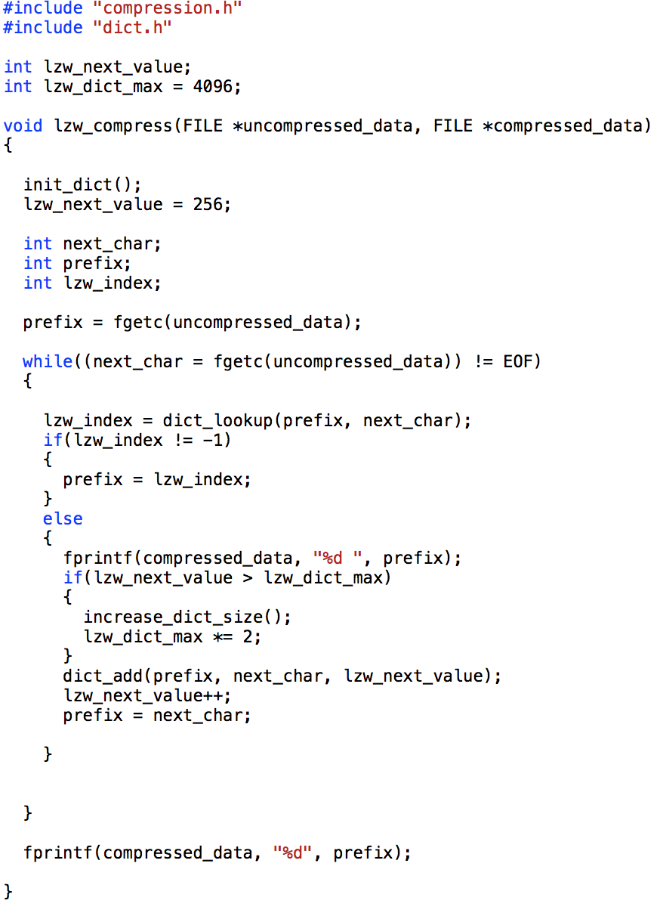
LZW Compression Controller
1 min
Orchestrates whole algorithm
Interfaces between SW and HW
Controls I/O FIFOs and the dictionary search algorithm

Slide 12
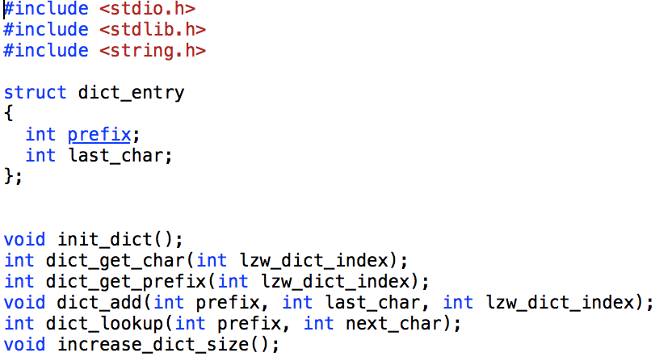
LZW Compression Dictionary
2 min
Top-level module for the dictionary
Contains multiple dictionary blocks in order to parallelize searches
Number of blocks in parallel can be customizable at synthesis-time

Slide 13
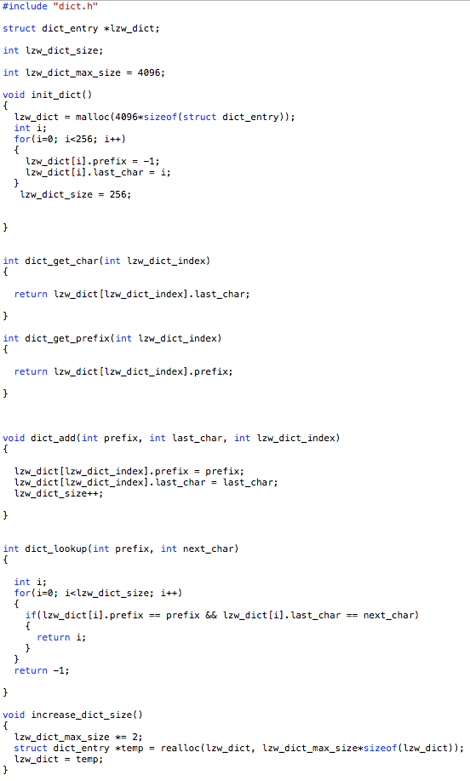
LZW Compression Dictionary Controller
1 min
Coordinates all dictionary blocks
Combines N-bit long vectors into a single std_logic for the top-level
Responsible for maintaining the dictionary length and writing to the dictionary

Slide 14
LZW Compression Dictionary Block
2 min
Dictionary blocks search through a 20-bit BRAM to find a matching prefix and character entry
If the entry is found in the block, the counter/current address will be used as the new prefix
The controller here is responsible for incrementing the read address and asserting the search_complete signal

Slide 15
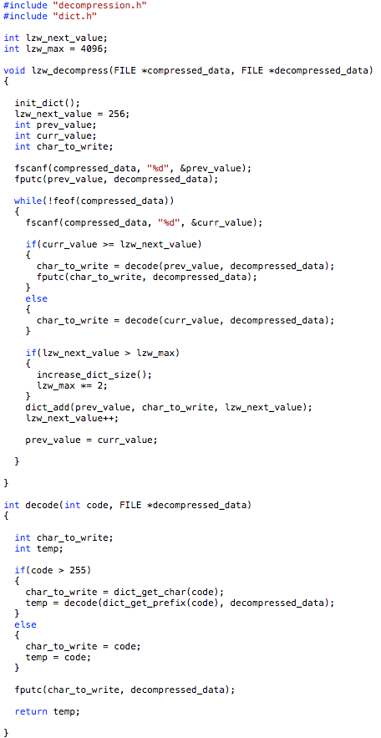
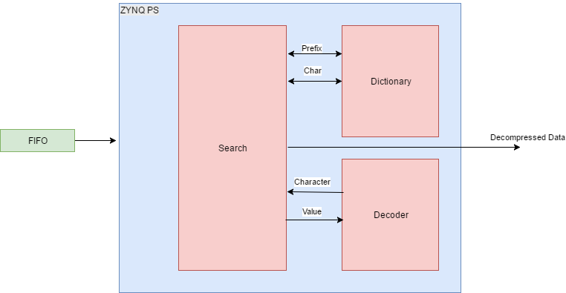
LZW Decompression Software Block
1 min
Reads in compressed data from H/W FIFO
Uses S/W dictionary initialized with 256 base ASCII characters
Recursively decodes compressed data to generate decompressed data

Slide 16
LZW Compression Summary - Questions?
5 min
 |  |  |  |  | January |  |  |  | February |  |  |  | March |  |  |  | April
ID | Task | Who | Status |  | 9 | 16 | 23 | 30 | 6 | 13 | 20 | 27 | 6 | 13 | 20 | 27 | 3 | 10 | 17
1 | S/W Compression | Shaun | Done
2 | S/W Decompression | Shaun | Done
3 | Architectural H/W Design | Travis | Done
4 | Architectural S/W Design | Shaun | Done
5 | Testbench | Travis | Not started
6 | Dictionary HDL | Shaun | In progress
7 | Toplevel HDL | Travis | Not started
8 | Finalizing/Optimizing | Travis | Not started
9 | Communicate H/W Compression results with S/W | Shaun | Starting with psuedo data from preset FIFO
10 | S/W decoding on Board | Shaun | Not started
11 | S/W Decompression on Board | Shaun | Not started

