Slide 1
HUMAN ACTIVITY RECOGNITION
Deep Learning Lab
Xiangyuan Meng & Wenwu Tang
Institute of Signal Processing and System Theory
University of Stuttgart
07.02.2023

Slide 2
Deep Learning Lab: HUMAN ACTIVITY RECOGNITION
Contents
1. Methods
1.1 Statistics of data from HAPT dataset
1.2 Model Architecture
2. Training process
3. Trainning result
3.1 Visualisation on exp.02 user 01 with GRU
3.2 Confusion Matrix on HAPT test result
4. Conclusion

Slide 3
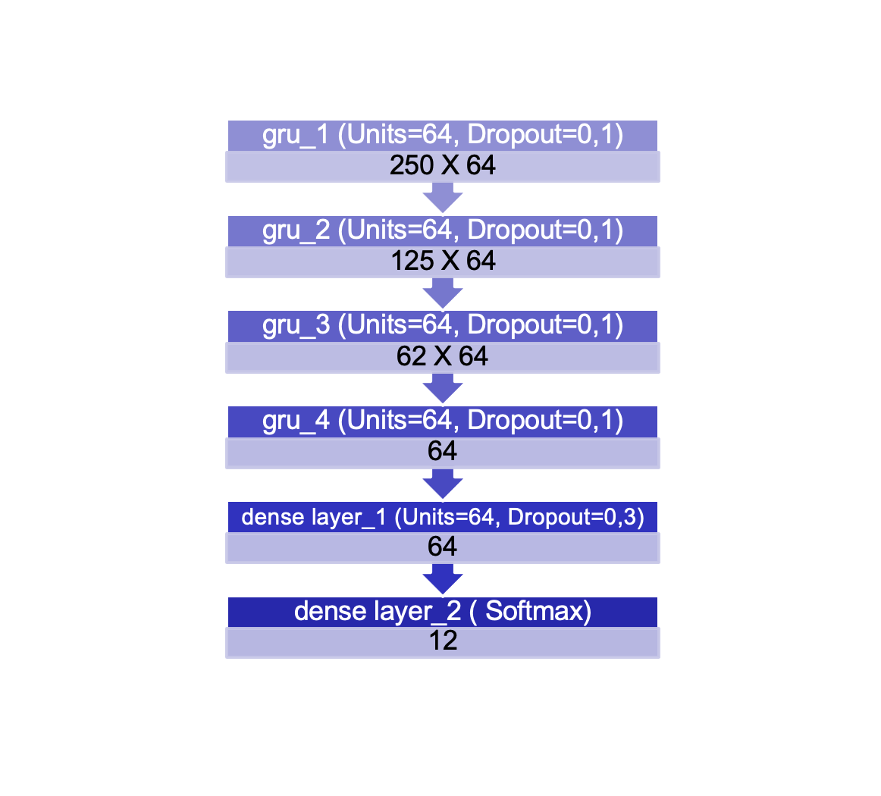
Deep Learning Lab: HUMAN ACTIVITY RECOGNITION
1. Methods

Slide 4
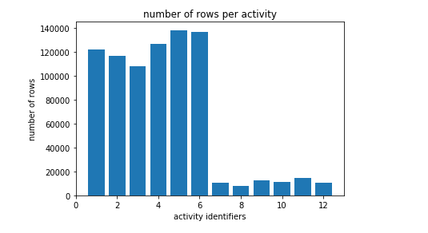
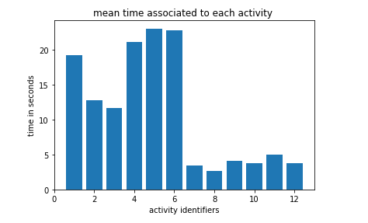
Statistics of data from HAPT dataset
The number and the duration of samples for dynamic activities (labels 7-12) are much smaller than that for static activities! It‘s an imbalanced data set.

Slide 5
Model Architecture
LSTM
GRU
lstm_1 (Units=32, Dropout=0,3)
250 X 32
lstm_2 (Units=32, Dropout=0,3)
125 X 32
lstm_3 (Units=32, Dropout=0,3)
62 X 32
lstm_4 (Units=32, Dropout=0,3)
31 X 32
dense layer_1 (Units=128, Dropout=0,4)
128
dense layer_2 (Units=128, Dropout=0,4)
128
lstm_5 (Units=32, Dropout=0,3)
32
dense layer_3 (Softmax)
12
gru_1 (Units=64, Dropout=0,1)
250 X 64
gru_2 (Units=64, Dropout=0,1)
125 X 64
62 X 64
gru_4 (Units=64, Dropout=0,1)
64
dense layer_1 (Units=64, Dropout=0,3)
64
dense layer_2 ( Softmax)
12
gru_3 (Units=64, Dropout=0,1)

Slide 6
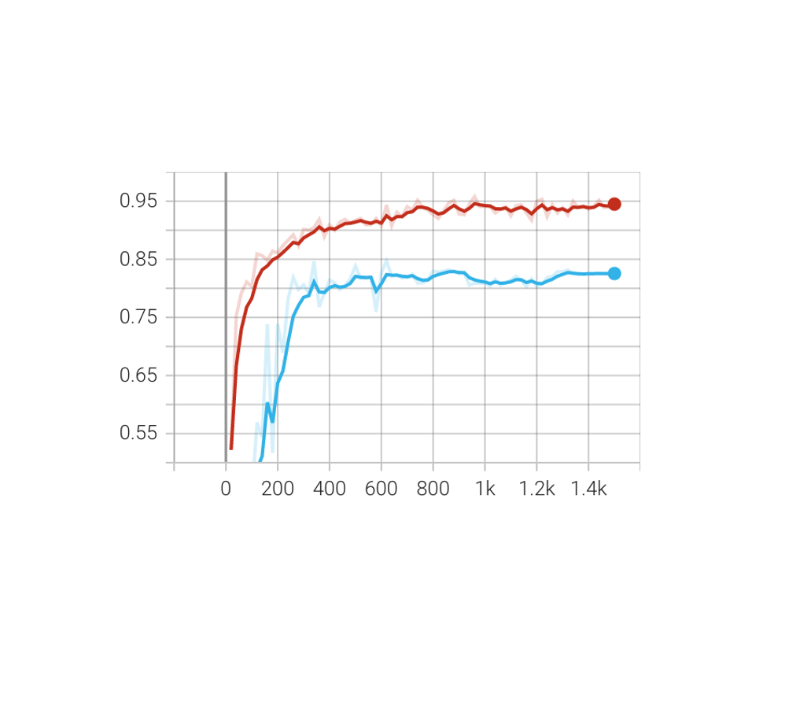
Deep Learning Lab: HUMAN ACTIVITY RECOGNITION
2. Training process

Slide 7
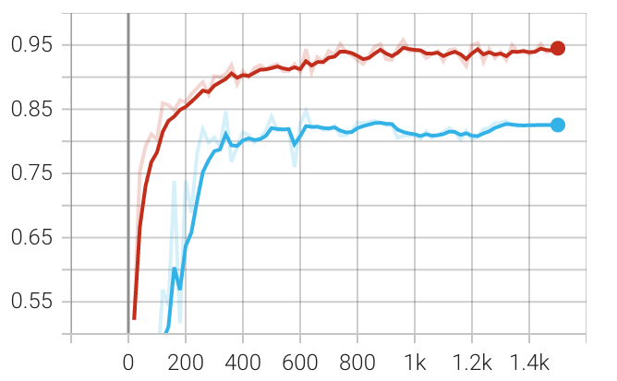
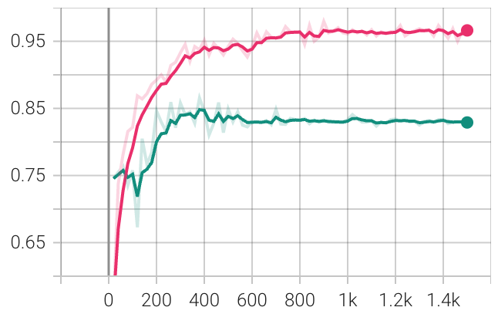
Train and validation accuracy on HAPT
LSTM
accuracy
Final Results: Train-Acc = 95,21%
Val-Acc = 82,55%
Training time = 9m55s
Related Data: Total params: 61,068
Trainable params: 60,812
Non-trainable params: 256
Train
Validation
Steps
GRU
accuracy
Final Results: Train-Acc = 97,34%
Val-Acc = 82,80%
Training time = 15m26s
Related Data: Total params = 94,412
Trainable params = 94,028
Non-trainable params = 384
Train
Validation
Steps
The convergence rates of both neural networks are very similar and both stabilize after about a thousand steps.

Slide 8
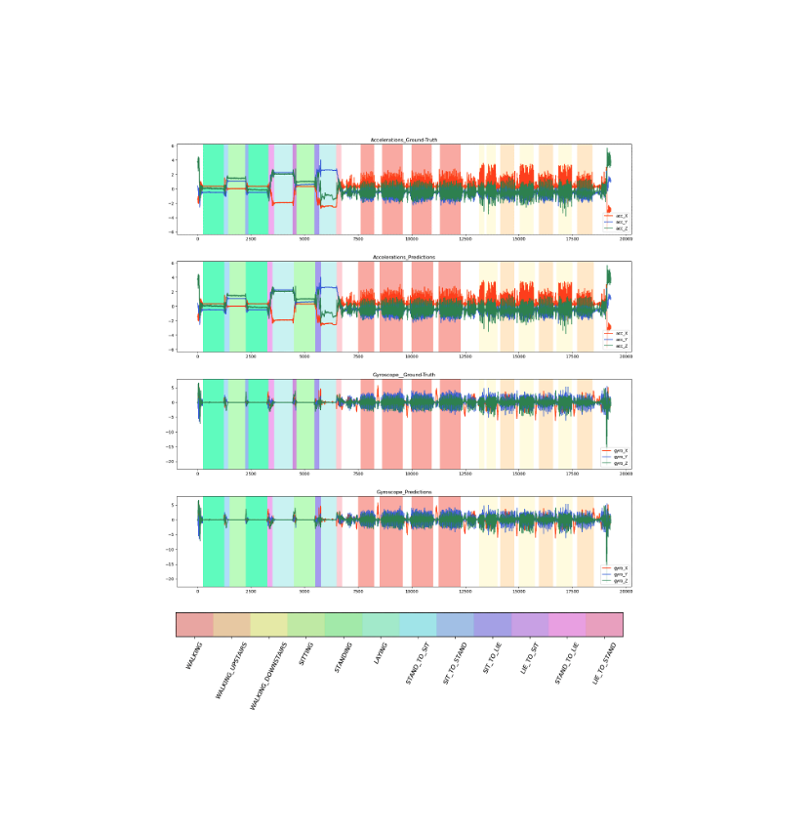
Deep Learning Lab: HUMAN ACTIVITY RECOGNITION
3. Trainning result

Slide 9
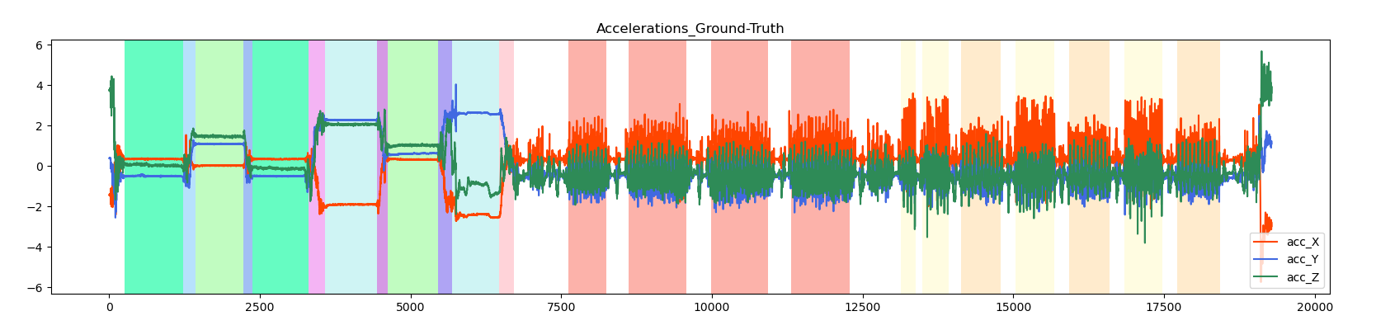
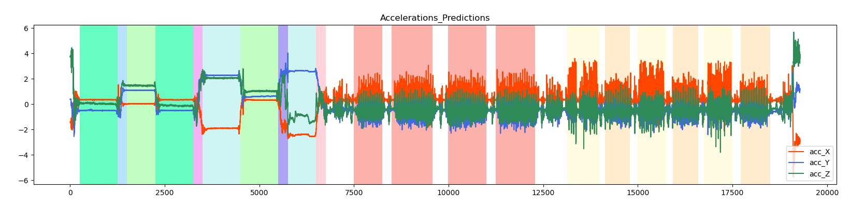
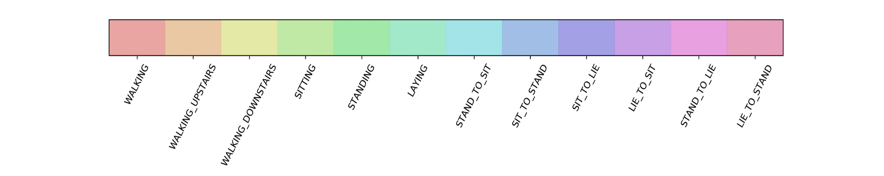
Visualisation on exp.02 user 01 with GRU

Slide 10
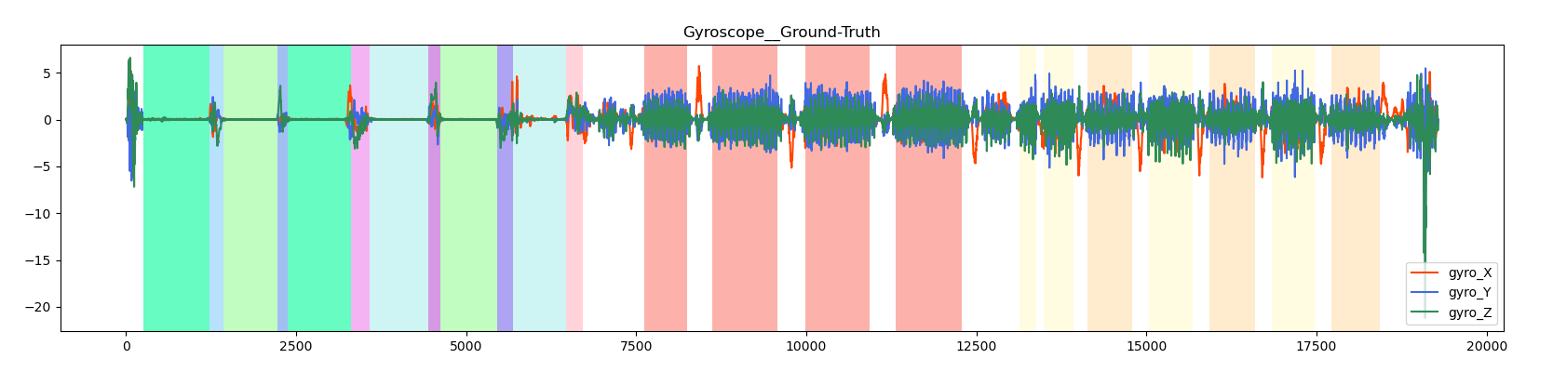
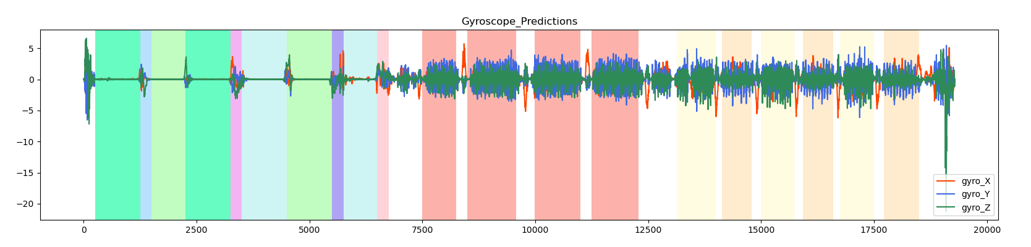
Visualisation on exp.02 user 01 with GRU

Slide 11
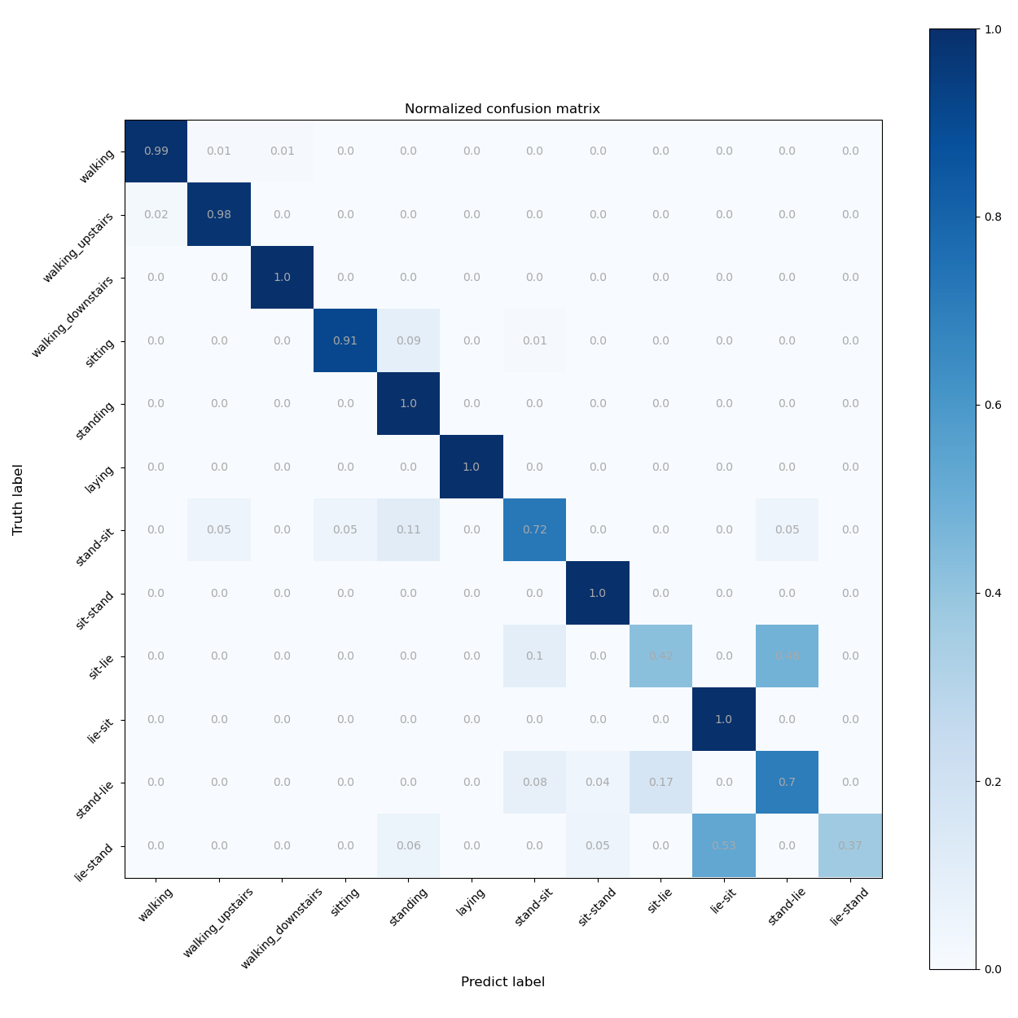
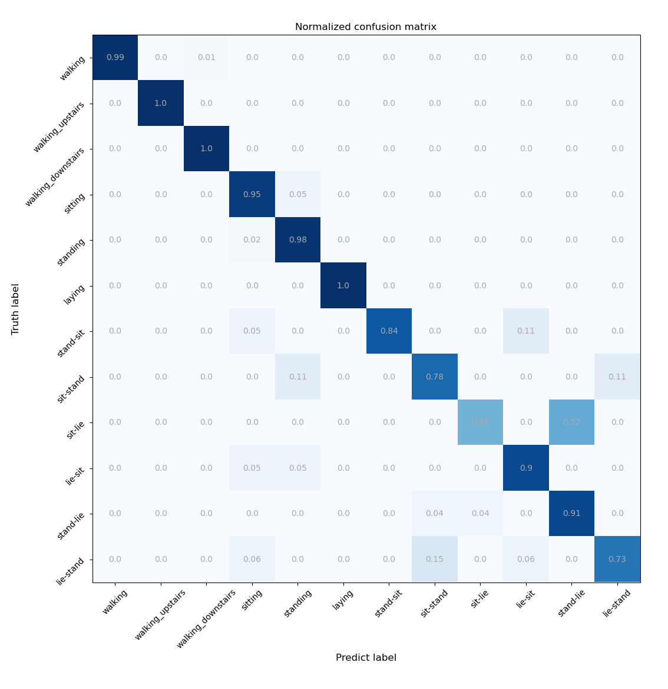
Confusion Matrix on HAPT test result
GRU
LSTM
95,82% Test Accuracy is achieved
94,40% Test Accuracy is achieved

Slide 12
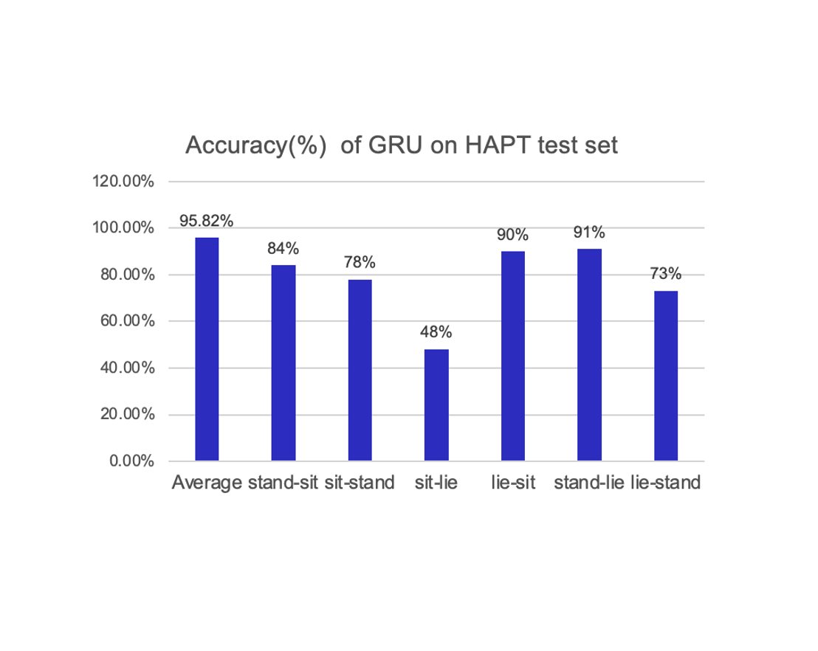
Deep Learning Lab: HUMAN ACTIVITY RECOGNITION
4. Conclusion

Slide 13
Conclusions
Both models have achieved high accuracy, which proves that the RNN networks can be applied for human activity recognition and have good performance.
Due to the shorter duration of dynamic activities(some are even shorter than window length), there are less training data for them, which leads to a imbalanced data set. so the accuracy of dynamic activities is much lower than static one.

Slide 14
Thanks for your Attention！
Xiangyuan Meng
Email: st176701@stud.uni-stuttgart.de
Tel.: +49 (0)17645677140
Wenwu Tang
Email: st180408@stud.uni-stuttgart.de
Tel.: +49 (0)15259552580
Institute of Signal Processing and System Theory
University of Stuttgart

