Slide 1
Model Architecture
LSTM
GRU
lstm_1 (Units=32, Dropout=0,3)
250 X 32
lstm_2 (Units=32, Dropout=0,3)
125 X 32
lstm_3 (Units=32, Dropout=0,3)
62 X 32
lstm_4 (Units=32, Dropout=0,3)
31 X 32
dense layer_1 (Units=128, Dropout=0,4)
128
dense layer_2 (Units=128, Dropout=0,4)
128
lstm_5 (Units=32, Dropout=0,3)
32
dense layer_3 (Softmax)
12
gru_1 (Units=64, Dropout=0,1)
250 X 64
gru_2 (Units=64, Dropout=0,1)
125 X 64
62 X 64
gru_4 (Units=64, Dropout=0,1)
64
dense layer_1 (Units=64, Dropout=0,3)
64
dense layer_2 ( Softmax)
12
gru_3 (Units=64, Dropout=0,1)

Slide 2
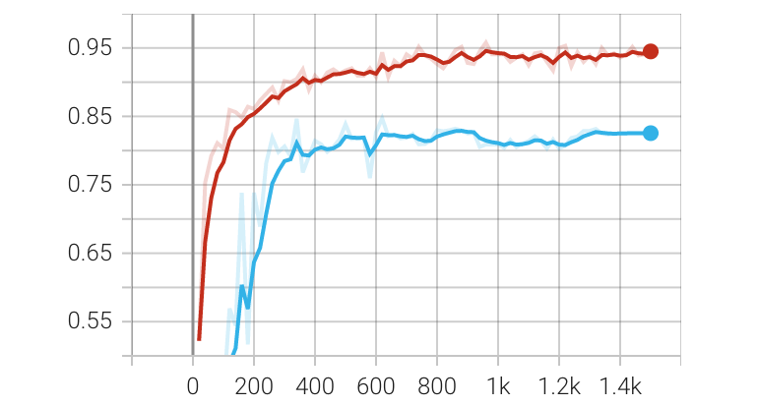
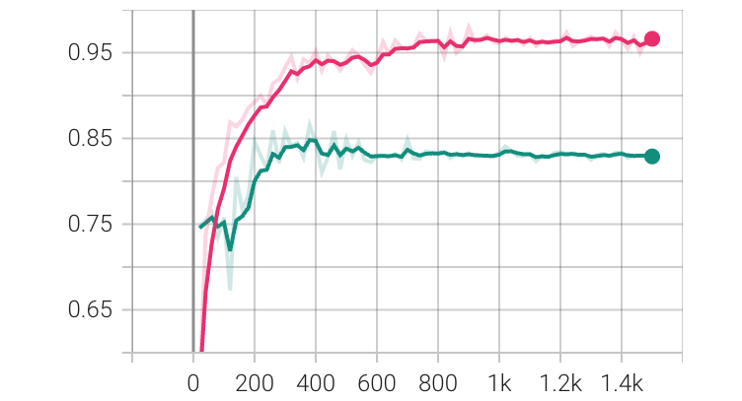
train and val accuracy on HAPT
LSTM
GRU
accuracy
accuracy
Steps
Steps
Train
Validation
Train
Validation

Slide 3
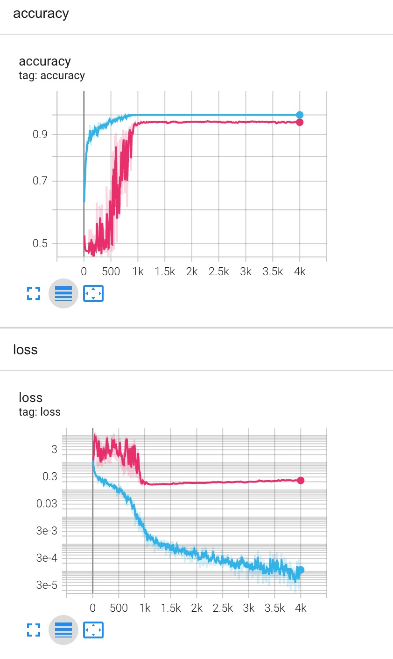
train and val accuracy on HAPT
Training loss
accuracy
Validation loss
loss
Training accuracy
Validation accuracy
Steps
Steps

Slide 4
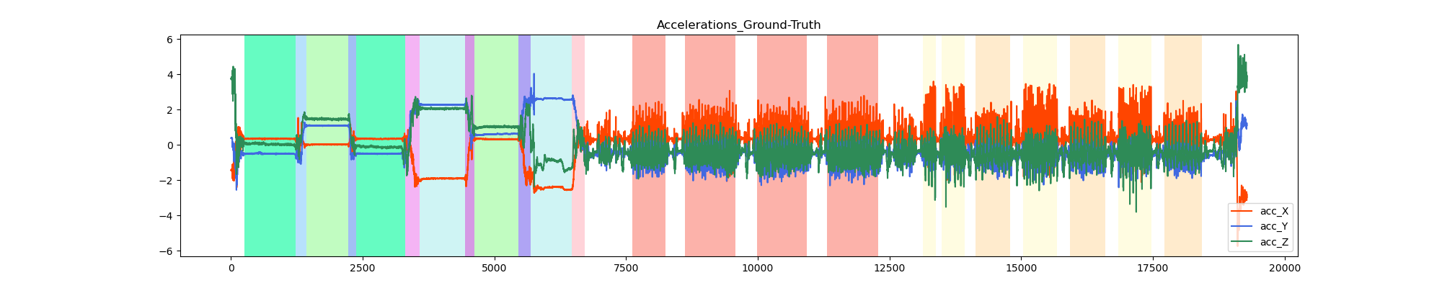
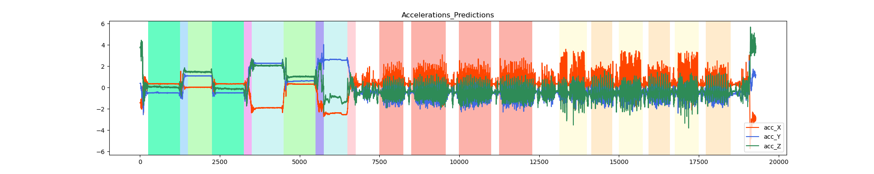
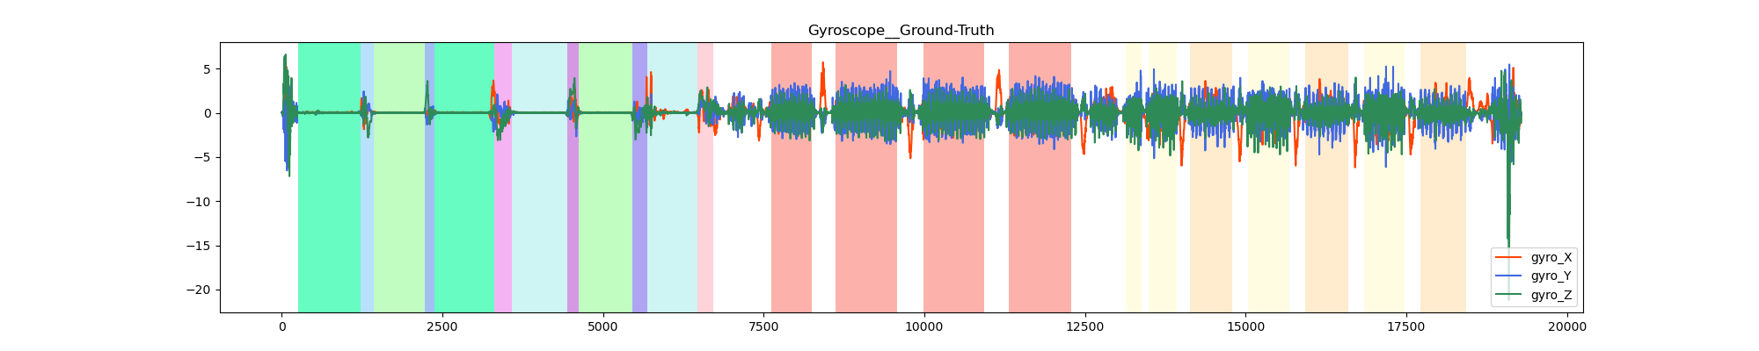
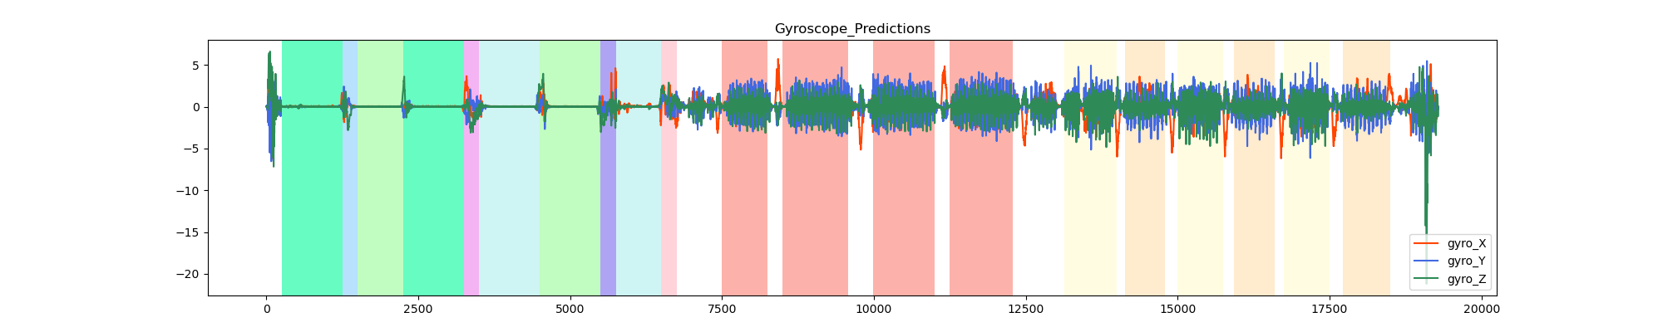
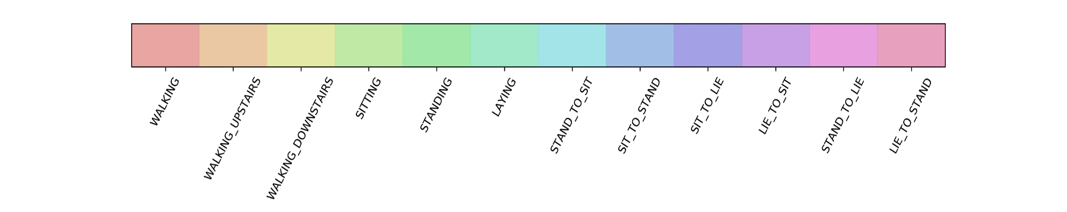

Slide 5
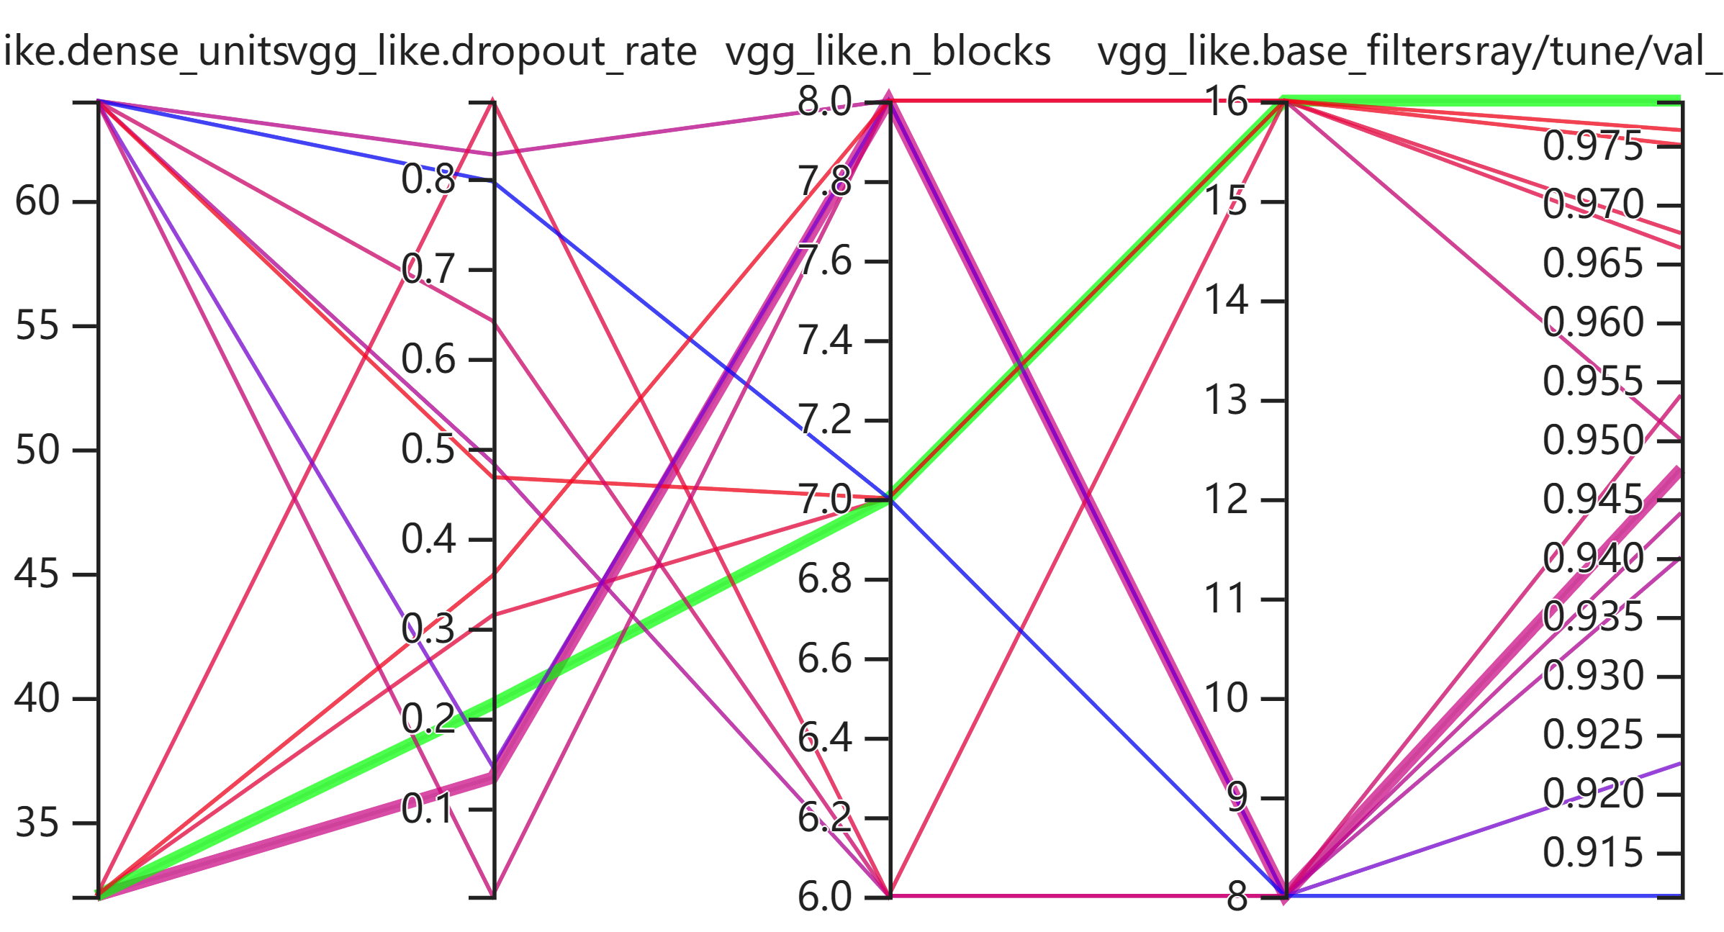
dense units
dropout rate
n blocks
base filters
val accuracy

Slide 6
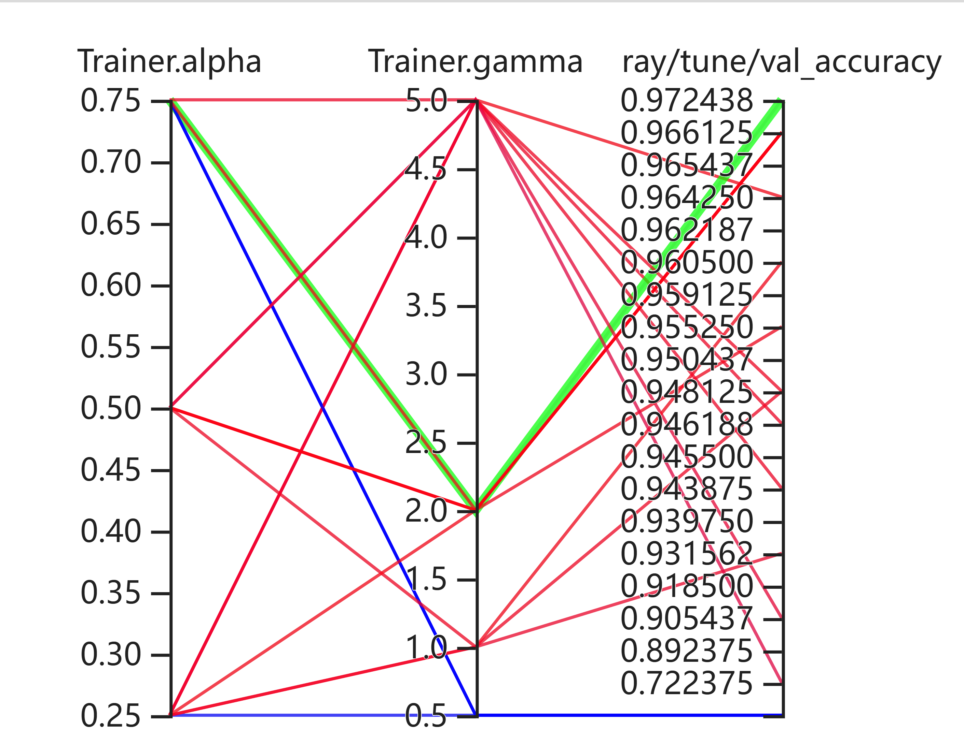
alpha
gamma
val accuracy

