Slide 1

HTML 5
SCLA

Slide 2
What is HTML
HTML - acronym
Hypertext Markup Language
HTML is a markup language used to tell your browser how to structure web pages.
It can be as complicated or as simple as the web developer (you) want it to be
HTML consists of a series of elements, which you use to enclose, wrap or mark up different parts of content to make it appear or act a certain way

Slide 3
Structure of a HTML Document
DOCTYPE
Tells browser to render page using HTML specifications
HTML Element
Encompasses all content on the web page. Also known as root element.
Head Element
Encompasses all meta data on web page. Not visible on view (browser)
Body Element
Encompasses all viewable content on web page. Things you actually see

Slide 4
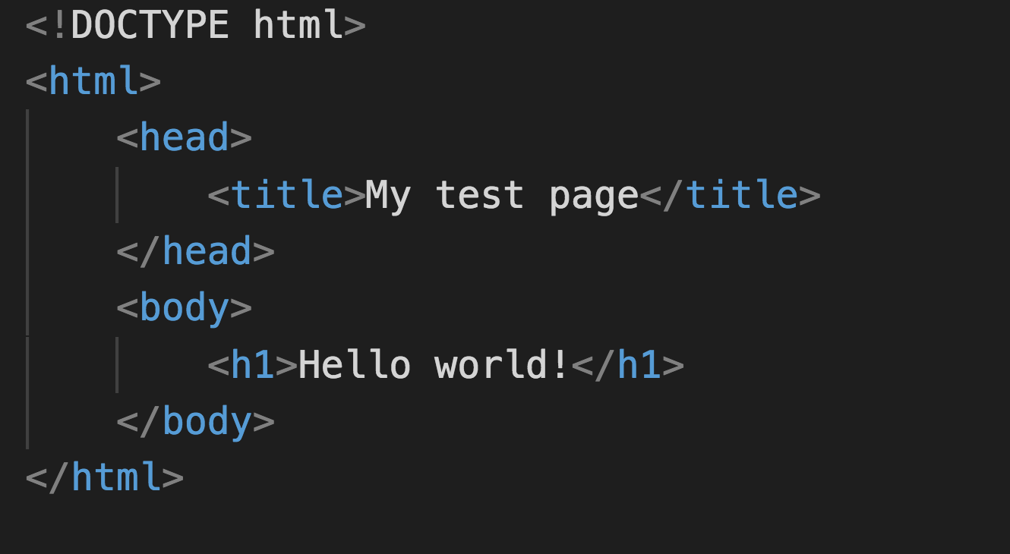
Putting it All Together!

Slide 5
Let’s Try it Ourselves (5 mins)
Follow along with me and let’s create our first HTML page
On your desktop create a folder called html
Open that folder in your editor
Create a new file and call it index.html
Write the code for a basic HTML skeleton
Save your file
Open it, by clicking on the index.html file in your folder

Slide 6

HTML Tags + Elements
We markup our content on your web page by using tags
These tags consist of 3 main parts
Opening tag
Content
Closing tag
These 3 together make up what we call HTML elements
The element above is known as a h1 element

Slide 7
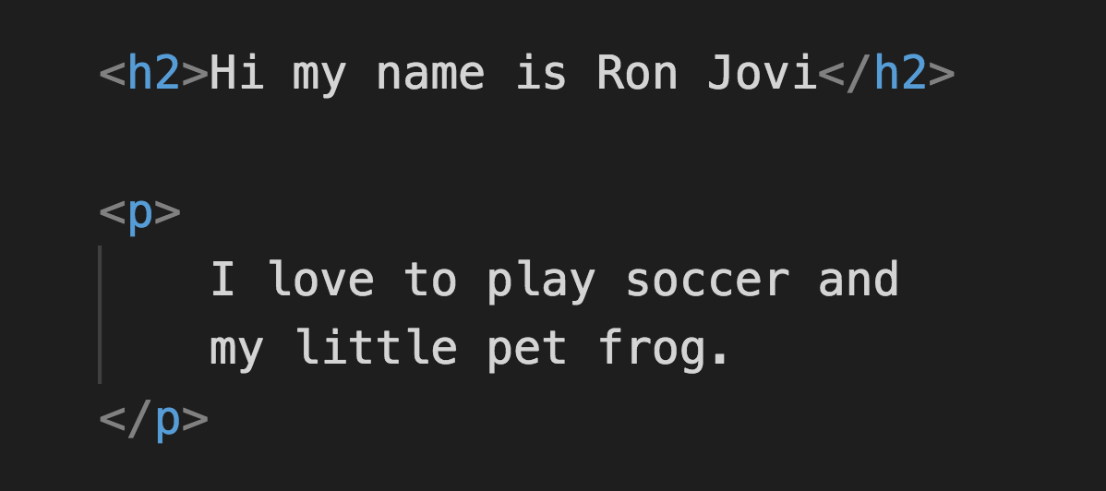
What would you call these Elements?

Slide 8
Common HTML Elements (5 mins)
Let’s take some time to do research on some common HTML elements
What tags do we use to add the following to our web page:
Images
Links (anchors)
Headers
Paragraphs
Lists

Slide 9
Empty Tags
Not all elements or tags come in pairs
These are known as empty tags or self-enclosing tags
All that really means is that there is only an opening tag and no closing tag
A good example is the image tag

Slide 10
URL’s
Uniform Resource Locator
URL’s are used to locate resources
Images
Other html files
Songs (mp3)
Etc
When trying to load images or link other html files you have to construct a URL that points that resource
Think of it as an address (when mailing letters)

Slide 11
HTML Attributes
Attributes contain extra information about the element
These things do not appear on the web page but they important for the element work or to identify the element
For example the image tag below has the attributes src and alt
SRC has the image URL – this loads the image on your page
HTML attributes always go in the opening tag (never closing tag!)

Slide 12
HTML Comments
In HTML, as with most programming languages, there is a mechanism available to write comments in code
These serve as notes for the developer that will help them understand what the code does
These notes/comments do not appear on the web page
Note comments go inside these symbols <!-- -->

Slide 13
DOM
Document Object Model
This DOM is a document model loaded in the browser and representing the document as a node tree
Each node represents a part of the document
You can view the DOM by using your developer tools
Right click inspect on your browser (let’s stick to chrome)
THE DOM IS YOUR ENTIRE WEB PAGE

Slide 14
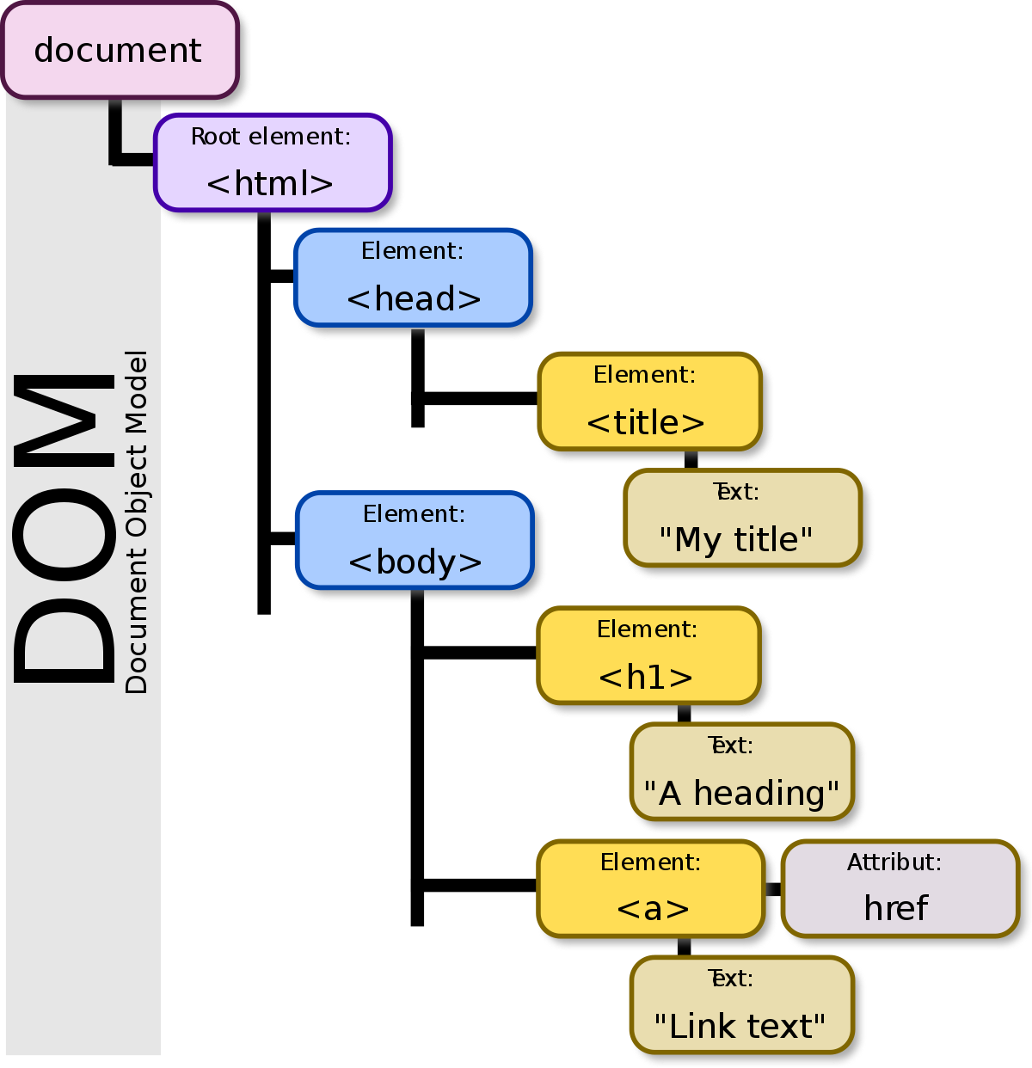

Slide 15
Activity (30 mins)
Now that you have a basic understanding of HTML, let’s build a basic HTML web page with the following:
1 header – must contain your full name
1 picture – must be a picture of your face
3 paragraphs – must be 3 sentences or more each and they must be about your favorite hobbies
3 links – each link must take you to your 3 favorite websites

Slide 16
Hints
There is no need to rewrite code over and over again, feel free to copy and reuse code
There are examples online that you can use just make sure to follow the golden rule: Do not use it unless you understand how it works
Help each other out - by helping each other you will grow even more!
Keep your work in a single folder – stay organized and name your folders and files appropriately

