Slide 1
CUSTOMER SUCCESS / INTERNAL BUSINESS REVIEW
Landscape SaaS
Operational Readiness Review
Onboarding · Remote Administration · Customer Risk · Resolution SOP
1
4 / 6
3
managed Ubuntu instance
successful recorded activities
reusable support playbooks
Felix Tong
Graduate Customer Success Manager
tongyifei_009@outlook.com
Operational assessment based on one controlled Ubuntu 24.04.4 LTS test instance

Slide 2
01 EXECUTIVE SUMMARY
Operational snapshot
managed instance
activities logged
first value milestone
support scenarios
1
6
Achieved
3
Ubuntu 24.04.4 LTS
4 succeeded · 2 failed
Remote script returned expected output
Script · tasks · process visibility
Recorded activity outcome
Work completed
✓
Instance registration and online verification
✓
Ubuntu Pro service-status cross-check
4 Succeeded
2 Failed (script setup)
✓
Remote script troubleshooting and validation
✓
Package install / uninstall and reboot
Both failures were resolved before the final script success.
LANDSCAPE / CUSTOMER SUCCESS
02 / 10

Slide 3
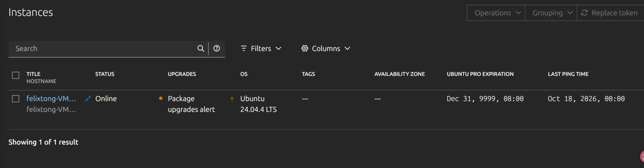
02 TEST DESIGN
Validation scope & evidence
Environment
Validated actions
Evidence sources
VMware · Ubuntu 24.04.4 LTS
landscape-client 24.02-0ubuntu5.7
Register · Run script · Install/Remove
Restart · Ubuntu Pro status
Landscape UI · Activities output
Terminal cross-check · client logs
Scope boundary
— Single instance only
— No production SLA assessment
— No enterprise-scale validation
— No real customer interviews
LANDSCAPE / CUSTOMER SUCCESS
03 / 10

Slide 4
03 TIME TO FIRST VALUE
From onboarding to first value
01
02
03
04
05
06
Environment
Pro enabled
Device online
First run
Remediated
Value proven
Ubuntu + VMware
ESM / Landscape
Registered
Script failed
Plugin + identity
Script succeeded
TTFV achieved after the first successful, verifiable remote script execution.
◎
Key friction points: account configuration, script execution prerequisites, and user permission restrictions.
LANDSCAPE / CUSTOMER SUCCESS
04 / 10

Slide 5
04 CASE STUDY
Script execution: issue to resolution
Plugin unavailable
FAILED
Validated remediation
17:46
ScriptExecution not enabled
1
Inspect manager.log
Root user rejected
2
Enable ScriptExecution
FAILED
18:06
Execution identity restricted
3
Set script_users
4
Rerun as authorized user
Authorized execution
SUCCEEDED
18:13 → 18:16
Hostname, uptime and dpkg returned
Outcome: remote execution restored without bypassing root-user restrictions.
LANDSCAPE / CUSTOMER SUCCESS
05 / 10

Slide 6
05 DELIVERY RESULTS
Remote administration validation
INSTALL
REMOVE
REBOOT
cbonsai 1.3.1-1
cbonsai
Ubuntu instance
21:47 → 21:50
21:56 → 21:59
22:09 → 22:12
Local dpkg-query confirmed installed
Local query confirmed not installed
Instance later returned Online
Auditability
Activities records creation, delivery, completion, outcome and command output.
However, submit-time confirmation was not clearly perceived during Install / Remove.
LANDSCAPE / CUSTOMER SUCCESS
06 / 10

Slide 7
06 CUSTOMER RISK
Customer experience risk register
ID
Observation
Assessment
Priority
UX-01
Install / Remove submission feedback not apparent
Observed twice
HIGH
UX-02
Script execution prerequisites unclear on first use
Resolved setup friction
HIGH
UX-03
Online instance shows “No processes running”
Root cause unverified
INVESTIGATE
UX-04
dpkg marked “Security upgrade”; candidate matches installed
Semantics / sync unclear
INVESTIGATE
No product defect is asserted where data synchronization or status semantics remain unverified.
LANDSCAPE / CUSTOMER SUCCESS
07 / 10

Slide 8
07 RESPONSE GUIDES
Customer-facing response playbooks
01
02
03
Task submitted, no visible response
Remote script execution fails
Processes page shows no data
RESPONSE
RESPONSE
RESPONSE
Locate activity → explain states → verify locally
Check Online → plugin → script user → read-only retest
Clarify goal → collect logs → avoid assumptions
SUCCESS CRITERION
SUCCESS CRITERION
SUCCESS CRITERION
Help admin independently track asynchronous work.
Restore authorized execution or escalate to Support.
Offer interim query path and investigate data flow.
LANDSCAPE / CUSTOMER SUCCESS
08 / 10

Slide 9
08 CUSTOMER SUCCESS OPERATIONS
Cross-functional incident SOP
CUSTOMER
Submit issue
Confirm outcome
↓
Business impact + evidence
CSM
Triage & impact
Update stakeholders
↓
Escalation packet
SUPPORT
Reproduce & diagnose
Fix / workaround
↓
Root cause + recommendation
PRODUCT / ENG
Assess product gap
Docs / backlog / release
CSM owns customer communication and closure; Support owns diagnosis; Product/Engineering owns product change.
LANDSCAPE / CUSTOMER SUCCESS
09 / 10

Slide 10
09 PRIORITIES & OWNERSHIP
Next-phase action plan
01
Onboarding enablement
02
Open investigations
Script prerequisites + first-run checklist
Processes empty state + dpkg status semantics
Owner: CSM / Enablement
Owner: Support / Product
03
Reusable support assets
04
Expand test coverage
Task-tracking guide + incident playbooks
Second Ubuntu instance; grouping and batch tasks
Owner: CSM / Support
Owner: Operations / Support
Direction: shorten TTFV, improve state clarity, and scale repeatable customer support.
LANDSCAPE / CUSTOMER SUCCESS
10 / 10

