Slide 1
Data preparation
Data analysis
processing.sh – generate data
Genomes
Coverage
Amplicon counts
Vcf files
Number of Ns
Filter (Length > 25000 & Ns < 5000)
Custom analysis
metadata
QC.sh – Review data and pick samples to exclude
Alignment
Tree
Manual inspection in Rstudio
Case reports
@Vang knows
Visualize in auspice
export.sh – tidy up data
Remove samples
Renaming
Dump data
nextstrain.sh – nextstrain analysis
Nextstrain workflow
Dump results

Slide 2
Folder structure and content
/metadata/ Metadata goes here, along with R scripts for curation etc.
/demultiplexed/
/[batch 1]/ demultiplexed data from batch 2
/[batch 2]/ demultiplexed data from batch 2
...
/processing/
/[batch 1]/ processed data from batch 1
/[batch 2]/ processed data from batch 2
...
/QC/
/manual_curation/ R scripts for manual QC + other stuff
/aligntree/ genomes, alignment and tree of all genomes from /processing/
/export/
/[timestamp]_export/ batch of exported sequences
/[timestamp]_export/ batch of exported sequences
/analysis/
/GISAID-data/ data downloaded from GISAID for comparative stuff
/data/ sequences and metadata
/nextstrain/ All output from nextstrain
/case-reports/ All output from case-reports

Slide 3
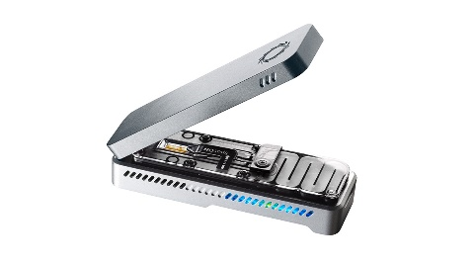
Data flow
Batch-wise:
demultiplexed
processing
QC
export
metadata
Agglomerated:
analysis

