Slide 1
Object-Oriented Analysis and Design with UML
Lecture3 Overview of UML

Slide 2
Index
What is a model?
What is UML?
UML Basic Structures
UML Building Blocks
things, relationships, diagrams
Common Mechanisms
Architecture
Ref: www.uml.org

Slide 3

What Is a Model?
A model is a simplification of reality.
Notes:
According to Grady Booch, IBM Fellow, a model provides the blueprints of a system. Models may encompass detailed plans, as well as more general plans that give a 30,000-foot view of the system under construction. A good model includes those elements that are not relevant to the given level of abstraction. Every system may be described from different aspects using different models, and each model is therefore a semantically closed abstraction of the system. A model may be structural, emphasizing the organization of the system, or it may be behavioral, emphasizing the dynamics of the system.
Define what is meant by the term “model.”

Slide 4
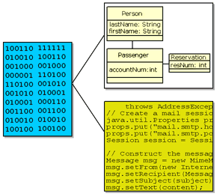
What is a Model?
A model is a semantically closed abstraction of a subject system.
A model is defined in UP as “a complete description of a system from a particular perspective.”
Examples of models:
UML model
Code
Data model
Notes:
In the Rational Unified Process (RUP), a model is defined as a complete specification of a problem or solution domain from a particular perspective. Each model is complete in the sense that you do not need any additional information to understand the system from that perspective. A problem domain or a system may be specified by a number of models that represent different perspectives for different project stakeholders.

Slide 5
Why Model?
Modeling achieves four aims:
Helps you to visualize a system as you want it to be.
Permits you to specify the structure or behavior of a system.
Gives you a template that guides you in constructing a system.
Documents the decisions you have made.
You build models of complex systems because you cannot comprehend such a system in its entirety.
You build models to better understand the system you are developing.
Notes:
According to Booch in The Unified Modeling Language User Guide, modeling achieves four aims:
1. Models help you to visualize a system, as you want it to be. A model helps the software team communicate the vision for the system being developed. It is difficult for a software team to have a unified vision of a system that is described only in specification and requirement documents. Models bring about understanding of the system.
2. Models permit you to specify the structure of behavior of a system. A model allows how to document system behavior and structure before coding the system.
3. Models give a template that guide you in constructing a system. A model is an invaluable tool during construction. It serves as a road map for a developer. Have you experienced a situation where a developer coded incorrect behavior because he or she was confused over the wording in a requirements document? Modeling helps alleviate that situation.
4. Models document the decisions you’ve made. Models are valuable tools in the long term because they give “hard” information on design decisions. You don’t need to rely on someone’s memory.
Sell the students on the value of visual modeling.
Clarify that you are discussing formal modeling, not modeling written on a white board or on the back of a napkin at lunch.

Slide 6
The Importance of Modeling
Less Important
More Important
Paper Airplane
Fighter Jet
Notes:
You can take a piece of paper and a paper clip, and, in a few minutes, have a paper airplane that entertains your kids. If it isn’t built just right, you can always start over and build another airplane.
Would it be smart for you to build a fighter jet in the same way? That is, start with some steel, nuts, bolts, and wiring and go right to work. Of course not. You’re building an airplane that costs millions of dollars, and the cost of failure is high. You’re also be part of a much larger team, needing blueprints and models to effectively communicate with one another. (The Unified Modeling Language User Guide, Booch, 1999.)
Emphasize that complex projects outside of the software industry require models.
It’s inconceivable that a defense contractor would build an airplane as complex as a fighter jet without modeling the airplane first. Why? Because unlike building paper airplanes, the cost of failure is significant.
As a general rule, modeling becomes more important as the complexity and expense rises.

Slide 7
What Is the UML?
The UML is a language for
Visualizing
Specifying
Constructing
Documenting
the artifacts of a software-intensive system.
Notes:
The software systems that you develop today are more complex than the human mind can comprehend. This is why you model systems. Your model selection profoundly influences how you attack the problem and shape the solution.
No single model is sufficient. Every complex system is best approached through a small set of nearly independent models.
Therefore, to increase comprehension, a common language like the Unified Modeling Language (UML) is used to express models.
A modeling language is a language whose vocabulary and rules focus on the conceptual and physical representation of a system. A modeling language like the UML is a standard language for software blueprints.
Introduce the UML. Remember many of your students have no idea what the UML really is.
The next four slides explain how the UML is a language for visualizing, specifying, constructing and documenting.

Slide 8
The UML Is a Language for Visualizing
Communicating conceptual models to others is prone to error unless everyone involved speaks the same language.
There are things about a software system you can’t understand unless you build models.
An explicit model facilitates communication.
Notes:
Typically, projects and organizations develop their own language for modeling systems, making it difficult for outsiders and new team members to understand what is going on.
Communicating these conceptual models to others is prone to error unless everyone involved speaks the same language. The UML offers a set of symbols that represents well-defined semantics. One developer can write a model in the UML, and another developer can interpret that model unambiguously.
There are things about a software system you can’t understand unless you build models that transcend the textual programming language. For example, the meaning of a class hierarchy can be inferred, but not directly grasped, by staring at the code for all the classes in the hierarchy. The UML is a graphical language that addresses this problem.
If the developer who cut the code never wrote down the models, the information would be lost forever. At best, the information would only be partially recoverable from the implementation after the developer has moved on. Writing models in the UML addresses this issue. An explicit model facilitates communication. (The Unified Modeling Language User Guide, Booch, 1999.)
Stress how the UML is designed to promote communication using pictures rather than text.
Using the UML allows the “light bulb” to go on in the minds of many people. Rather than trying to interpret a textual description of a system design, the UML offers a graphical representation of that same description.
In this case, a picture is truly worth a thousand words.

Slide 9
The UML Is a Language for Specifying
The UML builds models that are precise,
unambiguous, and complete.
Notes:
In this context, specifying means to build models that are precise, unambiguous, and complete. In particular, the UML addresses the specification of all the important analysis, design, and implementation decisions that must be made to develop and deploy software-intensive systems. (The Unified Modeling Language User Guide, Booch, 1999.)
The UML can be used to specify detailed or general models.
Anyone who has worked on a project where miscommunication occurred appreciates this feature of the UML.
The UML allows the modeler to specify their intentions in a clear, unmistakable manner.

Slide 10
The UML Is a Language for Constructing
UML models can be directly connected to a variety of programming languages.
Maps to Java, C++, Visual Basic, and so on
Tables in a RDBMS or persistent store in an OODBMS
Permits forward engineering
Permits reverse engineering
Notes:
The UML is not a visual programming language. However, models using the UML can be directly connected to a variety of programming languages, making it possible to map from a model in the UML to a programming language or even to a database.
If it is best expressed graphically, it is done graphically in the UML. If it is best expressed textually, it is done in the programming language.
This mapping permits forward engineering: the generation of code from a UML model to a programming language. Reverse engineering is also possible: the reconstruction of a model from implementation back into the UML.
The UML was designed with forward and reverse engineering in mind.
Rational has partners who provide round-trip engineering for other languages.

Slide 11
The UML Is a Language for Documenting
Use Case Diagram
Deployment Diagram
- À©µµ¿ì 95 : Å¬¶óÀÌ¾ðÆ®
ºÐ»ê È¯°æÀÇ ÇÏµå¿þ¾î¹× ³×Æ®¿÷À¸·ÎÀÇ Á¤º¸ ½Ã½ºÅÛ ¿¬°á ¸ðµ¨
- À©µµ¿ì NT: ÀÀ¿ë¼­¹ö
- À¯´Ð½º ¸Ó½Å: ÀÀ¿ë ¼­¹ö ¹× µ¥ÀÌÅ¸ ¼­¹ö, Åë½Å ¼­¹ö
- IBM ¸ÞÀÎÇÁ·¹ÀÓ: µ¥ÀÌÅ¸ ¼­¹ö, Åë½Å ¼­¹ö
Use Case 1
Window95
Windows95
Windows95
¹®¼­°ü¸®
Å¬¶óÀÌ¾ðÆ®.EXE
Windows
¹®¼­°ü¸® ¾ÖÇÃ¸´
Actor A
Use Case 2
Actor B
NT
Solaris
¹®¼­°ü¸® ¿£Áø.EXE
Alpha
Windows
ÀÀ¿ë¼­¹ö.EXE
UNIX
Use Case 3
NT
IBM
Mainframe
µ¥ÀÌÅ¸º£ÀÌ½º¼­¹ö
Sequence Diagram
Class Diagram
mainWnd
fileMgr :
document :
gFile
repository
FileMgr
DocumentList
Document
user
FileMgr
Document
add( )
name : int
fetchDoc( )
delete( )
docid : int
Æ¯Á¤¹®¼­¿¡ ´ëÇÑ º¸±â¸¦
1: Doc view request ( )
sortByName( )
get( )
numField : int
read() fill the
»ç¿ëÀÚ°¡ ¿äÃ»ÇÑ´Ù.
open( )
code..
2: fetchDoc( )
close( )
FileList
fList
read( )
sortFileList( )
3: create ( )
add( )
create( )
fillDocument( )
delete( )
1
4: create ( )
5: readDoc ( )
1
È­ÀÏ°ü¸®ÀÚ´Â ÀÐ¾î¿Â
6: fillDocument ( )
¹®¼­ÀÇ Á¤º¸¸¦ ÇØ´ç ¹®¼­
°´Ã¼¿¡ ¼³Á¤À» ¿äÃ»ÇÑ´Ù.
7: readFile ( )
Repository
rep
File
È­¸é °´Ã¼´Â ÀÐ¾îµéÀÎ
8: fillFile ( )
(from Persistence)
read( )
GrpFile
°´Ã¼µé¿¡ ´ëÇØ ÀÌ¸§º°·Î
9: sortByName ( )
name : char * = 0
º¸¿©ÁØ´Ù.
Á¤·ÄÀ» ½ÃÄÑ È­¸é¿¡
readDoc( )
read( )
readFile( )
open( )
create( )
fillFile( )
The UML addresses documentation of system architecture, requirements, tests, project planning, and release management.
Notes:
Project artifacts are critical in controlling, measuring, and communicating about a system during its development and after its deployment.
The UML addresses the documentation of a system’s architecture and all of its details. The UML also provides a language for expressing requirements and for tests. Finally, the UML provides a language for modeling the activities of project planning and release management. (The Unified Modeling Language User Guide, Booch, 1999.)
This slide does not represent all the diagrams defined in the UML specification. For example, there is no graphic presented here for a composite structure diagram or a timing diagram. Composite structure is a more advanced modeling concept that is not covered in this course. The timing diagram is new to UML2 and will be introduced in a later module.
UML diagrams should be treated as formal project artifacts.
Each diagram created by a project team should be treated as an artifact.
The UML can help alleviate some of the paper crunch that many software teams experience.

Slide 12
Why Unified?
To integrate models from different domains
Supporting Development Life Cycle:
Visual syntax for modeling
At all levels of development
From requirements to implementation
Wide Application Domains
Used to model different type of applications
From real-time embedded systems
To management decision support systems
Platform Neutral:
Excellent support for pure OO languages:
Smalltalk, Java, C#, ..
Also effective for hybrid languages:
Visual Basic
Support for Development Processes
For both UP and other software engineering processes
Own internal concepts
Tries to be consistent and uniform
in its application of internal concepts

Slide 13
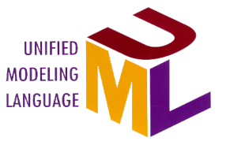

A Language Is Not Enough to Build a System
Team
-
Based
Development
Modeling
Unified
Language
Process
Notes:
The UML provides a standard for the artifacts of development (semantic models, syntactic notation, and diagrams) that must be controlled and exchanged. But the UML is not a standard for the development process.
Despite all its value, you cannot achieve successful development of today’s complex systems solely by using the UML. Successful development also requires employing an equally robust development process.
Emphasize here that the UML was not designed to stand alone, a process is also needed.
This slide establishes the need for more than the UML.
Some students may think that, if they know the UML, they’re done. They don’t need a process.
Establish that the UML, while a good and necessary first step, is not enough.
Just knowing the UML would be analogous to learning English by using a dictionary. Sure, all the words are there, but you still need to understand how the English language is structured before one can effectively speak.

Slide 14
Objects and UML
The Premise of UML:
Software and other systems can be modeled as
collection of collaborating objects
Object:
A cohesive cluster of data and behavior
Contains data and perform functions
Aspects of UML to describe a model:
Static Structure
Object types
and how they are related
Dynamic behavior
Object life cycles
and their collaboration

Slide 15
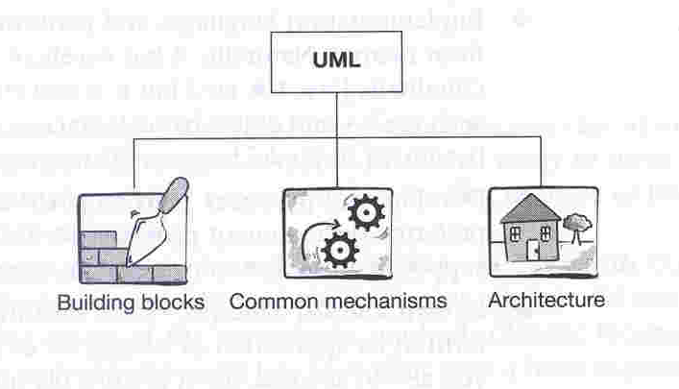
UML Structure
The structure of UML:
Building blocks
Things
Structural
Behavioral
Grouping
Annotation
Relationships
Diagrams
Common mechanisms
UML ways to achieve specific goals
Architecture
The view of system architecture

Slide 16
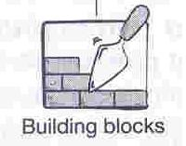
UML Building Blocks
Things
modeling elements
Relationships
how things are semantically related
Diagrams
Views of models
Show collection of things
What system do (analysis level diagrams)
How it will do (design level diagrams)
Things
Relationships
Diagrams

Slide 17
UML Things
Structural things
The nouns of a UML model:
classes,
interfaces,
collaboration,
use case,
active class,
component,
node
Behavioral Things
The verbs of a UML model :
interactions,
state manchine
etc
Grouping Things
Package:
to group semantically related elements
Annotation Things
The note to explain the diagrams
like a yellow sticky note

Slide 18
UML Relationships
To show on a model
How two or more things relate to each other
To capture meaningful connections between things
Type of relationships
Association
Links between objects
Aggregation – “whole-part” relationship
Composition – “ comprise/contains” – relationship
Dependency
Change to one object affects behavior of another object
Generalization
Realization
One classifier specifies a contract
the other classifier to carry out

Slide 19
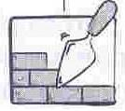
UML Relationships
Relationships
Association
Dependency
Generalization
Realization
UML Relationships and their graphical representation

Slide 20
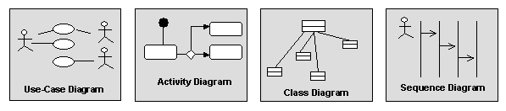
UML Diagrams
Diagrams graphically depict a view of a part of your model.
Different diagrams represent different views of the system that you are developing.
A model element will appear on one or more diagrams.
Notes:
Diagrams provide a means of visualizing and manipulating the model elements.

Slide 21
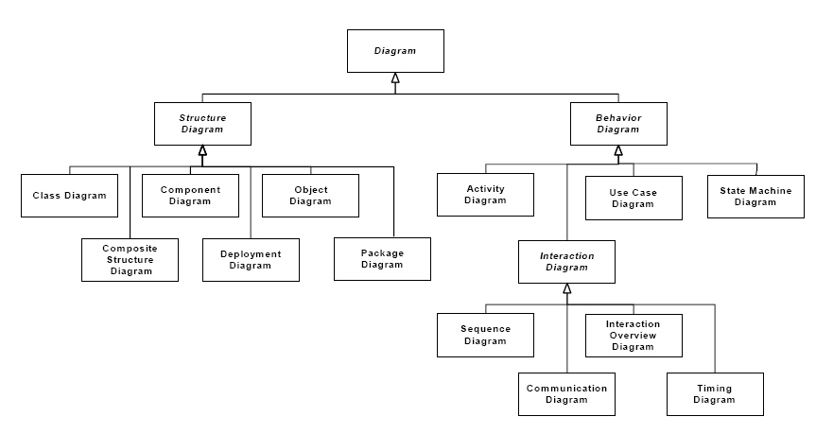

Slide 22
Common Diagrams (1 of 4)
Class diagram
set of classes, interfaces, and collaborations and their relationships
static design/process view
Object diagram
set of objects and their relationships
static design/process view
Use case diagram
set of use cases and actors (special kind of class) and their relationships
static use case view

Slide 23
Common Diagrams (2 of 4)
Interaction diagrams
show interaction consisting of a set of objects and their relationships including messages dispatched among them
Sequence diagram
emphasizes time-ordering of messages
Collaboration diagram/Communication diagram
structural organization of the objects that send/receive messages
dynamic view of the system

Slide 24
Common Diagrams (3 of 4)
Statechart diagram
shows state machine consisting of states, transitions, events, and activities
model behavior
dynamic view of the system
Activity diagram
specialization of the statechart diagram that shows the flow from activity to activity within the system
dynamic view of the system

Slide 25
Common Diagrams (4 of 4)
Component diagram
shows the organizations and dependencies among a set of components
related to class diagrams
static implementation view of the system
Deployment diagram
shows the configuration of run-time processing node and the components that live on them
related to component diagrams
static deployment view of an architecture

Slide 26
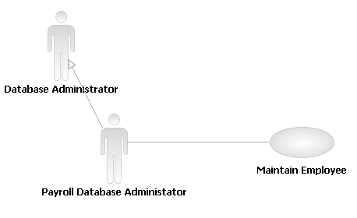
Use-Case Diagram
Actor
Someone or something that
Interacts with the system
Use Case
Units of system behavior
Notes:
The use-case model contains the following elements, which are displayed in a use-case diagram:
Actors: Used to represent someone or something outside the system that interacts with the system.
Use Case: Used to represent a unit of system behavior that comprises several possible sequences of actions.
Mention the possible relationships that appear in a use-case diagram.

Slide 27
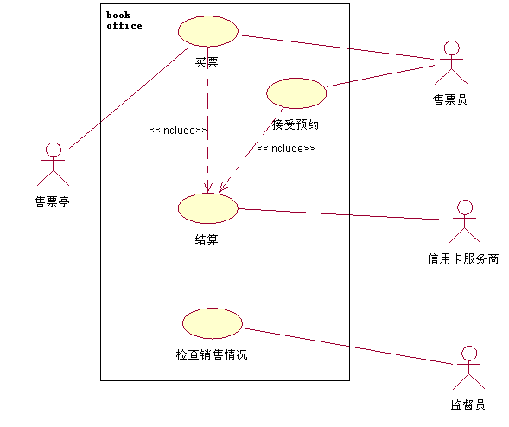
Samples (UML1.x)
Use Case Diagram

Slide 28
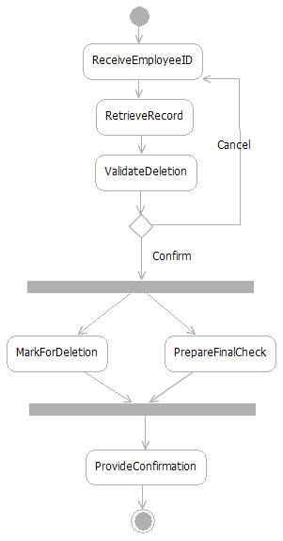
Activity Diagram
Action
A step in the flow of events
Decision
Flows split based on a guard
condition
Fork
Beginning of concurrent flows
Join
End of concurrent flow
Flow
Show the sequence of
activities
Notes:
Activities describe graphically the flow of events of a use case. The flow of events consists of a sequence of activities that together produce something of value for the actor. The flow of events consists of a basic flow and one or several alternative flows.
Actions: Represent the performance of an activity or step within the flow of events.
Flow/Edge: Show what activity state follows after another.
Decision/Merge Control which flow (of a set of alternative flows) follows once the activity has been completed, based on a guard condition. Decisions are used to show alternative threads in the flow of events of a use case.
Forks/Joins: Show the beginnings and ends of parallel subflows. Forks and joins are used to show concurrent threads in the flow of events of a use case.

Slide 29
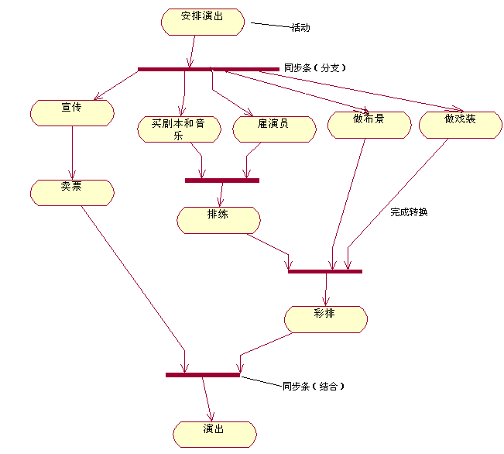
Activity Diagram

Slide 30
What is a Design Model?
A design model:
Describes the realization of use cases in terms of design elements
Describes the design of the application
Contains the following diagrams:
Class: Shows UML classes and relationships
Component: Shows the structure of elements in the implementation model
Communication and Sequence: Show how objects and classes interact
State Machine: Shows event-driven behavior
Notes:
The design model may include the following diagrams:
Class diagrams: Show the classes, their internal structure, and their relationships to other classes. May also show the package structure of the design model (package diagram).
Composite Structure diagrams: Show the runtime decomposition of a class.
Component diagrams: Used, in the design model, to show the high-level structure of the implementation model.
State Machine diagrams: Used to model the event-driven aspects of an object’s behavior.
Interaction diagrams: Used, in the design model, in use-case realizations to show how behavior is assigned to classes in the design model. The two interaction diagrams are semantically equivalent, so in Software Architect you can generate a sequence diagram under an interaction automatically from the interaction’s communication diagram or vice versa.
In Software Architect, one interaction diagram type can be generated automatically from another. So if you have a sequence diagram under an interaction and add a communication diagram, Software Architect will automatically populate the communication diagram with the correct interactions.

Slide 31
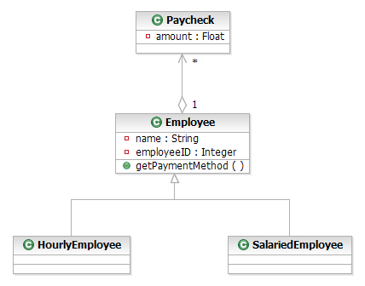
Class Diagram (Design Model)
Class
A description of a set of objects
Aggregation Represents a part-whole relationship
Attribute Named property of a class
Operation
Class behavior
Generalization Shows an inheritance relationship
Notes:
Class diagrams show the static structure of the model, in particular, its classes, their internal structure, and their relationships to other classes. Class diagrams do not show temporal information.
A class diagram typically displays the following elements and the relationships among them:
Classes: Describe sets of objects that share the same responsibilities, relationships, operations, attributes, and semantics.
Attributes: Named properties of the class or its objects. An attribute also defines the type of its instances.
Operations: Services that can be requested (the behavior of the class).
Packages: Can be included for the sake of context although UML 2.0 has brought package diagrams into the mainstream.

Slide 32
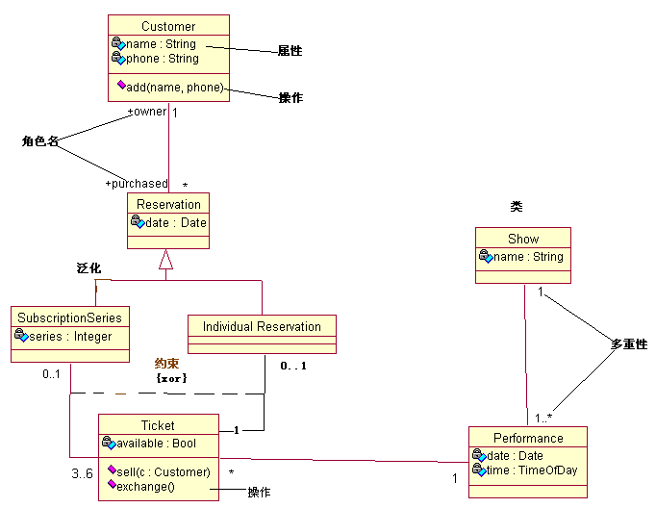
Class Diagram

Slide 33
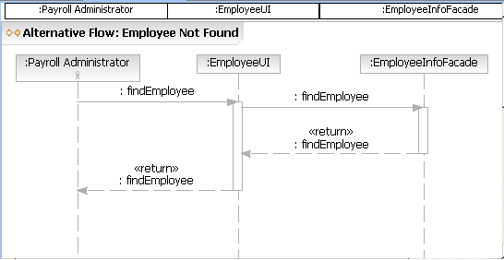
Sequence Diagram
Object
Shows the object involved in the interaction
Messages
Show data exchanged between objects
Lifeline
Shows the life of the object
Notes:
In the design model, sequence diagrams are used to show how objects interact to perform the behavior of all or part of a use case as part of a use-case realization. The sequence diagram clarifies the roles of objects in a flow of events, and thus it provides basic input for determining class responsibilities and interfaces.
Sequence diagrams display the following model elements:
Lifelines: Represent the existence of the object at a particular time
Actors: Can be included in the diagram when you want to show that an actor initiates the interaction
Messages: Communicate between objects that conveys information with the expectation that activity will ensue

Slide 34
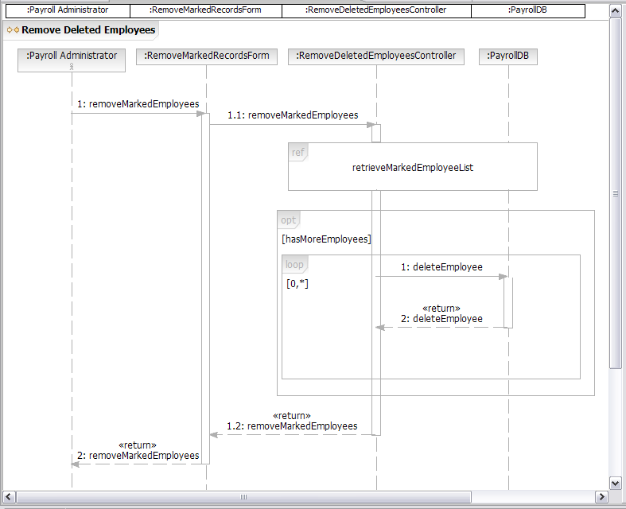
Sequence Diagram: Combined Fragments
Interaction Use (ref)
References another interaction
Optional Fragment (opt)
Executed if guard condition evaluates to true
Loop (loop)
Executed as long as the first guard condition evaluates to true
Notes:
To help with the modeling of, for example, multiple flows of events, which in the past always meant creating many interaction diagrams with only slight differences among them, you can use combined fragment notation—new with UML 2.0 and supported in Software Architect—which allows you to embed multiple paths through an interaction inside the same interaction diagram.
A combined fragment in a sequence diagram has an operator and one or more subinteractions in a nested region of the diagram. Gates may be defined on the combined fragment so that messages can be sent from the combined fragment to other parts of the main interaction.
Combined fragments have a keyword associated with them, shown on the frame surrounding the combined fragment. The more common combined fragment types include:
loop: The loop fragment contains one subfragment that executes as long as a Boolean guard condition evaluates to true.
ref: The combined fragment references another sequence diagram. In Software Architect, adding the ref operator from the toolbox automatically generates a new interaction instance in the model.
opt: The opt fragment type contains one subfragment that executes only when the guard condition evaluates to true.
See Software Architect Help for discussion of other keywords.

Slide 35
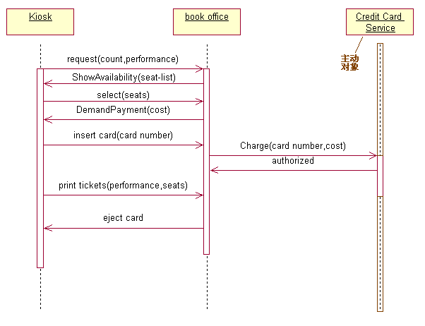
(UML1.x)
Sequence Diagram

Slide 36
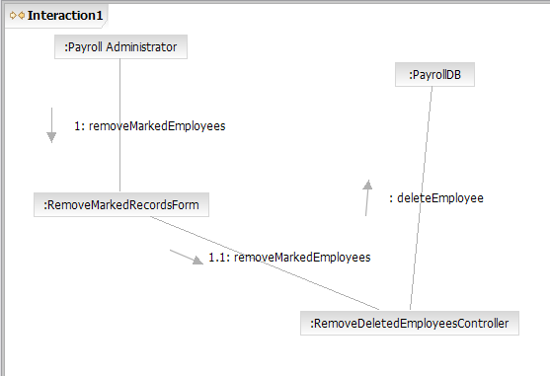
Communication Diagram
Objects
Shows the object involved in the interaction
Message
Shows data exchanged between objects
Notes:
Communication diagrams provide another way to show how objects interact to perform the behavior of a particular use case or a part of a use case. Where sequence diagrams emphasize the interactions of objects over time, communication diagrams are designed to emphasize the relationships between objects.
Objects: Objects show the name of the object and its class, separated by a colon:
objectname : classname
Links: Links are relationships among objects across which messages can be sent, shown as a solid line between two objects. A link can be an instance of an association, or it can be anonymous, meaning that its association is unspecified. Message flows are attached to links.
The diagram shown in the slide is based on the example sequence diagram from the previous slide. Two other elements that may appear in a communication diagram but do not appear in the example are:
Actors: Actor instances show the invoker of the interaction.
Messages: A message is a communication between objects that conveys information with the expectation that activity will ensue.
The communication diagram shown in the slide was generated from the sequence diagram on the previous slide.

Slide 37
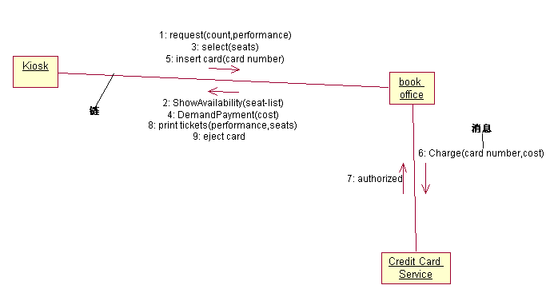
(UML1.x)
Collaboration Diagram

Slide 38
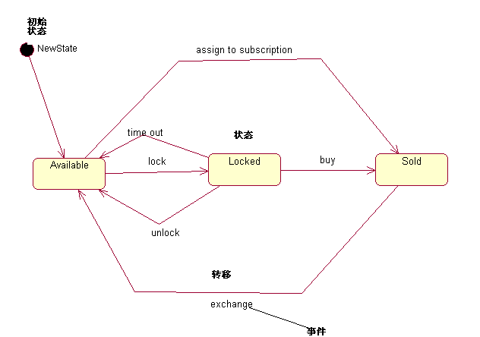
State Diagram

Slide 39
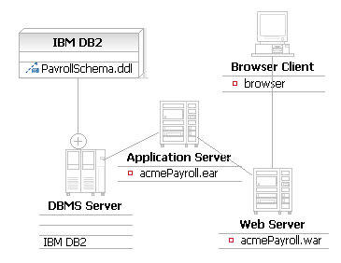
Deployment Diagram
Artifact
Represents a physical file
Owned Element Relationship
Shows another way of showing nested elements
Node
Represents a physical machine
Notes:
Deployment diagrams show the deployment architecture of the system, that is, which of the system’s software artifacts reside on which pieces of hardware.
Deployment diagrams display the following model elements:
Artifacts: Represent physical files (executable files, binaries, archives, and so on). In previous versions of UML, artifacts were called “components.”
Nodes: Represent any physical machine that can host software, such as a server or workstation. A node could also be used to model deployment to a virtual machine, for example, used as a test environment.

Slide 40
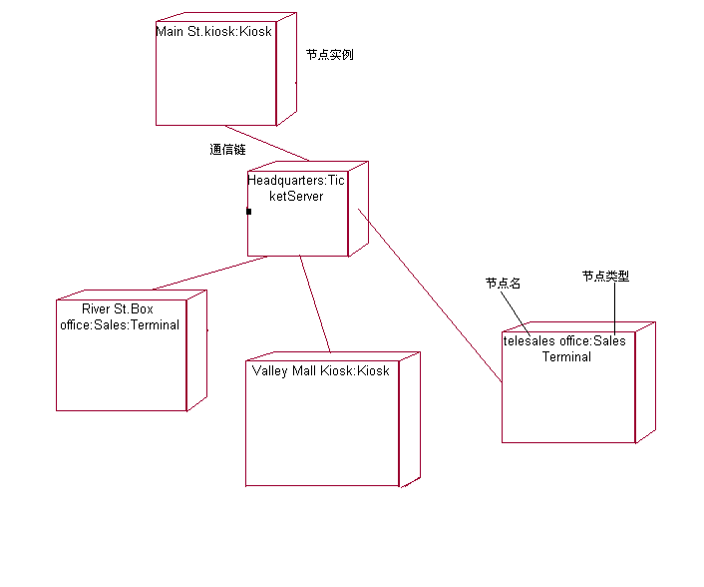
Deployment Diagram

Slide 41
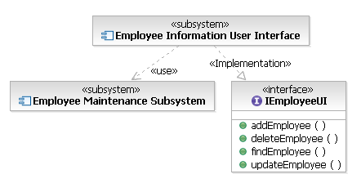
Component Diagram
Component
Modular parts of the system
Class
Included to show implementation relationships.
Notes:
Component diagrams show the runtime structure of the system at the level of software components. Components are the modular parts of the system and are made up of groups of related objects that are hidden behind an external interface.
Component notation is based on class notation, so a component can have attributes and operations.
Relationships among components can include connectors or dependencies.
The definition of “component” has changed for UML 2.0. Components are no longer just code files, DLLs, and so on.
Notice that the notation for a component diagram has changed and that a class box with the «component» keyword can now also be used to represent a component.

Slide 42
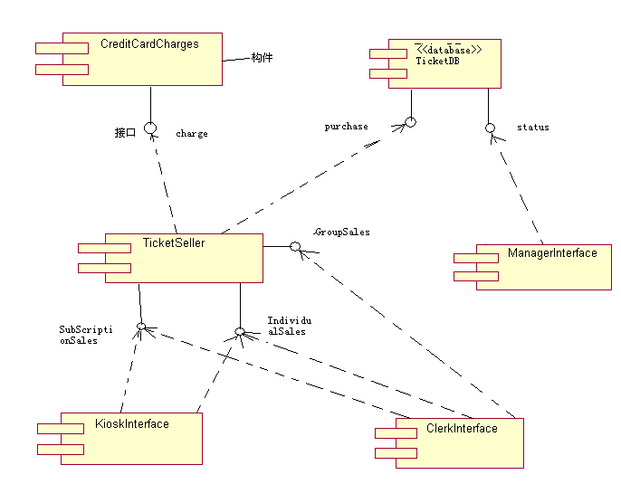
Component Diagram

Slide 43
composite structure diagram
The composite structure diagram which is new in UML 2.0, describes the participants and relationships that are internal to an individual classifier, such as an object, use case, class, or collaboration. A composite structure diagram is often attached to a larger diagram to describe the internal structure or context of one of the elements in the parent diagram. The diagram shows the roles and relationships that a set of object instances play in a system component.

Slide 44
Sample: Structure Diagram With Ports
Structured Class Name
Behavior Port
Service Port
Relay Port
Assembly Connector
partA
partB
Delegation Connector
Notes:
Ask the students if the ports on the internal parts are relay ports or behavior ports. From our perspective, we don’t know as the internals of the parts themselves are encapsulated away.

Slide 45
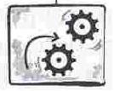
Common Mechanisms
Strategies applied for approaching object modeling
Common mechanisms in UML:
Specifications
Graphical and textual descriptions of semantics
Adornments
Added information on diagrams
Common divisions
Classifier and instance (abstract and concrete)
Interface and implementation (separate what and How)
Extensibility mechanisms
Constraints (extend semantics)
Stereotypes (adds new UML elements)
Tagged values ( extends an elements specs)
Notes:
Adornment: Süs

Slide 46
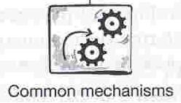
UML Common Mechanisms
Specifications
Common Divisions
Adornments
Extensibility Mechanisms
UML Common Mechanism Types

Slide 47
Common Mechanisms: Specifications
The “meat” of the model
Hold the model together
Give meaning to the model
Maintained using a CASE tool
CASE: Computer Aided Software Engineering
Provides ways to enter, view, and modify specifications
Models may be
Elided
Elements are present in backplane
Hidden in diagram to simplify the view
Incomplete
Some elements may be missing
Inconsistent
Model may contain contradictions
Drive in modeling is to evolve into
consistent models
Sufficiently complete models to construct software
Notes:
Adornment: Süs

Slide 48
Specifications provide the semantic
Semantic Backplane
Class Specification
Usecase Specification
Dependency Specification
BankAccount
name
accountNumber
deposit()
withdraw()
calculateIntereset()
Deposit
Modeling Element
Semantic Backplane

Slide 49
Common Mechanisms: Adornments
To provide more information
when needed on diagrams
Start model construction with
High level models
Use just the basic symbols
Add one or two adornments
Refine the model over time
Add more and more adornments
Until the model sufficiently detailed
Show the adornments only
to increase the clarity and readability
to highlight some important features
Window
Unadorned element
Window
(author=jim, status=tested
+size: Area = (100,100)
#visibility:Boolean=false
+defaultSoze: Rectangle
#maximumSize: Rectangle
-xptr:Xwindow*
+create()
+hide()
+display(location: Point)
-attachXWindow(xwin: Xwindow*)
Element with Adornments
Notes:
Adornment: Süs

Slide 50
UML Classifiers
Classifier | Semantics
Actor | A role played by an outside user of the system to whom the system delivers some value
Class | A description of a set of objects that share the same features
Classifier Role | A classifier restricted to a particular role in a collaboration
Component | A physical and replaceable part of a system that conforms to and realizes one or more interfaces
Datatype | A type whose values have no identity such as the primitive types, int, float, and char.
Interface | A collection of operations that are used to specify a servide offered by a class or component
Node | A physical, run-time element that represents a computational resource
Signal | An asynchronous message passed between objects
Subsystem | A grouping of elements – some of these may specify the behavior offered by contained elements
Usecase | A description of a sequence of actions that a subsytem performs to yield a value to a user

Slide 51
Common Mechanisms: Common Divisions
Describe ways of thinking about the world
Two types:
Classifier and instance
Classifier:
Abstract notion of type
Example: bank account
Instance:
Specific, concrete things
Example: “my bank account”
Interface and implementation
To separate what something does (interface)
From how it does (implementation)
Interface:
A contract to guarantee implementation must adhere
Implementation:
The actual specification to show how the functionality obtained
Notes:
Adornment: Süs

Slide 52
Common Mechanisms: Extensibility Mechanisms
To extend the model when UML is not sufficient
Constraints
A text string in braces “{}”
Specifies some conditions or rules
The modeling element must maintain
Stereotypes
Represents a variation of an existing models element.
Allow to introduce new modeling elements
Append the stereotype in guilemots “« »”
Tagged values
To add own properties to modeling elements
Example:
{tag1=value1, tag2=value2,.., tagN=valueN}
Notes:
Adornment: Süs

Slide 53
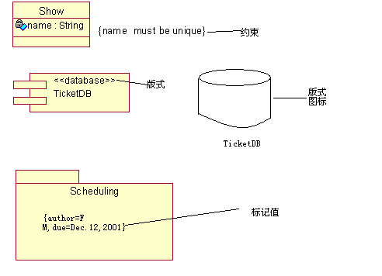

Slide 54
Architecture
Architecture is all about capturing the strategic aspects of the high-level concept of a system.
4+1 view
Create models that can be built and studied separately, but are still interrelated.
Logica l View
Implementation View
Analysts/Designers
Programmers
Structure
Software management
Use-Case View
End-user
Functionality
Process View
Deployment View
System engineering
System integrators
System topology, delivery,
installation, communication
Performance, scalability, throughput
Notes:
The key phrase is “nearly independent,” meaning that models can be built and studied separately, but are still interrelated.
To understand the architecture of object-oriented systems, you need several complementary and interlocking views. An architectural view can be defined as a simplified description (an abstraction) of a system from a particular perspective or vantage point, covering particular concerns, and omitting entities that are not relevant to this perspective. Views are “slices” of models.
Each of the views below may have structural and behavioral aspects. Together, they represent the blueprints of a software system.
Use-case view exposing the requirements of the system
Logical view capturing the vocabulary of the problem space and the solution space
Process view modeling the distribution of the system’s processes and threads
Implementation view addressing the physical realization of the system
Deployment view focusing on system engineering issues
To address these different needs, Rational has defined the “4+1 view” architecture model.
Remember that not all systems require all views. The number of views is dependent on the system you’re building. For example, a single processor does not require a deployment view or a small program does not require an implementation view and so on.
Many interrelated models are needed to accurately describe a system.
Introduce the 4+1 views of architecture first.
It’s important that they understand from the beginning that the models created/read represent a specific view of the system.

Slide 55

Architecture Description
Software Architecture Document
Represents comprehensive overview of the architecture of the software system
Includes
Architectural Views
Goals and constraints
Requirements that architecture must support
Technical constraints
Change cases
Size and performance characteristics
Quality, extensibility, and portability targets
Notes:
The Software Architecture Document serves as a communication medium between the architect and other project team members regarding architecturally significant decisions which have been made on the project.
For more information, see Artifacts->Analysis and Design Artifact Set->Software Architecture Document in RUP.

Slide 56
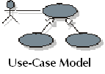

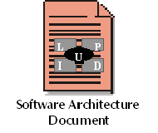
Architecture Description (cont.)
Views are pulled from other artifacts
Implementation Model
Design Model
Deployment Model
Notes:
In addition to its own data, the Software Architecture Document reports on architectural features contained in other artifacts. Note that both the Logical View and Process View are subsets of the Design Model.

Slide 57
Architecture As a Basis for Project Management
A stable architecture represents a significant project milestone.
Poor architecture is often a reason for project failure.
Architecture is a prerequisite for predictable planning.
Architecture is the source of numerous high-payoff/high-risk decisions.
Notes:
In RUP, the architecture is primarily an outcome of the Analysis & Design discipline workflow. As the project re-enacts this workflow, iteration after iteration, the architecture evolves and becomes refined and polished. As each iteration includes integration and test, the architecture is quite robust by the time the product is delivered. This architecture is a main focus of the iterations of the Elaboration phase, at the end of which the architecture is normally baselined.

Slide 58
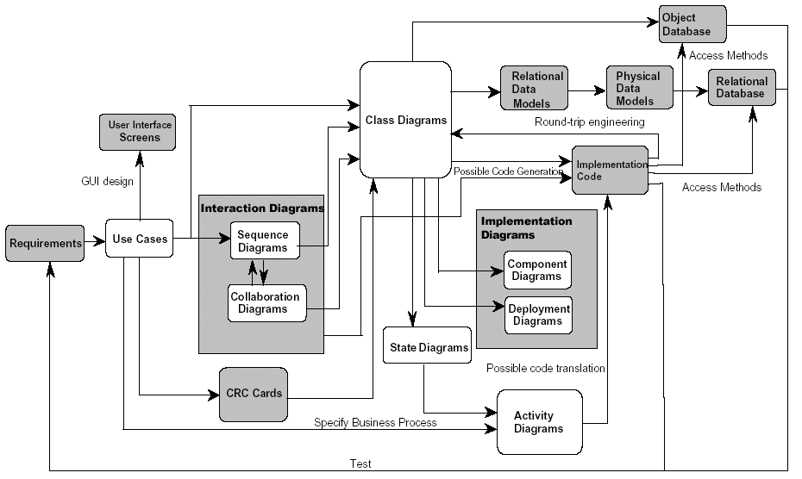

Slide 59
Reading
http://www.ibm.com/developerworks/rational/library/769.html
http://www.sparxsystems.com.au/resources/uml2_tutorial/index.html

