Slide 1
Object-Oriented Analysis and Design with UML
Lecture 5 Advanced Use Case Modeling

Slide 2
Index
Use case Inclusion
Use case Extension
Use case generalization
Actor generalization
Writing Effective Use Case

Slide 3
Use Case Inclusion
ChangeEmployeeDetails
ViewEmployeeDetails
Manager
DeleteEmployeeDetails

Slide 4
Inclusion
Defines how one use case can invoke behavior defined by another use case
Used to include
the behavior of one use case into
This use case is called : inclusion use case
into the flow of another one
This use case is called : base use case
Is a little bit like a function call
Prevents repeating the use cases
Base
Use Case
<<include>>
Inclusion
Use Case

Slide 5
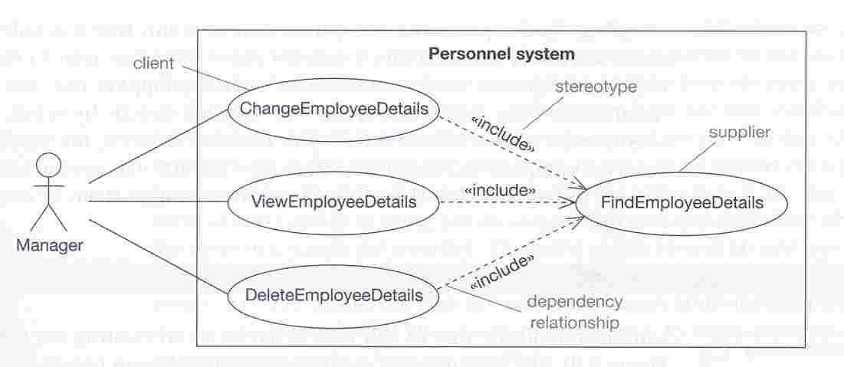
Example to «include»

Slide 6
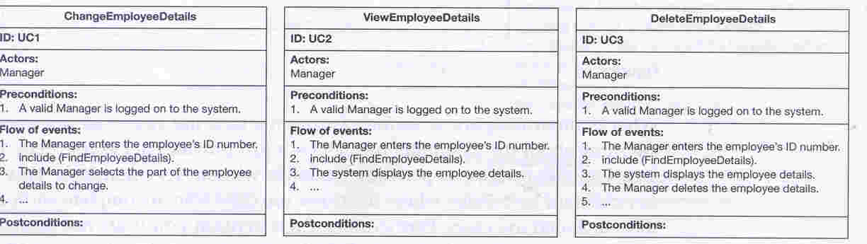
Specification for «include»

Slide 7
Use Case Extension
ReturnBook
BorrowBook
Librarian
FindBook

Slide 8
Extension
To add a new behavior
to an existing use case
at a predefined extension point
Base use case:
The use case that is extended
Does not have visibility to the extensions
Extension use case
The use case modifying the behavior of the base use case
Access and modifies all base attributes and operations
Defines a use-case that is a variation of another, usually for handling an abnormal situation
Extension
Use Case
<<extend>>
Base
Use Case

Slide 9
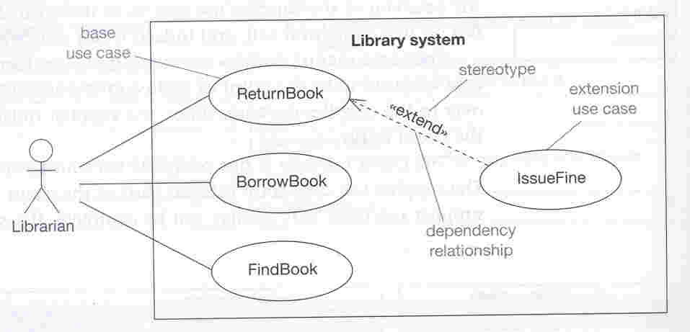
Example to «extend»

Slide 10
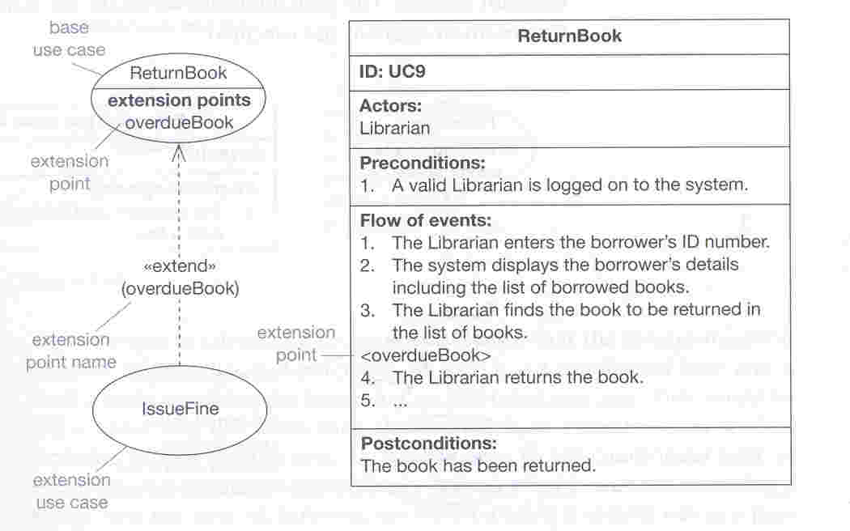
Specification for «extend»

Slide 11
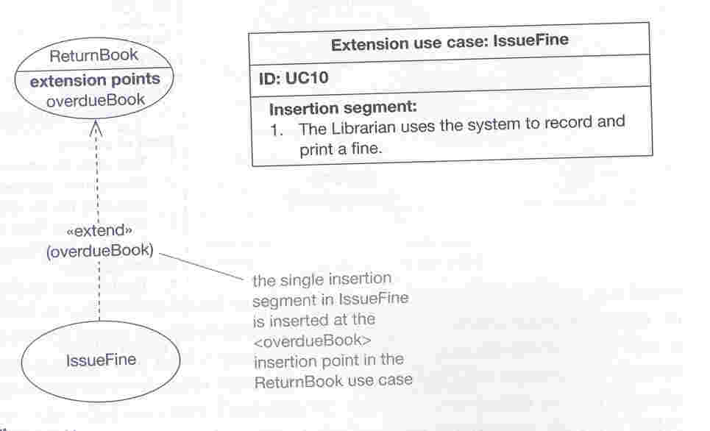
Extension use case example

Slide 12
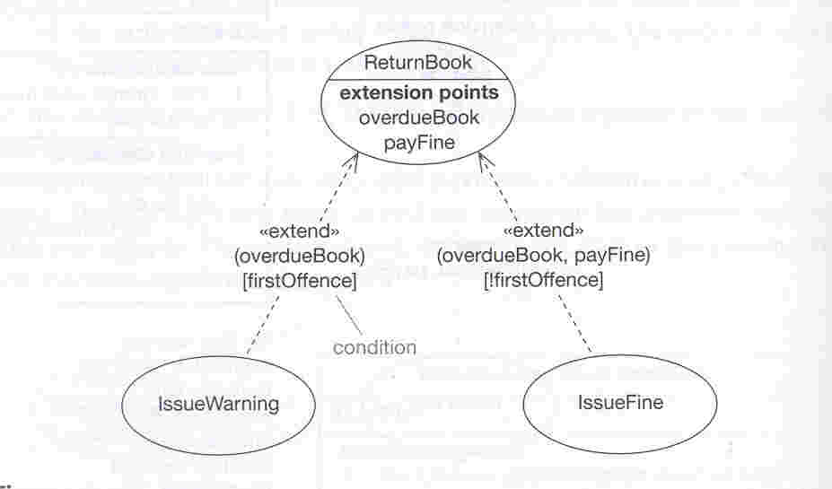
Conditional Extensions
The extension might dependent on a condition
First time issue a warning only!

Slide 13
Use Case Generalization
FindBook
FindCD
Customer
Sales System

Slide 14
Use Case Generalization
Used to represent
one or more use cases are the special case of a more general case
Father Use Case
Child Use Case

Slide 15
Use Case Generalization
The child use case
Automatically inherits all features from its parent
The child use case may
Inherit features from their parent use case
Add new features
Override (change) inherited some of the features

Slide 16
Restrictions to Override
Use case element | Inherit | Add | Override
Relationship | Y | Y | N
Precondition | Y | Y | Y
Postcondition | Y | Y | Y
Step in main flow | Y | Y | Y
Alternative flow | Y | Y | Y
Attribute | Y | Y | N
Operation | Y | Y | Y
The child automatically inherits all features from its parent.
But not every type of use case element may be overridden!

Slide 17
Use Case Generalization: Example
The parent use case:
FindProduct
Two specializations
FindBook
FindCD

Slide 18
Parent Use Case Specification

Slide 19
Child Use Case Specifications
Notes:
Genre: An expressive style of music.

Slide 20
Use Case Relationship
Inclusion
Inclusion enables to reuse one use case's steps inside another use case.
Extension
Allows creating a new use case by adding steps to existing use cases
Generalization
Allows child use cases to inherit behavior from parent use cases

Slide 21
Actor Generalization
Used to simplify diagrams
Customer & SalesAgent
Triggers the same use-cases
Only difference is the CalculateCommission
Too many crossed lines

Slide 22
Actor Generalization
For the common behavior There should be another role:
Purchaser
The other roles are derived

Slide 23
Actor Generalization
Express with generalization
The communication of actors with the same set of use cases
Good style:
Parent actors are usually abstract
Substitutability principle:
A descendant actor is replaced anywhere the parent is expected
Used to test the correctness

Slide 24
Example (self service machine)
Self service machine
Buy a product
Self service machine
customer
Collect Money
Collector
Self service machine
Restock
Supplier

Slide 25
Example (self service machine – includes relationship)
<<includes>>
Restock
Open Machine
<<includes>>
Close Machine
<<includes>>
Collect
Open Machine
<<includes>>
Close Machine

Slide 26
Example (self service machine – extends relationship)
<<includes>>
Restock
Open Machine
<<includes>>
Close Machine
<<extends>>
Restock According
to Sales

Slide 27
Example (self service machine – generalize relationship): Actor-to-Actor relationship
generalized actor
Agent
specialized
actor
Supplier
Collector

Slide 28
Example (self service machine)
Buy a product
Self Service Machine
<<includes>>
customer
Restock
Open Machine
<<includes>>
<<extends>>
Close Machine
Restock according to sales
<<includes>>
Collect
<<includes>>
supplier
collector

Slide 29
When to use advanced features?
If they simplify the use case model
The best use cases are the simple ones
The model must be understandable by all stakeholders
Actors and use cases are easily understood
Actor generalization is more difficult to grasp
Heavy use of «include» makes the complete picture harder to visualize
«extend» is very hardly understood
the meaning of «extend» is widely misunderstood

Slide 30
Exercise
Refine the use case diagram for the course registration system using relationships.

Slide 31
Steps for Creating a Use-Case Model
Find actors and use cases.
Identify and briefly describe actors.
Identify and briefly describe use cases.
Write the use cases.
Outline all use cases.
Prioritize the use-case flows.
Detail the flows in order of priority.

Slide 32
Find Actors
Who is pressing the keys (interacting with the system)?
Student
Registrar
Registration System
The student never touches the system; the registrar operates it.
Or, are you building an Internet application?
Online Registration System
Student

Slide 33
Identify Actors
Who/what uses the system?
Who/what gets information from this system?
Who/what provides information to the system?
Where in the company is the system used?
Who/what supports and maintains the system?
What other systems use this system?

Slide 34
Description of an Actor
Text
Name Student
Brief description A person who signs up for a
course.
Relationships with
use cases
Register for Courses
Student

Slide 35
Checkpoints for Actors
Have you found all the actors? Have you accounted for and modeled all roles in the system's environment?
Is each actor involved with at least one use case?
Can you name at least two people who would be able to perform as a particular actor?
Do any actors play similar roles in relation to the system? If so, merge them into a single actor.
✓

Slide 36
Find Use Cases
What goal am I trying to achieve by using the system?
GOAL 1
Actor
GOAL 2

Slide 37
Identify Use Cases
What are the goals of each actor?
Why does the actor want to use the system?
Will the actor create, store, change, remove, or read data in the system? If so, why?
Will the actor need to inform the system about external events or changes?
Will the actor need to be informed about certain occurrences in the system?
Does the system supply the business with all of the correct behavior?

Slide 38
Description of a Use Case
Name Register for Courses
Brief description The student selects
the courses they wish to
the next semester. A
schedule of
primary and alternate courses is produced.
Relationships with
actors
Register for Courses
Student

Slide 39
Checkpoints for Use Cases
The use-case model presents the behavior of the system; it is easy to understand what the system does by reviewing the model.
All use cases have been identified; the use cases collectively account for all required behavior.
All features map to at least one use case.
The use-case model contains no superfluous behavior; all use cases can be justified by tracing them back to a functional requirement.
✓

Slide 40
Functional Decomposition
Is breaking down a problem into small, isolated parts.
The parts work together to provide the functionality of the system.
Often do not make sense in isolation.
Use cases:
Are NOT functional decomposition.
Keep the functionality together to describe a complete use of the system.
Provide context.

Slide 41
Functional Decomposition: An Example
Process Transaction
Insert Card
Bank Consortium
Enter PIN
Select “To” Account
Select Transfer Funds
Customer
Enter Amount
Select “From” Account
Select Withdraw Cash
Select Account Balance

Slide 42
Avoid Functional Decomposition
Symptoms
Very small use cases
Too many use cases
Uses cases with no result of value
Names with low-level operations
“Operation” + “object”
“Function” + “data”
Example: “Insert Card”
Difficulty understanding the overall model
Corrective Actions
Search for larger context
“Why are you building this system?”
Put yourself in user’s role
“What does the user want to achieve?”
“Whose goal does this use case satisfy?”
“What value does this use case add?”
“What is the story behind this use case?”

Slide 43
Use Case: A Corrected Example
Withdraw Cash
Transfer Funds
Bank Consortium
Customer
Deposit Funds

