Slide 1
Tanzania Connect-A-Thon Results
IntraHealth International
August 2016

Slide 2
Tanzania Interoperability Workshop - Use Case Request Form
Group Members Kam Rwegasira, Kelvin Mbwilo, Sovello Mgani, Sosthenes Bagumhe, Isaiah Zacharia, Faustin Polycarp
Proposed Name of Use Case | Vaccination (Flow Up)
Purpose of Use Case (What type of information do you want to send or get?) | Number of children vaccinated. Availability and number of equipment holding stocks
For whom is the data is intended? | MOH Immunization & Vaccination Department (IVD) reporting into DHIS2

Slide 3
Tanzania Interoperability Workshop - Use Case Request Form
Who has the data? (list data systems in involved) | Tanzania Immunization Registry (TimR) Number of children vaccinated. VIMS Availability and number of equipment holding stocks DHIS2 Report using the DHIS2 UID for the indicators HFR Has the facility ID VIMS has internal facility ID TimR has HFR ID doesn't have DHIS2 UID

Slide 4
Interoperability Layer: How are these systems communicating?
Who are they talking with
Access control
Audit Logging
Translators
Synchronization Services
Public Access / Open Data
Protected Health Information
Health Facility Registry
Terminology Service
DHIS2 (HMIS)
VIMS
Interoperability Layer
Immunization Registry

Slide 5
Interoperability Layer: Defined by Use Cases
What are the use cases
Consumption reports to DHIS2 and VIMS
Inventory Reports to DHIS2, VIMS, eLMIS
Next step: Need to list out all use cases IL will support
Health Facility Registry
Terminology Service
DHIS2 (HMIS)
VIMS
Interoperability Layer
Immunization Registry

Slide 6
OpenHIM
(Interop Layer)
Health Information Mediator (HIM)
Immunization Registry
Client Registry
Terminology Service
Tanzania eHealth Architecture
TImR
InterLinked Registry
Master Facility List
DHIS2 (HMIS)
Mobile App
SMS App
Translates data into CSD, FHIR and GS1 standards
Ensure authorization to access data. Log all transactions.
Routine Indicator Reporting

Slide 7
Number of children vaccinated.
110779-6 is the Access Medical and Dialysis Centre, ….
Master Facility List
Terminology Service
DHIS2 (HMIS)
Core Information
Services
What are the health facilities?
What are the health facilities?
Immunization Registry
Generators Of
Information

Slide 8
Number of children vaccinated.
Master Facility List
Terminology Service
DHIS2 (HMIS)
Core Information
Services
Here is the indicator for facility 110779-6
for this month
Immunization Registry
Generators Of
Information
Mobile App
Paper records

Slide 9
Number of children vaccinated.
Master Facility List
Terminology Service
DHIS2 (HMIS)
Core Information
Services
I translate and manage relationships between code systems
Immunization Registry
Generators Of
Information

Slide 10




Standards Used This Week
Immunization
Terminologies (CodeSystem, ValueSet, ConceptMap)
Care Services Discovery
Inventory Reports (Stock Levels)
Used architecture

Slide 11
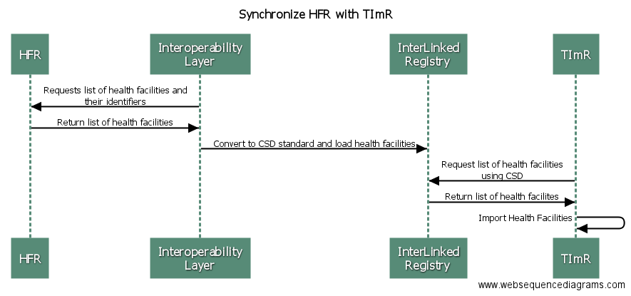

Slide 12
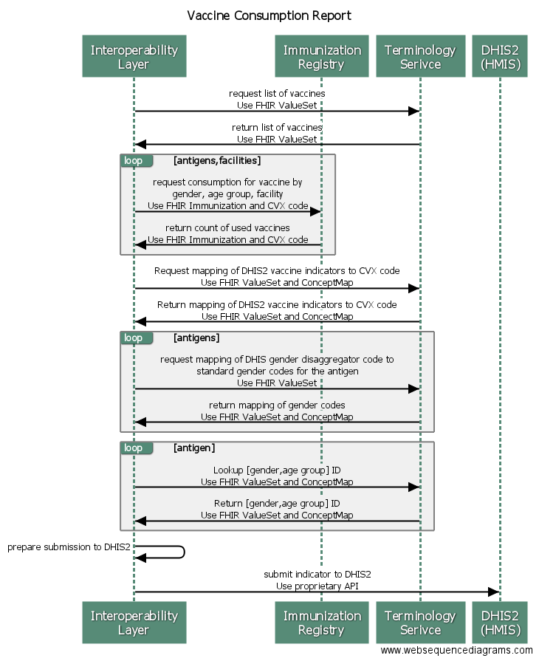

Slide 14
Inventory / Stock Level Reports
I store mapping from internal VIMS product codes and DHIS2 code to CVX codes
I have indicator codes for vaccine consumption
Master Facility List
Terminology Service
DHIS2 (HMIS)
Core Information
Services
I have an internal product code
Immunization Registry
VIMS
Generators Of
Information
I already use CVX codes for Vaccines

Slide 15
Inventory / Stock Level Reports
If I had indicators added, I could consume GS1 reports with the help of the IL
Master Facility List
Terminology Service
DHIS2 (HMIS)
Core Information
Services
Next Step: Need to sort
GTINs (Global Trade Identification Number) mapped to VIMS product codes
GLNs (Global Location Numbers) added to HFR
eLMIS
Immunization Registry
VIMS
Generators Of
Information
I produce GS1 Inventory Report
I produce GS1 Inventory Report

Slide 16
Lesson Learned: Inconsistent data lists are a barrier to interoperability
Terminology Service can provide a common API to share and map between terminologies
Some mappings need to still be done
GTINs
Disaggregators for vaccines in DHIS2 depend on the vaccine (e.g. reported age groups could change with each vaccine). We only mapped BCG “by hand”
It would be nice to have a user interface to help manage and browse terminologies

Slide 17
Lesson Learned: Need to be able to manage multiple facility identifiers in HFR
Several systems have their own internal identifiers for a health facility
Internal identifiers are important for accessing system APIs -- either directly or via the Interoperability Layer
If all systems shared their internal ID with the Health Facility Registry the IL could be used to do any needed cross referencing
VIMS, eLMIS
GLNs
DHIS2 UID
HRHIS
etc.
However: each system should be responsible for the mapping of their identifier to the master HFR ID

