Slide 1
HIS eco-system
Data is a precious resource the ability to share data and metadata increases the value a country’s investment
DHIS2 sits in a complex health information eco-system data exchange needs are not limited to only between DHIS2 instances
Sharing requires resources we have an imperative to reduce implementation burden and provide stable means for sharing data

Slide 2


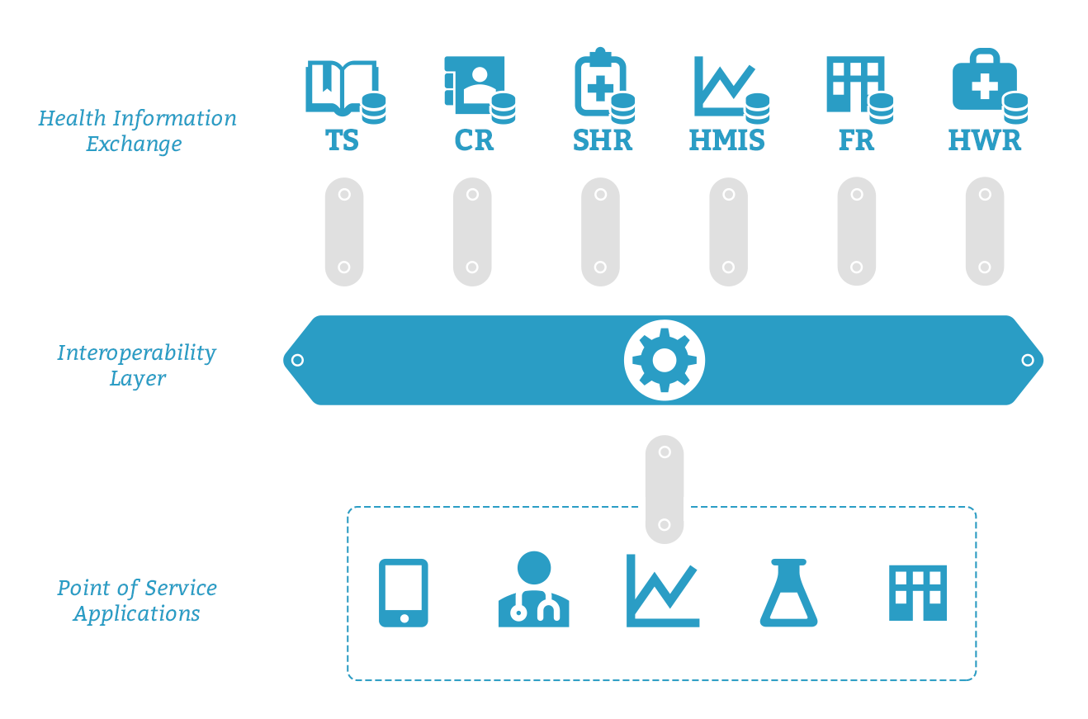
OpenHIE

Slide 3








OpenHIE & DHIS2
webapi
façade
ADX – Aggregate Data Exchange
CSD – Care Services Discovery
PIXm - Mobile Patient Identifier Exchange
PDQm – Mobile Patient Demographic Query
MHD – Mobile access to Health Documents
CDA – Clinical Document Architecture
mACM - Mobile Alert Communication Management
GS1 – Inventory Report
FHIR Value Set & Sharing Value Sets (SVS)

Slide 4
Aggregate Data Exchange (ADX)
DHIS2
Reporting data by:
Org Unit
Time/Period of Reporting
Value (Data Element)
Disaggregators ( Category Options)
ADX
HRIS
EMR

Slide 5


What is a health worker? What is a health facility?
all people engaged in the promotion, protection or improvement of the health of the population
DHIS2
Zambia: Users
SA: Org Unit 7
PSI: Tracker Entity
Org Unit Level
Level 4
Level 4 and below
Level 4 sometimes, or maybe Level 5
Org Unit Group
External System
External System
External System
External System
External System

Slide 6
Care Services Discovery (CSD) & Common Data Model
DHIS2
Zambia: Users
SA: Org Unit 7
PSI: Tracker Entity
Org Unit Level
Level 4
Level 4 and below
Level 4 sometimes, or maybe Level 5
Org Unit Group
CSD InfoManager
External System

Slide 7
Care Services Discovery Standard & Inter-Linked Registry
InterLinked Registry
HRIS
DHIS2
CSD InfoManager
http://github.com/openhie/openinfoman
External System (CSD Service Finder)

Slide 8
DATIM Inter Linked Registry : Sharing Indicators and Mechanisms
DHIS2
CSD InfoManager
ADX metadata
DHIS2
DHIS2
CSD Services Finder
CSD Services Finder
Implementing Partners and Ministries of Health

Slide 9
DHIS2 Tracker + Transactional Data
DHIS2
Who are the subjects of care?
PIXm and PDQm
What clinical information is known
about the subject of care?
MHD and CDAs
External System
http://wiki.ihe.net/index.php? title=CDA_Release_2.0_Content_Modules

Slide 10
mHero + mACM
Initiate SMS based work flow
& get (un)structured response back
RapidPro
SMS / Email / IVR platform
InterLinked Registry
RapidPro HW Contact ID
iHRIS Health Workers
DHIS2 Facility + Hierarchy
mACM Alert Aggregator
Proprietary API
iHRIS
mHealth Application

Slide 11
Supply Chain
DHIS2
GTIN & GS1 Inventory Report
LMIS

