Slide 1
Data Intensive Computing
Assignment 3 – Code Offloading

Slide 2
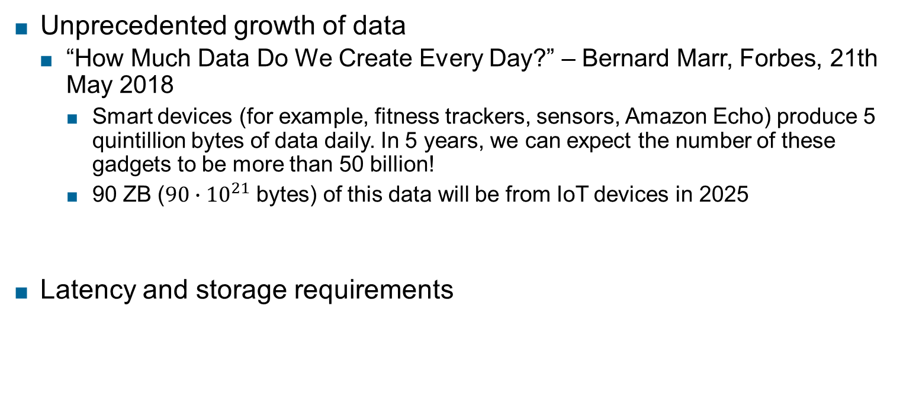
Why Code Offloading?
Unprecedented growth of data
“How Much Data Do We Create Every Day?” – Bernard Marr, Forbes, 21th May 2018
Smart devices (for example, fitness trackers, sensors, Amazon Echo) produce 5 quintillion bytes of data daily. In 5 years, we can expect the number of these gadgets to be more than 50 billion!
90 ZB ($90∙{10}^{21}$ bytes) of this data will be from IoT devices in 2025
Latency and storage requirements

Slide 3



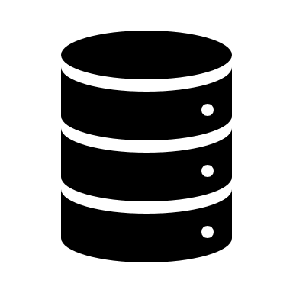






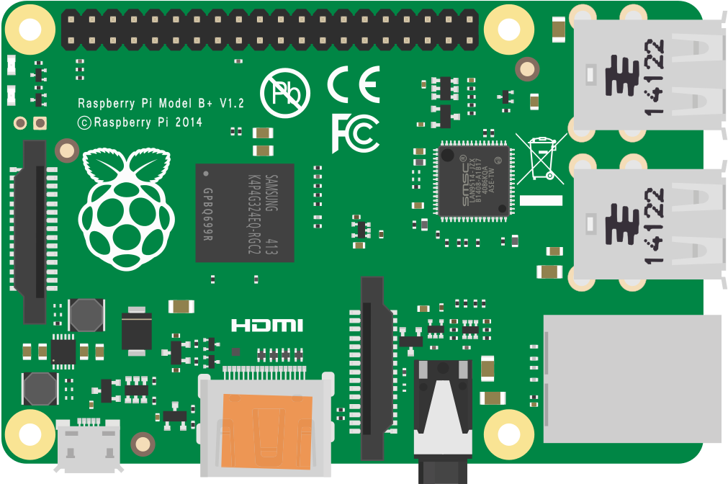



Code Offloading
SENSING
DEVICES
CLOUD NODES
HETEROGENEOUS
DATA
Offloading to Cloud Nodes
High resource availability
Higher latency
APPLICATIONS
CODE OFFLOADING:
Execute (part of) an application on remote surrogate devices
LOCAL
EXECUTION
EDGE DEVICES
USER
EQUIPMENT
Offloading to Edge Nodes
Lower Latency
Lower Availability
Limited resources

Slide 4
Offloading challenges
Identification of application parts to offload
CPU-intensive, DATA-intensive…
Allowing execution on heterogeneous remote nodes
Interoperation between local and remote code

Slide 5
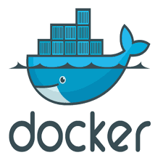
Containers
A container is a standard unit of software that packages up code and all its dependencies so the application runs quickly and reliably from one computing environment to another
Container images: executable package of software that includes everything needed to run an application: code, runtime, system tools, system libraries and settings.
Docker: leading container technology

Slide 6
Docker vs Virtual Machines
APP 0
APP 1
APP 2
APP 3
APP 4
APP 0
APP 1
APP 2
APP 3
APP 4
Guest
OS
Guest
OS
Guest
OS
Docker
Hypervisor
Host OS
Hardware infrastructure
Hardware infrastructure

Slide 7
A basic Docker container
FROM python:3.7.9-slim-buster
RUN useradd -ms /bin/bash username
COPY . /app
WORKDIR /app
RUN ls
ENTRYPOINT [ "python3" ]
CMD [ "app.py" ]
Source container image
Add user username
Copy local directory to /app container directory
Set /app as working directory
Execute “app.py” with “python3”

Slide 8
Adding dependencies
FROM python:3.7.9-slim-buster
RUN apt-get update -y && apt-get install -y --no-install-recommends curl python3-pip python3-dev libsm6 libxext6 libxrender-dev libatlas-base-dev libavcodec-dev libavformat-dev libswscale-dev libv4l-dev libxvidcore-dev libx264-dev libopencv-dev build-essential pkg-config libjpeg-dev libpng-dev libgtk-3-dev && rm -rf /var/lib/apt/lists/*
#Allow pi wheels
RUN echo "[global]\nextra-index-url=https://www.piwheels.org/simple" >> /etc/pip.conf
RUN useradd -ms /bin/bash username
COPY . /app
#Copy the requirements.txt to leverage Docker cache
COPY ./requirements.txt /app/requirements.txt
WORKDIR /app
# Upgrade pip and install requirements
RUN pip3 install --upgrade pip; pip3 install --no-cache-dir -r requirements.txt;
RUN ls
ENTRYPOINT [ "python3" ]
CMD [ "app.py" ]

Slide 9
Container deployment
#Build docker image from Dockerfile
docker build -t dic-assignment .
# Run docker container locally
docker run -v local_directory:/app -d -p 5000:5000 dic-assignment

Slide 10
Interoperation between local and remote machine
Need to access service remotely through REST interface
Flask Webserver
from flask import Flask
app = Flask(__name__)
#Redirecting POST and GET request to method hello()
@app.route(“/”, methods=['POST', 'GET'])
def hello():
return "Hello World!"
if __name__ == "__main__":
app.run()

Slide 11
Input/Output from HTTP REST interface
from flask import Flask, request, Response, jsonify
Getting input value:
data_input = request.values.get(‘VAR_NAME’)
Processing data:
if data_input.endswith(‘.jpg’):
print(‘input path is a .jpg file’)
Returning response code:
status_code = Response(status = 200)
return status_code

Slide 12
Invoking Flask web service
cURL, (client URL): command line tool to transfer data to and from a server.
cURL lets you talk to a server by specifying the location (in the form of a URL) and the data you want to send
run inference on single image files from a path
curl http://localhost:5000/ -d “VAR1=./filename.jpg"
Multivariable input:
curl http://localhost:5000/ -d “VAR1=./filename.jpg&VAR2=1"

Slide 13
Assignment
The goal of the assignment is to develop a data processing application using Docker, Python and Tensorflow and understanding the mechanisms behind computation and data offloading.
Implementation of data processing application
Dockerization of application
Collect data on local and remote execution
Report

Slide 14
Data processing loop
Send data to the deployed service using cURL
Retrieve data from REST interface
Process data inside detection_loop
Retrieve results
Collect data about execution

Slide 15
Target applications
Object detection: the application takes as input an image and returns the objects that has been detected on the image.
Speech recognition: the application takes as input audio files and recognizes a set of keywords inside the audio files
Object detection: https://www.tensorflow.org/hub/tutorials/object_detection
Speech recognition: https://www.tensorflow.org/tutorials/audio/simple_audio
Code should be commented in the main parts

Slide 16
Dockerization
Deploy application inside a Docker container
File stub is provided to the students
Application should be accessible both locally and on Hadoop cluster using curl
Credentials will be provided

Slide 17
Measuring time
You will need to collect data about inference time (inside detection_loop) and data transfer time on remote node
Tensorflow methods (see documentation)
time, timeit python modules
Time linux syscall
Anything, as long as it is documented in the report

Slide 18
Your report
Information on your implementation design choices:
Information on how application has been developed, explaining the most important design choices and any modification to the Dockerfile or requirements.txt needed to make your implementation work;
Commands needed to deploy your container;
Explanation on how you calculate inference and transfer time;
Information on your experimental setup. i.e., CPU power, network bandwidth and any additional hardware (GPU) that you use to run your experiments;
Data about local/remote inference time and transfer time;
Comments on your execution: it is worth to offload execution on the remote cluster? If not, why? What would be needed to improve performance of remote and local execution? Can you think of a scenario where offloading improves performance?

Slide 19
Evaluation
Based on:
Dockerfile and requirements.txt;
Their app.py implementation including all additional files (if any) you implemented to make it work;
Report, in .doc, .docx or .pdf format.
Assignment part | Rating
Implementation | 40
Dockerization | 10
Local/Remote Execution | 20
Report | 30

Slide 20
Questions?
vincenzo@ec.tuwien.ac.at

