Slide 1

Texture
Computer Vision and Pattern Recognition
CS 4243
S1-Y2023/24

Slide 2
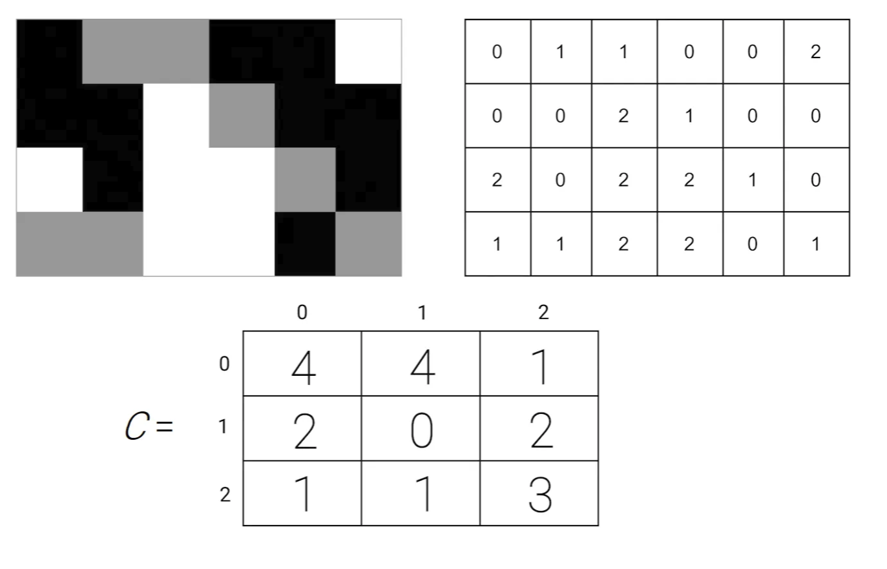
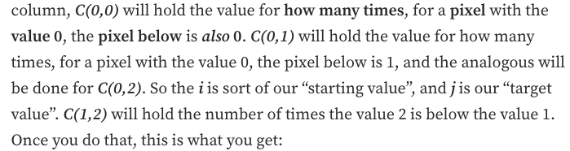
Grey-level Co-occurrence Matrices
Find a pattern along certain direction

Slide 3
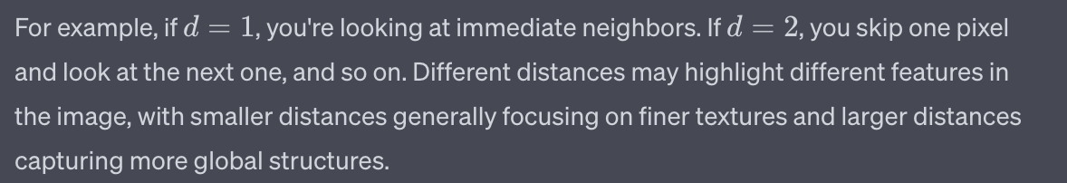

Statistical Methods: GLCM Grey-level Co-occurrence Matrices
Usually,
$Θ=\{0^{o}$, ${90}^{o}\}$ , or,
$Θ=\{0^{o}$, ${45}^{o}$, ${90}^{o}$, ${135}^{o}\}$
And
d= {1,3,9} , or,
d= {1,4,16} , or ….

Slide 4
Statistical Methods: GLCM Grey-level Co-occurrence Matrices
Functions to be applied on GLCM matrices:

Slide 5
Statistical Methods: GLCM Grey-level Co-occurrence Matrices
Each proposed function represents certain properties of the texture. Maximum and Energy, ( f1 and f2), are basic statistics of Φ.
Entropy, f3 , measures the texture homogeneity.
Correlation function, f4, is image linearity metric.
Linear directional structures in direction θ result in large
correlation values in that direction. This can also measure the image coarseness.
Inverse Difference Moment (IDM), f5, measures the extent to which the same tones tend to be neighbours.
Inertia (or Contrast), f6, is a texture dissimilarity measure.

Slide 6
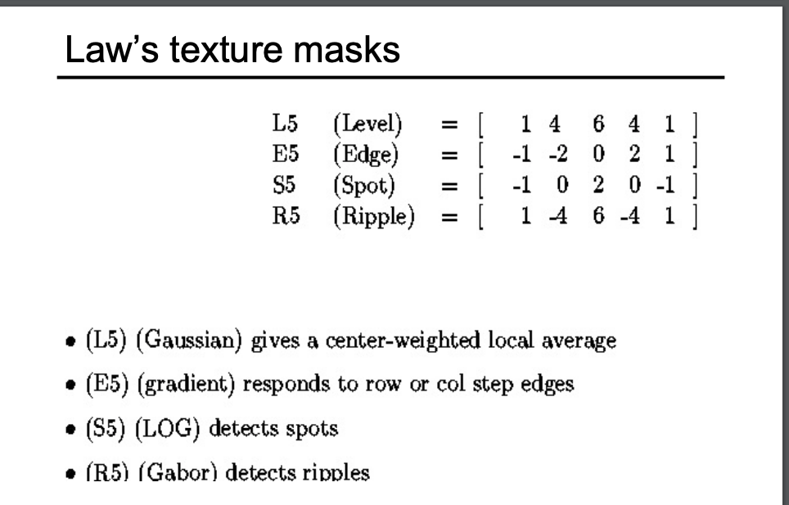

Slide 7
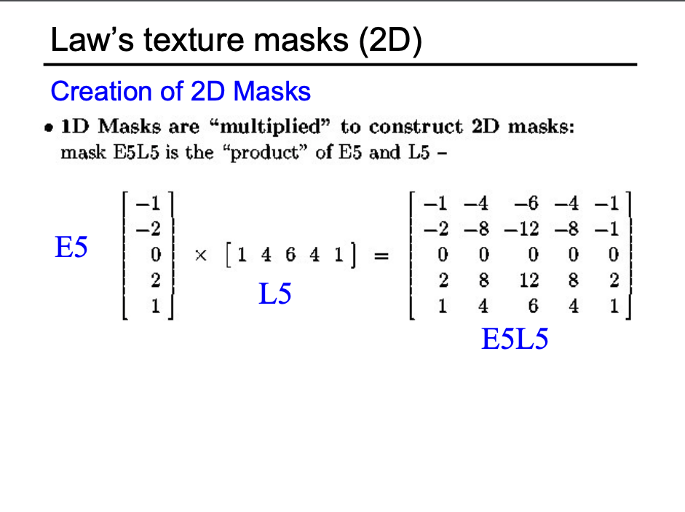

Slide 8
Laws Filter
L5 (Level): [1, 4, 6, 4, 1]
Function: Represents average gray levels over a region. When used in texture energy measures, it helps identify areas of the image that have consistent brightness levels. It can be thought of as a kind of low-pass filter, highlighting broader, homogeneous regions.
E5 (Edge): [-1, -2, 0, 2, 1]
Function: Detects changes in brightness levels, corresponding to edges in an image. Edges are significant changes in gray levels between neighboring regions, and this filter helps capture those transitions. Essentially, it works as an edge detector.
S5 (Spot): [-1, 0, 2, 0, -1]
Function: Captures isolated points or small bright spots on a darker background or vice versa. The central positive value emphasizes the spot, while the negative values suppress the surrounding regions.
R5 (Ripple): [1, -4, 6, -4, 1]
Function: Detects periodic structures, or fine ripples in the texture. This can be useful for textures with regular, fine patterns.

