Slide 1

Parting Surface Methodology
Release 2
October 2, 2008
N.Arthaud
Audi Forum Chemnitz Dec 11 th 2007 / DASSAULT SYSTEMES Confidential – Page

Slide 2
Criteria for a good Parting Surface methodology
Quality of the Parting Surface
  As few faces as possible
  Outer boundary with as few curves as possible
  As many planar faces as possible
  Parting Surface and Original Surface must be easy to join with standard tolerance
Simplicity of use and Productivity
  The Parting Surface should be produced with as few clicks as possible
  A small number of commands should be enough to produce the result
  Each command should be used only a few times
Stability of the design:
  When the original surface is updated, reconstruction of the parting surface should be as simple as possible
  The parting surface should be reused rather than recreated whenever possible
Audi Forum Chemnitz Dec 11 th 2007 / DASSAULT SYSTEMES Confidential – Page

Slide 3
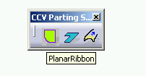
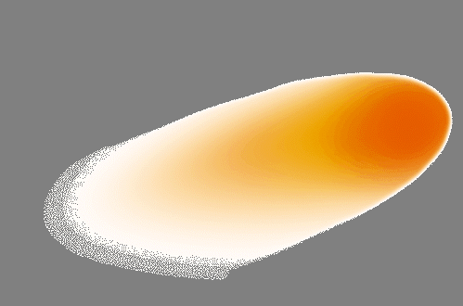
The PowerCopy PowerCopies Parting Surfaces
A set of powercopies has been developped to facilitate creation of Parting Surfaces
They favor creation of planar faces on planar sections of the parting line because of higher productivity and quality of the result
However it should be noted that if the molded part is changed, the parts of the parting line which were initially planar may no longer be planar with the updated version
The powercopies can easily be changed into UDF by any VAR or advanced user with adequate licence
The powercopies can be included in a toolbar as in the examples below
Audi Forum Chemnitz Dec 11 th 2007 / DASSAULT SYSTEMES Confidential – Page

Slide 4
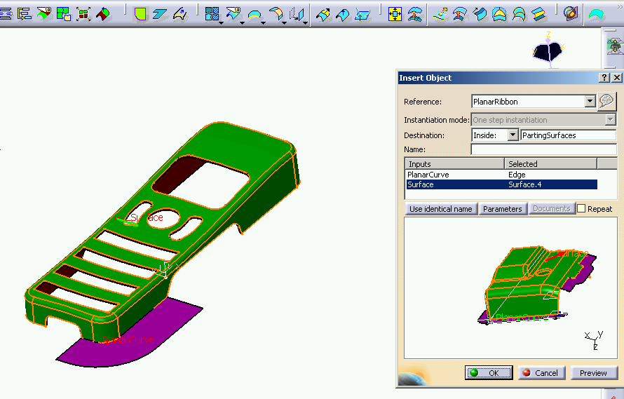
Step 1 : planar faces
Step 1: create the main planar surfaces. Use Power Copy PlanarRibbon
Audi Forum Chemnitz Dec 11 th 2007 / DASSAULT SYSTEMES Confidential – Page

Slide 5
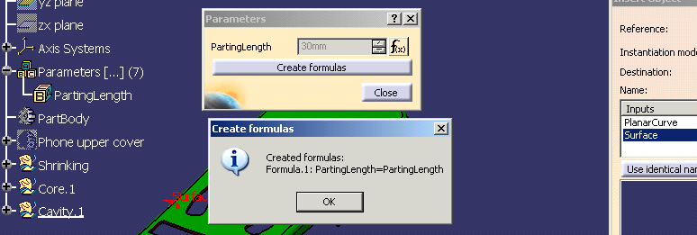
Step 1 : planar faces
The power copy is intended to be as stable as possible when surfaces are modified.
If the parting surface does not show on preview, invert surface orientation
When creating the single planar surfaces, make sure that the destination « geometrical set » is set to the right value
You may adjust the ribbon length with the power copy parameter. If you want a square surface just create a ribbon large enough so that you can split it later by a projected sketch.
In order to have a more associative design, create a parameter for the ribbon length first and then reuse it in power copy instantiation
The sides of the planar surface favors main absolute directions (X,Y,Z)
Audi Forum Chemnitz Dec 11 th 2007 / DASSAULT SYSTEMES Confidential – Page

Slide 6
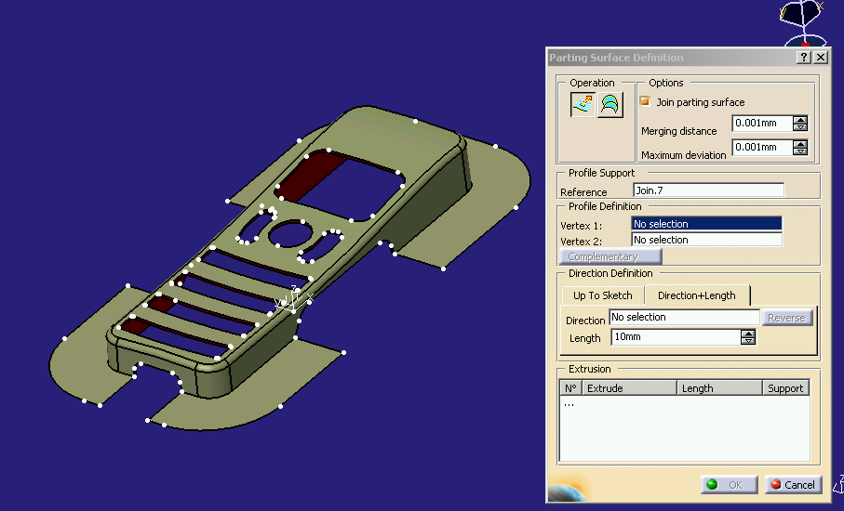
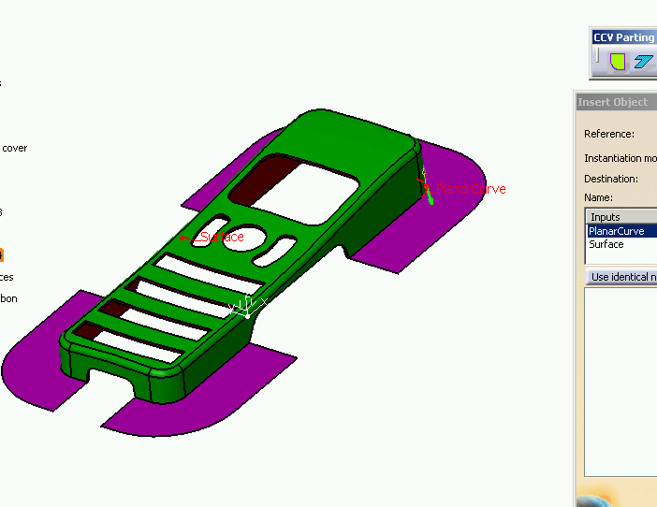
Step 2 : extrudes
The recommanded method for creation of planar surface favors sides which are parallel to the main axes => they are convenient to use as extrude directions.
When a section of boundary is bounded by two edges parallel to the same main direction, extrude gives the best quality result.
Reuse the same length parameter already used for the planar surfaces
In order to simplify the extrude creation, you may create a join between the planar parting surfaces and the first surface. This way , you will see fewer vertices and it will be easier to create the extrudes. But it is not mandatory ( useful only on more complex surfaces )
Audi Forum Chemnitz Dec 11 th 2007 / DASSAULT SYSTEMES Confidential – Page

Slide 7
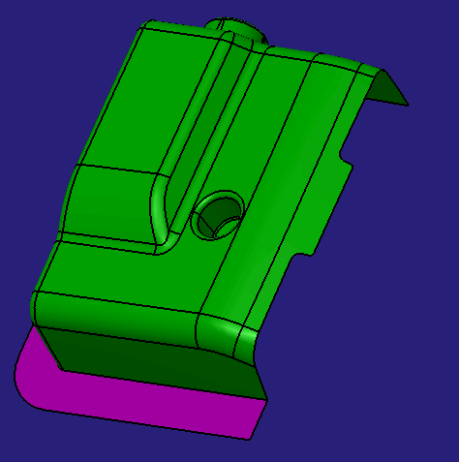
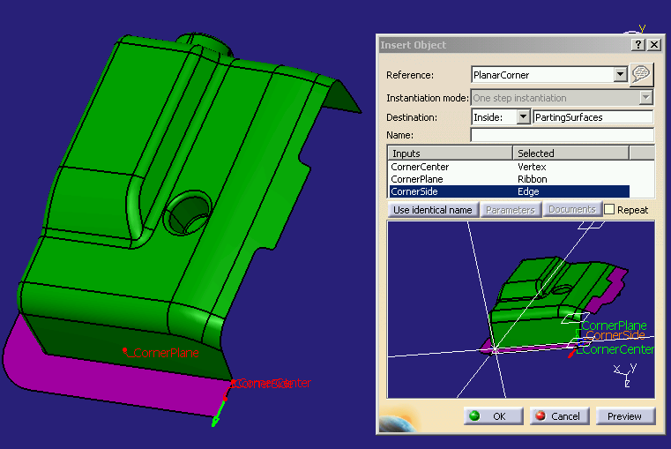
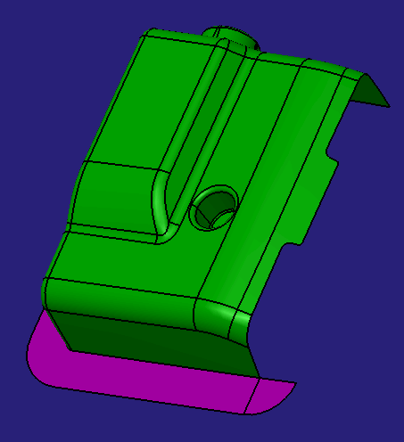
Step 3 : Corners
Sometimes it is useful to create a corner surface to extend one of the planar surfaces previously created
Using sweeps or lofts to create corner surfaces may lead to impossible situation or to lower quality
Use the powercopy CornerSurface. The edge must start from the corner. The plane does not need to go through the corner ( you may select an adjacent planar parting face if useful ).
Audi Forum Chemnitz Dec 11 th 2007 / DASSAULT SYSTEMES Confidential – Page

Slide 8
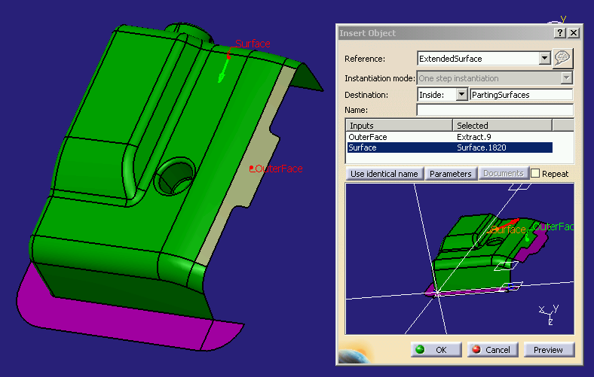
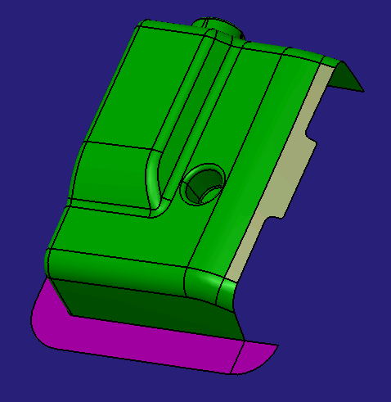
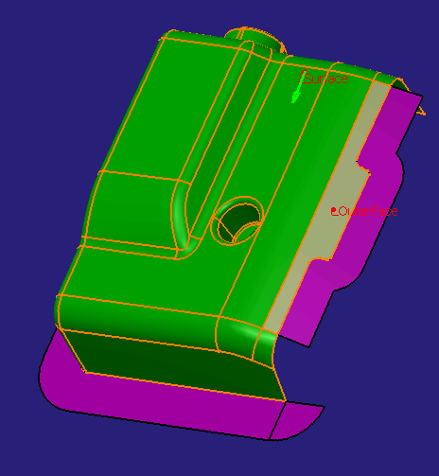
Step 4 : Extension of Surfaces
Sometimes , it is useful to extend a surface
  To maintain a user intent
  To work around a poor quality boundary
Use the powercopy ExtendedSurfaces. You first need to extract the surface
Audi Forum Chemnitz Dec 11 th 2007 / DASSAULT SYSTEMES Confidential – Page

Slide 9
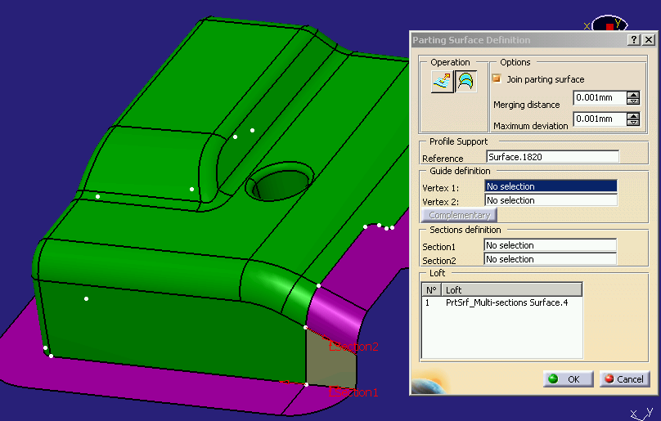
Step 5 : Lofts
Whenever the two sides of the parting surface are already known you may use a loft. If the directions of the two sides vary too much, create a corner first
Audi Forum Chemnitz Dec 11 th 2007 / DASSAULT SYSTEMES Confidential – Page

Slide 10
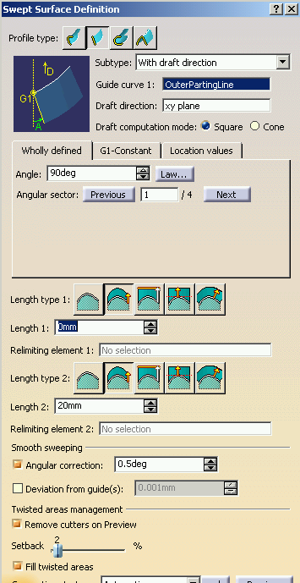
Step 6 : Sweeps
Sweeps are useful when a portion of parting line is more or less in a given plane ( for instance normal to the pulling direction ) : the sweep is able to take a « convex corner »
It benefits from a « remove twist » capability in case of « concave corner »
It is not even necessary to specify a direction :
  use « sweep segment » with draft direction
  Give the parting line or a portion of parting line as guide curve
  Give the plane as draft direction
  Choose 90 degrees
  Specify length
  Request smooth sweeping with anglular correction
  Use remove cutters on preview and fill twisted areas
Audi Forum Chemnitz Dec 11 th 2007 / DASSAULT SYSTEMES Confidential – Page

Slide 11
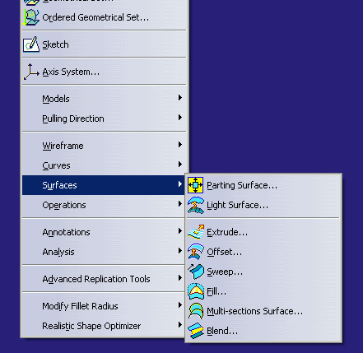
Step 7 : Others
For special situations, you may also use the various surface functions available in CCV
Audi Forum Chemnitz Dec 11 th 2007 / DASSAULT SYSTEMES Confidential – Page

