Slide 1
Core Cavity Template
Nicole ARTHAUD
July 3rd 2009
CONFIDENTIAL

Slide 2
Summary
Before you start
How to use the CoreCavityTemplate
Output of the CoreCavityTemplate
Using the CoreInsert and CavityInsert in a MoldBase
AdvancedTasks

Slide 3
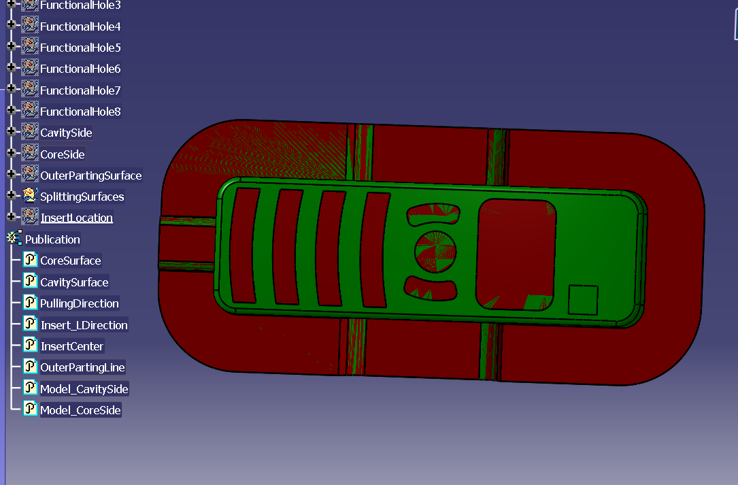
Before you start :
You must have prepared the manufacturing surfaces.
Therefore you need a CATPart ( any name ) containing the separated surfaces and some indications about position of the expected insert
This information is provided as publications

Slide 4
Before you start
All which is required is a component (CATPart) with the following publications :
The CoreSurface ( surface )
The CavitySurface ( surface )
The PullingDirection ( line )
The InsertCenter ( point )
The Insert_LDirection ( line )
The Model_Coreside
The Model_Cavity Side
The OuterPartingLine ( curve )
The CoreSurface and CavitySurface must be oriented toward the inside of the plastic model, that is :
The core surface is oriented toward cavity
The cavity surface is oriented toward core
To quickly check the orientation of a surface, check the default direction of its offset surface or else include it as first surface of a join and see the arrow
The split of a solid model by a parting line produces naturally surfaces oriented according to the above convention.
The PullingDirection is oriented toward cavity ( UP )
The publication names must be respected

Slide 5
Summary
Before you start
How to use the CoreCavityTemplate
Output of the CoreCavityTemplate
Using the CoreInsert and CavityInsert in a MoldBase
AdvancedTasks

Slide 6
Core Cavity Template : Function
The Core Cavity Template is a product structure which is intended to automatize and /or guide the creation of core insert and cavity insert
This product structure can be found in the directory :
Intel_a/Startup/Tooling/MTD/Templates/CoreCavityTemplate/
The root of this product structure is called :
CoreCavityTemplate.CATProduct

Slide 7
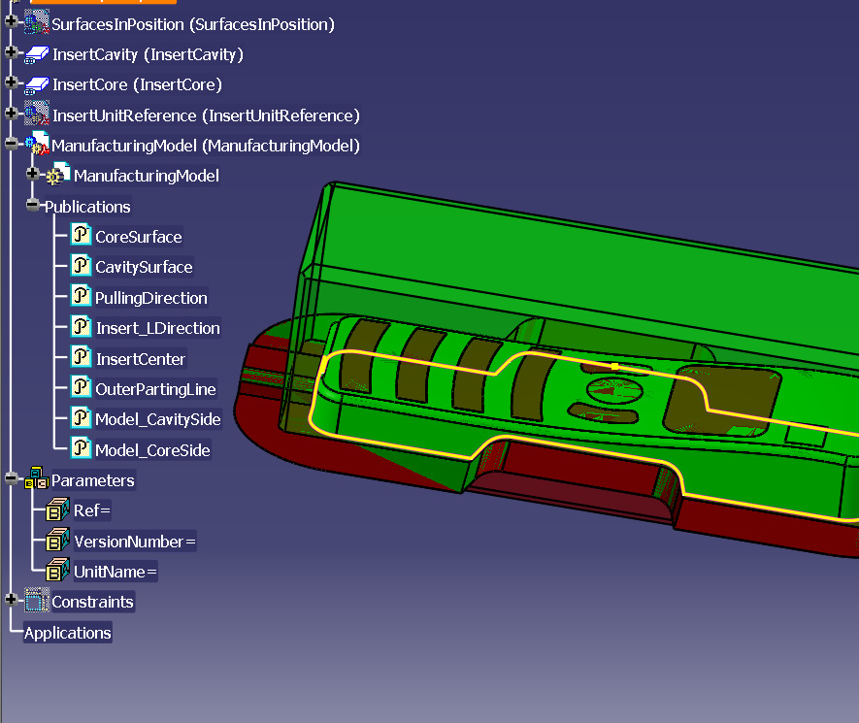
How to use the Core CavityTemplate :
The user opens the CoreCavityTemplate product structure
He updates the project info and release
He saves the entire product structure in a new directory, dedicated to the current project.

Slide 8
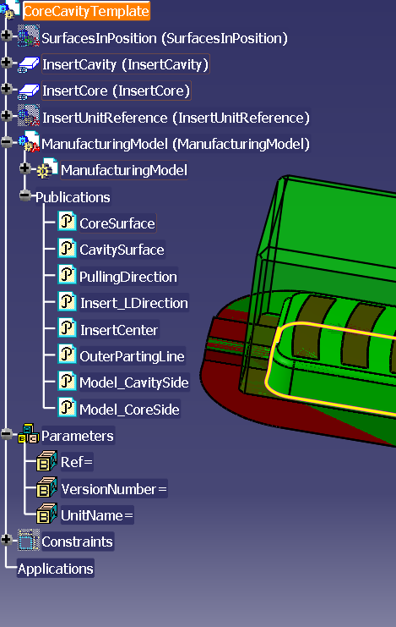
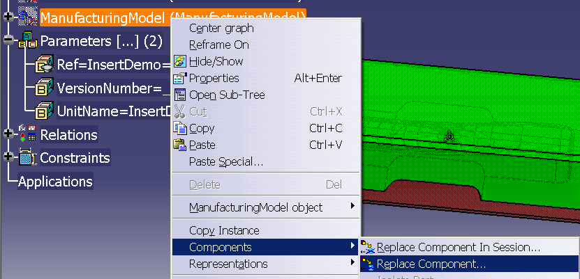
How to Use the Core CavityTemplate :
The user replaces in Assembly WorkBench the component « ManufacturingModel » by his own model ( with identical publications )
He updates everything ( ASD update, PDG update, Knowledge update )
He saves the entire product structure

Slide 9
Output of the Core CavityTemplate :
The two components « CavityInsert » and « CoreInsert » are the two outputs of the CoreCavityTemplate.
They are « almost » ready to use in MTD, as Tooling Components

Slide 10
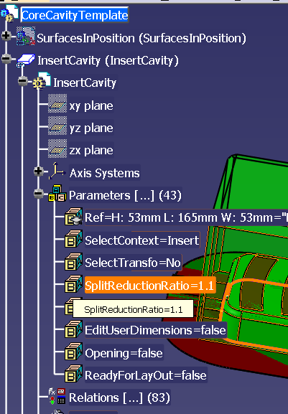
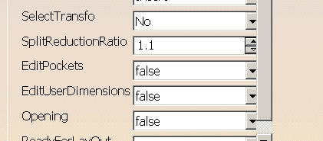
Step1 : the split of the inserts by the core and cavity surfaces
Sometimes the parting surface is « rounded » whereas the inserts are rectangular. This may cause some difficulties : the associative construction of the insert fails to update
In order to solve this difficulty, it is useful to manage the active part of the cavity parting surface
This is achieved by modifying a reduction ratio, which is automatically used in the same way in Core and Cavity Inserts
It is defined in the Cavity Insert.
It must be greater than or equal to 1

Slide 11
Step 1 : Adjustement to the shape of the model
Outer Parting Surface
Model
Insert Center
SplitReductionRatio =1
SplitReductionRatio =1.1
If needed, modify the value of the parameter SplitReductionRatio to make sure the insert will be split by the outer parting surface
It is also possible to move the InsertCenter to optimize the insert size

Slide 12
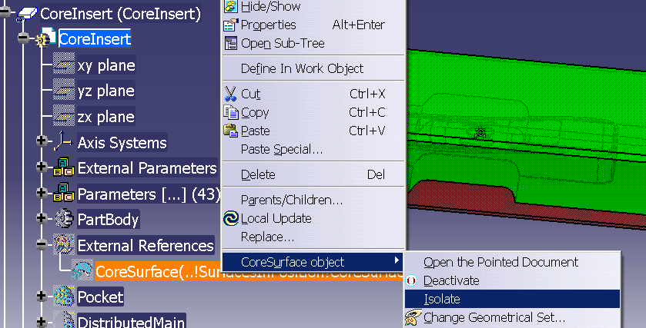
Step 2 : isolation of the CoreInsert and CavityInsert
The Core and Cavity Insert can now be « separated » from the template, in order to be used in a Mold Structure.
However, before using them, it is necessary to cut the link between these two components and the original model, for two reasons :
To be able to use them in the context of the MoldBase
To be able to perform multiprints
This is done by « isolation » of the CoreSurface in the CoreInsert, and similarly for Cavity.

Slide 13
Summary
Before you start
How to use the CoreCavityTemplate
Output of the CoreCavityTemplate
Using the CoreInsert and CavityInsert in a MoldBase
AdvancedTasks

Slide 14
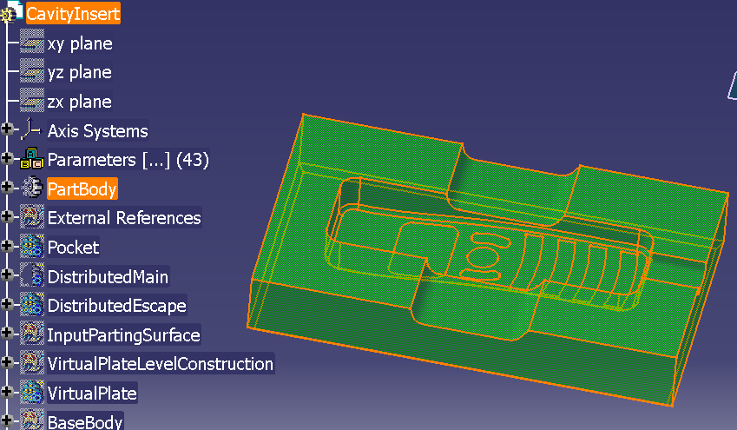
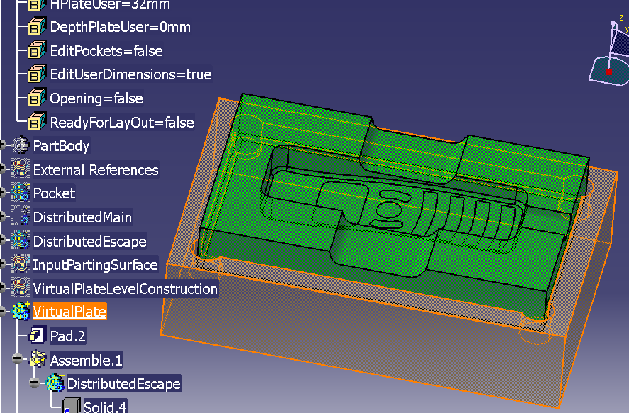
CoreInsert and CavityInsert geometry
The core and cavity inserts both contain
In the main part body : The geometry of the insert
In body VirtualPlate : A virtual plate whose only purpose is to assist the user in definition of the insert
In bodies Pocket, DistributedMain,DistributedEscape : Several variants of pockets for the insert
In some geometrical sets : associative auxiliary constructions

Slide 15
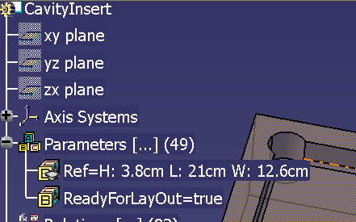
CoreInsert and CavityInsert Ref
The core and cavity inserts both contain a user parameter Ref which gives the expected dimensions of the insert before fabrication

Slide 16
CoreInsert and CavityInsert parameters
The Core and Cavity inserts both contain
Visible parameters : free for the user to edit
Hidden parameters which should not be edited by the user : needed to ensure the geometry constructions, ususally defined by formula
The CoreInsert contains
External parameters : needed to insure the communication of information from the cavity insert, to ensure consistency

Slide 17
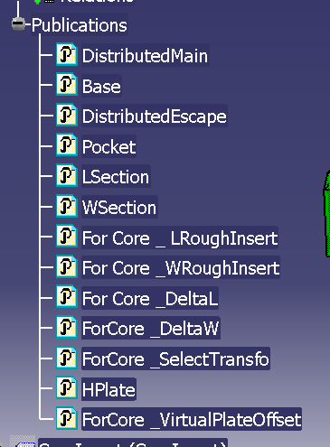
Cavity Insert publications
Manufacturing information
DistributedMain
DistributedEscape
Pocket
Positionning information
Base ( the point to position on the mold plate )
Dimension information useful for insert layout :
Height of the receiving cavity plate (HPlate)
The length and width requirements to insert one cavity insert : LSection and WSection
Synchronisation information
Used in the CoreInsert for synchronization of core and cavity inserts : these publications are prefixed : ForCore

Slide 18
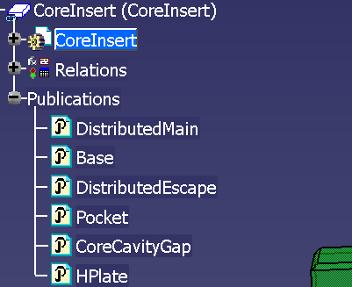
Core Insert publications
Manufacturing information
DistributedMain
DistributedEscape
Pocket
Positionning information
Base ( the point to position on the mold plate )
Dimension information useful for insert layout :
Height of the receiving cavity plate (HPlate)
The expected gap between the Core Plate and the Cavity Plate : CoreCavityGap ( it is the distance between the CoreInsert and the Cavity Insert « base » points which ensures closure of the CoreInsert and CavityInsert

Slide 19
Summary
Before you start
How to use the CoreCavityTemplate
Output of the CoreCavityTemplate
Using the CoreInsert and CavityInsert in a MoldBase
AdvancedTasks

Slide 20
Parameters :
Set to « false » the parameters
EditUserDimensions
EditPockets
Opening
Set « SelectContext » as « Insert »
Set « ReadyForLayout » as « true »

Slide 21
Summary
Before you start
How to use the CoreCavityTemplate
Output of the CoreCavityTemplate
Using the CoreInsert and CavityInsert in a MoldBase
AdvancedTasks : editing dimensions

Slide 22
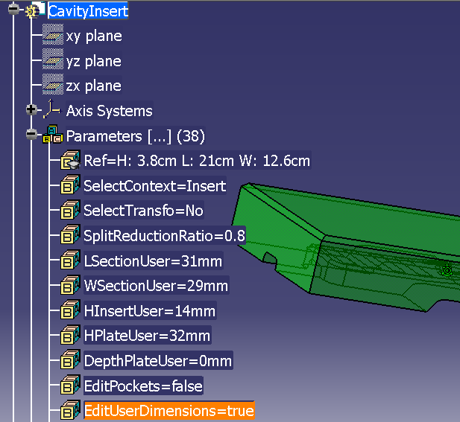
Dimensions of the Inserts
Automatic dimensions are computed for the insert
They can be adjusted by the user.
In order to edit dimensions , set the value of EditUserDimensions at « true »
The length and width dimensions are common to the Core and Cavity inserts : they are edited in the Cavity side
The height dimensions can be edited independantly in the Core and in the Cavity inserts

Slide 23

Automatic length and width dimensions for the inserts
The template automatically computes the minimum length and width dimensions needed for the CavitySurface
The SplitReductionRatio is applied to these dimensions
The dimensions are rounded
The result of rounding is the minimum dimension in L and in W for the insert,
It appears in the Ref parameter
A rectangle, centered on the InsertCenter ( user input) and using these dimensions defines the section of the Inserts

Slide 24
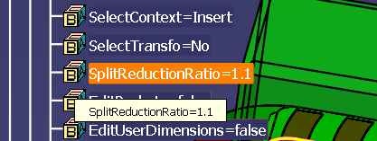
Editing length and width dimensions of the inserts
The user can modify these insert dimensions only by edition of the parameter SplitReductionRatio
Bounding L
Rough L = ( Bounding L * SplitReductionRatio ) rounded

Slide 25

Editing length and width dimensions of the virtual plates
The user can decide on the length and width of the VirtualPlate by editing LsectionUser and WSectionUser.
The length and width dimensions of the virtual plate will be defined by adding half of these values on each side of the insert

Slide 26

Height of the CavityInsert
The template automatically computes the minimum height needed from the cavity surface ( rounded )
The user can increase this height by editing the value HInsertUser .
This computed height appears in the ref parameter
Bounding H
Rough H = ( Bounding H * HInsertUser) rounded

Slide 27

Position of the Insert in the VirtualPlate
Default values :
one face of the virtual plate corresponds to the extreme point of the cavity surface
The other face corresponds to the bottom of the pocket
Both can be edited by means of DepthPlateUser and HPlateUser
DepthPlateUser
HPlateUser

Slide 28
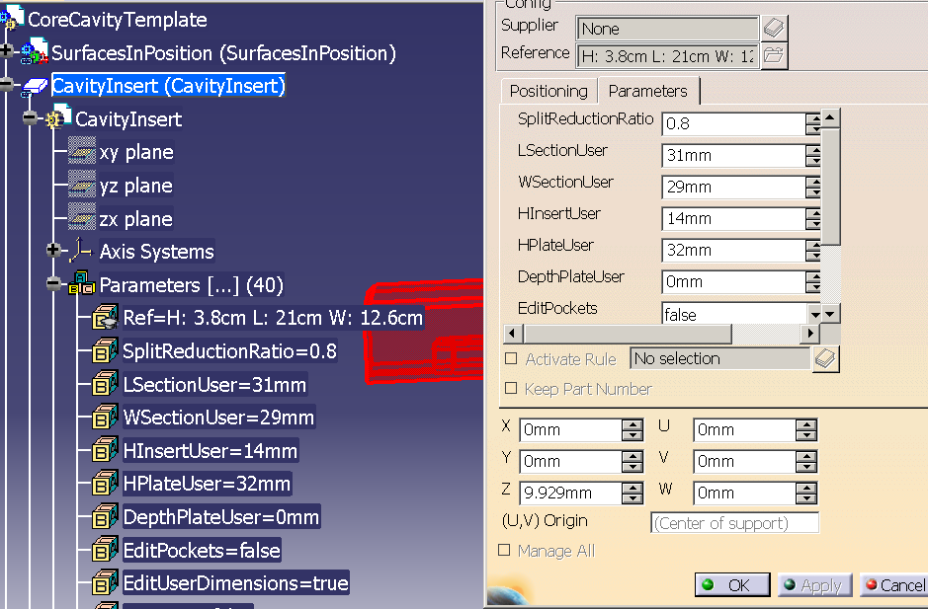
Dimensions of the Inserts
The height and depth associated respectively to the cavity and core sides are defined similarly ( either by direct edition of parameters or via MTD )
After finishing edition of the dimensions, set the parameter EditUserDimensions to « false » so that the corresponding dimension parameters will be made invisible to the user.

Slide 29
Summary
Before you start
How to use the CoreCavityTemplate
Output of the CoreCavityTemplate
Using the CoreInsert and CavityInsert in a MoldBase
AdvancedTasks : editing pockets

Slide 30
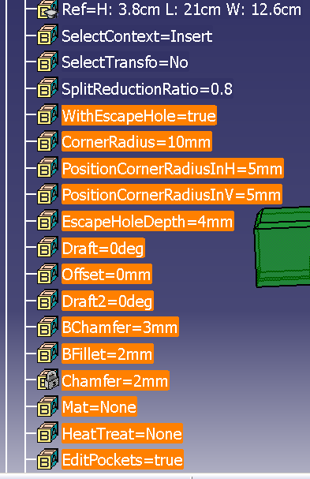
Editing the pockets of the Inserts
The user can choose to edit the insert pockets ( independantly in CoreInsert and CavityInsert )
For this he must set the parameter EditPockets to « true »
Then he must choose whether he wants « EscapeHoles » or not by edition of the parameter WithEscapeHole
The user parameters which are displayed can be edited either directly or via MTD
When done, set back the parameter EditPockets to false

Slide 31
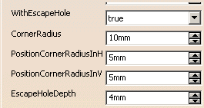
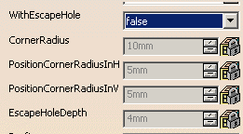
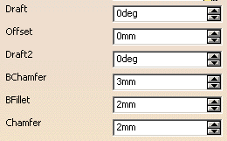
Edition of Insert Pockets – available only when EditPockets = true
It is possible to select the type of pocket and associated parameters

Slide 32
Summary
Before you start
How to use the CoreCavityTemplate
Output of the CoreCavityTemplate
Using the CoreInsert and CavityInsert in a MoldBase
AdvancedTasks : assisting the user decision

Slide 33
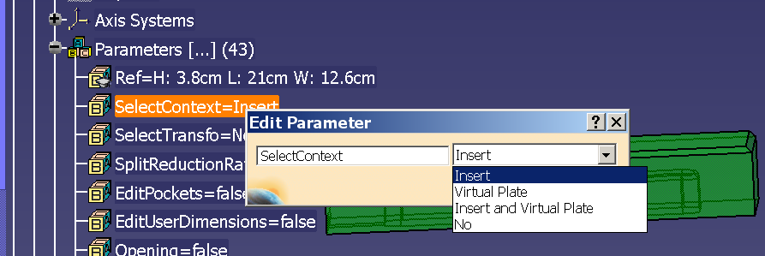
Edition of the context to assist user decisions
It is possible to vizualize the insert, the virtual plate or both
Seeing only the virtual plate is useful when defining the pockets
Seeing both the insert and the virtual plate is useful when adjusting the insert depth in the plate
When using the inserts in a Mold Structure or a layout the virtual plate is not useful and should be hidden
This context can be done independantly on both insert

Slide 34
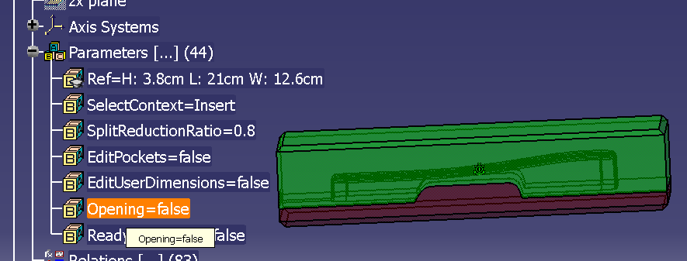
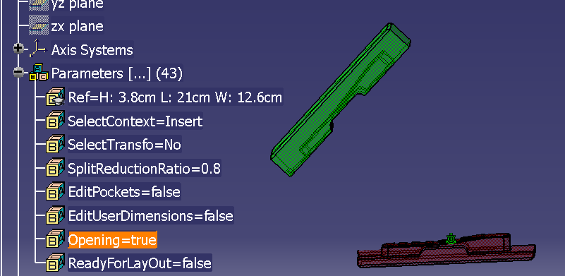
Understanding the Shape of the Core and Cavity Insert
Sometimes it is difficult to see the shape of the Core and Cavity Inserts because they are represented in closed position.
One can select temporarily Opening = true , in order to see better. It is located in CavityInsert

Slide 35
Thank you

