Slide 1

Autonomous Orbital Maintenance Platform
Fault Diagnosis and Contingency Recovery
Michele Tozzola

Slide 2

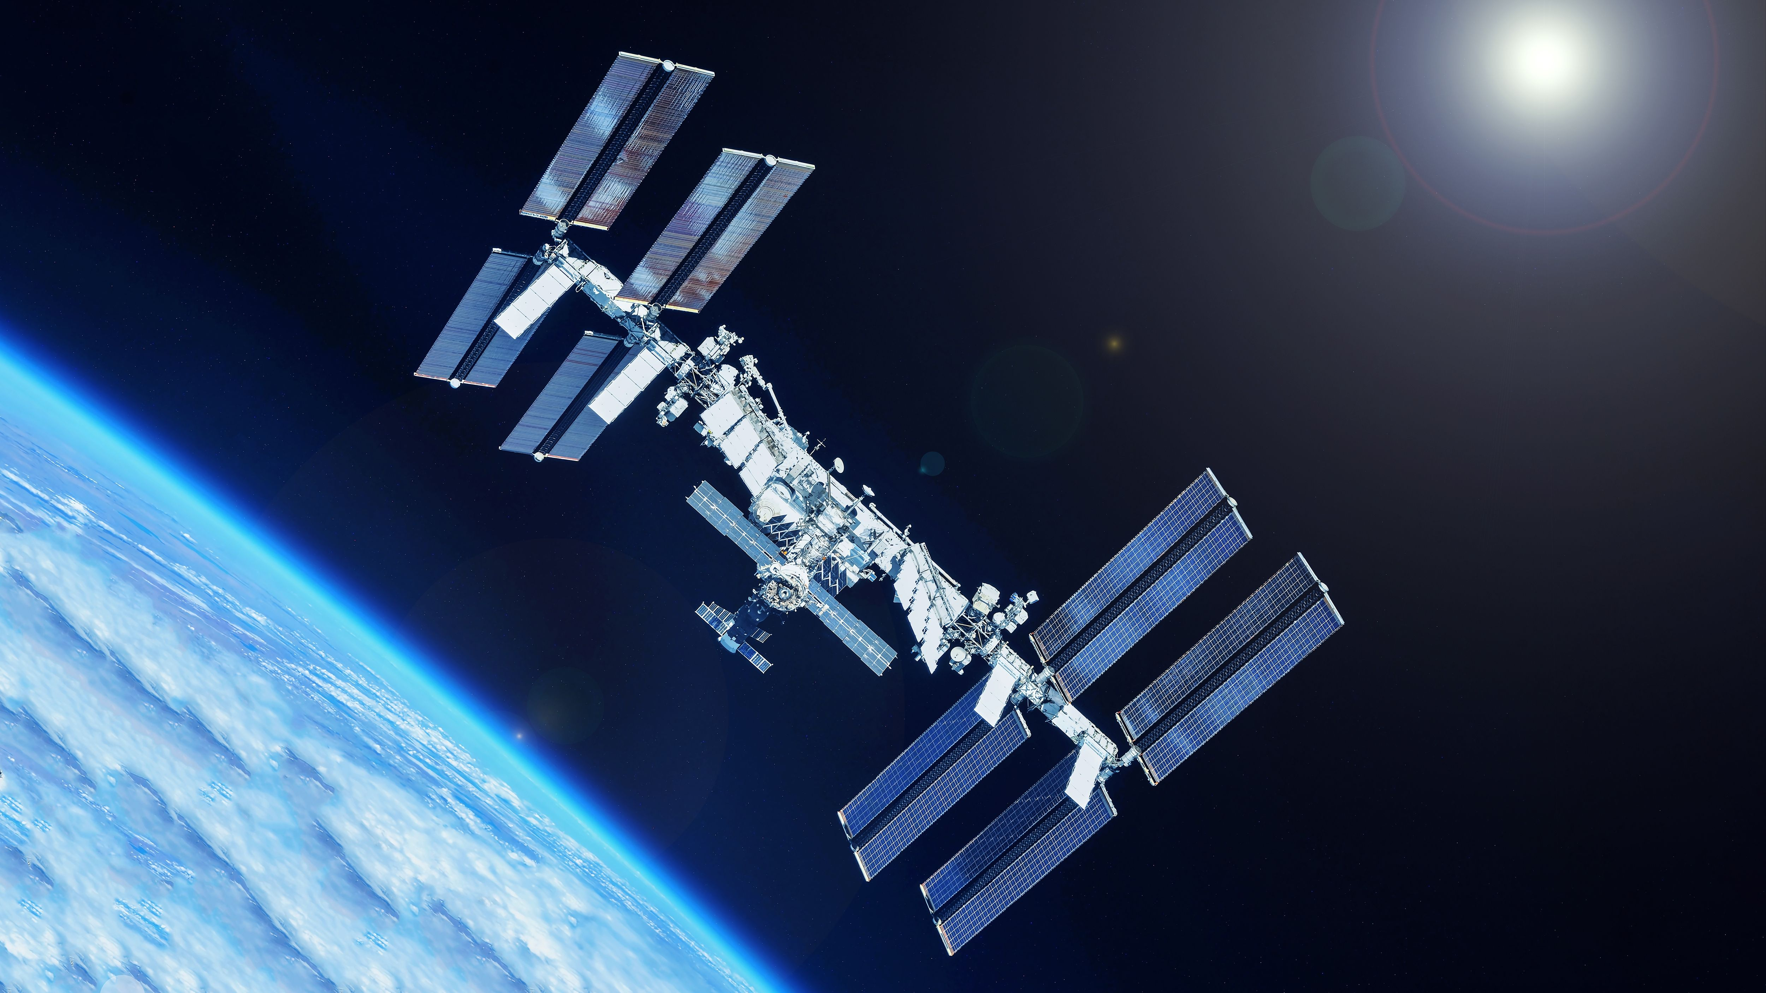
Scenario
A free-climbing robot on an external platform with fault-prone components
Not all faults are directly observable
The robot must perform diagnostic actions, identify the fault, execute a recovery or repair procedure and verify the system again

Slide 3
Architecture flow
Observe symptoms
Run diagnostic test
Confirm the fault
Repair
Verify
Notes:
- Concept of multiple possible failure but only one confirmed fault

Slide 4
Modularity
What is the name of the new fault?
What is the name of the symptom(s) associated with this fault?
What is the name of the new diagnostic test to identify this fault?
What is the name of the recovery action to fix this fault?
Which specific components can this test be applied to? (applicable_test <test> <component>)
Which symptom must be present for this test to be relevant? (test_requires_symptom <test> <symptom>)
Does this test require specific physical conditions?
(test_requires_open <test>)
(test_requires_closed <test>)
(test_requires_neighbor <test>)

Slide 5
Modularity
Does this test indicate the new fault? (test_indicates <test> <fault>)
Is the new symptom unreliable? (unreliable_symptom <symptom>)
Does this fault physically prevent the component from moving? (fault_prevents_movement <fault>)
Which recovery action fixes this specific fault? (fixed_by <recovery_action> <fault>)
What physical requirements are needed to execute this recovery action?
(recovery_requires_torque <recovery_action>)
(recovery_requires_spare <recovery_action>)
(recovery_requires_closed <recovery_action>)
Which old symptom does it clear? (recovery_clears_symptom <recovery_action> <old_symptom>)
Which new symptom does it set? (recovery_sets_symptom <recovery_action> <new_symptom>)

Slide 6
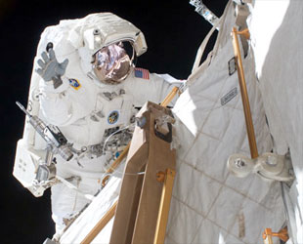
Inspiration
During the STS-131 mission, a critical valve on a newly installed ammonia coolant tank got stuck in the closed position. Because of the severity of the malfunction, NASA heavily considered adding an unplanned fourth spacewalk (EVA) and extending the shuttle's mission to manually fix the issue.
Mission specialist Clayton Anderson waves while working to install a new ammonia tank outside the station. (NASA)

Slide 7
Assumption
General:
At least one element in a system tank-valve-tank is working properly.
When independent indicators agree during a specific system state, their collective output is considered reliable.
Valve:
What the robot sees might not be the true state of the valve
Pressure sensors:
If the sensor is reading erratic values, it is broken
If the sensor is reading a stable pressure, it might be broken, provided adjacent sensors disagree
If the sensor is reading a changing pressure, it is working for sure (no drift effect)
Notes:
- Say that a short time assumption is done (No drift)

Slide 8
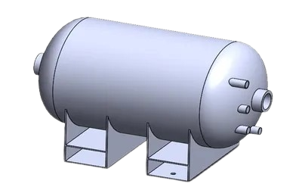
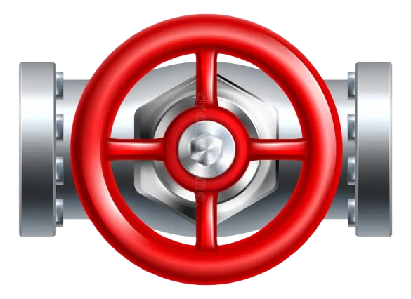


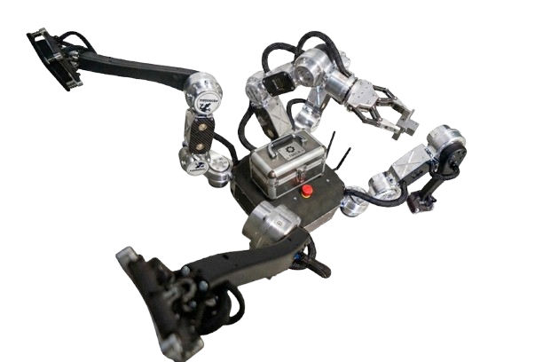

Problem 1 Q1
Loc1
Loc2
Loc3
Open
Notes:
- Tell about the Warehouse that contains spare sensor
- The robot has a toolbox with an adjustable wrench inside

Slide 9
Plan for problem 1*
Do all the diagnostic actions
Move to Loc3
Take the spare sensor and put it in the toolbox
Move to Loc2 and close the valve to secure the environment
Go to Loc1 and replace the sensor
Go to Loc2 and open the valve again
Verify if everything works properly
Go to Loc3 and leave the broken sensor in the warehouse
Total steps: 27
*:Some simplification has been made for readability

Slide 10
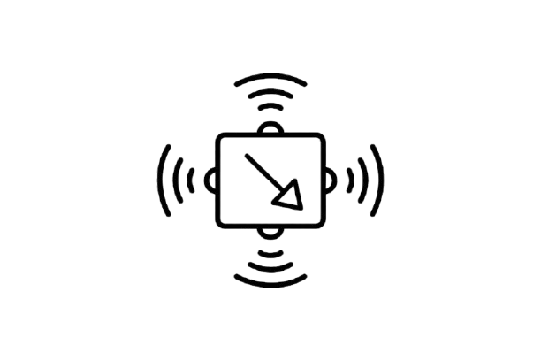
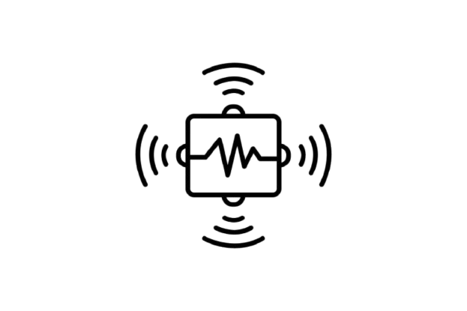
Problem 2 Q1
Loc1
Loc2
Loc3
Open
Closed

Slide 11
Plan for problem 2*
Do all the diagnostic actions
Move to Loc3
Take both the spare sensors and put them in the toolbox
Handle the first system as in problem 1.
Go to Loc2 and take the adjustable wrench from the toolbox
Change size of the tool to match the size of the valve
Fix the valve leakage
Go to Loc1 and replace the broken sensor with the spare one
Verify if everything works properly
Go to Loc3 and leave the broken sensors in the warehouse
Total steps: 49
*:Some simplification has been made for readability

Slide 12
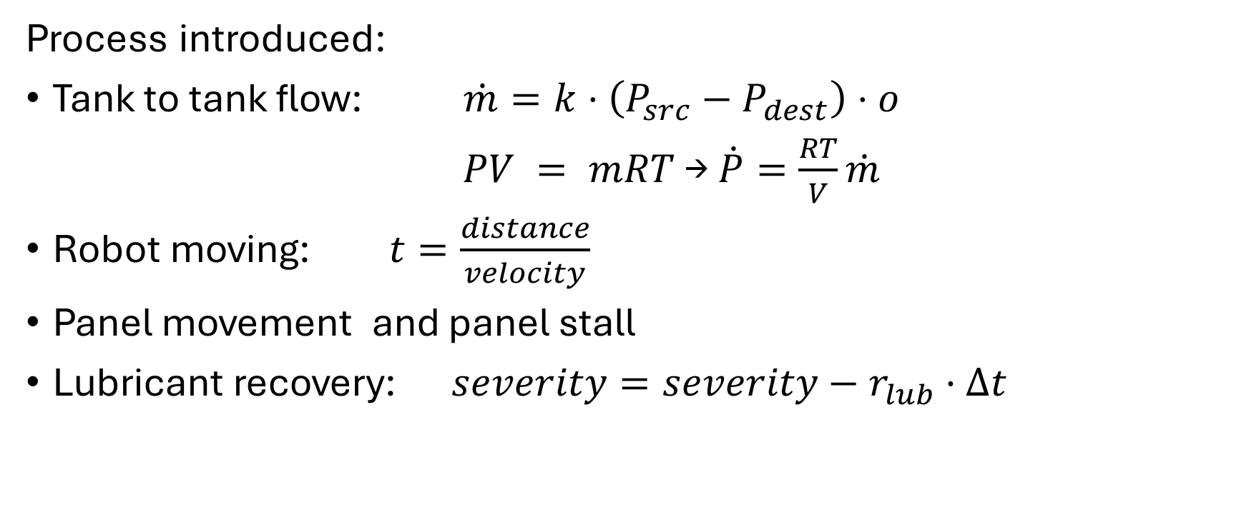
PDDL+
Process introduced:
Tank to tank flow: $\dot{m}=k⋅\left(P_{src}−P_{dest}\right)⋅o$
$PV = mRT$ → $\dot{P}=\frac{RT}{V}\dot{m}$
Robot moving: $t=\frac{distance}{velocity}$
Panel movement and panel stall
Lubricant recovery: $severity=severity−r_{lub}·Δt$
Notes:
- Now scission between what the robot can see and logic that model the physical world
- I can use confirm_fault and rule_out_fault even with panel because is modular

Slide 13
Problem 1 Q2
Loc1
Loc2
Loc3
100Pa
Closed
50Pa
Panel 1
0.1 opening
jammed
Panel 2
Notes:
- The panel 2 is jammed ma the robot dosen’t know until it try to open it

Slide 14
Plan for problem 1 PDDL+ *
Do all the diagnostic actions
Move to Loc2
Take the adjustable wrench from the toolbox and tighten the valve
Place the adjustable wrench in the toolbox and move to Loc3
Try to open the panel 2 until the alarm triggers
Run the diagnostic for jammed panel and confirm the fault
Start lubricant recovery and wait
Open the panel and replace the broken sensor
Close the panel and verify if everything is working properly
Plan-Length: 99
*:Some simplification has been made for readability
Notes:
- The robot realese object and ritake it

Slide 15
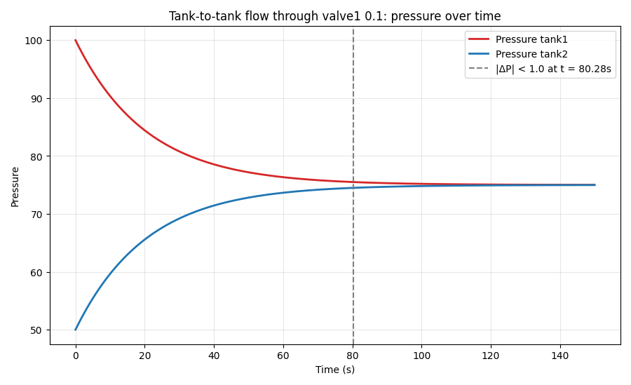
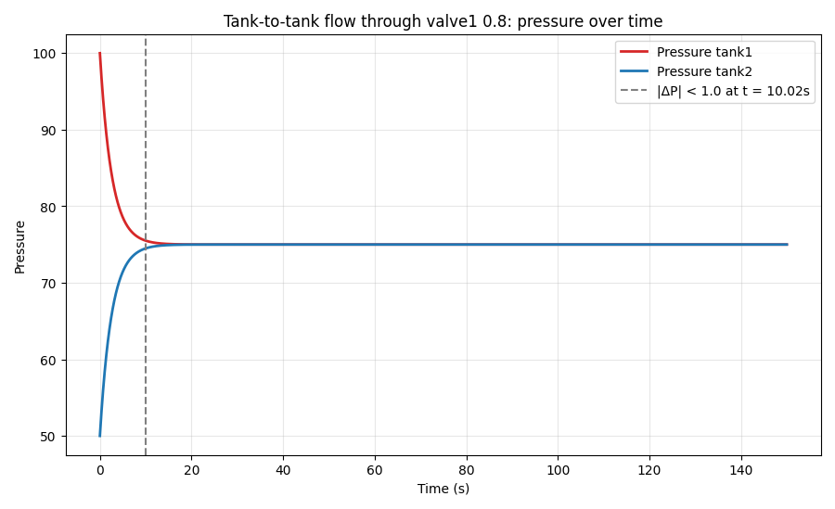
Plan 2 Q2
Same scenario of problem one but with two differences
The valve now is almost fully open (0.8)
The distance between each location is doubled
Plan: Unsolvable

Slide 16
Technical discussion
Limitation of the classical PDDL for diagnosis and partial observability:
Fully observable world
The world changes only after an action of the robot
No external event and process
Diagnostic action Vs goal-achieving actions:
Purpose
Preconditions
Fault Progression and Planning Urgency:
Continuous processes can drive the system toward irreversible failure
No external event and process
Toward a POMDP-Based Model:
From possible faults to probability distribution (act before confirm).
Tests become observation
Process and repairing actions stochastic
From (equalized) to cost
Notes:
| Effect on physical world | None, they only add/remove conceptual predicates | Change actual component state |
| Purpose | Reduce uncertainty / narrow hypothesis space | Move the world toward the goal |
| Preconditions | Depend on symptoms already observed, not on the true fault | Gated by `confirmed_fault` |
| Reversibility | Effectively monotonic — knowledge only accumulates | Physically consequential and sometimes constrained (e.g. can't `open_valve` if a movement-preventing fault is possible) |

Slide 17
Improvements
Associate at each fault a danger or caution priority
The robot reads multiple time the pressure from the sensor and assign on its own the symptoms
Add a process to increase the severity of the jam for the panel (like over-heating)
Add a pump to restore the initial pressure inside the tanks
Add time of execution for each significant action to close the gap with the real world

Slide 18
Thank you for the attention

