Slide 1

Welcome to the
New Term
Teacher Roberts • GEP 7 & 9 • A Fresh Start
Achievement • Confidence • Teamwork

Slide 2

THIS TERM
How This Term Will Be Different
1
Simpler Lessons
2
Formula First
Clear goals for every class — you always know what to expect
Teach step-by-step so every student can follow along
3
Answers First
4
Fun & Stress-Free
See the answer first, then understand why it's correct
Learning is engaging, positive, and enjoyable every day

Slide 3

CLASS STYLE
Class Style &
Atmosphere
"We grow as
a team."
🤝 Teamwork Every Lesson
👥 Pair Work & Group Activities
❤️ Support Classmates — We Are Family
🌟 Positive, United, Friendly

Slide 4

EXPECTATIONS
What I Expect From You
01
Pen & Notebook
Always bring your materials to every class
02
Take Notes
Your notes will help you get full marks in exams
03
Stay Focused
Active participation means faster progress
04
Ask Questions
No question is too small — don't be shy!

Slide 5
EVERY WEEK
Weekly Routine
Vocabulary
Grammar
Teamwork
E-Learning
New words and phrases practised every session with real-life context
Student book formulas broken down simply — step by step
Group discussions and collaborative activities to build confidence
Weekly progress check — stay current and earn bonus points

Slide 6

E-LEARNING
E-Learning Rules
Stay
Current.
Stay
Ahead.
MUST
Stay up-to-date every week — no exceptions
BONUS
Finish early and earn extra bonus points
EXAM
E-learning directly helps you in exams
CHECK
Teacher will monitor your progress weekly

Slide 7
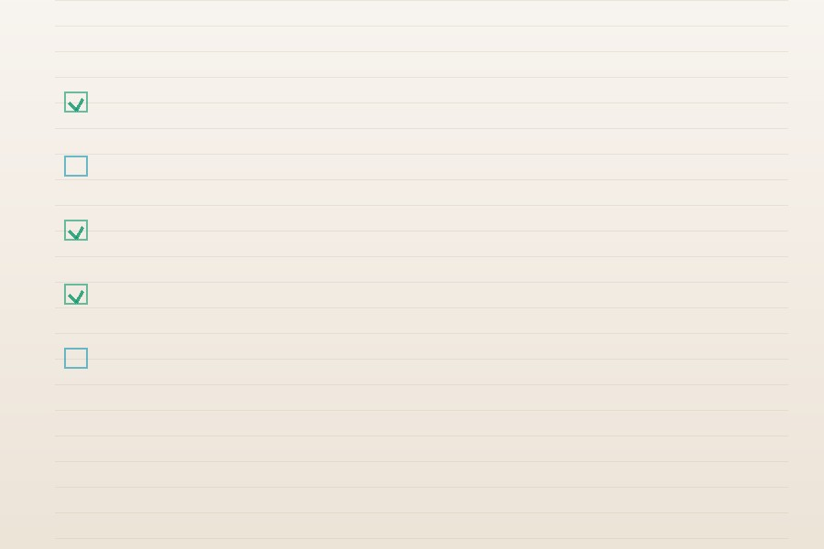
ASSESSMENT
End-of-Term Exam
No
Surprises.
✓
Based only on what we study together
✓
Your class notes will help you get full marks
✓
We will prepare as a team before the exam
✓
You WILL succeed if you attend & take notes

Slide 8

THIS TERM
Class
Presentation
→ One presentation this term — simple topic
→ Topic will be useful and relevant to your life
→ Teacher Roberts will help you prepare fully
→ A real chance to build speaking confidence

Slide 9

YOUR TEACHER
About
Teacher
Roberts
"Lived it.
Travelled it.
Teach it."
🇬🇧 From Birmingham, England
🌍 Lived in Spain, Italy, Portugal, St Kitts & Nevis
🌏 3 years in SE Asia — Lao, Thailand, Vietnam
✈️ Loves travel, YouTube, writing & crypto
🏆 Here to help YOU succeed

Slide 10

MY PROMISE
My Promise to You
I will support you inside and outside class
Tell me privately or in class if you don't understand
I want you to learn real English for real life
We grow together as a team — always

Slide 11

Let's Have a
GREAT TERM!
Work Together
Stay Positive
Help Each Other
Make It the Best Class
Teacher Roberts • GEP 7 & 9

