Slide 1
Afterpulse Measurement
Ding Xun
QPQI
USTC

Slide 2
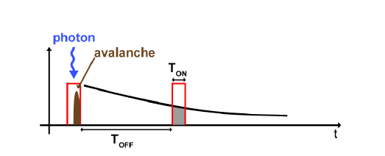
Dual Gate Method (Time-Correlated Carriers Counting)
First gate: photon impinging forces an avalanche (100% prob.)
Second gate: change Toff, measure Pt
Subtract the primary dark counts prob.
Anti M, Tosi A, Acerbi F, et al.
Modeling of afterpulsing in
single-photon avalanche diodes.

Slide 3
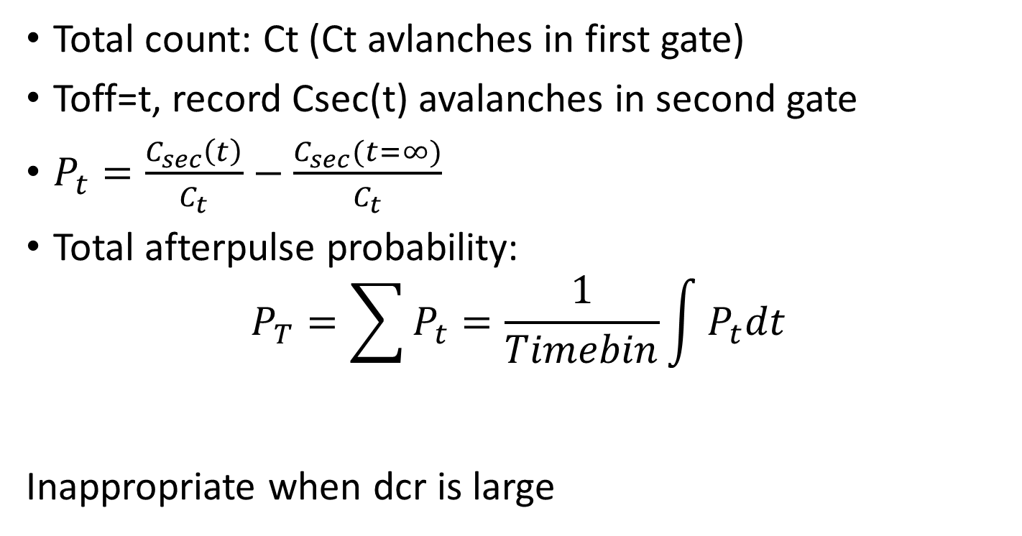
Dual Gate Method
Total count: Ct (Ct avlanches in first gate)
Toff=t, record Csec(t) avalanches in second gate
$P_{t}=\frac{C_{sec}\left(t\right)}{C_{t}}−\frac{C_{sec}(t=∞)}{C_{t}}$
Total afterpulse probability:
$$P_{T}=\sum{P_{t}}=\frac{1}{Timebin}\int{P_{t}dt}$$
Inappropriate when dcr is large

Slide 4
Time intervals Method
Measuring time interval between two avalanches
Fit the histogram of time interval
red curve: exponential dist. of darkcount or continuous photon impinging
Afterpulse: area above red
curve

Slide 5
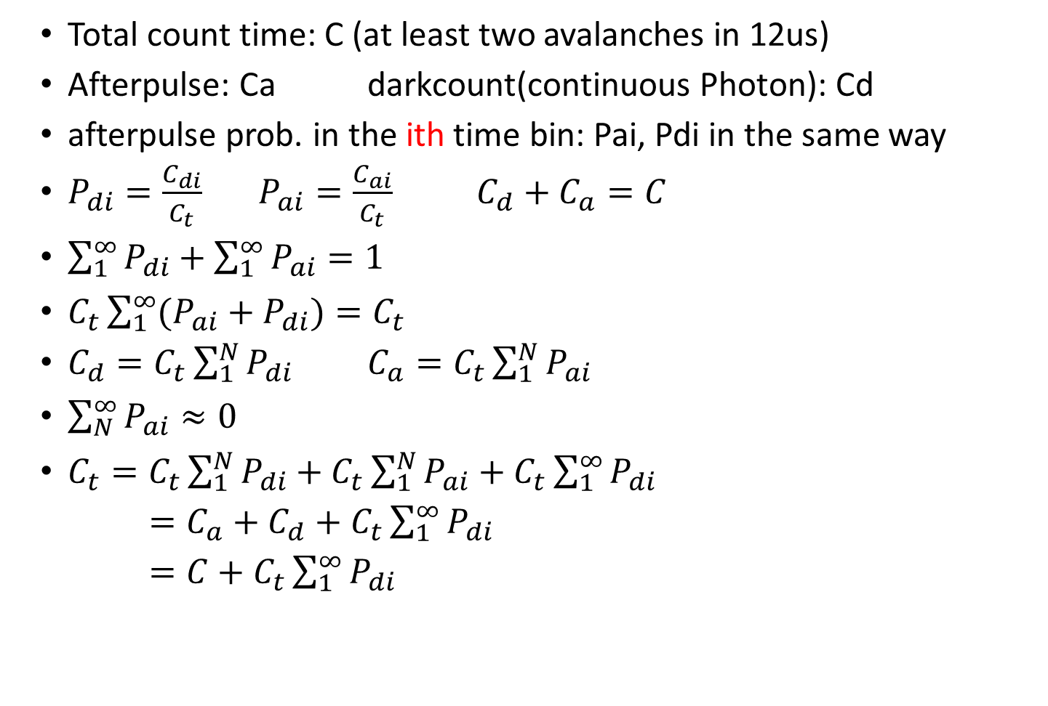
Time intervals Method
Total count time: C (at least two avalanches in 12us)
Afterpulse: Ca darkcount(continuous Photon): Cd
afterpulse prob. in the ith time bin: Pai, Pdi in the same way
$P_{di}=\frac{C_{di}}{C_{t}}$ $P_{ai}=\frac{C_{ai}}{C_{t}}$ $C_{d}+C_{a}=C$
$\sum_{1}^{∞}{P_{di}+\sum_{1}^{∞}{P_{ai}}=1}$
$C_{t}\sum_{1}^{∞}{(P_{ai}+P_{di})}=C_{t}$
$C_{d}=C_{t}\sum_{1}^{N}{P_{di}}$ $C_{a}=C_{t}\sum_{1}^{N}{P_{ai}}$
$\sum_{N}^{∞}{P_{ai}≈0}$
$C_{t}=C_{t}\sum_{1}^{N}{P_{di}}+C_{t}\sum_{1}^{N}{P_{ai}}+C_{t}\sum_{1}^{∞}{P_{di}}$
$=C_{a}+C_{d}+C_{t}\sum_{1}^{∞}{P_{di}}$
$=C+C_{t}\sum_{1}^{∞}{P_{di}}$

Slide 6
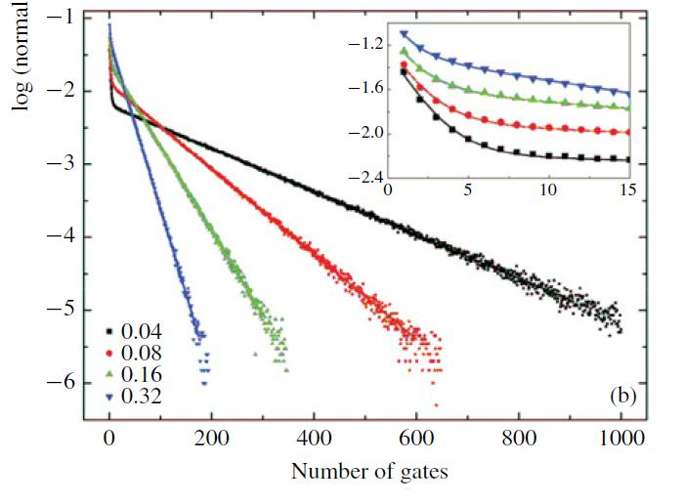

Time Interval Method
Afterpulse prob. has nothing to do with photon flux
Measuring time window
$C_{t}=C+C_{t}\sum_{1}^{∞}{P_{di}}$
da Silva T F, Xavier G B, von der Weid
J P. Real-time characterization of
gated-mode single-photon detectors.

Slide 7
Avalanche buildup and propagation effects on photon-timing jitter in Si-SPAD with non-uniform electric field
Antonino Ingargiola, Mattia Assanelli, Andrea Gallivanoni, Ivan Rech, Massimo Ghioni and Sergio Cova

Slide 8

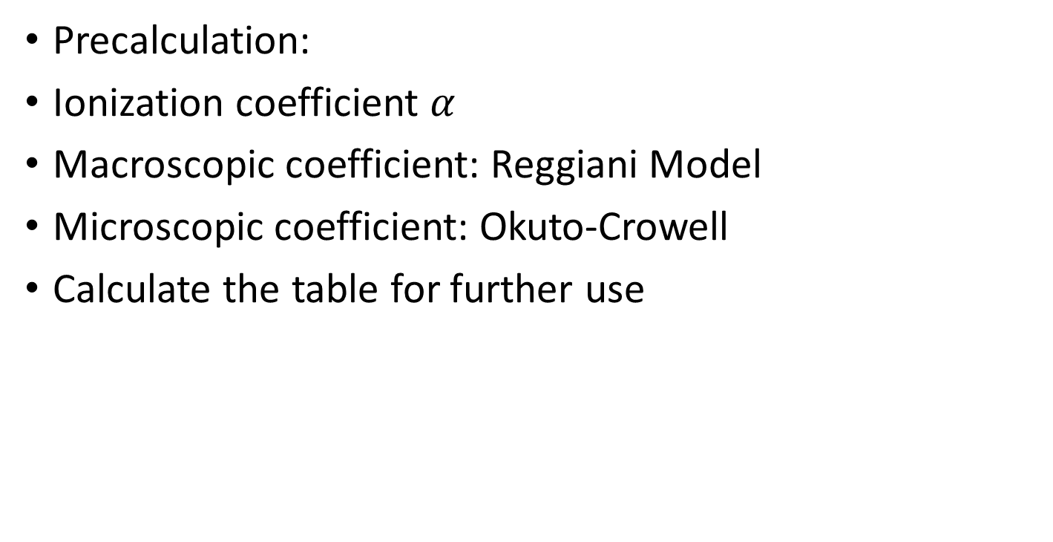
Buildup Simulation
Precalculation:
Ionization coefficient $α$
Macroscopic coefficient: Reggiani Model
Microscopic coefficient: Okuto-Crowell
Calculate the table for further use

Slide 9

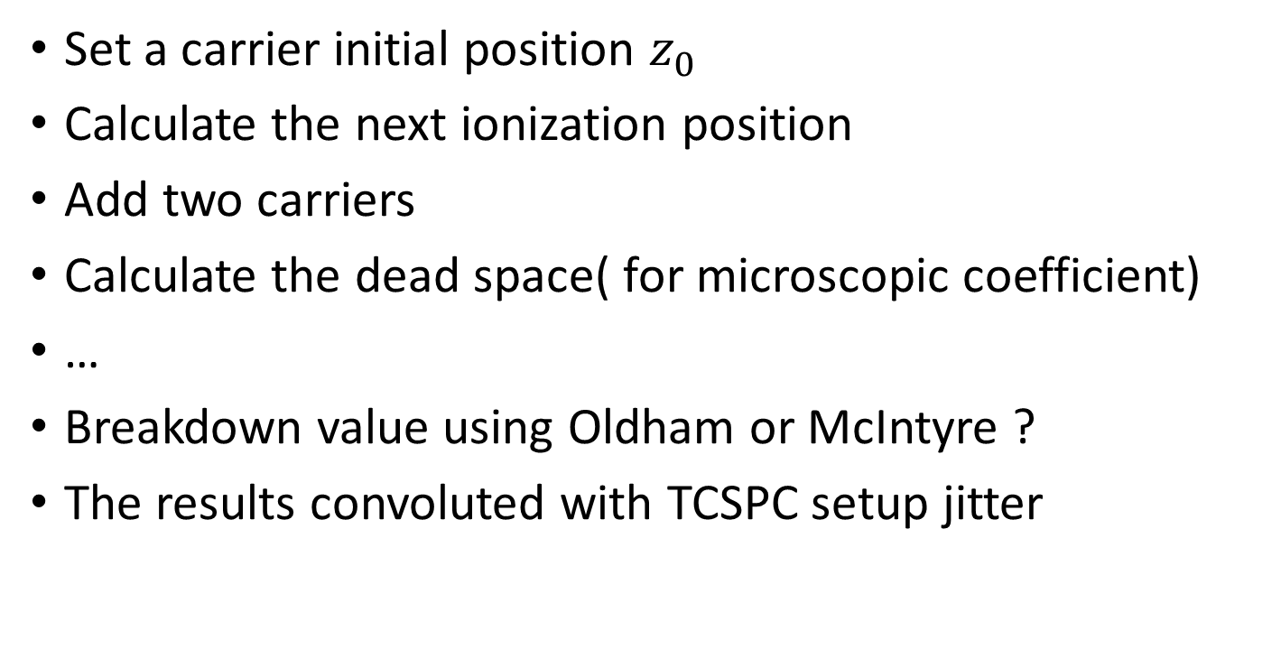
Buildup Simulation
Set a carrier initial position $z_{0}$
Calculate the next ionization position
Add two carriers
Calculate the dead space( for microscopic coefficient)
…
Breakdown value using Oldham or McIntyre ?
The results convoluted with TCSPC setup jitter

Slide 10

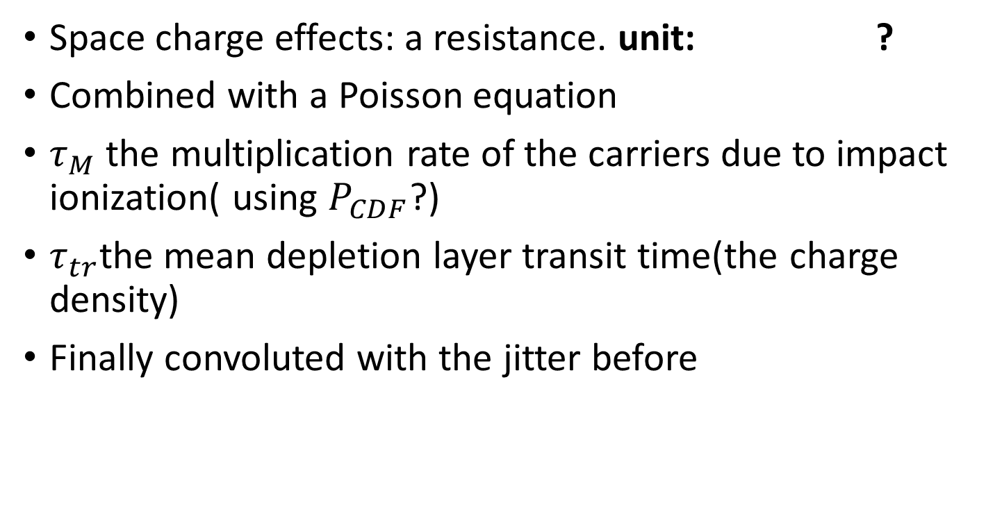
Lateral Simulation
Space charge effects: a resistance. unit: ?
Combined with a Poisson equation
$τ_{M}$ the multiplication rate of the carriers due to impact ionization( using $P_{CDF}$?)
$τ_{tr}$the mean depletion layer transit time(the charge density)
Finally convoluted with the jitter before

Slide 11

Lateral Simulation
Extension:
Solve the equations step by step
Every temporal step choose a random number in Poisson distribution whose parameter$λ={1/τ}_{M}$

