Slide 1

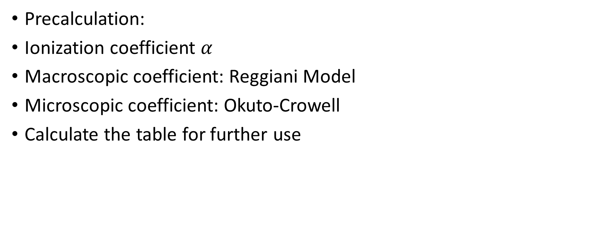
Buildup Simulation
Precalculation:
Ionization coefficient $α$
Macroscopic coefficient: Reggiani Model
Microscopic coefficient: Okuto-Crowell
Calculate the table for further use

Slide 2

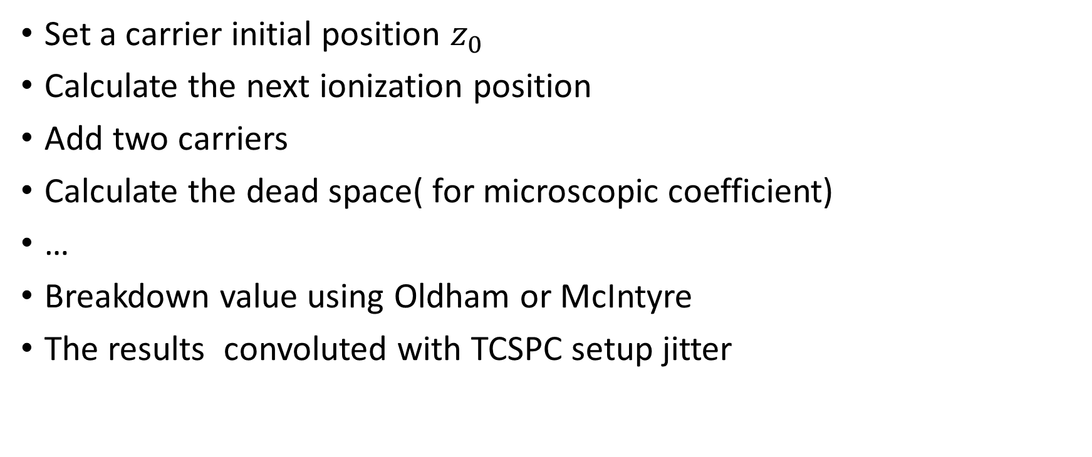
Buildup Simulation
Set a carrier initial position $z_{0}$
Calculate the next ionization position
Add two carriers
Calculate the dead space( for microscopic coefficient)
…
Breakdown value using Oldham or McIntyre
The results convoluted with TCSPC setup jitter

Slide 3

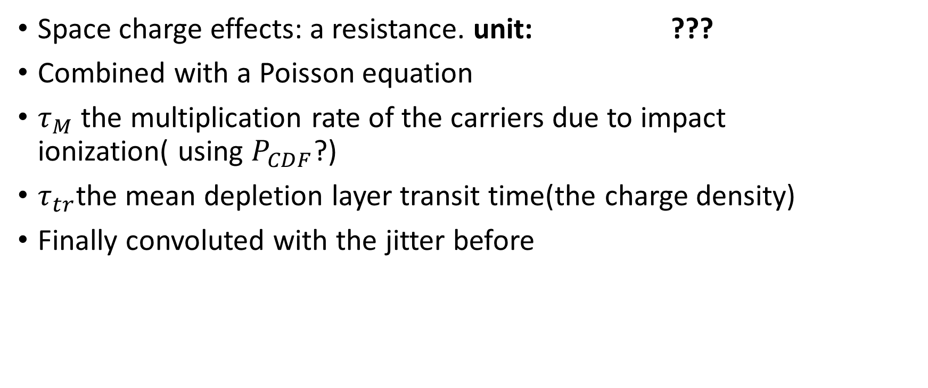
Lateral Simulation
Space charge effects: a resistance. unit: ???
Combined with a Poisson equation
$τ_{M}$ the multiplication rate of the carriers due to impact ionization( using $P_{CDF}$?)
$τ_{tr}$the mean depletion layer transit time(the charge density)
Finally convoluted with the jitter before

Slide 4

Lateral Simulation
Extension:
Solve the equations step by step
Every temporal step choose a random number in Poisson distribution whose parameter$λ={1/τ}_{M}$

