Slide 1
Quantative Method and recently experiments
Xun Ding
Tianzhe Zheng

Slide 2
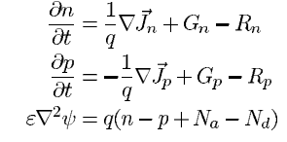

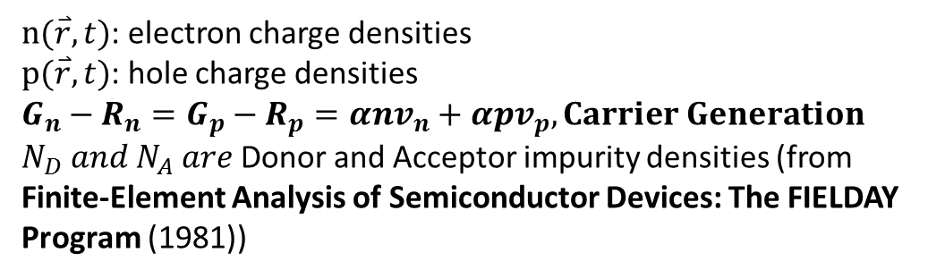
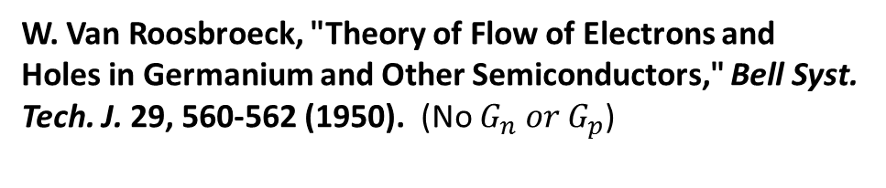
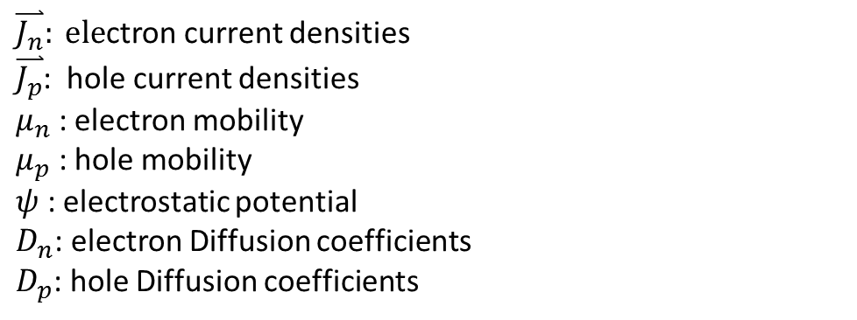
Deterministic Model
W. Van Roosbroeck, "Theory of Flow of Electrons and Holes in Germanium and Other Semiconductors," Bell Syst. Tech. J. 29, 560-562 (1950). (No $G_{n} or G_{p}$)
R. J. Van Overstraeten, H. J. DcMan, and R. P. Mertens, "Transport Equations in Heavy Doped Silicon," IEEE Trans. Electron Devices ED-20, 290-298 (1973).
$n(\overset{⃑}{r},t)$: electron charge densities
$p(\overset{⃑}{r},t)$: hole charge densities
$$G_{n}−R_{n}=G_{p}−R_{p}=αnv_{n}+αpv_{p},Carrier Generation$$
$N_{D} and N_{A} are$Donor and Acceptor impurity densities (from Finite-Element Analysis of Semiconductor Devices: The FIELDAY Program (1981))
$\overset{⃑}{J_{n}}: ele$ctron current densities
$\overset{⃑}{J_{p}}$: hole current densities
$μ_{n}$ : electron mobility
$μ_{p}$ : hole mobility
$ψ$ : electrostatic potential
$D_{n}$: electron Diffusion coefficients
$D_{p}$: hole Diffusion coefficients

Slide 3
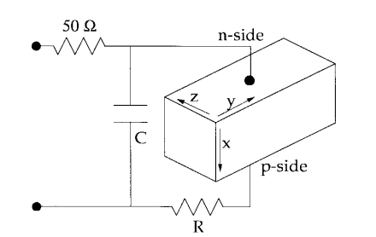
Assumption
The depleted region thickness does not change during the transient ,assuming a doping profile
The ohmic path due to the neutral regions is accounted for by introducing an equivalent lumped resistor

Slide 4
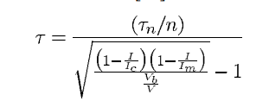
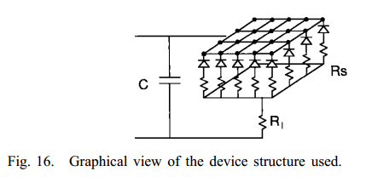



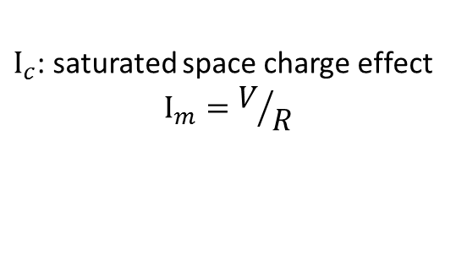
Simulation of realistic devices
The detector may be described as an ensemble of elementary devices connected in parallel, where as the neutral regions in the structure of Fig have been described with a resistor network.
$I_{c}$: saturated space charge effect
$$I_{m}=V/R$$
Ref:Simulazione di fenomeni di trasporto e di fotoemissione in dispositivi a valanga per la rivelazione di singoli fotoni,”Ph.D. Dissertation,A.Spinelli ???
Ref: Quasistatic Approximation for Semiconductor Avalanches (1970)

Slide 5

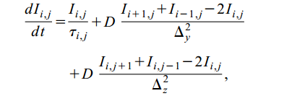
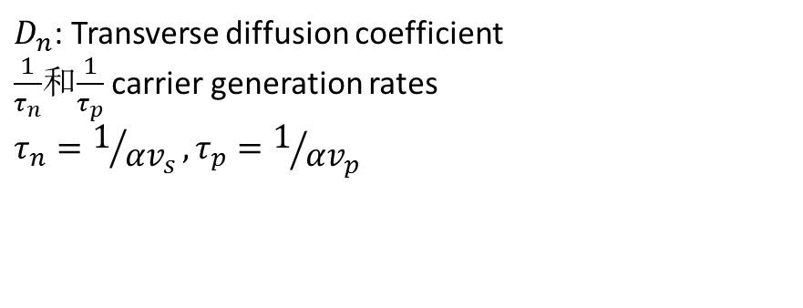
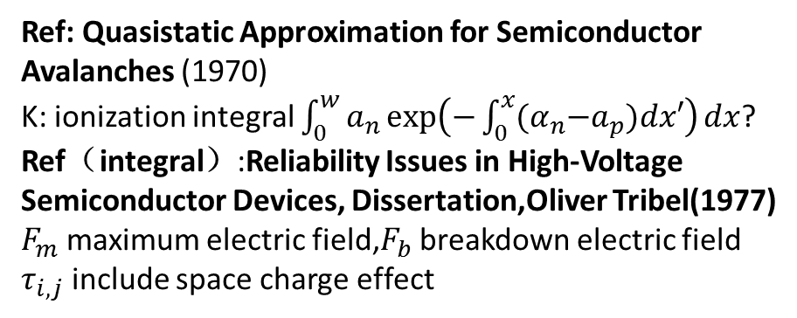
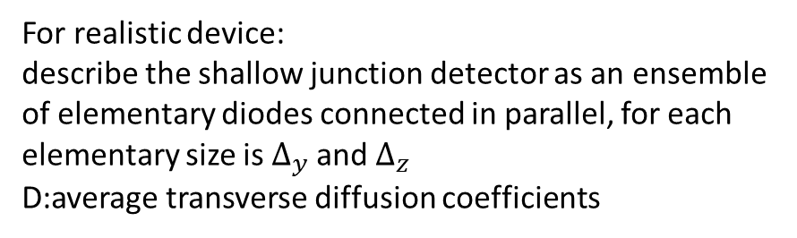
Avalanche transients in shallow p-n junctions biased above breakdown
$D_{n}$: Transverse diffusion coefficient
$\frac{1}{τ_{n}}$和$\frac{1}{τ_{p}}$ carrier generation rates
$$τ_{n}=1/{αv_{s}},τ_{p}=1/{αv_{p}}$$
For realistic device:
describe the shallow junction detector as an ensemble of elementary diodes connected in parallel, for each elementary size is $∆_{y}$and $∆_{z}$ D:average transverse diffusion coefficients
Ref: Quasistatic Approximation for Semiconductor Avalanches (1970)
K: ionization integral $\int_{0}^{w}{a_{n}\exp\left(−\int_{0}^{x}{{(α}_{n}−a_{p})dx′}\right)dx}$?
Ref（integral）:Reliability Issues in High-Voltage Semiconductor Devices, Dissertation,Oliver Tribel(1977)
$F_{m}$ maximum electric field,$F_{b}$ breakdown electric field
$τ_{i,j}$ include space charge effect

Slide 6
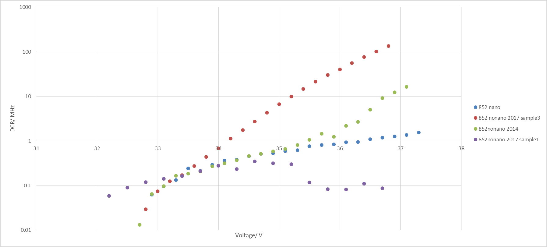
DCR Test in 852
Including 1 nonano in 2014, 1 nano and 2 nonano in 2017

