Slide 1
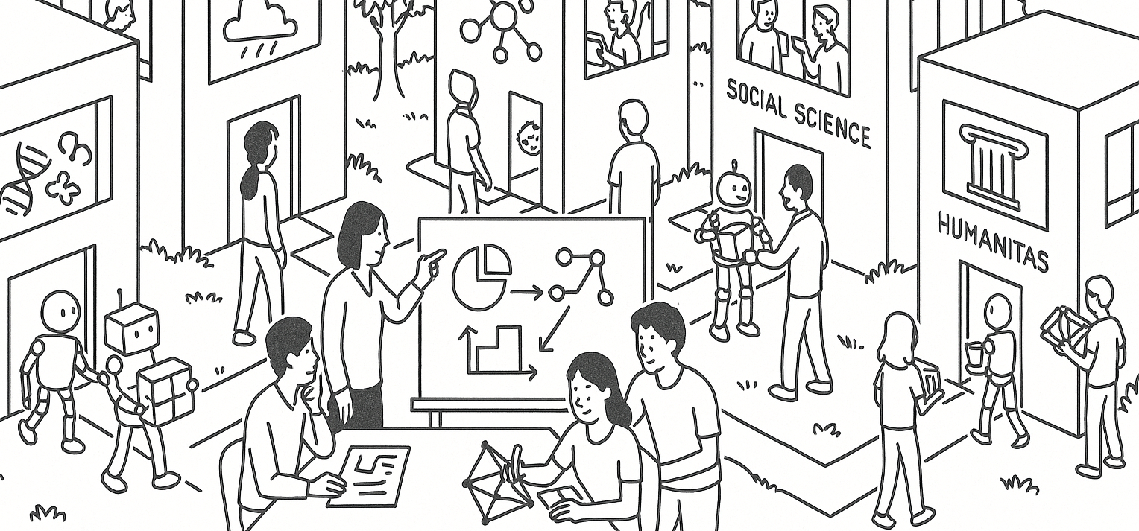

Describing and visualizing data
STAT UN 1001 · LECTURE 5
SEPTEMBER 22, 2026
Notes:
Opening slide. Today consolidates all Chapter 2 concepts so Thursday can focus on project work.

Slide 2
Week 3 plan
NUMERICAL DATA
Mean notation, 0/1 variables, bins, quartiles, variance, standard deviation, shape, and transformations
CATEGORICAL DATA
Contingency tables, conditional proportions, association, and comparison
Interpreting Graphs (Figures)
Bar plot, histogram, boxplot, scatterplots, other plots in the book
Thursday: project discussion and work session
COLUMBIA UNIVERSITY · DEPARTMENT OF STATISTICS
02
Notes:
1 minute. Tell students the class will work from their own preparation quiz. Thursday introduces no new Chapter 2 material.

Slide 3
What the flipped activity showed
Binned counts
61.9%
38.7%
Quartiles
73.0%
reported some uncertainty about frequency tables, contingency tables, or conditional proportions
Column proportion
76.2%
Row proportion
77.8%
0/1 sum
81.0%
COLUMBIA UNIVERSITY · DEPARTMENT OF STATISTICS
03
Notes:
2 minutes. Aggregate results only: 63 practice submissions and 62 anonymous check-ins. Avoid naming or identifying students.

Slide 4
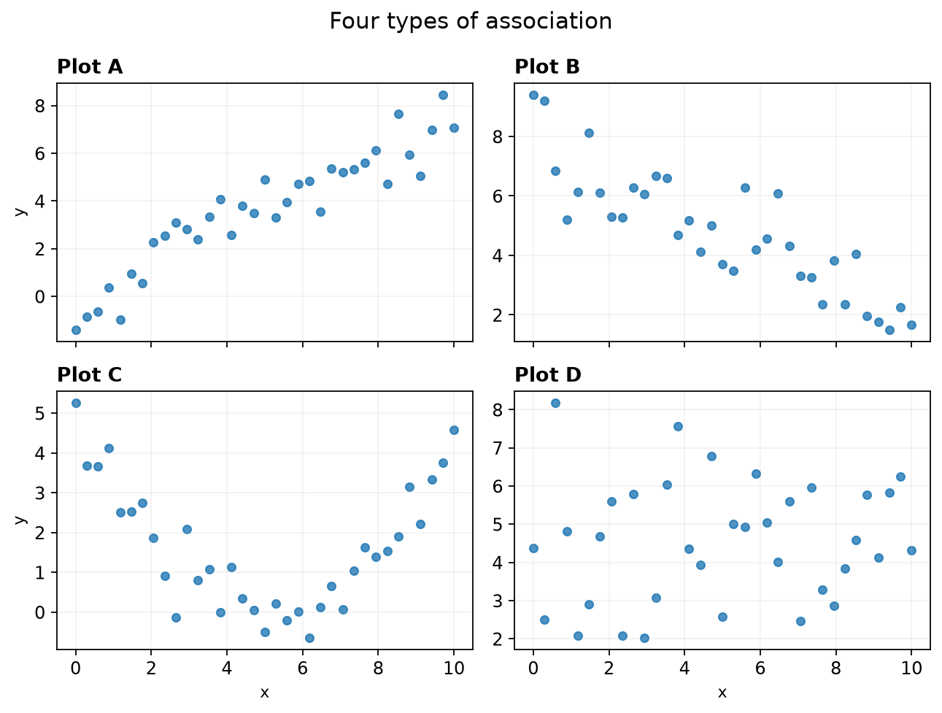
Quiz questions 1–2 | Association
Which classification is correct?
A. A positive linear, B negative linear, C nonlinear, D no clear association
B. A negative linear, B positive linear, C no association, D nonlinear
C. A and B nonlinear, C and D linear
D. All four show positive linear association
What makes plot C nonlinear?
COLUMBIA UNIVERSITY · DEPARTMENT OF STATISTICS
04
Notes:
3 minutes. Ask students to classify each panel and explain what changes in plot C. Correct: A. The changing slope or curvature makes C nonlinear. Questions 1 and 2 adapted from OpenIntro Chapter 2.

Slide 5
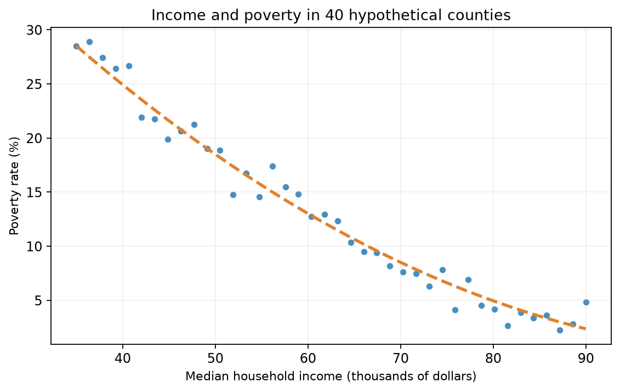
Association and nonlinearity
Q1: 96.8% correct
A straight line assumes a nearly constant slope.
The pattern decreases steeply at first and then flattens. Its slope changes across the x-axis.
Strong association can be nonlinear.
COLUMBIA UNIVERSITY · DEPARTMENT OF STATISTICS
05
Notes:
1 minute. Correct classification: A positive linear, B negative linear, C nonlinear, D no clear association.

Slide 6
Quiz questions 3–4 | The mean
In x̄ = (x₁ + x₂ + … + xₙ) / n, what does n represent?
X is the variable name;
x₁ is the first value for case #1
Mean is a summary of all observed values of this variable
A. The number of observations in the sample
B. The numerical value of the final observation
C. The population mean
D. The number of variables in every data set
Compute the mean of 1, 2, 1, 2, 4.
COLUMBIA UNIVERSITY · DEPARTMENT OF STATISTICS
06
Notes:
3 minutes. Ask for n first, then give 30 seconds for the five-number calculation. Correct: n is the number of observations; mean = 2.

Slide 7
Mean notation in one example
Q3: 84.1% correct
x₁ + x₂ + … + xₙ
n
the observed values
the number of observations
1 + 2 + 1 + 2 + 4 = 10
10 / 5 = 2
COLUMBIA UNIVERSITY · DEPARTMENT OF STATISTICS
07
Notes:
2 minutes. Ask: if a dataset has 100 rows and five variables, what is n when averaging one variable? Answer: 100 observed values, assuming no missing values.

Slide 8
Quiz questions 5–6 | A 0/1 variable
Eight service requests
Cases?
Variable?
Values?
1, 0, 1, 1, 0, 0, 1, 1
1 means resolved within one day. 0 means otherwise.
Q5. What does the sum represent?
Q6. What does the mean represent?
A. The number resolved within one day: 5
B. The number not resolved: 3
C. The total number of requests: 8
D. The average resolution time: 5
A. 5/8 = 0.625, the proportion coded 1
B. 3/8 = 0.375, the proportion coded 1
C. 5, the average number of days
D. 8/5 = 1.6, requests per day
COLUMBIA UNIVERSITY · DEPARTMENT OF STATISTICS
08
Notes:
4 minutes. Poll Q5 first, then Q6. Correct: sum = 5 cases coded 1; mean = 5/8 = 0.625, the proportion coded 1.

Slide 9
The 0/1 indicator rule
Q5: 81.0% correct
1 + 0 + 1 + 1 + 0 + 0 + 1 + 1
SUM
MEAN
5
5/8 = 0.625
number of cases coded 1
fraction of cases coded 1
The key is to understand what the denominator should be: a mean of what values among which cases?
COLUMBIA UNIVERSITY · DEPARTMENT OF STATISTICS
09
Notes:
2 minutes. Six students chose total cases = 8 for the sum. Stress that each 1 contributes one to the count.

Slide 10
Quiz question 7 | Create binned counts
61.9% correct
Values
5.2, 7.4, 7.5, 8.1, 9.9, 10.0, 10.8, 12.5
This is confusing. Will avoid in the future.
Bins
5.0–7.5 7.5–10.0 10.0–12.5
Place a boundary value in the lower bin. What are the three counts?
A. 3, 3, 2
B. 2, 3, 3
C. 2, 2, 4
D. 3, 2, 3
COLUMBIA UNIVERSITY · DEPARTMENT OF STATISTICS
10
Notes:
4 minutes. Ask pairs to place 7.5 and 10.0 before counting. Correct: A, 3, 3, 2. The most common incorrect answer was B.

Slide 11
Boundary values determine the counts
5.0–7.5
7.5–10.0
10.0–12.5
5.2 7.4 7.5
8.1 9.9 10.0
10.8 12.5
3
3
2
A histogram begins with a counting rule that assigns every observation to one bin.
COLUMBIA UNIVERSITY · DEPARTMENT OF STATISTICS
11
Notes:
2 minutes. Name the boundary convention before drawing the histogram. Different software may use a different endpoint convention, but no observation should enter two bins.

Slide 12
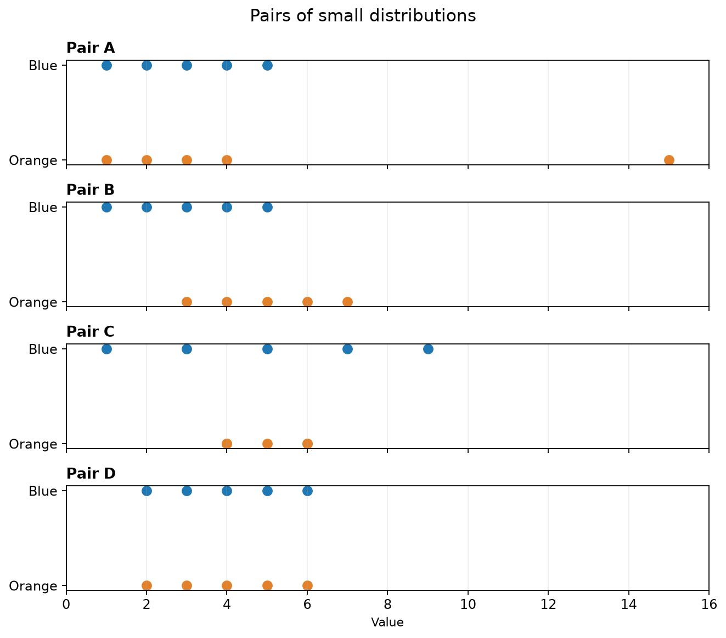
Quiz questions 8–9 | Center and spread
Q8
Which pair has equal medians and a larger blue IQR?
Q9
For Pair A, which color has the larger mean and standard deviation?
COLUMBIA UNIVERSITY · DEPARTMENT OF STATISTICS
12
Notes:
5 minutes. Q8 answer: Pair C. Q9 answer: orange has a larger mean and SD because of 15. Ask students to mark the median and the middle 50% rather than judging only total range.

Slide 13
Center and spread answer
Q9: 81.0% correct
Q8: Pair C
Both medians are 5. Blue has the wider middle 50%.
Q9: Orange
The value 15 moves the mean right and increases the distances from the mean.
COLUMBIA UNIVERSITY · DEPARTMENT OF STATISTICS
13
Notes:
2 minutes. Nine students reversed the effect of the large high value on mean and spread.

Slide 14
Quiz question 13 | Median and quartiles
73.0% correct
Ordered values
1 2 3 4 5 6 7 8 9
Exclude the median when finding the lower and upper quartiles. What are the median, Q1, and Q3?
A. Median = 5, Q1 = 2.5, Q3 = 7.5
B. Median = 5, Q1 = 3, Q3 = 7
C. Median = 4.5, Q1 = 2, Q3 = 8
D. Median = 5, Q1 = 1, Q3 = 9
It is like cutting a cake.
COLUMBIA UNIVERSITY · DEPARTMENT OF STATISTICS
14
Notes:
4 minutes. Correct: A. Thirteen students selected B. Ask students to identify the two halves before taking either quartile.

Slide 15
Quartiles are medians of the two halves
1 2 3 4
5
6 7 8 9
lower half
median
upper half
Q1 = (2 + 3) / 2 = 2.5
Q3 = (7 + 8) / 2 = 7.5
IQR = Q3 − Q1 = 5
COLUMBIA UNIVERSITY · DEPARTMENT OF STATISTICS
15
Notes:
2 minutes. State the course convention explicitly: for an odd number of values, exclude the overall median before finding Q1 and Q3.

Slide 16
Variance and standard deviation
Dataset A
Dataset B
2 2 2 2
0 2 2 4
mean = 2 SD = 0
mean = 2 SD > 0
Variance
Standard deviation
Average squared distance from the mean
Square root of variance, returned to the original units
Sample SD uses n − 1 because estimating the mean from the same sample makes spread look slightly too small.
COLUMBIA UNIVERSITY · DEPARTMENT OF STATISTICS
16
Notes:
6 minutes. Begin with the two datasets. Ask which has more spread before naming variance. Explain why deviations are squared, why SD returns to the original units, and give only the intuition for n − 1. Distinguish SD from standard error.

Slide 17
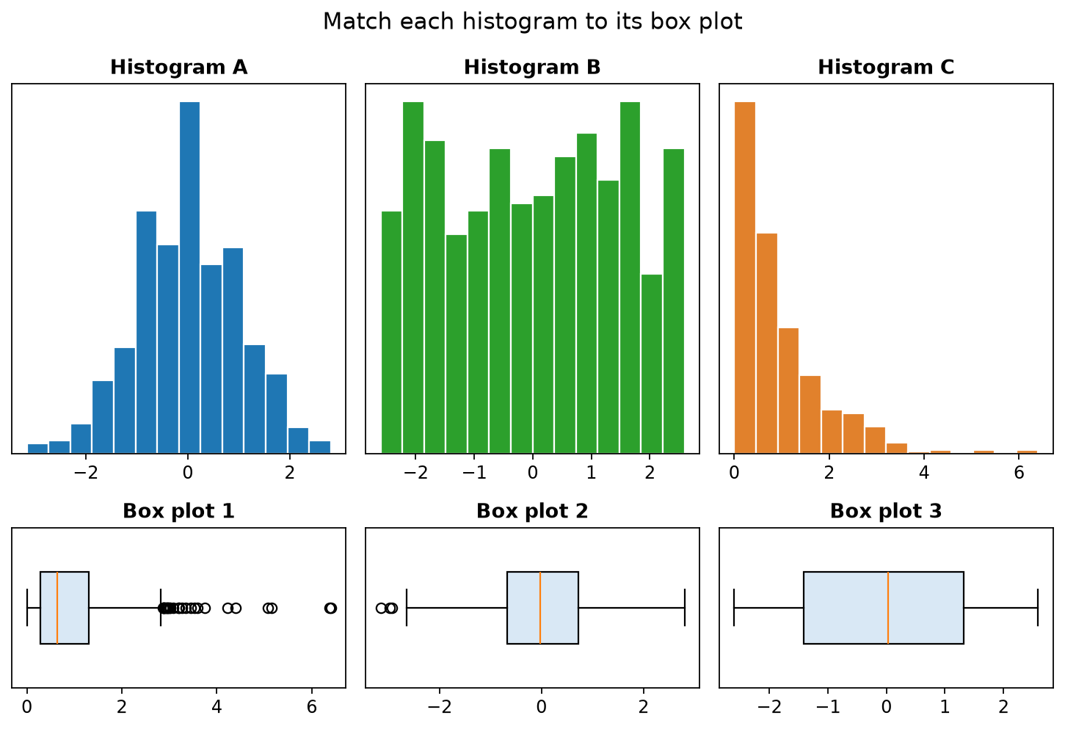
Quiz question 10 | Match the displays
Match each histogram to its box plot.
A. A → 2, B → 3, C → 1
B. A → 1, B → 2, C → 3
C. A → 3, B → 1, C → 2
D. A → 2, B → 1, C → 3
Which visual clues did you use?
COLUMBIA UNIVERSITY · DEPARTMENT OF STATISTICS
17
Notes:
3 minutes. Correct: A to 2, B to 3, C to 1. Ask for evidence from symmetry, whisker lengths, middle-half width, and outliers.

Slide 18
Shape, box plots, and modes
A → 2
B → 3
C → 1
Quiz question 12
A mode is a prominent peak or concentration, not every one-bin fluctuation.
COLUMBIA UNIVERSITY · DEPARTMENT OF STATISTICS
18
Notes:
2 minutes. Q12 correct definition: a prominent peak or concentration. A distribution may be unimodal, bimodal, or multimodal.

Slide 19
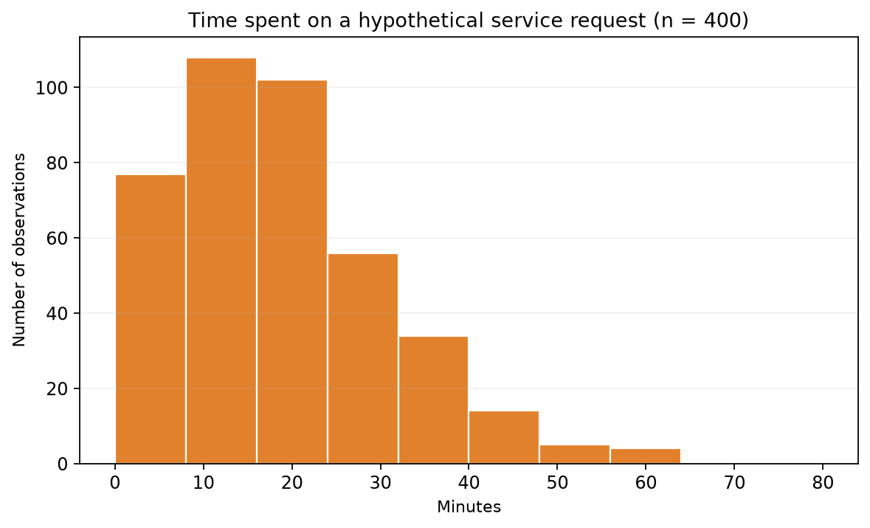
Quiz question 11 | Read a skewed histogram
A. Median roughly 16–20 minutes, mean probably higher
B. Median roughly 55–60 minutes, mean lower
C. Median must equal mean because n = 400
D. Median cannot be estimated from a histogram
Where do about 200 observations fall below?
COLUMBIA UNIVERSITY · DEPARTMENT OF STATISTICS
19
Notes:
4 minutes. Correct: A. Build cumulative counts from left to right. The long right tail pulls the mean above the median.

Slide 20
Skew connects shape to center
Median
Around 16–20 minutes
Mean
Probably higher than the median
The tail points toward the larger values that pull the mean.
COLUMBIA UNIVERSITY · DEPARTMENT OF STATISTICS
20
Notes:
2 minutes. Link this to resistance: the median and IQR resist extreme values more than the mean and SD.

Slide 21
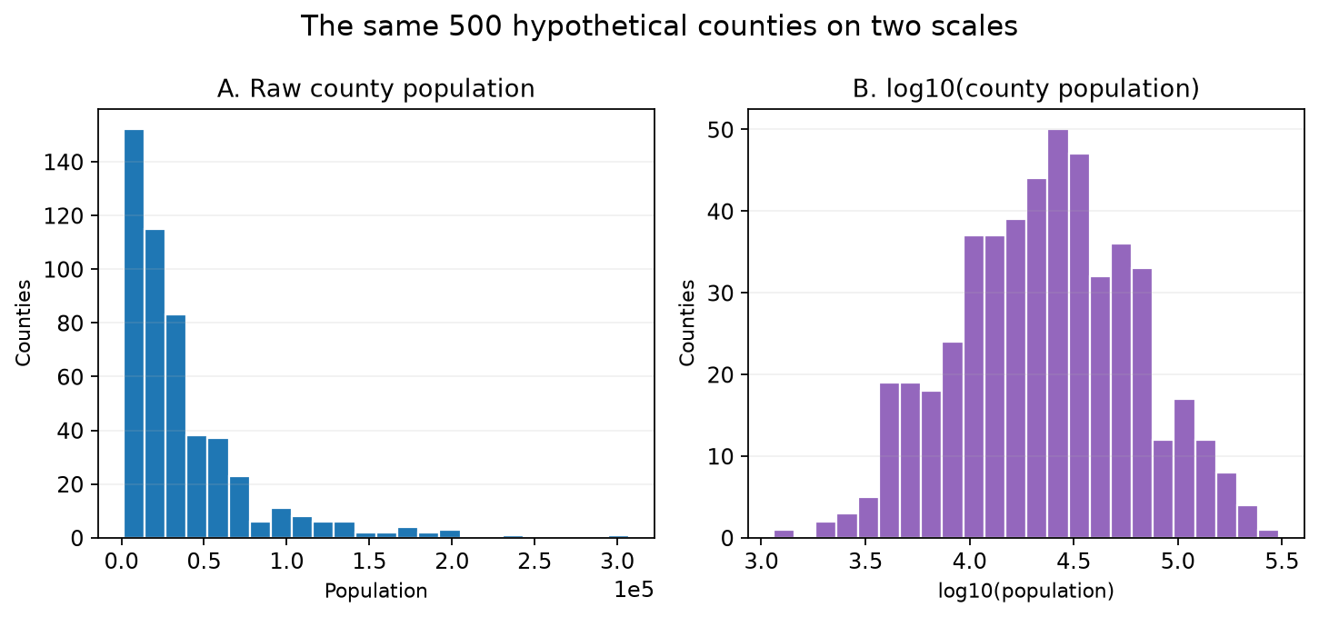
Quiz question 14 | Why use a log scale?
What is the main benefit of panel B?
A. Compresses large values and separates smaller ones
B. Removes counties with large populations
C. Makes all counties have the same population
D. Proves the original distribution was symmetric
COLUMBIA UNIVERSITY · DEPARTMENT OF STATISTICS
21
Notes:
3 minutes. Correct: A. A log transformation changes the scale, not the cases. It helps when positive values span orders of magnitude.

Slide 22
The log scale reveals crowded structure
Same counties
Different horizontal scale
Large values compress. Smaller values separate. Patterns hidden near zero become visible.
Transformations affect how distances look.
COLUMBIA UNIVERSITY · DEPARTMENT OF STATISTICS
22
Notes:
2 minutes. Ask what remains unchanged: the cases and their ordering. Ask what changes: spacing and interpretation of equal distances.

Slide 23
Quiz question 15 | Create a contingency table
85.7% correct, 6 requested the answer
Eight students used a video or text explanation, then rated it helpful.
Video–Yes, Video–Yes, Video–No, Video–Yes
Text–Yes, Text–No, Text–No, Text–No
Entries are ordered as Video–Yes, Video–No; Text–Yes, Text–No. Which table is correct?
A. 3, 1; 1, 3
B. 4, 0; 0, 4
C. 3, 3; 1, 1
D. 1, 3; 3, 1
COLUMBIA UNIVERSITY · DEPARTMENT OF STATISTICS
23
Notes:
4 minutes. Have the class count one cell at a time. Correct: A.

Slide 24
Each case enters one cell
Explanation | Helpful: Yes | Helpful: No
Video | 3 | 1
Text | 1 | 3
Row totals answer questions among explanation formats. Column totals answer questions among helpfulness groups.
COLUMBIA UNIVERSITY · DEPARTMENT OF STATISTICS
24
Notes:
2 minutes. Check that the four cells sum to eight. Name the two variables and their categories.

Slide 25
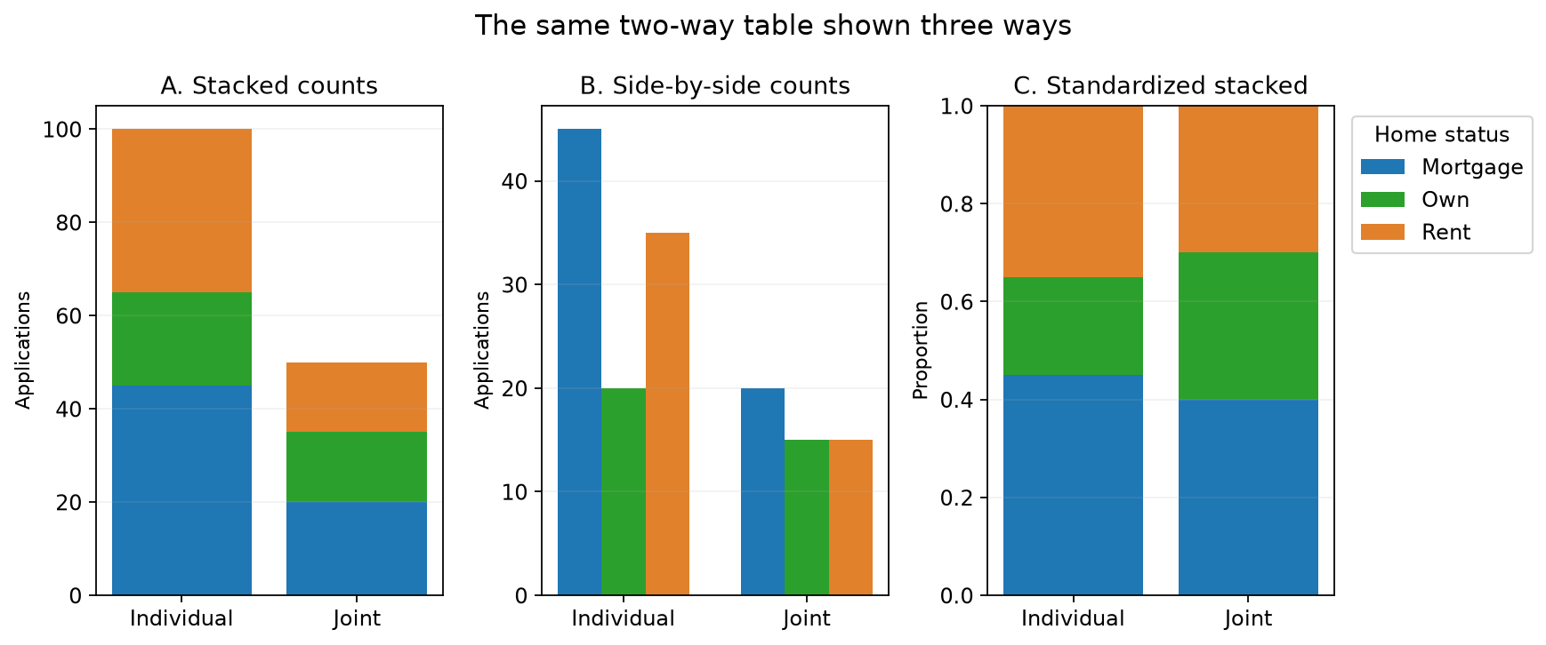
Quiz questions 16–17 | Which denominator?
Q16
What does 45/100 represent?
Q17
What does 45/(45 + 20) represent?
Say the denominator in words before calculating.
COLUMBIA UNIVERSITY · DEPARTMENT OF STATISTICS
25
Notes:
5 minutes. Q16: among individual applications, the proportion from applicants with a mortgage. Q17: among mortgage applications, the proportion that were individual. Ask 'among whom?' twice.

Slide 26
Conditional proportions begin with “among”
Q16–17: 76–78% correct
45 / 100
45 / (45 + 20)
Among individual applications,
what fraction had a mortgage?
Among mortgage applications,
what fraction were individual?
The denominator is a row total.
The denominator is a column total.
Condition first. Calculate second.
COLUMBIA UNIVERSITY · DEPARTMENT OF STATISTICS
26
Notes:
2 minutes. Ask students to translate both fractions into a sentence. Reversing the condition changes the question.

Slide 27
Quiz question 18 | Association from proportions
Video users
Text users
3 of 4 helpful = 75%
1 of 4 helpful = 25%
Which conclusion is supported descriptively?
A. Helpfulness was associated with format in this small group
B. The variables were independent because both groups had four students
C. The helpful percentages were the same
D. The table proves video causes greater learning for every student
COLUMBIA UNIVERSITY · DEPARTMENT OF STATISTICS
27
Notes:
3 minutes. Correct: A. Conditional proportions differ, so the variables are associated in this sample. Counts alone do not support causation or broad generalization.

Slide 28
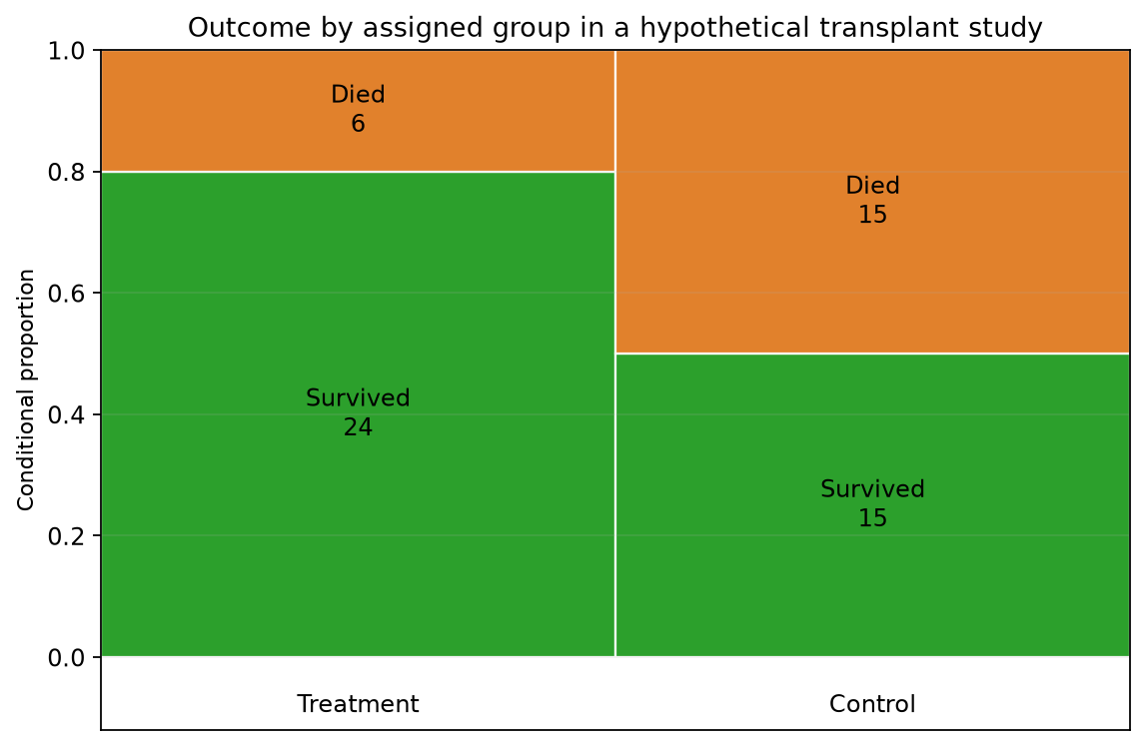
Quiz question 19 | Randomized treatment comparison
Treatment: 24 survived, 6 died
Control: 15 survived, 15 died
Which comparison is correct?
A. 80% versus 50%. Random assignment supports a causal comparison
B. 50% versus 80%
C. The proportions are identical because both groups have 30 patients
D. No proportion can be computed from a mosaic plot
COLUMBIA UNIVERSITY · DEPARTMENT OF STATISTICS
28
Notes:
3 minutes. Correct: A. Treatment survival = 24/30 = 80%; control survival = 15/30 = 50%. Random assignment supports a causal treatment comparison, subject to ordinary study limitations.

Slide 29
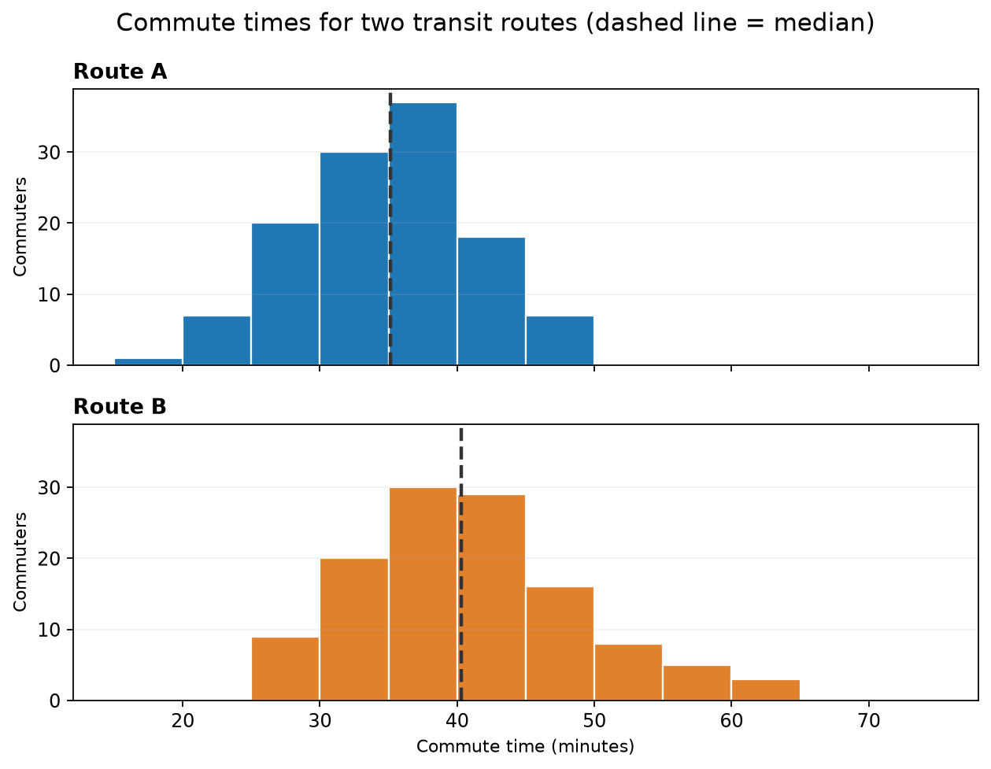
Quiz question 20 | Compare distributions
Which comparison is best supported?
A. Route A has a lower typical time and less variability
B. Route A has a higher typical time and more variability
C. The routes have identical centers and spreads
D. Only the maximum matters
Center · spread · shape · unusual observations
COLUMBIA UNIVERSITY · DEPARTMENT OF STATISTICS
29
Notes:
3 minutes. Correct: A. Route A has a lower median and narrower distribution. A complete comparison addresses center, spread, shape, and unusual observations.

Slide 30
One-minute exit check
1
Explain the difference between a count and a conditional proportion in one sentence.
2
Name one Chapter 2 idea that you can now explain more clearly.
Thursday is reserved for project discussion and work.
Quiz problems and plots adapted from OpenIntro Statistics, Chapter 2, CC BY-SA 3.0.
COLUMBIA UNIVERSITY · DEPARTMENT OF STATISTICS
30
Notes:
1 minute. Collect responses verbally, on paper, or through the usual class channel. Invite remaining questions to office hours. Attribution: OpenIntro Statistics, 4th edition, Chapter 2, CC BY-SA 3.0.

Slide 31
NEWS STORY · SEPTEMBER 2026
When the comparison group changes, the question changes
THE BMJ · INVESTIGATION
Start here
A vaccine-safety algorithm lost sensitivity when reports for the two new mRNA vaccines came to dominate the database.
What is a VAERS case?
A submitted report of an event after vaccination—not a randomly sampled vaccinated person.
More than 90% of roughly 1.1 million first-year VAERS reports concerned the mRNA covid vaccines, according to the investigation.
What can a signal do?
Flag a pattern for further study. It does not, by itself, establish causation.
Source: David Willman, The BMJ, 16 Sep 2026
STAT UN 1001 · Two-way tables
1
Notes:
Source: https://www.bmj.com/content/394/bmj-2026-100806 ; Context on VAERS: https://www.cdc.gov/vaccine-safety-systems/vaers/
Teaching note: Present the article as an investigation into signal detection. A VAERS report is not proof that a vaccine caused an event.

Slide 32
HYPOTHETICAL TEACHING EXAMPLE
Scenario 1: compare Vaccine A with an established baseline
Reported outcome
Vaccine group | Event X | Other events | Total | Event X proportion
Vaccine A | 50 | 950 | 1,000 | 5%
Established vaccines | 90 | 8,910 | 9,000 | 1%
PRR
5% ÷ 1%
= 5.0
Question answered
Does Vaccine A stand out relative to the reporting pattern for established vaccines?
The cases here are reports; 5% is not the risk among all vaccinated people.
STAT UN 1001 · Two-way tables
2
Notes:
Hypothetical counts developed for instruction; they are not VAERS estimates. PRR here is the ratio of two conditional proportions: P(Event X | Vaccine A report) / P(Event X | established-vaccine report). Ask students to identify cases, variables, values, and margins.

Slide 33
SAME 5% FOR VACCINE A
Scenario 2: another new vaccine dominates “everyone else”
Vaccine group | Event X | Other events | Total | Event X proportion
Vaccine A | 250 | 4,750 | 5,000 | 5%
New Vaccine A2 | 225 | 4,275 | 4,500 | 5%
Older vaccines | 5 | 495 | 500 | 1%
“Everyone else”
(225 + 5)
────────
(4,500 + 500)
= 4.6%
PRR = 5% ÷ 4.6% = 1.09
What changed?
Not Vaccine A's 5%. The comparison group changed—from an older baseline to a pool dominated by Vaccine A2.
STAT UN 1001 · Two-way tables
3
Notes:
Hypothetical counts developed for instruction; they are not VAERS estimates. The BMJ investigation describes the real-world statistical phenomenon as masking. Source: https://www.bmj.com/content/394/bmj-2026-100806.full.pdf
Ask students to calculate the pooled comparison proportion before revealing 4.6% and 1.09.

Slide 34
INTERPRET, THEN REDESIGN
A statistic is an answer—but to which question?
Interpret the association
Redesign the comparison
PRR ≈ 1 says:
1
What population-level question do we want to answer?
Vaccine A and this particular comparison group look similar in the reporting database.
2
Which reports belong in a meaningful baseline group?
3
Should we stratify by age, sex, or time period?
It does not say:
Both match an established baseline—or that no causal risk exists.
4
What other surveillance data could corroborate a signal?
Discussion: Write one sentence stating the question answered by each table.
STAT UN 1001 · Two-way tables
4
Notes:
Closing prompt: Before interpreting an association, ask what exactly is in the comparison group and therefore what question the statistic answers. A stronger analysis could compare each new vaccine with a prespecified established baseline, stratify on relevant variables, and corroborate patterns in active surveillance or population-based data. CDC VAERS limitations: https://www.cdc.gov/vaccine-safety-systems/vaers/

