Slide 1
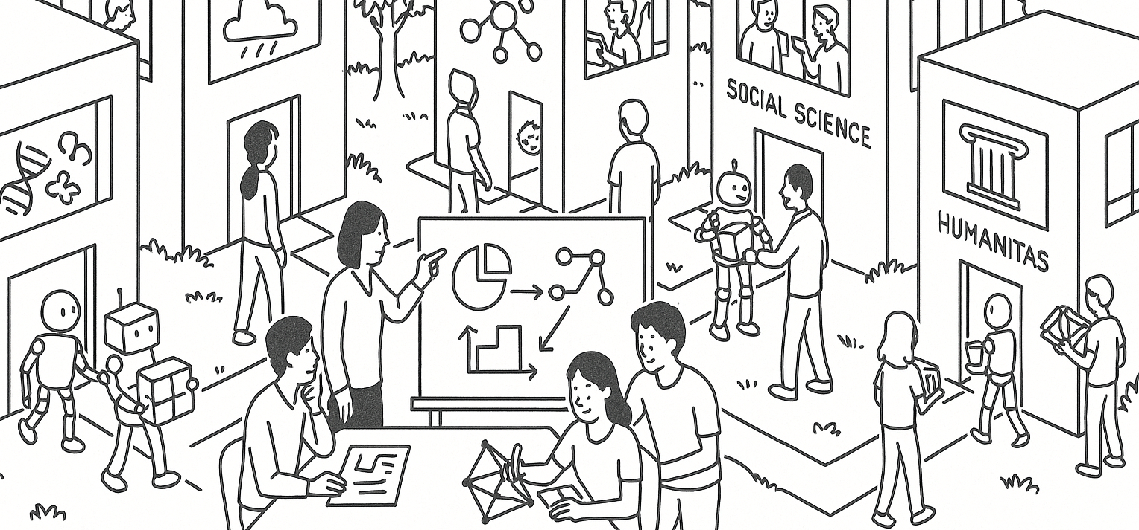

Categorical comparisons and probability
STAT UN 1001 · LECTURE 7
SEPTEMBER 29, 2026
Notes:
Combined lecture deck. Sources: Week 04 original categorical/probability slides, Week 04 student-response probability outline, OpenIntro Statistics Chapter 3.1-3.2, and Canvas Week 04 practice/check-in summaries.

Slide 2
From Flipped Activities Check-In
HARDEST ISSUE
PRACTICE QUIZ LOW POINTS
Knowing which rule applies
26 students
Independence from Venn: 45/64 correct
Two-city rain independence: 47/64 correct
Disjoint addition: 51/64 correct
NEXT
Understanding independence
13 students
Today’s repeated question: what does the event mean?
COLUMBIA UNIVERSITY · DEPARTMENT OF STATISTICS
03
Notes:
Show that the lecture responds to check-in and practice quiz data.

Slide 3
Counts and proportions
Report group | Event X | Other events | Total
Vaccine A | 50 | 950 | 1,000
Older vaccines | 90 | 8,910 | 9,000
Total | 140 | 9,860 | 10,000
Which group has more reports?
Which group has the larger Event X proportion?
COLUMBIA UNIVERSITY · DEPARTMENT OF STATISTICS
04
Notes:
Original Week 04 comparison slide, enlarged.

Slide 4
The comparison group
Report group | Event X | Total | Event X proportion
Vaccine A | 250 | 5,000 | 5.0%
New Vaccine A2 | 225 | 4,500 | 5.0%
Older vaccines | 5 | 500 | 1.0%
If “everyone else” mostly means New Vaccine A2, what question does the comparison answer?
COLUMBIA UNIVERSITY · DEPARTMENT OF STATISTICS
05
Notes:
Original Week 04 comparison-group slide, enlarged.

Slide 5
Probability: Chance process and sample space
CHANCE PROCESS
EVENTS
C: has a cat
A: has a car
B: has a child under age 2
…
Randomly sample one household
OUTCOME
SAMPLE SPACE
one selected household’s combination of traits
all possible combinations that could be selected
What outcome did we observe if the household has a cat, no car, and no child under 2?
COLUMBIA UNIVERSITY · DEPARTMENT OF STATISTICS
07
Notes:
Start probability with one concrete setup.

Slide 6
Events as sets of outcomes
C AND A
C OR A
NOT C
cat and car
cat, car, or both
no cat
In probability, “or” includes the overlap unless the problem says otherwise.
COLUMBIA UNIVERSITY · DEPARTMENT OF STATISTICS
08
Notes:
Translate notation into words.

Slide 7
Venn diagram regions
SURVEY 100 HOUSEHOLDS
C: cat
A: car
35 have a cat
60 have a car
25 have both
10
25
35
READ FROM THE DIAGRAM
cat only = 10
both = 25
car only = 35
neither = 30
neither: 30
COLUMBIA UNIVERSITY · DEPARTMENT OF STATISTICS
09
Notes:
Introduce the household Venn counts.

Slide 8
Overlap and double-counting
C: cat
A: car
P(C or A)
= P(C) + P(A) − P(C and A)
35/100 + 60/100 − 25/100
= 70/100
10
25
35
The 25 households in the overlap appear in both circle totals.
What would go wrong if we used 35 + 60 = 95?
COLUMBIA UNIVERSITY · DEPARTMENT OF STATISTICS
10
Notes:
Show the addition rule as an accounting correction.

Slide 9
Complements
C: cat
A: car
P(not A) = 1 − P(A)
P(cat or car) = 70/100
10
25
35
P(neither cat nor car)
= 30/100
neither: 30
Complement means everything outside the event.
COLUMBIA UNIVERSITY · DEPARTMENT OF STATISTICS
11
Notes:
Connect neither and at least one.

Slide 10
Disjoint events
TEST
Can both happen for the same randomly selected household?
DISJOINT
NOT DISJOINT
exactly 0 cars versus exactly 2 cars
has a cat versus has a car
If events are disjoint, P(A or B) = P(A) + P(B).
COLUMBIA UNIVERSITY · DEPARTMENT OF STATISTICS
12
Notes:
Clarify disjoint before independence.

Slide 11
Independent events
Events are independent when knowing one happened does not change the probability of the other.
HOUSEHOLD QUESTION
KEY DISTINCTION
Does knowing a household has a car change how likely it is to have a cat?
Disjoint asks whether both can happen.
Independent asks whether one changes the probability.
Overlap alone does not answer independence.
COLUMBIA UNIVERSITY · DEPARTMENT OF STATISTICS
13
Notes:
Give the central plain-language definition.

Slide 12
Household independence check
C: cat
A: car
P(C) = 0.35
P(A) = 0.60
P(C and A) = 0.25
If independent:
10
25
35
0.35 × 0.60 = 0.21
Observed overlap is 0.25, so this constructed example does not fit independence exactly.
neither: 30
COLUMBIA UNIVERSITY · DEPARTMENT OF STATISTICS
14
Notes:
Use product check with enlarged formulas.

Slide 13
Two-way table independence check
 | Car | No car | Total
Cat | 25 | 10 | 35
No cat | 35 | 30 | 65
Total | 60 | 40 | 100
Product check:
P(C and A) = 0.25
P(C)P(A) = 0.21
Conditional check:
P(C | A) = 25/60
P(C) = 35/100
Does knowing the household has a car change the probability of cat ownership?
COLUMBIA UNIVERSITY · DEPARTMENT OF STATISTICS
15
Notes:
Second representation for the same household example.

Slide 14
Phone and computer Venn
I: iPhone
M: Apple computer
SETUP
100 students
54 use an iPhone
32 use an Apple computer
22 use both
32
22
10
ASK
What is P(iPhone or Apple computer)?
What is P(neither)?
neither: 36
COLUMBIA UNIVERSITY · DEPARTMENT OF STATISTICS
16
Notes:
Direct practice-quiz connection.

Slide 15
Phone and computer independence
P(I) = 0.54
P(M) = 0.32
P(I and M) = 0.22
I: iPhone
M: Apple computer
32
22
10
Under independence:
0.54 × 0.32 = 0.1728
COLUMBIA UNIVERSITY · DEPARTMENT OF STATISTICS
17
Notes:
Address the exact hard practice-quiz question type.

Slide 16
Two-city rain example
HYPOTHETICAL DAILY WEATHER
P(New York rain) = 0.30
P(Boston rain) = 0.35
P(both rain) = 0.18
0.30 × 0.35 = 0.105
0.18 is larger than 0.105, so these hypothetical probabilities do not support independence.
COLUMBIA UNIVERSITY · DEPARTMENT OF STATISTICS
18
Notes:
Relatable independence example with data caveat.

Slide 17
Conditional probability
P(A given B) means: restrict attention to B, then ask how often A occurs.
 | Poor sleep | Not poor sleep
High social use | 28 | 42
Lower social use | 36 | 94
Among high-use students, what proportion report poor sleep?
COLUMBIA UNIVERSITY · DEPARTMENT OF STATISTICS
19
Notes:
Keep original conditional probability idea with larger table.

Slide 18
Probability trees
FIRST BRANCH
Choose the first event or group.
SECOND BRANCH
Condition on the first branch, then split into the next outcomes.
PATH PROBABILITY
Multiply along a path. Check that branches add to 1 at each split.
COLUMBIA UNIVERSITY · DEPARTMENT OF STATISTICS
20
Notes:
Keep the original probability-tree setup as board work.

Slide 19
Rule choice map
not A or none
A and B
A or B
complement
overlap
check for disjoint and overlap
given A or among A
independent
conditional denominator
multiplication rule
Read the event wording first. Rewrite the wording into events. The formula comes after the meaning.
COLUMBIA UNIVERSITY · DEPARTMENT OF STATISTICS
21
Notes:
Respond to the most common check-in concern with larger wording.

Slide 20
Fast practice: households
IN 100 HOUSEHOLDS
cat
car
45 have a car
30 have a cat
15 have both
?
?
?
DO THIS FIRST
Draw the Venn regions.
Find P(car or cat).
Find P(neither).
Check independence.
Answers: cat only 15, car only 30, both 15, neither 40. Not exactly independent.
COLUMBIA UNIVERSITY · DEPARTMENT OF STATISTICS
22
Notes:
Active response slide.

Slide 21
Quiz 1 Reminders
Quiz 1: Lectures 1–5 and OpenIntro Chapters 1–2
Today’s probability material is not on Quiz 1.
Quiz 1 is paper-based, 15 minutes, at the end of lecture. You may bring one single-sided note.
COLUMBIA UNIVERSITY · DEPARTMENT OF STATISTICS
24
Notes:
End with scope reminder and exit prompts.

